Slide 1
Czech New Wave
CZS36 + CMA018
Dr. Šárka Gmiterková
Fall 2023
30. 11. 2023

Slide 2
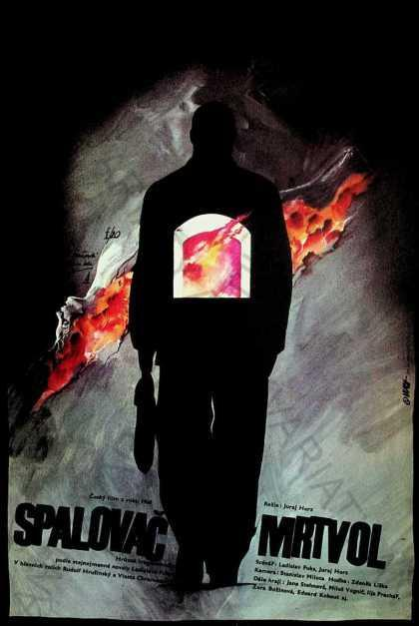
The Cremator (1968)
Director: Juraj Herz
Based on the novel by Ladislav Fuks
Screenplay: Juraj Herz and Ladislav Fuks
DOP: Stanislav Milota
Music: Zdeněk Liška
Staring: Rudolf Hrušínský, Vlasta Chramostová, Ilja Prachař, Jiří Menzel…

Slide 3
The Cremator – discussion points
The story of Karel Kopfrkingl and his family takes place in the late 1930s, when the parts of Czechoslovakia bordering with Germany and Austria, were annexed by the Third Reich. This led to strong nationalistic tendencies and forced takeover of Jewish companies and possesion.
The Cremator was finished in 1968, shortly after the invasion of the armies of the Warsaw pact. Despite its premiere in March 1969, the film was banned from wider distribution in 1973 and returned to cinemas in 1990.
What was the reason for banning the film (in your opinion)?
Being a very rare case of horror cinema, try to think about what contributes to the eerie effect of this movie the most (image, editing, soundtrack, performance, storytelling…)
Since from the generic perspective this is quite an unusual film, why does it fall under the New Wave category? What are the factors that support such labelling?

Slide 4
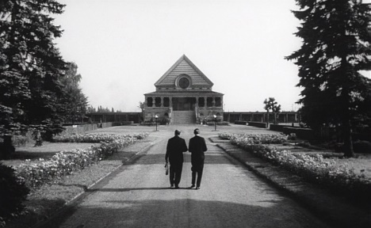
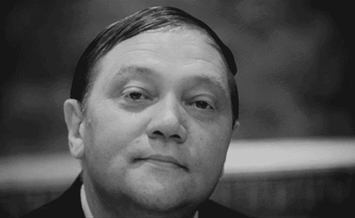
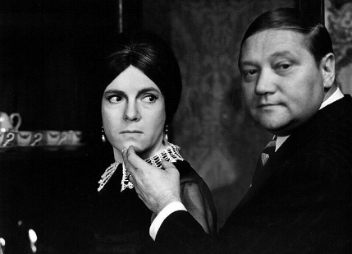
The Cremator – horror a la Czech
„Well, this is a first domestic grotesque horror, but it is a horror a la Czech. By that I mean that intellectually The Cremator stands next to the best works our cinema produced in the past years; a horror with an idea, where dread goes hand in hand with irony and where actions carry a meaning of a great visual and symbolic power.“ (period review)
Hannah Arendt: the banality of evil
Kopfrkingl as a stand-in for an ordinary Czech man, who can be persuaded and seduced by a distructive ideology (compare with portrayal of war era in Closely Watched Trains or Diamonds of the Night)
Stylistic aspects of the film (extreme close ups, disorienting editing) support and enhance the performance aspects (Rudolf Hrušínský as Kopfrkingl)

Slide 5
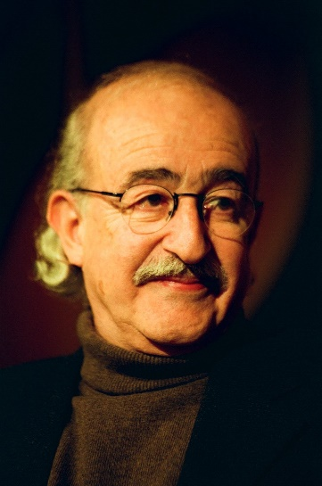
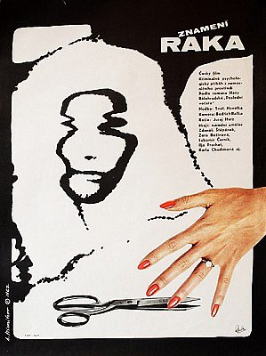
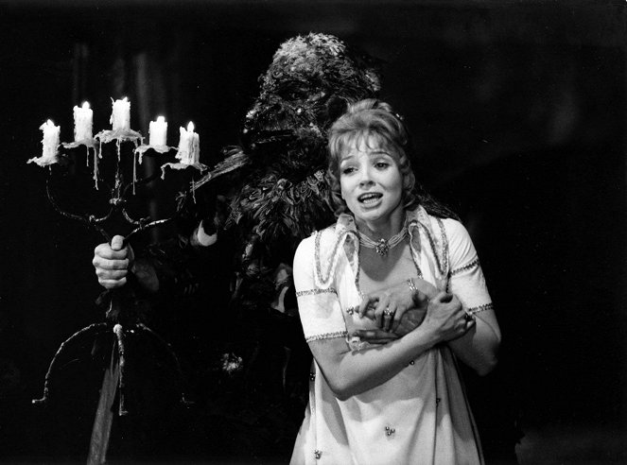
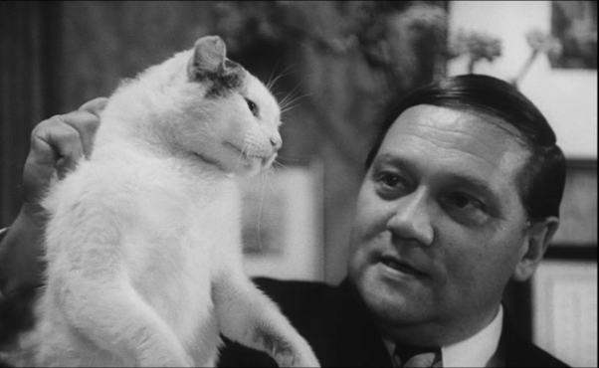
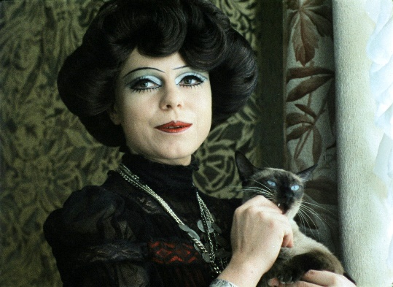
Juraj Herz 1934–2018
Born in Kežmarok (Slovakia), but studied in Prague and his films were made at FSB, therefore they are considered Czech
Studied DAMU to become a pupeteer >> strong inclination towards grotesque and overt stylization
The sign of a cancer (1966)– feature debut, a thriller set in a hospital, combining murder mystery amidst daily mundane existence of doctors and patients
During normalization period he gravitated towards horrors and fairytales, usually combining them into unique works of art, such as: Morgiana (1972), Beauty and the Beast (1978) or The Ninth Heart (1978)

Slide 6
About the oral exam:
Dates: In person Tuesday December 19th 2023, 10:00 and 13:00, office C.317; then on MS Teams Wednesday January 3rd at 10:00 and 14:00 and finally Tuesday January 9th at 10:00 and 14:00
Duration: 120 minutes
Capacity: 5 students maximum
Registration: Please register for the term of your choice in the IS system
Prepare: an anotation and an interpretation of 10 films which we have watched together and some of them are uploaded in the IS system (others are available on Netflix and other platforms) PLUS a resumé of one article/chapter you have been provided.
Length of the indivudal annotations plus one reading resumé: 200 words maximum
Due date – no later than 24 hours before the exam upload the file in the homework vault with the date and hour of your registered exam.

Slide 7
Films for your oral exam resumés
Films we have watched in class (or we will watch):
  Black Peter, Pearls of the deep, Black and White Sylva, Courage for Every Day, Joseph Killian, Black Keys Fugue, Intimate Lighting, Daisies, The Murder of Mr. Devil, Loves of a Blonde, Diamonds of the Night, The Cremator, Closely Watched Trains, The Case for a Rookie Hangman, The Firemen‘s Ball OR The Party and the Guests
  + Mouthfull (combine with another mid-feature title, since this is a short film)
Films The Joke and The Sign of a Cancer are uploaded in the IS system in a file, but unfortunately we won‘t have time to screen them in class. Feel free to watch them and include them in your resumés

Slide 8
Censorship…
as a form of communication? As a tactical game? As a form of PR?
Censorship as the invisible and other side of the golden sixties
Prevailing negative perception of censorship X a form of communication, a tactical game and/or negotiation
Censorship as a hidden process >> only fragments of written records and a few oral testimonies survived
Does not pertain only to the totalitarian regimes
The concept of “dispersed censorship“ (including self-censorship) + the existence of „structural gaps“
Not only censorship limits and erases layers of meaning, but sometimes is the co-creator
„Censohip intervention“ X “administrative intervention“, carried out by „authorized organs“ and „organisation personel“, sometimes „official reviewers“, who merely „recommend“ individual measures

Slide 9
Cinema censorship institutions
(on the side of film production)
The censorship communication is carried out by:
  ČSF director: Alois Poledňák (1959–1969)
  FSB (Barrandov studios) director: based on the proposals coming from the CG he greenlighted screenplays, preparations and field works, budgets and key creative personnel. He had the right to watch the dailies, greenlight the first copy of the film; in fact, he could decide any matter connected to the agenda of the studios. In the years 1963–1969 this man was Vlastimil Harnach.
  Central (main) dramaturg: he follows the dramaturgical activities of all CGs as they start working on a topic or story early on. In cooperation with CGs he prepares dramaturgical and production plans, he reviews them from the idelogical and artistic perspectives, he greenlights the screenplays of films in preproduction; he can request review of any story in any stage of the creative proces; he can attend meetings, screenings of the dailies and suggest revisions. In the years 1960–1968 this man was Břetislav Kunc.
  Censorship was carried out by individual dramaturgs or CG leaders once they declined to work on potentially risky topics and stories.

Slide 10
Crucial factor: decentralized dramaturgy
1959–1962: one central institution oversees the development phase of film projects (Ideology and Artistic Council) >> its reviews are strict and rigid + filmmakers test its limits with topics and stories with various amount of social and moral criticism = the strategy of caution results in dramaturgical crisis; Czechoslovak films lack originality, modern expression and progressive ideas
February 1962: ČSF becomes independent economic institution, which fall under communist party supervision only in matters of ideological nature
March 1962: the central Ideology and Artistic Council is cancelled
April1962: individual Ideology and Artistic Councils are created and are attached to individual CGs (consisting of 7–8 internal and external employees) >> their power increases
Outside of film production censorship was carried out by Central Press Supervision Office (CPSO), on the higher level Ideological Department of the Central Committee of the Communist Party of Czechoslovakia

Slide 11
1962–1965: the years of carefull liberalization
Revised cultural politics: previously banned artists were returning to the public sphere, new generation of young artists; first testimonies of self-censorship appear in media
FSB starts to strategically orient itself on recruiting young autheurs >> in 1963 nine directors made their feature debut – Miloš Forman, Věra Chytilová, Jaromil Jireš, Pavel Hobl, Zdenek Sirový or Čestmír Mlíkovský >> cheap films with international visibility (even success), sometimes commercial success on top of all things
FSB and artists are becoming more confident – they test limits of censorship processes, for example they did not present materials for approval before production was started/finished
This changed in 1965: 22 censorship interventions, the numbers show a tension between CPSO, Communist Party and FSB (CGs)

Slide 12
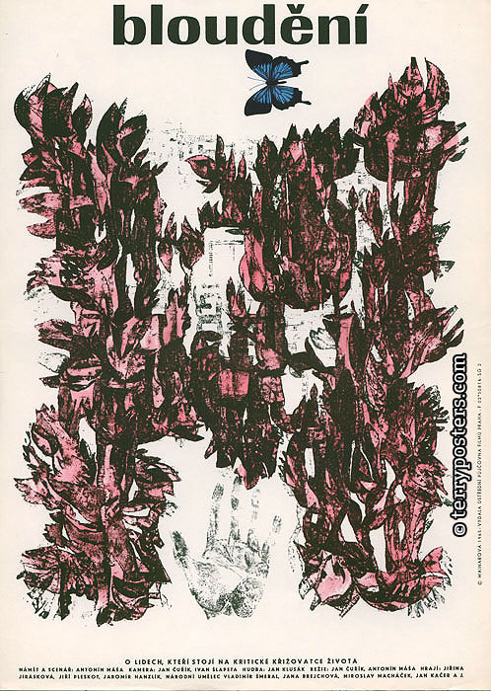
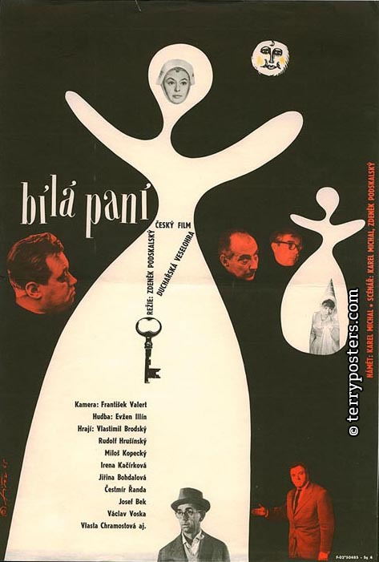
1965: the year of problematic films
This is the end of searching of and identifying structural gaps
Economic priorities – films should suceed at the box office (form of censorship?)
CPSO considers year 1965 as a problematic one, a string of films causing troubles during the approval process, most notably: Courage for Everyday (1964, dir. Evald Schorm), Thirty-three Silver Quails (1964, dir. Antonín Kachlík), The Hero is Afraid (1965, dir. František Filip) or Searching (1965, dir. Jan Čuřík, Antonín Máša)
In reaction to this development, FSB stops at least three work-in-progress projects as a form of preventive regulation

