Slide 1
Welcome to CJV_K_AGP1 English Grammar Course

Slide 2
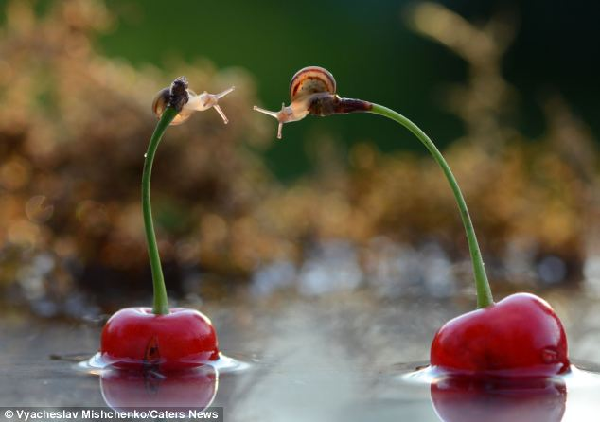
GET TO KNOW EACH OTHER

Slide 3
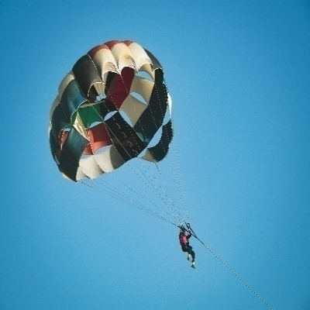
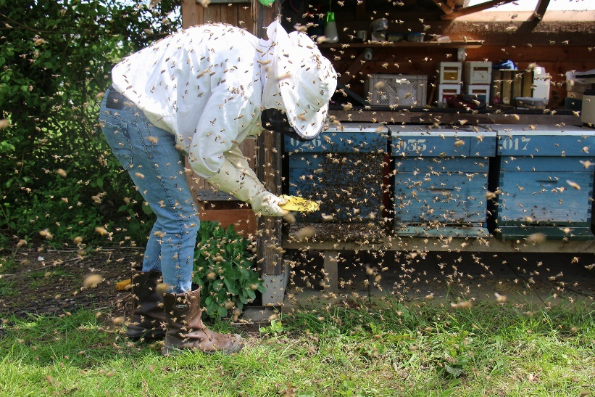
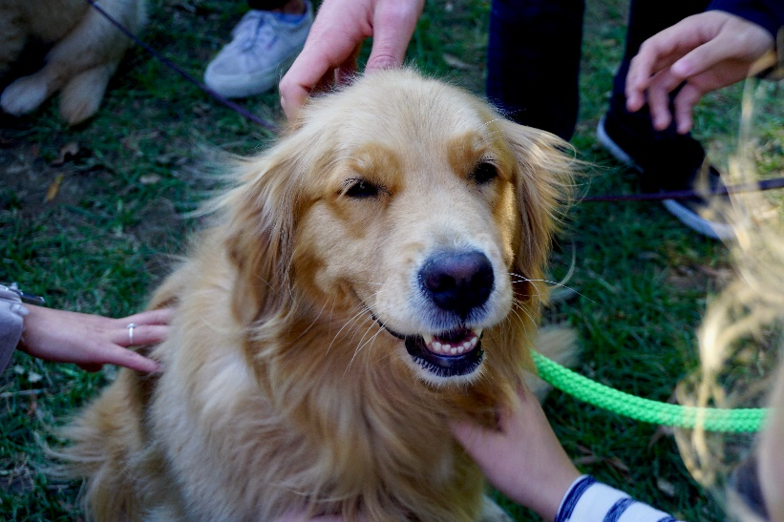
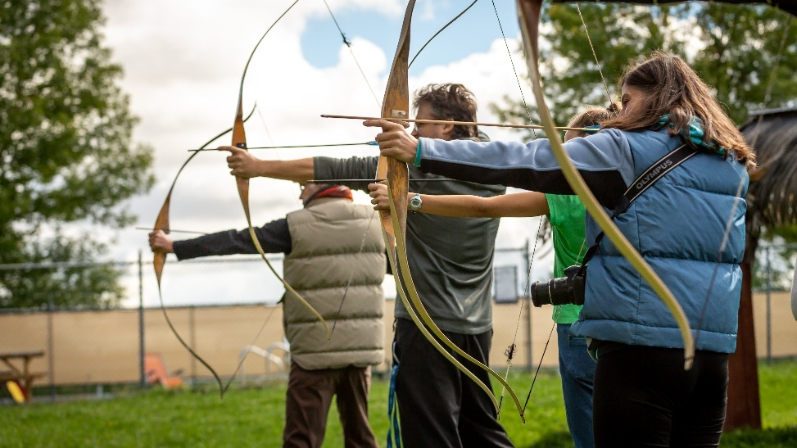
MEMORABLE ME
1. takE three minutes to think of unique or memorable factS about yourself that make it easy for others to remember you.
2. We will start with one person introducing themselves by saying their name and sharing their memorable fact(S).
3. the next person will repeat the previous person‘s name, their memorable thingS before introducing themselves, etc.

Slide 4
Words that are not used in continuous
like love hate want need prefer
know realise suppose mean understand
believe remember belong contain
consist depend seem

Slide 5
I think he's lying. (= believe)
I'm thinking about the plan. (= am considering)
The food tastes delicious. (= has a delicious flavour)
He is tasting the food. (= is testing the flavour of)
I can see some people. (= perceive with my eyes)
I see what you mean. (= understand)
I'm seeing my doctor tomorrow. (= am meeting)
It looks as if they've finished the job. (= appears)
Mike is looking out of the window, (is directing his eyes

Slide 6
This perfume smells nice. (= has a nice smell)
He is smelling the milk. (= is sniffing)
7 Bob has a Porsche. (= possesses)
He's having a shower at the moment. (= is taking a shower)
8 The chicken weighs 2 kilos. (= has a weight of)
The butcher is weighing the meat. (= is measuring
how heavy it is)

Slide 7
He is a rude person. (= character - permanent state)
He is being rude. (= behaviour - temporary situation)

Slide 8
https://www.listeninenglish.com/tf-011.php

