Slide 1
Pluricultural Competences in Action III
Athena Alchazidu

Slide 2
Warm-up
When we speak about cultural differences, what st things come to your mind first of all?

Slide 3
Braim storm
When we talk about cultural differences, what are the first things that come to your mind?

Slide 4
Cultural differences.
History
Society
Language and Communication
Body Language.
Gestures
Eye contact.

Slide 5
Listening
Cultural differences
Me vs We Culture VIDEO
https://www.youtube.com/watch?v=78haKZhEqcg&t=185s

Slide 6
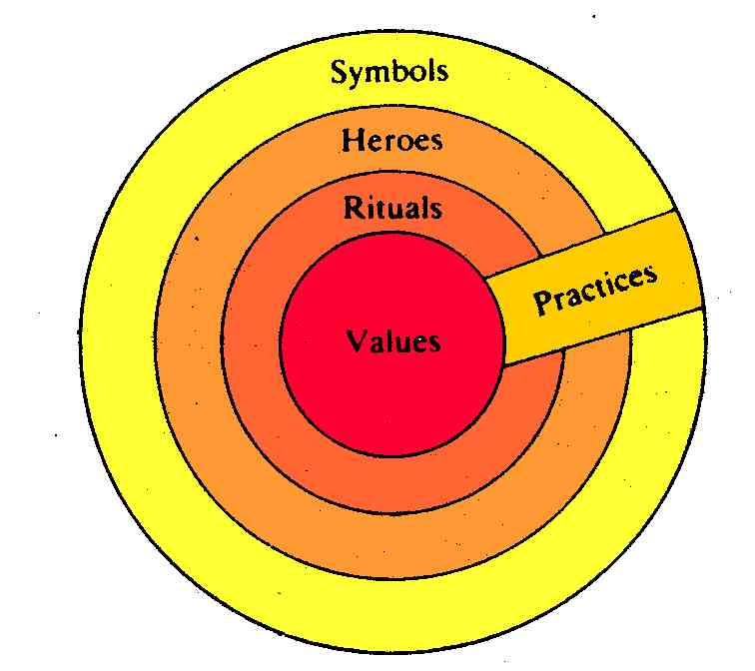
Geert Hendrik Hofstede
model of the „Cultural Onion“
(Hofstede, 2012)

Slide 7
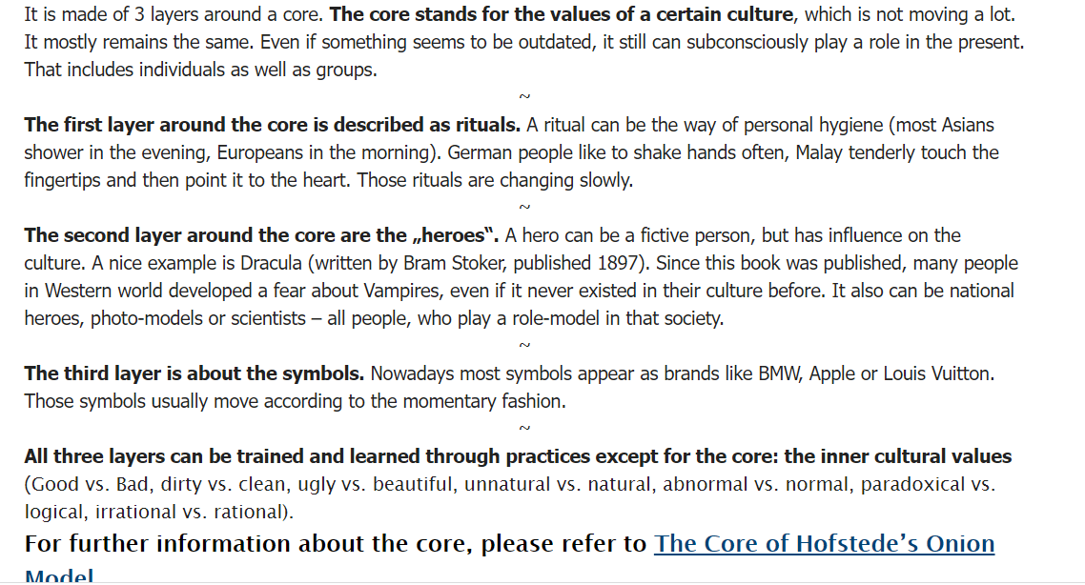

Slide 8
Topics
Cultural differences
Personal space - proximity
Eye Contact
Notes:
Socrates: discussion with students, Plato: dialogue with his teacher Socrates, Aristotle: While Plato's teacher Socrates discussed with his partners and sought to reach their agreement, Aristotle's writings already contain a binding argument for how to teach it to the pupils.

Slide 9
Workshop
Activities
1) Individual
2) In pairs
3) In groups

Slide 10
Workshop
Use worksheets
see the Syllabus, please

Slide 11
Questions & Answers. Discussion.

Slide 12
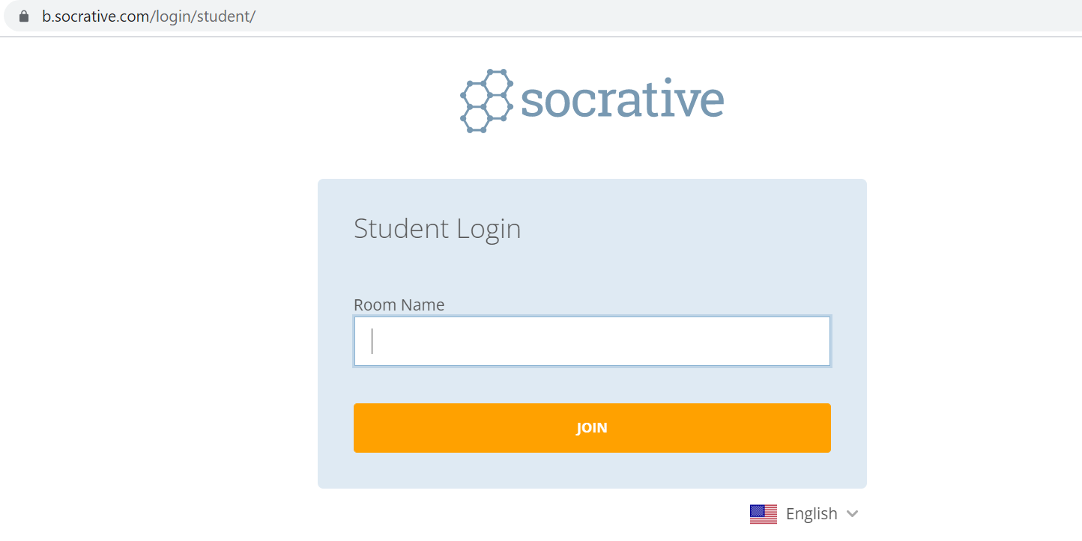
Exit ticket
Socrative
Interpret

Slide 13
Which part of the seminar have you enjoyed most today and why?
Have you missed anything?
If so, what is it
Socrative
Interpreto

Slide 14
Final slide: Reflection
Cultural differences should not separate us from each other, but rather cultural diversity brings a collective strength that can benefit all of humanity.
Robert Alan

Slide 15
Thank you for your attention

