Slide 1
Pluricultural Competences in Action I
Athena Alchazidu, Kateřina Sedláčková

Slide 2
Warm-up
What is culture?
How do you understand this concept?

Slide 3
Basic Concepts
culture
1 of 2 noun cul·​ture ˈkəl-chər
1
a: the customary beliefs, social forms, and material traits of a racial, religious, or social groupalso : the characteristic features of everyday existence (such as diversions or a way of life) shared by people in a place or timepopular culture
Southern culture
b: the set of shared attitudes, values, goals, and practices that characterizes an institution or organizationa corporate culture focused on the bottom line
c: the set of values, conventions, or social practices associated with a particular field, activity, or societal characteristicstudying the effect of computers on print culture
Changing the culture of materialism will take time …—Peggy O'Mara
Source: Merriam-Webster Dictionary
Notes:
https://bit.ly/3aK5Osn

Slide 4
Basic Concepts
d: the integrated pattern of human knowledge, belief, and behavior that depends upon the capacity for learning and transmitting knowledge to succeeding generations
2
a: enlightenment and excellence of taste acquired by intellectual and aesthetic training
b: acquaintance with and taste in fine arts, humanities, and broad aspects of science as distinguished from vocational and technical skillsa person of culture
3
: the act or process of cultivating living material (such as bacteria or viruses)
in prepared nutrient mediaalso : a product of such cultivation
4
: CULTIVATION, TILLAGEWe ought to blame the culture, not the soil.—Alexander Pope
5
: the act of developing the intellectual and moral faculties especially by education
6
: expert care and trainingbeauty culture
Source: Merriam-Webster Dictionary
Source: Mindtools.com
Notes:
https://bit.ly/3aK5Osn

Slide 5
Culture
Think of typical cultural manifestations:
In your country
In a neighbouring country
In a country from another continent

Slide 6
Workshop
Activities
1) Individual
2) In pairs
3) In groups

Slide 7
Workshop
Use worksheets
see the Syllabus, please

Slide 8
Questions & Answers. Discussion.

Slide 9
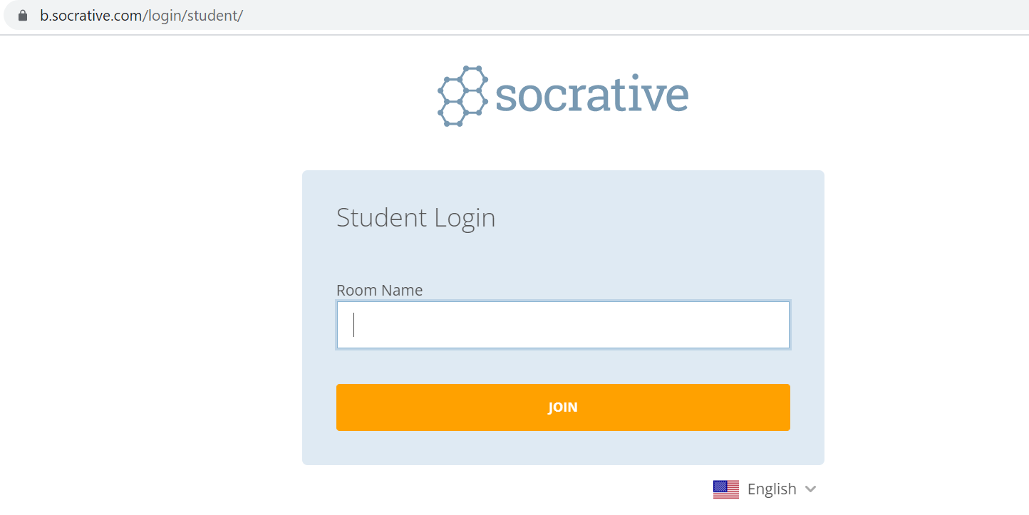
Exit ticket
Socrative
Interpret

Slide 10
Which part of the seminar have you enjoyed most today and why?
Have you missed anything?
If so, what is it
Socrative
Interpreto

Slide 11
Final slide: Reflection
Cultural differences should not separate us from each other, but rather cultural diversity brings a collective strength that can benefit all of humanity.
Robert Alan

Slide 12
Thank you for your attention

