Slide 1
Plurilingual Approach to Translation. Key Concepts I
Athena Alchazidu
Spring 2024

Slide 2
Key Concepts
„We are all (potential) plurilinguals”
Enrica Piccardo (2019)

Slide 3
Warmer
What is plurilingualism?

Slide 4
Plurilingualism
The term “plurilingualism” describes a process of dynamic, creative “languaging” across the boundaries of language varieties. It also refers to the theory underlying this process, as well as the relevant language policy aims and related methodological approaches. I discuss below the distinction between plurilingualism and multilingualism. Plurilingualism represents a complex phenomenon that transcends language boundaries both in language use
(E. Piccardo, 2019)

Slide 5
Approaches to Translation
Translation
Pluril-
ingual
Pluri-
cultural

Slide 6
Plurilingualism and Pluriculturalism
Plurilingualism is closely linked to pluriculturalism, and in the CEFR they in fact appear together throughout under the term “plurilingual and pluricultural competence”. This is seen as a dynamically developing, unbalanced, partial competence that should also be a major educational aim (Beacco & Byram, 2007).

Slide 7
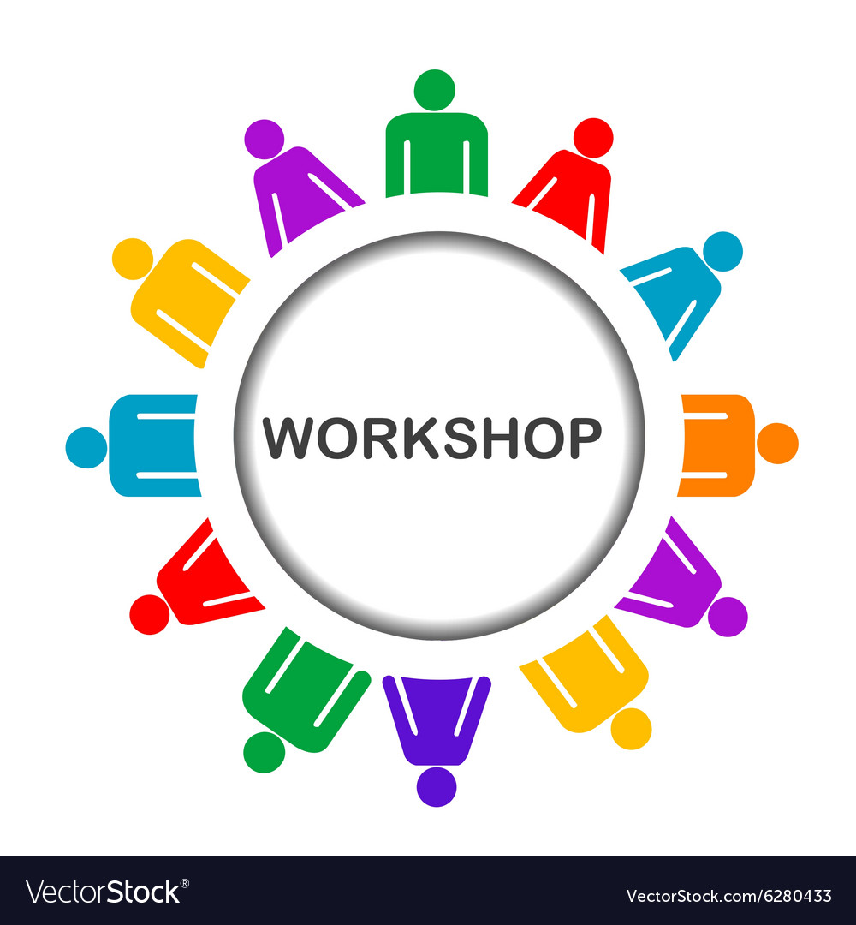
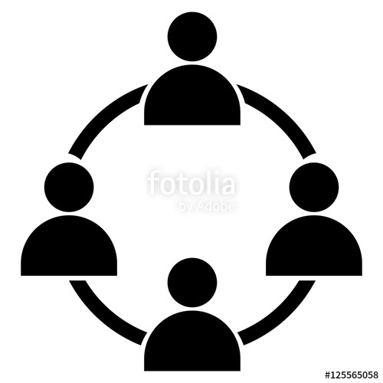
Workshop
Activities
1) Individual
2) In pairs
3) In groups

Slide 8
Workshop
Use worksheets
see the Syllabus, please

Slide 9
Questions & Answers. Discussion.

Slide 10
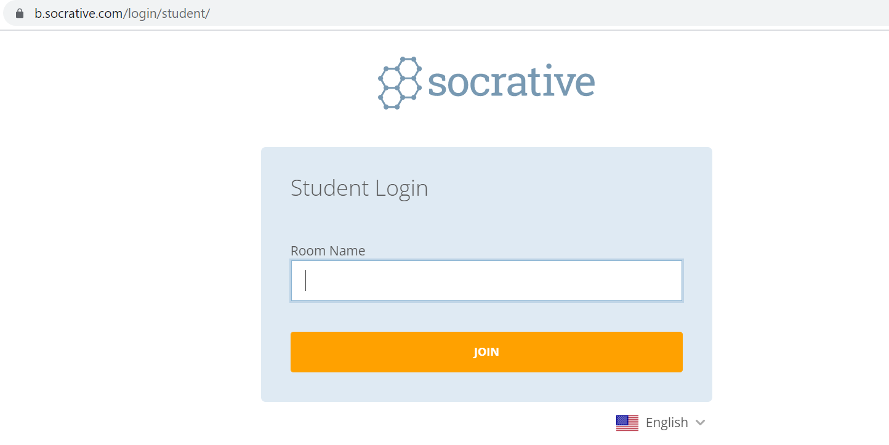
Exit ticket
Socrative
Interpret

Slide 11
Which part of the seminar have you enjoyed most today and why?
Have you missed anything?
If so, what is it
Socrative
Interpreto

Slide 12
References
Beacco, J.-C., & Byram, M. (2007). From linguistic diversity to plurilingual education: Guide for the development of language education policies in Europe. Strasbourg: Council of Europe. rm.coe.int/CoERMPublicCommonSearchServices/ DisplayDCTMContent?documentId=09000016802fc1c4
Beacco J.-C., Byram, M., Cavalli, M., Coste, D., Egli Cuenat, M., Goullier, F., & Panthier, J. (2016) Guide for the development and implementation of curricula for plurilingual and intercultural education. Strasbourg: Council of Europe. rm.coe.int/CoERMPublicCommonSearchServices/DisplayDCTMContent? documentId=09000016806ae621

Slide 13
References
Berthoud, A-C., Grin, F., & Lüdi, G. (2013) Exploring the dynamics of multilingualism: The DYLAN project. Amsterdam: John Benjamins.

Slide 14
References
Spanish resources
Anthony Pym
Univerzita v Tarragoně
a Intercultural Studies Group LINK
Teorías contemporáneas de la traducción
(online) (2012) – a další zdroje LINK

Slide 15
Thank you for your attention

