Slide 1
Plurilingual Approach to Translation. Key Concepts II
Athena Alchazidu
Spring 2024

Slide 2
Key concepts
What is the concept of a
„Turn“ in translation?

Slide 3
Translatology – „Turns“
Anthony Pym on „Turns“
Turns: “To have a turn”, in colloquial British, Australian and Irish English (we take this from Michael Cronin), means to feel sick and giddy. Translation Studies has been having quite a lot of turns, it seems […]. This suggests that translation scholars are like a flock of sheep, being led now one way, now the other. There is no easier intellectual sleaze than to pretend that everyone should take up what you want to do. Recommendation: Avoid, if you have any sense of self-respect or collective integrity.

Slide 4
Approaches to Translation
Translation
Pluril-
ingual
Pluri-
cultural

Slide 5
Plurilingualism and Pluriculturalism
Plurilingualism is closely linked to pluriculturalism, and in the CEFR they in fact appear together throughout under the term “plurilingual and pluricultural competence”. This is seen as a dynamically developing, unbalanced, partial competence that should also be a major educational aim (Beacco & Byram, 2007).

Slide 6
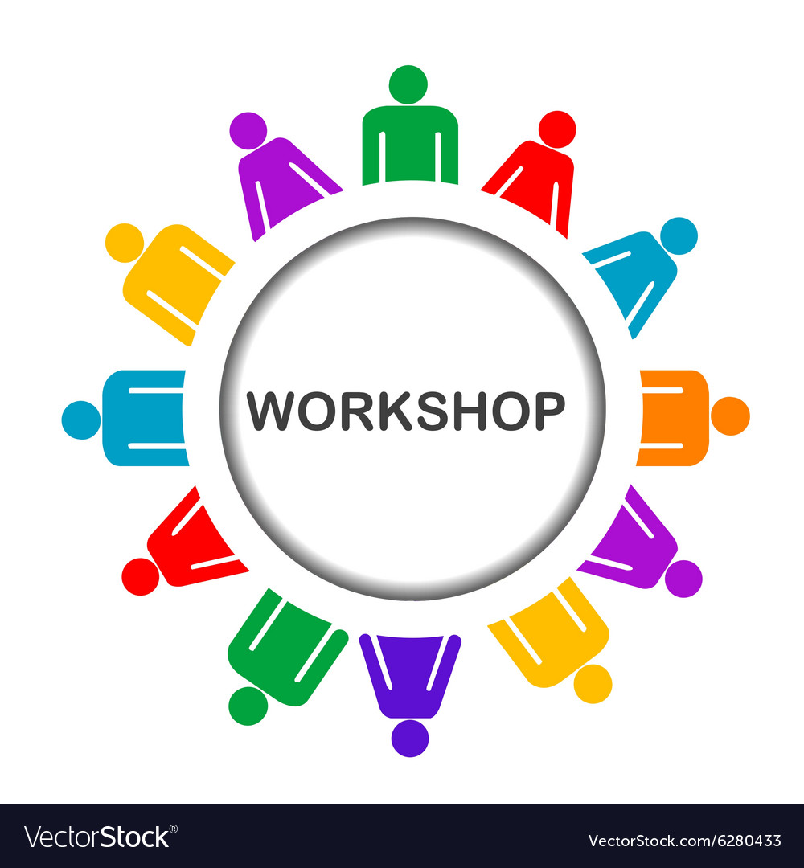
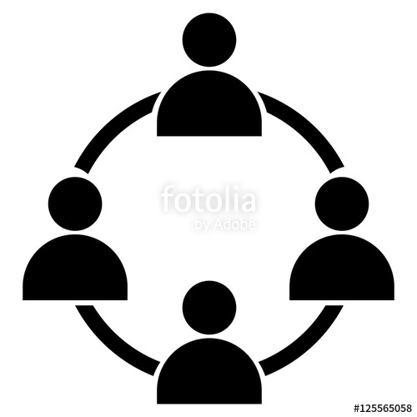
Workshop
Activities
1) Individual
2) In pairs
3) In groups

Slide 7
Workshop
Use worksheets
see the Syllabus, please

Slide 8
Questions & Answers. Discussion.

Slide 9
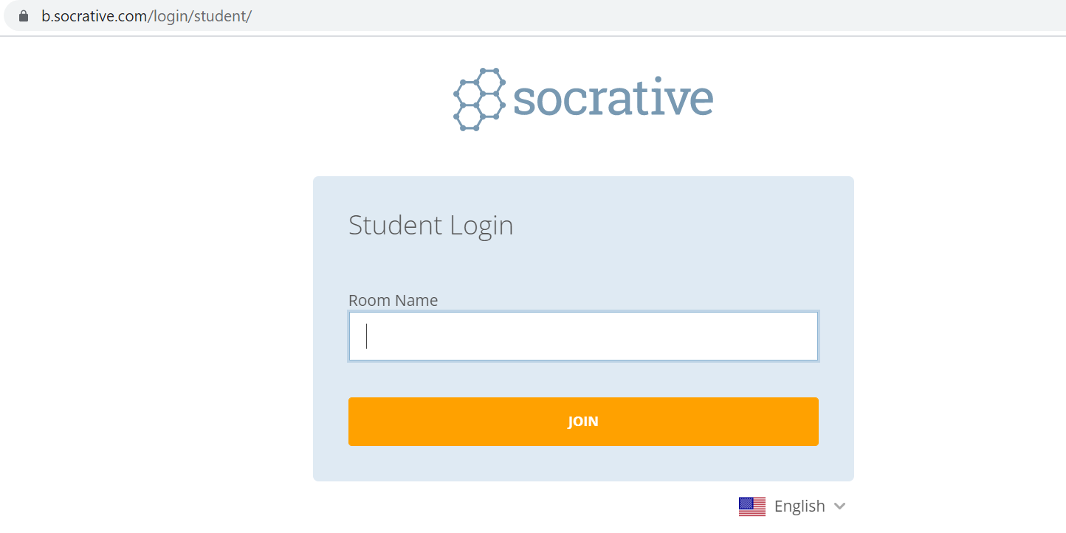
Exit ticket
Socrative
Interpret

Slide 10
Which part of the seminar have you enjoyed most today and why?
Have you missed anything?
If so, what is it
Socrative
Interpreto

Slide 11
References
Beacco, J.-C., & Byram, M. (2007). From linguistic diversity to plurilingual education: Guide for the development of language education policies in Europe. Strasbourg: Council of Europe. rm.coe.int/CoERMPublicCommonSearchServices/ DisplayDCTMContent?documentId=09000016802fc1c4
Beacco J.-C., Byram, M., Cavalli, M., Coste, D., Egli Cuenat, M., Goullier, F., & Panthier, J. (2016) Guide for the development and implementation of curricula for plurilingual and intercultural education. Strasbourg: Council of Europe. rm.coe.int/CoERMPublicCommonSearchServices/DisplayDCTMContent? documentId=09000016806ae621

Slide 12
References
Berthoud, A-C., Grin, F., & Lüdi, G. (2013) Exploring the dynamics of multilingualism: The DYLAN project. Amsterdam: John Benjamins.

Slide 13
References
Spanish resources
Anthony Pym
Univerzita v Tarragoně
a Intercultural Studies Group LINK
Teorías contemporáneas de la traducción
(online) (2012) – a další zdroje LINK

Slide 14
Thank you for your attention

