Slide 1


Introduction to Plurilingual
Approaches to Translation I
Athena Alchazidu
Spring 2024

Slide 2


Warmer
What do the pluricultural approaches in translation consist in?

Slide 3

Basic Concepts
Bilingual
Translation
Plurilingual

Slide 4
Basic Concepts
Multilingualism
Plurilingualism

Slide 5
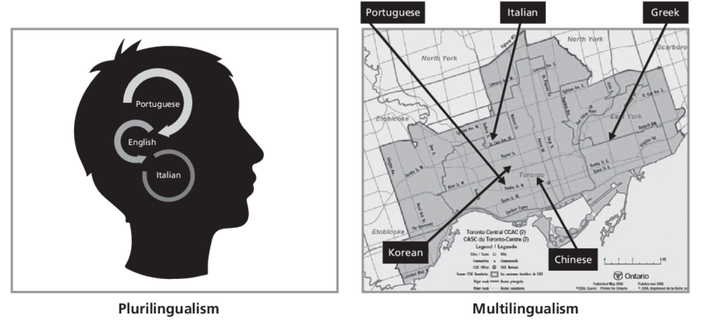
Basic Concepts
Graphic representation of the concept
Source: Yecid Ortega, 2019

Slide 6
Basic Concepts
Multiculturalism
Translation
Pluriculturalism

Slide 7
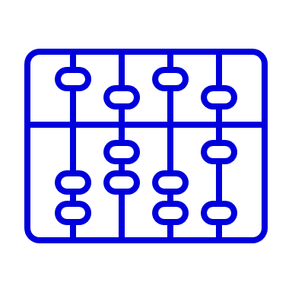

Translation Studies
The value of translation in the curriculum resides in its place as a real-world activity of mediating the intercultural exchange of meaning in the context of linguistic and cultural diversity, and where it expands access to new worlds through language use and languaging (i.e., articulating the practices of intercultural language use). Fundamentally, it enables students to understand that we are all situated in our own languages and cultures and that there is no one common place from which meaning can be mediated. (Scarino, 2016)

Slide 8
Translation Studies
Andrew Chesterman:
“…translation itself represents theory.”
A. Chesterman, The idea of a theory (2007)

Slide 9
Translation Studies – Theory
Terminology:
Transposition
Iconicity
Adequacy
Deverbalisation
Relevance
Equivalence
Key terms

Slide 10
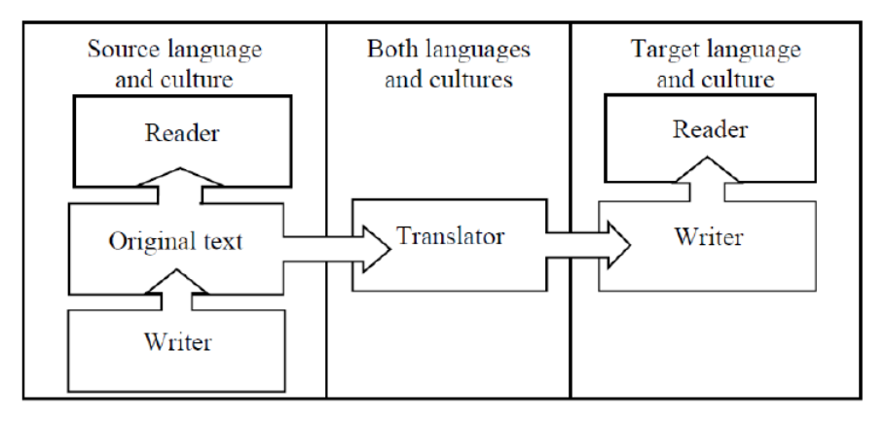
Translation Studies – Theory
The role of a translator
Source: A. Liddicoat, 2015

Slide 11




Workshop
Activities
1) Individual
2) In pairs
3) In groups

Slide 12

Workshop
Use worksheets
see the Syllabus, please

Slide 13

Questions & Answers. Discussion.

Slide 14
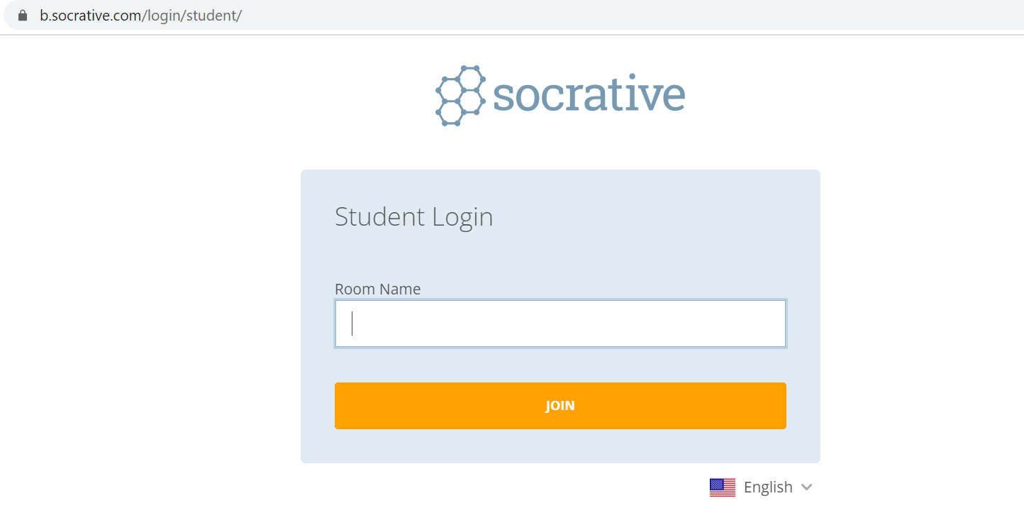

Exit ticket
Socrative
Interpret

Slide 15

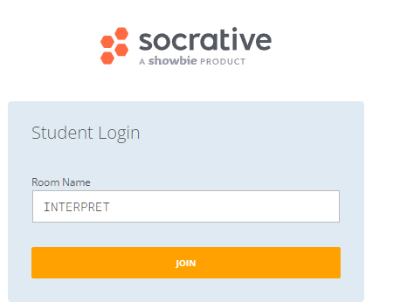
Which part of the seminar have you enjoyed most today and why?
Have you missed anything?
If so, what is it
Socrative
Interpreto

Slide 16
References
Pintado Gutiérrez, Lucía. 2019. “Mapping Translation in Foreign Language Teaching: Demystifying the Construct.” In Translating and Language Teaching. Continuing the
Dialogue, ed. by Melita Koletnik, and Nicolas Frœliger, 23-38. Newcastle Upon Tyne: Cambridge Scholars Publishing.

Slide 17
References
Pym, Anthony. 2018. “Where Translation Studies Lost the Plot: Relations with Language Teaching.” Translation and Translanguaging in Multilingual Contexts 4 (2): 204-222.
Pym, Anthony, Kirsten Malmkjær, and María del Mar Gutiérrez-Colón Plana. 2013. Translation and Language Learning: The Role of Translation in the Teaching of Languages in the European Union. A Study. Luxembourg: Publications Office of the European Union.

Slide 18
References
BITRA
Bibliography of Translation and Interpreting LINK
EST
European Society for Translation Studies LINK

Slide 19
References
Spanish resources
Anthony Pym
Univerrsidad de Tarragona
Intercultural Studies Group LINK
Teorías contemporáneas de la traducción
(online) (2012) – a další zdroje LINK

Slide 20

Thank you for your attention

