Slide 1


Introduction to Plurilingual
Approaches to Translation II
Athena Alchazidu
Spring 2024

Slide 2


Warmer
What are the most common translation strategies?

Slide 3

Theoretical Framework
In additional language learning the educational goal is to expand learners’ multilingual repertoires and develop multilinguality and interculturality. We take the position that multilinguality is inherently intercultural as it involves constant movement between languages and cultures in which both language and culture are constituent parts of meaning making and interpretation (Liddicoat and Scarino, 2013).

Slide 4

Theoretical Framework
observation, description, analysis and interpretation of phenomena shared when communicating and interacting;
active engagement with the interpretation of self (intraculturality) and ‘other’ (interculturality) in diverse contexts of social exchange;
(Liddicoat & Scarino, 2013)

Slide 5
Theoretical Framework
understanding the ways in which language and culture come into play in interpreting, creating and exchanging meaning, and the recognition and integration into communicating of an understanding of the self (and others) as already situated in one’s own language and culture when communicating with others;
understanding that interpretation can occur only through the evolving frame of reference developed by each individual: learning a new language becomes a part of the process.
(Liddicoat & Scarino, 2013)

Slide 6

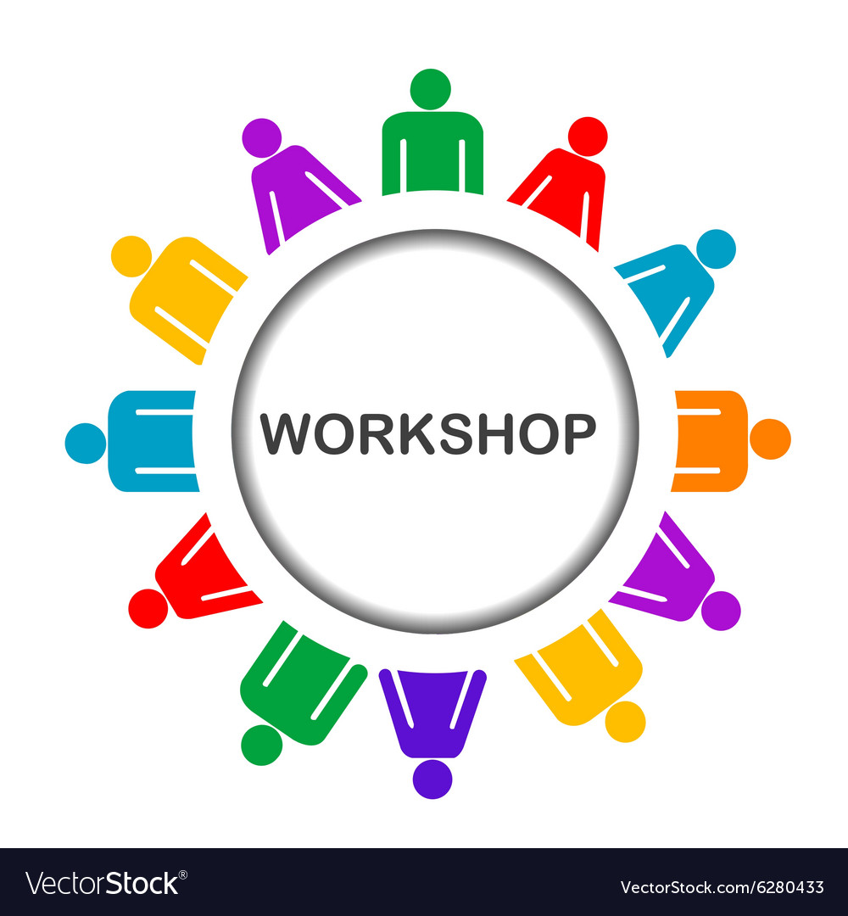


Workshop
Activities
1) Individual
2) In pairs
3) In groups

Slide 7

Workshop
Use worksheets
see the Syllabus, please

Slide 8

Questions & Answers. Discussion.

Slide 9
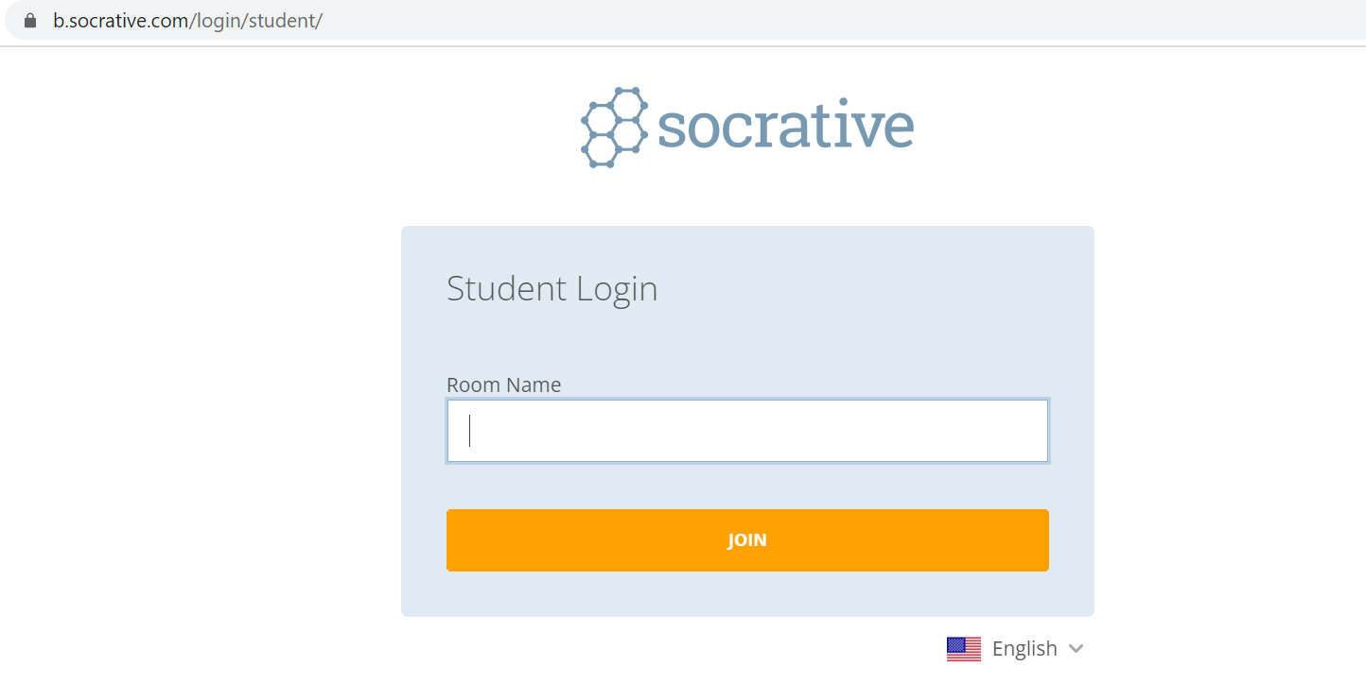

Exit ticket
Socrative
Interpret

Slide 10

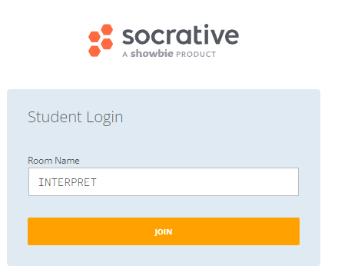
Which part of the seminar have you enjoyed most today and why?
Have you missed anything?
If so, what is it
Socrative
Interpreto

Slide 11
References
Pintado Gutiérrez, Lucía. 2019. “Mapping Translation in Foreign Language Teaching: Demystifying the Construct.” In Translating and Language Teaching. Continuing the
Dialogue, ed. by Melita Koletnik, and Nicolas Frœliger, 23-38. Newcastle Upon Tyne: Cambridge Scholars Publishing.

Slide 12
References
Pym, Anthony. 2018. “Where Translation Studies Lost the Plot: Relations with Language Teaching.” Translation and Translanguaging in Multilingual Contexts 4 (2): 204-222.
Pym, Anthony, Kirsten Malmkjær, and María del Mar Gutiérrez-Colón Plana. 2013. Translation and Language Learning: The Role of Translation in the Teaching of Languages in the European Union. A Study. Luxembourg: Publications Office of the European Union.

Slide 13
References
BITRA
Bibliography of Translation and Interpreting LINK
EST
European Society for Translation Studies LINK

Slide 14
References
Spanish resources
Anthony Pym
Univerrsidad de Tarragona
Intercultural Studies Group LINK
Teorías contemporáneas de la traducción
(online) (2012) – a další zdroje LINK

Slide 15

Thank you for your attention

