Slide 1


Introduction to Plurilingual
Approaches to Translation III
Athena Alchazidu
Spring 2024

Slide 2


Warmer
What are the benefits and the shortcuts of the naturalization vs exotization strategy?

Slide 3
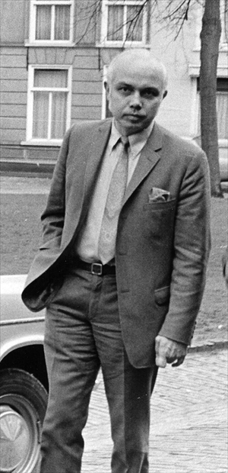
Translation Studies – Theory
The Origins of the Discipline
James S. Holmes,
The Name and Nature
of Translation Studies, (1972)

Slide 4
Translatology: Turns
The Cultural Turn in Translation Studies
Chapter in:
Susan Bassnett and André Lefevere
Translation, History and Culture (1990)

Slide 5
Translatology: Turns
The Translation Turn in Cultural Studies
Chapter in:
Susan Bassnett
Constructing Culture. Essays on Literary Translation (1998), eds. Bassnett and Lefevere

Slide 6
Translatology: Turns
?
Sociological Turn
Turn towards creativity
Hypothetic turn towards linguistics
Technological turn

Slide 7
Translatology: Turns
?
Linguistic Turns
Bilingual - Multilingual -Plurilingual

Slide 8




Workshop
Activities
1) Individual
2) In pairs
3) In groups

Slide 9

Workshop
Use worksheets
see the Syllabus, please

Slide 10

Questions & Answers. Discussion.

Slide 11
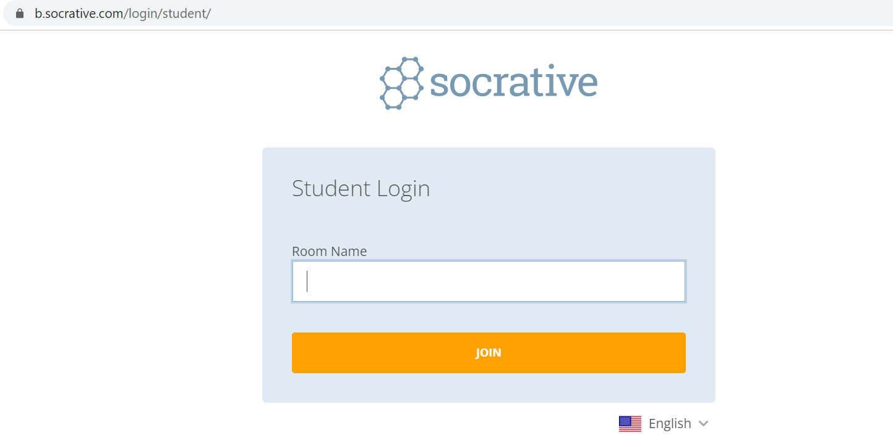

Exit ticket
Socrative
Interpret

Slide 12

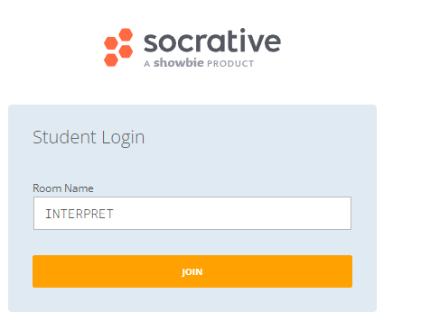
Which part of the seminar have you enjoyed most today and why?
Have you missed anything?
If so, what is it
Socrative
Interpreto

Slide 13
References
Pintado Gutiérrez, Lucía. 2019. “Mapping Translation in Foreign Language Teaching: Demystifying the Construct.” In Translating and Language Teaching. Continuing the
Dialogue, ed. by Melita Koletnik, and Nicolas Frœliger, 23-38. Newcastle Upon Tyne: Cambridge Scholars Publishing.

Slide 14
References
Pym, Anthony. 2018. “Where Translation Studies Lost the Plot: Relations with Language Teaching.” Translation and Translanguaging in Multilingual Contexts 4 (2): 204-222.
Pym, Anthony, Kirsten Malmkjær, and María del Mar Gutiérrez-Colón Plana. 2013. Translation and Language Learning: The Role of Translation in the Teaching of Languages in the European Union. A Study. Luxembourg: Publications Office of the European Union.

Slide 15
References
BITRA
Bibliography of Translation and Interpreting LINK
EST
European Society for Translation Studies LINK

Slide 16
References
Spanish resources
Anthony Pym
Univerrsidad de Tarragona
Intercultural Studies Group LINK
Teorías contemporáneas de la traducción
(online) (2012) – a další zdroje LINK

Slide 17

Thank you for your attention

