Slide 1

11
THE MACROECONOMICS OF OPEN ECONOMIES

Slide 2
6
Open-Economy Macroeconomics

Slide 3
The Flow of Goods: Exports, Imports, Net Exports (revision)
Exports are goods and services that are produced domestically and sold abroad.
Imports are goods and services that are produced abroad and sold domestically.
Net exports (NX) are the value of a nation’s exports minus the value of its imports.
Net exports are also called the trade balance.

Slide 4
Open-Economy Macroeconomics: Basic Concepts
Open and Closed Economies
  A closed economy is one that does not interact with other economies in the world.
    There are no exports, no imports, and no capital flows.
  An open economy is one that interacts freely with other economies around the world.
  An open economy interacts with other countries in two ways.
    It buys and sells goods and services in world product markets.
    It buys and sells capital assets in world financial markets.

Slide 5
The Flow of Goods: Exports, Imports, Net Exports
A trade deficit is a situation in which net exports (NX) are negative.
  Imports > Exports
A trade surplus is a situation in which net exports (NX) are positive.
  Exports > Imports
Balanced trade refers to when net exports are zero—exports and imports are exactly equal.

Slide 6
The Flow of Goods: Exports, Imports, Net Exports
Factors That Affect Net Exports
  The tastes of consumers for domestic and foreign goods.
  The prices of goods at home and abroad.
  The exchange rates at which people can use domestic currency to buy foreign currencies.
  The incomes of consumers at home and abroad.
  The costs of transporting goods from country to country.
  The policies of the government toward international trade.

Slide 7

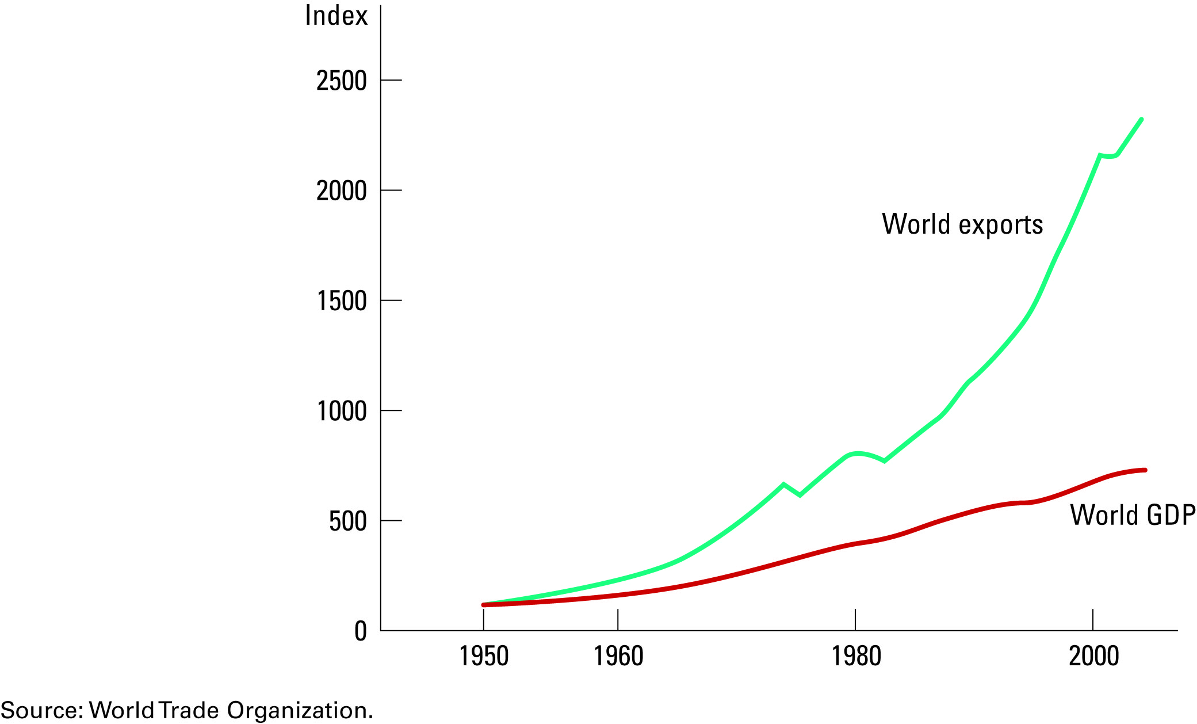
Figure 1 The Increasing Openness of the World Economy
Copyright©2010 South-Western

Slide 8
The Flow of Financial Resources: Net Capital Outflow
Net capital outflow refers to the purchase of foreign assets by domestic residents minus the purchase of domestic assets by foreigners.
  A UK resident buys shares in the BMW and a Japanese resident buys a bond issued by the UK government.
  When a UK resident buys shares in BMW, the German car company, the purchase raises UK net capital outflow.
  When a Japanese resident buys a bond issued by the UK government, the purchase reduces the UK net capital outflow.

Slide 9
The Flow of Financial Resources: Net Capital Outflow
Variables that Influence Net Capital Outflow
  The real interest rates being paid on foreign assets.
  The real interest rates being paid on domestic assets.
  The perceived economic and political risks of holding assets abroad.
  The government policies that affect foreign ownership of domestic assets.

Slide 10
The Equality of Net Exports and Net Capital Outflow
Net exports (NX) and net capital outflow (NCO) are closely linked.
For an economy as a whole, NX and NCO must balance each other so that:
NCO = NX
  This holds true because every transaction that affects one side must also affect the other side by the same amount.

Slide 11
Saving, Investment, and Their Relationship to the International Flows
Net exports is a component of GDP:
Y = C + I + G + NX
National saving is the income of the nation that is left after paying for current consumption and government purchases:
Y - C - G = I + NX
National saving (S) equals Y - C – G, so S = I + NX, or
Domestic Investment
Net Capital Outflow
Saving
=
+
S
=
I
+
NCO

Slide 12
Figure 2 US National Saving, Domestic Investment, and Net Foreign Investment
(a) National Saving and Domestic Investment (as a percentage of GDP)
Percent
of GDP
20
Domestic investment
18
16
14
12
National saving
10
1960
1965
1970
1975
1980
1985
1990
1995
2000
Copyright©2010 South-Western

Slide 13
Figure 2 US National Saving, Domestic Investment, and Net Foreign Investment
(b) Net Capital Outflow (as a percentage of GDP)
Percent
of GDP
4
3
2
Net capital
1
outflow
0
–1
–2
–3
–4
1960
1965
1970
1975
1980
1985
1990
1995
2000
Copyright©2010 South-Western

Slide 14
THE PRICES FOR INTERNATIONAL TRANSACTIONS: REAL AND NOMINAL EXCHANGE RATES
International transactions are influenced by international prices.
The two most important international prices are the nominal exchange rate and the real exchange rate.
  The nominal exchange rate is the rate at which a person can trade the currency of one country for the currency of another.
  The real exchange rate is the rate at which a person can trade the goods and services of one country for the goods and services of another.

Slide 15
Nominal Exchange Rates
The nominal exchange rate is expressed in two ways:
  In units of foreign currency per euro.
  And in euros per unit of the foreign currency.
Assume the exchange rate between the Japanese yen and the euro is 80 yen to one euro.
  One euro trades for 80 yen.
  One yen trades for 1/80 (= 0.0125) of a euro.
Appreciation refers to an increase in the value of a currency as measured by the amount of foreign currency it can buy.
Depreciation refers to a decrease in the value of a currency as measured by the amount of foreign currency it can buy.

Slide 16
Real Exchange Rates
The real exchange rate compares the prices of domestic goods and foreign goods in the domestic economy.
  If a kilo of Swiss cheese is twice as expensive as a kilo of English cheese, the real exchange rate is 1/2 a kilo of Swiss cheese per kilo of English cheese.
The real exchange rate depends on the nominal exchange rate and the prices of goods in the two countries measured in local currencies.
  The real exchange rate is a key determinant of how much a country exports and imports.

Slide 17
Real Exchange Rates
A depreciation (fall) in the UK real exchange rate means that UK goods have become cheaper relative to foreign goods.
This encourages consumers both at home and abroad to buy more UK goods and fewer goods from other countries.
As a result, UK exports rise, and UK imports fall, and both of these changes raise UK net exports.
Conversely, an appreciation in the UK real exchange rate means that UK goods have become more expensive compared to foreign goods, so UK net exports fall.

Slide 18
A FIRST THEORY OF
EXCHANGE RATE DETERMINATION: PURCHASING POWER PARITY
The purchasing power parity theory is the simplest and most widely accepted theory explaining the variation of currency exchange rates.
Purchasing power parity is a theory of exchange rates whereby a unit of any given currency should be able to buy the same quantity of goods in all countries.
According to the purchasing power parity theory, a unit of any given currency should be able to buy the same quantity of goods in all countries.

Slide 19
The Basic Logic of Purchasing Power Parity
The theory of purchasing power parity is based on a principle called the law of one price.
  According to the law of one price, a good must sell for the same price in all locations.
  If the law of one price were not true, unexploited profit opportunities would exist.
The process of taking advantage of differences in prices in different markets is called arbitrage.
  If arbitrage occurs, eventually prices that differed in two markets would necessarily converge.
According to the theory of purchasing power parity, a currency must have the same purchasing power in all countries and exchange rates move to ensure that.
Notes:
Delete this slide – it duplicates the prior slide???

Slide 20
Implications of Purchasing Power Parity
If the purchasing power of the euro is always the same at home and abroad, then the exchange rate cannot change.
The nominal exchange rate between the currencies of two countries must reflect the different price levels in those countries.
When the central bank prints large quantities of money, the money loses value both in terms of the goods and services it can buy and in terms of the amount of other currencies it can buy.

Slide 21
Figure 3 Money, Prices, and the Nominal Exchange Rate During the German Hyperinflation
Indexes
(Jan. 1921
=
100)
1,000,000,000,000,000
10,000,000,000
Money supply
Price level
100,000
1
.00001
Exchange rate
.0000000001
1921
1922
1923
1924
1925
Copyright©2010 South-Western

Slide 22
Limitations of Purchasing Power Parity
Many goods are not easily traded or shipped from one country to another.
Tradable goods are not always perfect substitutes when they are produced in different countries.

Slide 23
Key Macroeconomic Variables in an Open Economy
An open economy is one that interacts freely with other economies around the world.
The important macroeconomic variables of an open economy include:
  net exports
  net foreign investment
  nominal exchange rates
  real exchange rates

Slide 24
Macroeconomic Model of an Open Economy
Basic Assumptions:
  The model takes the economy’s GDP as given.
  The model takes the economy’s price level as given.
The Market for Loanable Funds
  S = I + NCO
  At the equilibrium interest rate, the amount that people want to save exactly balances the desired quantities of investment and net capital outflows.
  The supply of loanable funds comes from national saving (S).
  The demand for loanable funds comes from domestic investment (I) and net capital outflows (NCO).

Slide 25
The Market for Loanable Funds
The supply and demand for loanable funds depend on the real interest rate.
A higher real interest rate encourages people to save and raises the quantity of loanable funds supplied.
The interest rate adjusts to bring the supply and demand for loanable funds into balance.
At the equilibrium interest rate, the amount that people want to save exactly balances the desired quantities of domestic investment and net foreign investment.

Slide 26
Figure 1 The Market for Loanable Funds
Real
Interest
Rate
Supply of loanable funds
(from national saving)
Equilibrium
real interest
rate
Demand for loanable
funds (for domestic
investment and net
capital outflow)
Equilibrium
Quantity of
quantity
Loanable Funds
Copyright©2010 South-Western

Slide 27
The Market for Foreign Currency Exchange
The two sides of the foreign currency exchange market are represented by NCO and NX.
NCO represents the imbalance between the purchases and sales of capital assets.
NX represents the imbalance between exports and imports of goods and services.
In the market for foreign currency exchange, pounds are traded for foreign currencies.
For an economy as a whole, NCO and NX must balance each other out, or:
NCO = NX

Slide 28
The Market for Foreign Currency Exchange
The price that balances the supply and demand for foreign currency is the real exchange rate.
The demand curve for foreign currency is downward sloping because a higher exchange rate makes domestic goods more expensive.
The supply curve is vertical because the quantity of pounds supplied for net capital outflow is unrelated to the real exchange rate.
The real exchange rate adjusts to balance the supply and demand for pounds.
At the equilibrium real exchange rate, the demand for pounds to buy net exports exactly balances the supply of pounds to be exchanged into foreign currency to buy assets abroad.

Slide 29
Figure 2 The Market for Foreign Currency Exchange
Real
Exchange
Rate
Supply of pounds
(from net capital outflow)
Equilibrium
real exchange
rate
Demand for pounds
(for net exports)
Equilibrium
Quantity of Pounds Exchanged
quantity
into Foreign Currency
Copyright©2010 South-Western

Slide 30
EQUILIBRIUM IN THE OPEN ECONOMY
In the market for loanable funds, supply comes from national saving and demand comes from domestic investment and net capital outflow.
In the market for foreign currency exchange, supply comes from net capital outflow and demand comes from net exports.
Net capital outflow links the loanable funds market and the foreign currency exchange market.
  The key determinant of net capital outflow is the real interest rate.

Slide 31
Figure 3 How Net Capital Outflow Depends on the Interest Rate
Real
Interest
Rate
Net capital outflow
0
Net capital outflow
Net Capital
is negative.
is positive.
Outflow
Copyright©2010 South-Western

Slide 32
EQUILIBRIUM IN THE OPEN ECONOMY
Prices in the loanable funds market and the foreign currency exchange market adjust simultaneously to balance supply and demand in these two markets.
As they do, they determine the macroeconomic variables of national saving, domestic investment, net foreign investment, and net exports.
Notes:
Second bullet: next to last line: net capital outflow

Slide 33
Figure 4 The Real Equilibrium in an Open Economy
(a) The Market for Loanable Funds
(b) Net Capital Outflow
Real
Real
Interest
Supply
Interest
Rate
Rate
r
r
Demand
Net capital
outflow,
NCO
Quantity of
Net Capital
Loanable Funds
Outflow
Real
Supply
Exchange
Rate
E
Demand
Quantity of
Pounds
(c) The Market for Foreign Currency Exchange
Copyright©2010 South-Western

Slide 34
HOW POLICIES AND EVENTS AFFECT AN OPEN ECONOMY
The magnitude and variation in important macroeconomic variables depend on the following:
  Government budget deficits
  Trade policies
  Political and economic stability

Slide 35
Government Budget Deficits
In an open economy, government budget deficits . . .
  reduces national saving, which . . .
    shifts the supply curve for loanable funds to the left, which . . .
    raises interest rates.
  crowd out domestic investment,
    Higher interest rates reduce investment.
  cause net foreign investment to fall.
    A decrease in net foreign investment reduces the supply of pounds to be exchanged into foreign currency.
    This causes the real exchange rate to appreciate.
Notes:
Last bullet: net capital outflow

Slide 36
Figure 5 The Effects of Government Budget Deficit
(a) The Market for Loanable Funds
1. A budget deficit reduces
(b) Net Capital Outflow
the supply of loanable funds . . .
Real
Real
Interest
S
S
Interest
Rate
Rate
r₂
B
r₂
r
A
r
2. . . . which
3. . . . which in
increases
turn reduces
the real
Demand
net capital
interest
outflow.
NCO
rate . . .
Quantity of
Net Capital
Loanable Funds
Outflow
Real
S
S
Exchange
4. The decrease
Rate
in net capital
outflow reduces
the supply of pounds
E₂
to be exchanged
into foreign
5. . . . which
E₁
currency . . .
causes the
real exchange
rate to
Demand
appreciate.
Quantity of
Pounds
(c) The Market for Foreign Currency Exchange
Copyright©2010 South-Western

Slide 37
Trade Policy
A trade policy is a government policy that directly influences the quantity of goods and services that a country imports or exports.
  Tariff: A tax on an imported good.
  Import quota: A limit on the quantity of a good produced abroad and sold domestically.
Because they do not change national saving or domestic investment, trade policies do not affect the trade balance.
  For a given level of national saving and domestic investment, the real exchange rate adjusts to keep the trade balance the same.
Trade policies have a greater effect on microeconomic than on macroeconomic markets.

Slide 38
Trade Policy
Effect of an Import Quota
  Because foreigners need pounds to buy UK net exports, there is an increased demand for pounds in the market for foreign currency.
    This leads to an appreciation of the real exchange rate.
  There is no change in the interest rate because nothing happens in the loanable funds market.
  There is no change in net foreign investment even though an import quota reduces imports.
  An appreciation of the pound in the foreign exchange market encourages imports and discourages exports.
  This offsets the initial increase in net exports due to import quota.

Slide 39
Figure 6 The Effects of an Import Quota
(a) The Market for Loanable Funds
(b) Net Capital Outflow
Real
Real
Interest
Supply
Interest
Rate
Rate
r
r
3. Net exports,
however, remain
Demand
the same.
NCO
Quantity of
Net Capital
Loanable Funds
Outflow
Real
Supply
Exchange
Rate
1. An import
quota increases
E₂
the demand for
pounds . . .
2. . . . and
causes the
E
real exchange
rate to
D
appreciate.
D
Quantity of
Pounds
(c) The Market for Foreign-Currency Exchange
Copyright©2010 South-Western

Slide 40
Political Instability and Capital Flight
  Capital flight is a large and sudden reduction in the demand for assets located in a country.
Capital flight has its largest impact on the country from which the capital is fleeing, but it also affects other countries.
If investors become concerned about the safety of their investments, capital can quickly leave an economy.
Interest rates increase and the domestic currency depreciates.

Slide 41
Political Instability and Capital Flight
When investors around the world observed political problems in Mexico in 1994, they sold some of their Mexican assets and used the proceeds to buy assets of other countries.
    This increased the supply of pesos in the foreign currency exchange market.
  This increased Mexican net capital outflow.
  The demand for loanable funds in the loanable funds market increased, which increased the interest rate.

Slide 42
Summary
Net exports are the value of domestic goods and services sold abroad minus the value of foreign goods and services sold domestically.
Net capital outflow is the acquisition of foreign assets by domestic residents minus the acquisition of domestic assets by foreigners.
An economy’s net capital outflow always equals its net exports.
An economy’s saving can be used to either finance investment at home or to buy assets abroad.

Slide 43
Summary
When the nominal exchange rate changes so that each euro buys more foreign currency, the euro is said to appreciate or strengthen.
When the nominal exchange rate changes so that each euro buys less foreign currency, the euro is said to depreciate or weaken.
According to the theory of purchasing power parity, a unit of currency should buy the same quantity of goods in all countries.
The nominal exchange rate between the currencies of two countries should reflect the countries’ price levels in those countries.

Slide 44
Summary
To analyze the macroeconomics of open economies, two markets are central — the market for loanable funds and the market for foreign currency exchange.
In the market for loanable funds, the interest rate adjusts to balance supply for loanable funds (from national saving) and demand for loanable funds (from domestic investment and net capital outflow).
In the market for foreign currency exchange, the real exchange rate adjusts to balance the supply of pounds (for net capital outflow) and the demand for pounds (for net exports).
Net capital outflow is the variable that connects the two markets.

Slide 45
Summary
A policy that reduces national saving, such as a government budget deficit, reduces the supply of loanable funds and drives up the interest rate.
The higher interest rate reduces net capital outflow, reducing the supply of pounds.
The pound appreciates, and net exports fall.
A trade restriction increases net exports and increases the demand for pounds in the market for foreign currency exchange.
As a result, the pound appreciates in value, making domestic goods more expensive relative to foreign goods. This appreciation offsets the initial impact of the trade restrictions on net exports.

Slide 46
Summary
When investors change their attitudes about holding assets of a country, the effects on the country’s economy can be profound.
Political instability in a country can lead to capital flight.
Capital flight tends to increase interest rates and cause the country’s currency to depreciate.

