Slide 1

8
THE DATA OF MACROECONOMICS

Slide 2
1
Introduction to Macroeconomics:
Nation’s Income and Living Standard Dynamics

Slide 3
Why to Study Economics?
“Economics is a study of mankind in the ordinary business of life.” Marshal (1890)
Economic education helps…
In personal life…
2. In business…
3. In dealing with government…
to understand the world in which you live
to be smarter participant in the economy
to get the potential and the limits of economic policy

Slide 4
Why to Study Economics?
Economic education will not…
… make your life easier
but will give you a philosophy how to make the most of living
… by itself make you rich
but it will give you some tools that may help you in that endeavor
… give universal solution to any economic problem
but makes you more responsible about your choice of state policy

Slide 5
Key Issues in Economics
How people make decisions… how much to work, what to buy, how much to save and how to invest their savings
How people interact with one another… how the multitude of buyers and sellers of a good together determine the price at which the good is sold and the quantity that is sold
What forces and trends affect the economy as a whole… the growth in average income, the fraction of the population that cannot find work, and the rate at which prices are rising

Slide 6
Why to Study Economics?
Three directions in which economics could help us:
Personal life
Business
Government policy
Decision
making
Market interaction
Social/Total outcome
1.Tradeoffs
2.Opportunity cost
3.Marginal thinking
4.Incentives
5. Benefits of trade
6. Price coordination
7. Rule enforcement
8. Productivity
9. Inflation
10. Unemployment
MICROECONOMICS
MACROECONOMICS

Slide 7
Micro- versus Macroeconomics
Microeconomics
  Microeconomics is the study of how INDIVIDUAL households and firms make decisions and how they interact with one another in markets.
Macroeconomics
  Macroeconomics is the study of the economy as a whole.
  Its goal is to explain the economic changes that affect ALL households, firms, and markets at once.

Slide 8
Key Issues in Macroeconomics
Macroeconomics answers questions such as the following:
  Why is average income high in some countries and low in others?
  Why do prices rise rapidly in some time periods while they are more stable in others?
  Why do production and employment expand in some years and contract in others?

Slide 9
NATION’S INCOME AND LIVING STANDARD DYNAMICS
As when judging a person whether she is doing well or poorly, a nation’s overall economy is judged also based on its total income.
Similarly, the dynamics of living standard in an economy is measured through monitoring of the changes in the cost of living of everyone in the economy over time.

Slide 10
NATION’S INCOME AND LIVING STANDARD DYNAMICS
The main questions concerning nation’s income and living standard are as follows:
How Gross Domestic Product (GDP) is defined and calculated? Is GDP a good measure of economic well-being?
How Consumer Price Index (CPI) is constructed? Why the CPI is an imperfect measure of the cost of living?
What are the differences between CPI and GDP deflator as measures of the overall price level?
What distinguishes real GDP from nominal GDP?
What is the distinction between real and nominal interest rates?

Slide 11
The Measurement of Gross Domestic Product
Gross domestic product (GDP) is a measure of the income and expenditures of an economy.
It is the total market value of all final goods and services produced within a country in a given period of time.
For an economy as a whole, income must equal expenditure because:
  Every transaction has a buyer and a seller.
  Every dollar of spending by some buyer is a dollar of income for some seller.
The equality of income and expenditure can be illustrated with the circular-flow diagram.

Slide 12

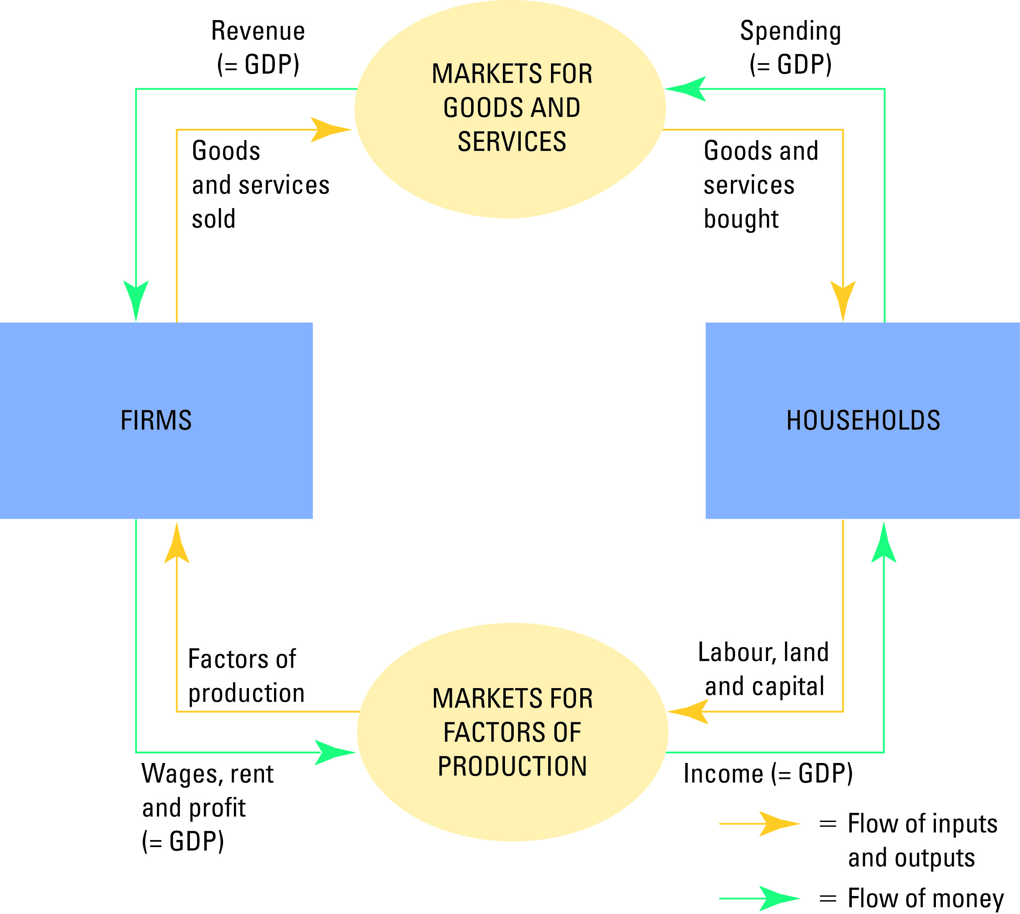
Figure 1 The Circular-Flow Diagram
Copyright©2010 South-Western

Slide 13
The Measurement of Gross Domestic Product
“GDP is the Market Value . . .”
  Output is valued at market prices.
“. . . Of All Final . . .”
  It records only the value of final goods, not intermediate goods (the value is counted only once).
“. . . Goods and Services . . . “
  It includes both tangible goods (food, clothing, cars) and intangible services (haircuts, house cleaning, doctor visits).
“. . . Produced . . .”
  It includes goods and services currently produced, not transactions involving goods produced in the past.
“ . . . Within a Country . . .”
  It measures the value of production within the geographic confines of a country.
“. . . In a Given Period of Time.”
  It measures the value of production that takes place within a specific interval of time, usually a year or a quarter (three months).

Slide 14
The Components of GDP
GDP includes all items produced in the economy and sold legally in markets.
What Is Not Counted in GDP?
  GDP excludes most items that are produced and consumed at home and that never enter the marketplace.
  It excludes items produced and sold illicitly, such as illegal drugs.

Slide 15
The Components of GDP
GDP (Y) is the sum of the following:
  Consumption (C)
  Investment (I)
  Government Purchases (G)
  Net Exports (NX)
Y = C + I + G + NX

Slide 16
The Components of GDP
Consumption (C):
  The spending by households on goods and services, with the exception of purchases of new housing.
Investment (I):
  The spending on capital equipment, inventories, and structures, including new housing.
Government Purchases (G):
  The spending on goods and services by local and central governments.
  Does not include transfer payments because they are not made in exchange for currently produced goods or services.
Net Exports (NX):
  Exports minus imports.

Slide 17

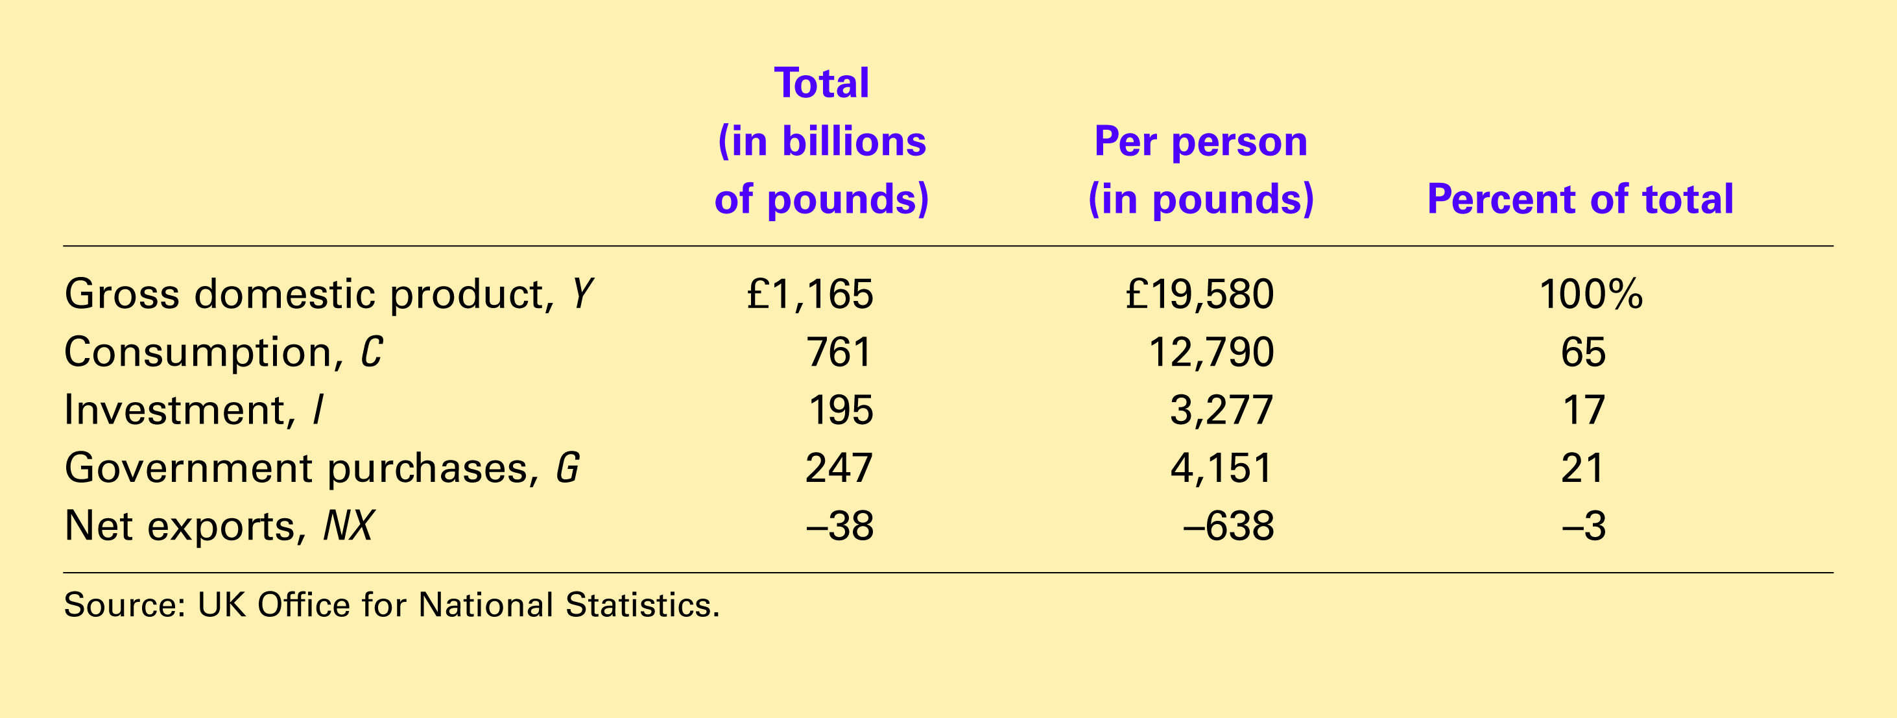
Table 1 GDP and Its Components
Copyright©2010 South-Western

Slide 18
Other Measures of Income
Gross National Product (GNP):
  The total income earned by a nation’s permanent residents (called nationals).
Net National Product (NNP):
  The total income of a nation’s residents (GNP) minus losses from depreciation (the wear and tear on economy’s stock of capital equipment and structures).
National Income (NI):
  Total income earned by a nation’s residents in the production of goods and services (NNP – indirect taxes + subsidies).
Personal Income (PI):
  Income the households and non-corporate businesses receive.
  (NI – retained earnings – income taxes and social insurance + government social and interest payments to households) .
Disposable Personal Income (DPI):
  (PI – personal payments to government)

Slide 19
GDP and Economic Well-Being
GDP is the best single measure of the economic well-being of a society.
GDP per person tells us the mean income and expenditure of the people in the economy.
Higher GDP per person indicates a higher standard of living.
GDP is not a perfect measure of the happiness or quality of life, however.

Slide 20
GDP and Economic Well-Being
Some things that contribute to well-being are not included in GDP.
  The value of leisure.
  The value of a clean environment.
  The value of almost all activity that takes place outside of markets, such as the value of the time parents spend with their children and the value of volunteer work.

Slide 21
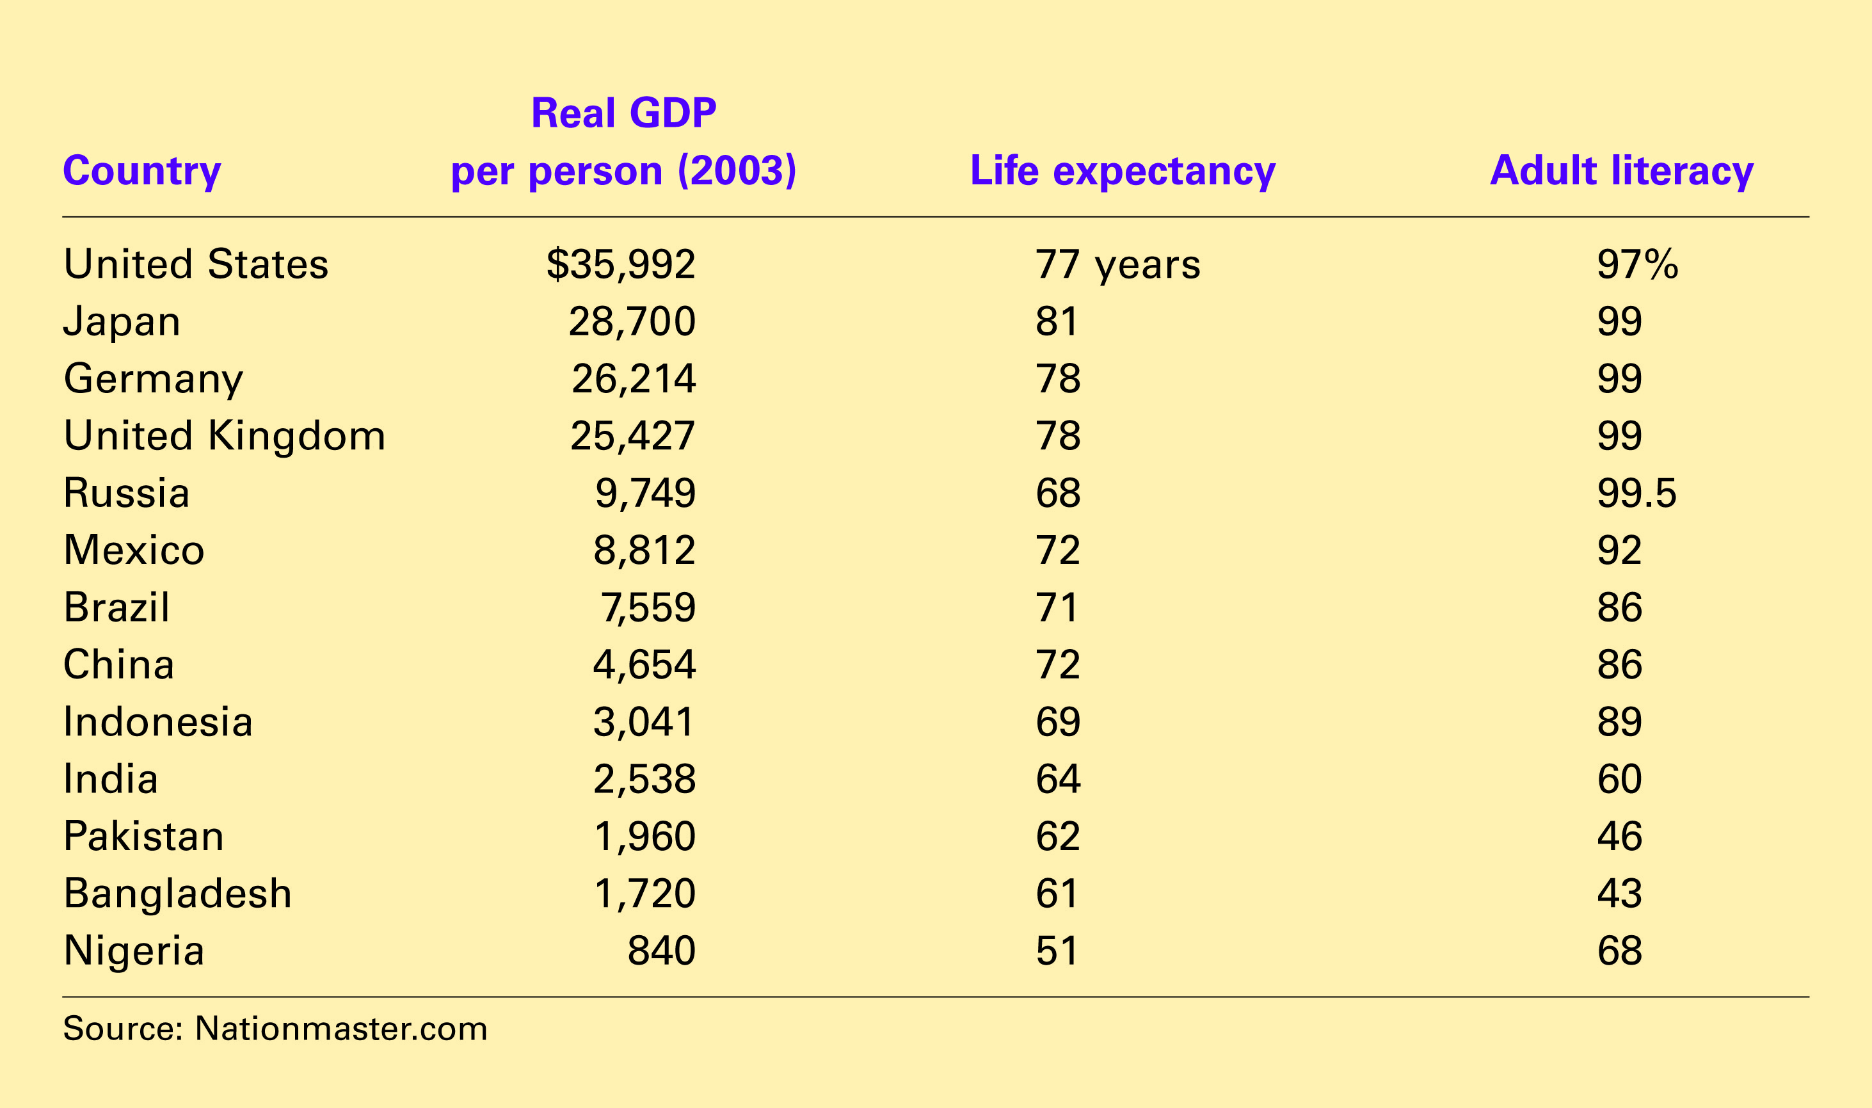
Table 3 GDP, Life Expectancy, and Literacy
Copyright©2010 South-Western

Slide 22
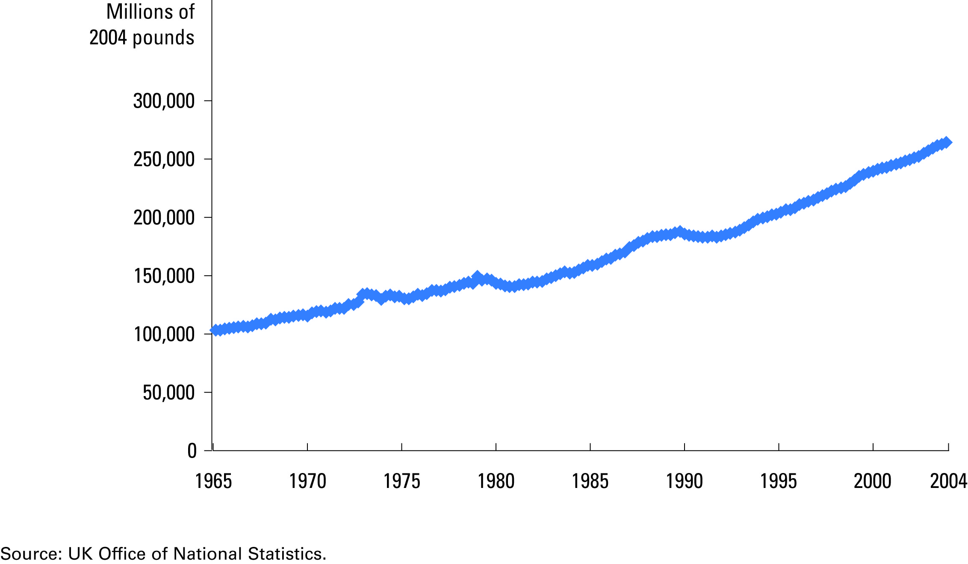
Figure 2 Real GDP in the United Kingdom
Copyright©2010 South-Western

Slide 23
Real versus Nominal GDP
Nominal GDP values the production of goods and services at current prices.
Real GDP values the production of goods and services at constant prices.
An accurate view of the economy requires adjusting nominal to real GDP by using the GDP deflator.

Slide 24
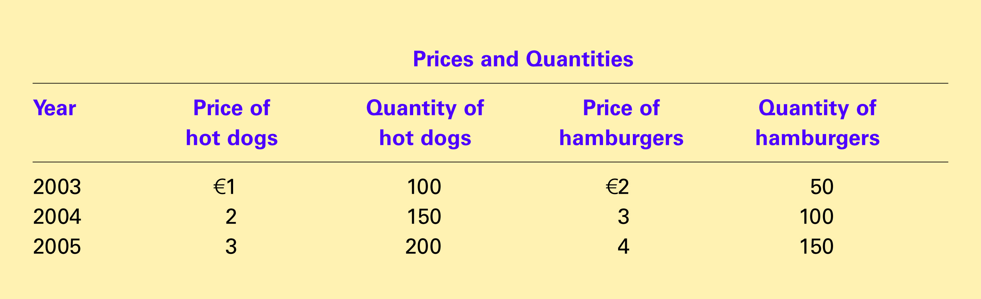
Table 2 Real and Nominal GDP
Copyright©2010 South-Western

Slide 25
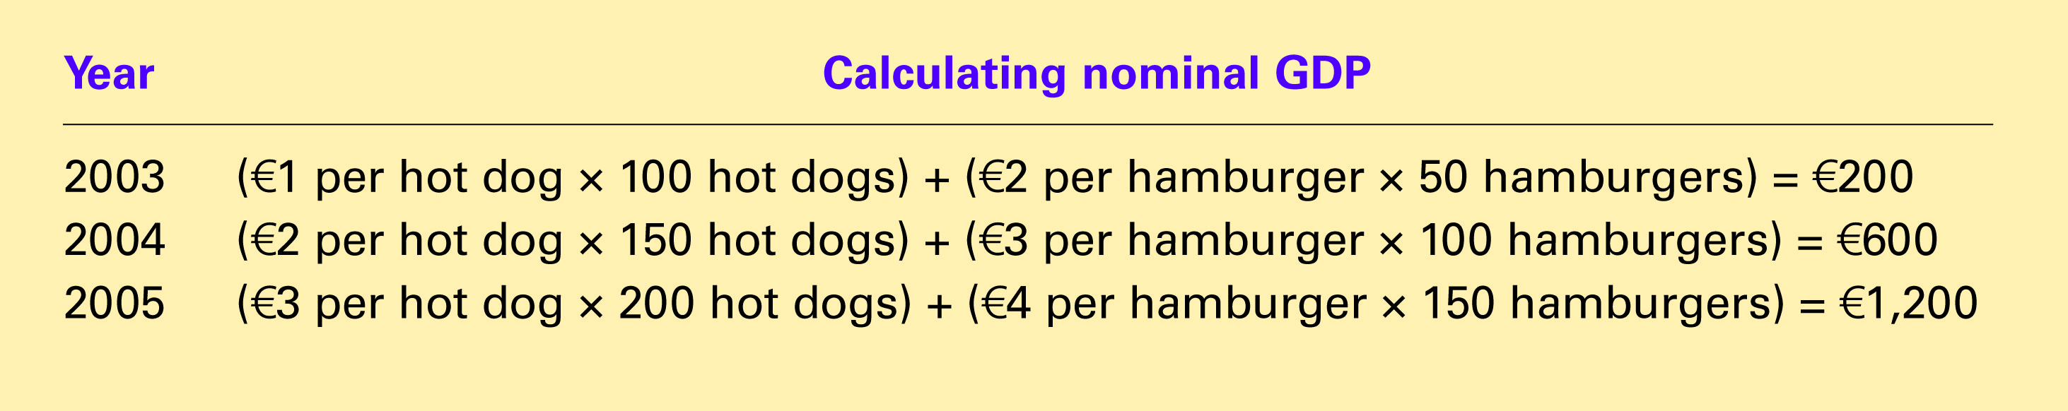
Table 2 Real and Nominal GDP
Copyright©2010 South-Western

Slide 26
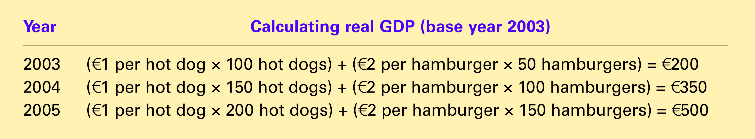
Table 2 Real and Nominal GDP
Copyright©2010 South-Western

Slide 27
The GDP Deflator
The GDP deflator is a measure of the price level calculated as the ratio of nominal GDP to real GDP times 100.
It tells us the rise in nominal GDP that is attributable to a rise in prices rather than a rise in the quantities produced.

Slide 28
The GDP Deflator
The GDP deflator is calculated as follows:

Slide 29
The GDP Deflator
Converting Nominal GDP to Real GDP
  Nominal GDP is converted to real GDP as follows:

Slide 30
The Consumer Price Index
The consumer price index (CPI) is a measure of the overall cost of the goods and services bought by a typical consumer.
The Office of National Statistics reports the CPI each month.
It is used to monitor changes in the cost of living over time.
When the CPI rises, the typical family has to spend more money to maintain the same standard of living.

Slide 31
How the Consumer Price Index Is Calculated
Step 1 Fix the Basket: Determine what prices are most important to the typical consumer.
Step 2 Find the Prices: Find the prices of each of the goods and services in the basket for each point in time.
Step 3 Compute the Basket’s Cost: Use the data on prices to calculate the cost of the basket of goods and services at different times.
Step 4 Choose a Base Year and Compute the Index: Compute the index by dividing the price of the basket in one year by the price in the base year and multiplying by 100.
Step 5 Compute the inflation rate: The inflation rate is the percentage change in the price index from the preceding period.

Slide 32
Inflation Rate
Inflation refers to a situation in which the economy’s overall price level is rising.
The inflation rate is the percentage change in the price level from the previous period.
  The inflation rate is calculated as follows:

Slide 33
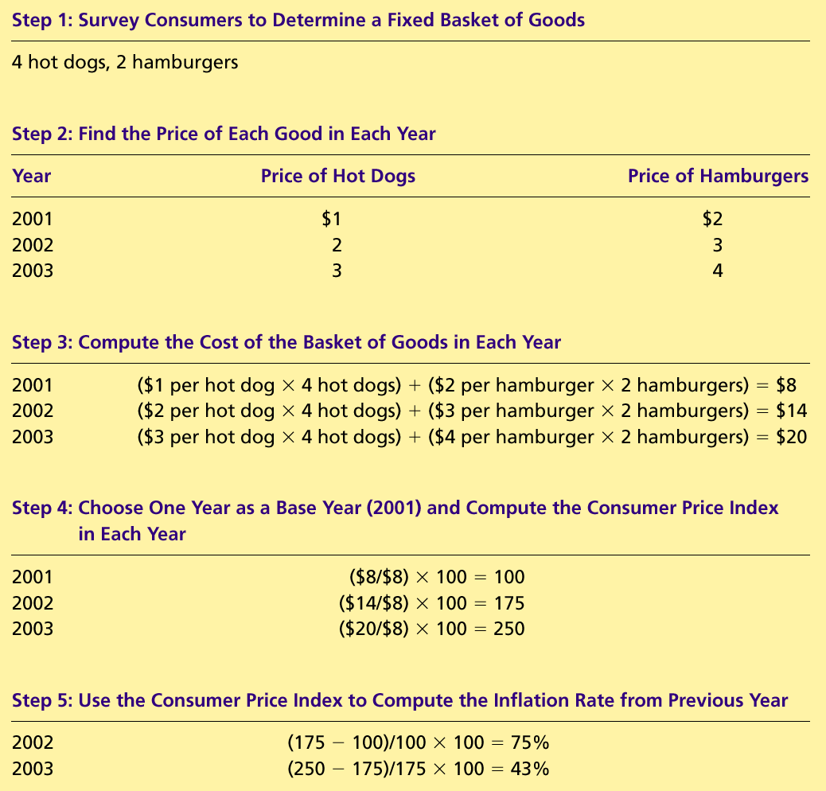
Table 1 Calculating the Consumer Price Index and the Inflation Rate: An Example
Copyright©2010 South-Western

Slide 34

Table 1 Calculating the Consumer Price Index and the Inflation Rate: An Example
Copyright©2010 South-Western

Slide 35
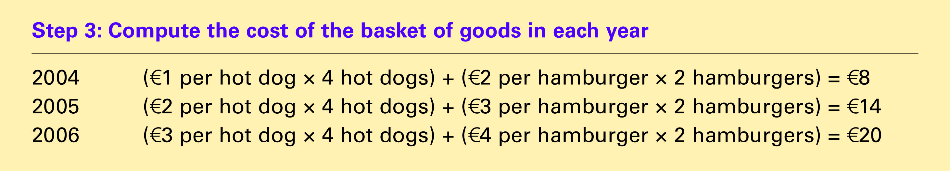
Table 1 Calculating the Consumer Price Index and the Inflation Rate: An Example
Copyright©2010 South-Western

Slide 36
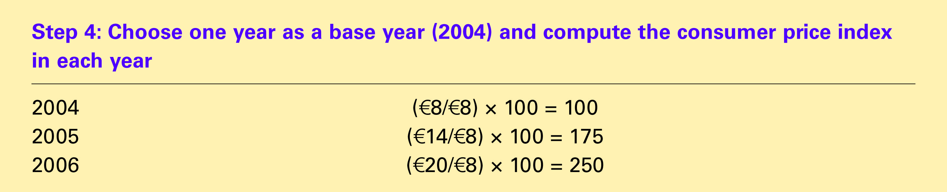
Table 1 Calculating the Consumer Price Index and the Inflation Rate: An Example
Copyright©2010 South-Western

Slide 37
Table 1 Calculating the Consumer Price Index and the Inflation Rate: An Example
Copyright©2010 South-Western

Slide 38
How the Consumer Price Index Is Calculated
Calculating the Consumer Price Index and the Inflation Rate: Real-world Example
  Base Year is 2002.
  Basket of goods in 2002 costs €1,200.
  The same basket in 2004 costs €1,236.
  CPI = (€1,236/ €1,200) × 100 = 103.
  Prices increased 3 percent between 2002 and 2004.

Slide 39
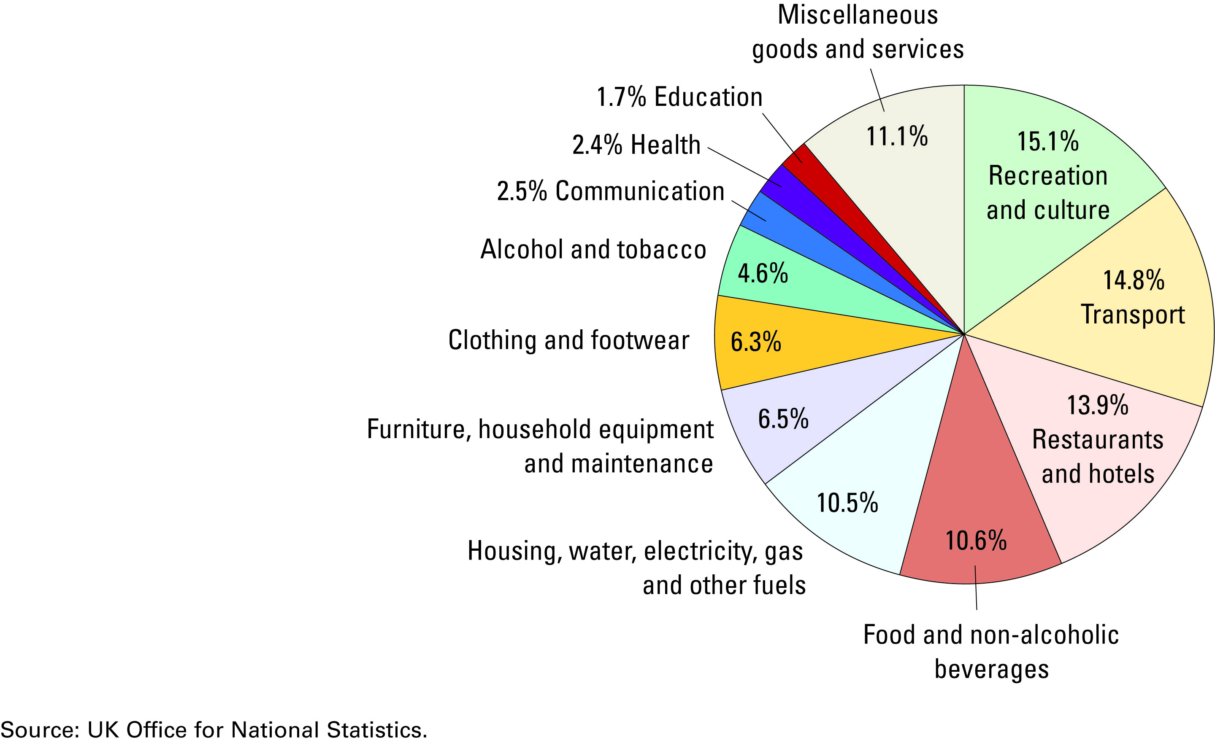
FYI: The Typical Basket of Goods and Services
Copyright©2010 South-Western

Slide 40
Problems in Measuring the Cost of Living
The CPI is an accurate measure of the selected goods that make up the typical bundle, but it is not a perfect measure of the cost of living.
  Substitution bias
  Introduction of new goods
  Unmeasured quality changes
  The issue is important because many government programs use the CPI to adjust for changes in the overall level of prices.

Slide 41
Problems in Measuring the Cost of Living
Substitution Bias
  The basket does not change to reflect consumer reaction to changes in relative prices.
    Consumers substitute toward goods that have become relatively less expensive.
    The index overstates the increase in cost of living by not considering consumer substitution.

Slide 42
Problems in Measuring the Cost of Living
Introduction of New Goods
  The basket does not reflect the change in purchasing power brought on by the introduction of new products.
    New products result in greater variety, which in turn makes each euro more valuable.
    Consumers need less money to maintain any given standard of living.

Slide 43
Problems in Measuring the Cost of Living
Unmeasured Quality Changes
  If the quality of a good rises from one year to the next, the value of a euro rises, even if the price of the good stays the same.
  If the quality of a good falls from one year to the next, the value of a euro falls, even if the price of the good stays the same.
  The ONS tries to adjust the price for constant quality, but such differences are hard to measure.

Slide 44
Indexation
When some money amount is automatically corrected for inflation by law or contract, the amount is said to be indexed for inflation.
Cost-of living allowance (COLA) – partial or complete indexation of the wage to the consumer price index as a clause in long-term contracts between firms and unions.
Indexation is also a feature of many laws concerning adjustment for inflation of the government social benefits.

Slide 45
The GDP Deflator versus the Consumer Price Index
The ONS calculates other prices indexes:
  The producer price index (PPI), which measures the cost of a basket of goods and services bought by firms rather than consumers.
  The changes in PPI are often thought to be useful in predicting changes in CPI.

Slide 46
The GDP Deflator versus the Consumer Price Index
Economists and policymakers monitor both the GDP deflator and the consumer price index to gauge how quickly prices are rising.
There are two important differences between the indexes that can cause them to diverge:
  The GDP deflator reflects the prices of all goods and services produced domestically, whereas the consumer price index reflects the prices of all goods and services bought by consumers.
  The consumer price index compares the price of a fixed basket of goods and services whereas the GDP deflator compares the price of currently produced goods and services to the price of the same goods and services in the base year.

Slide 47
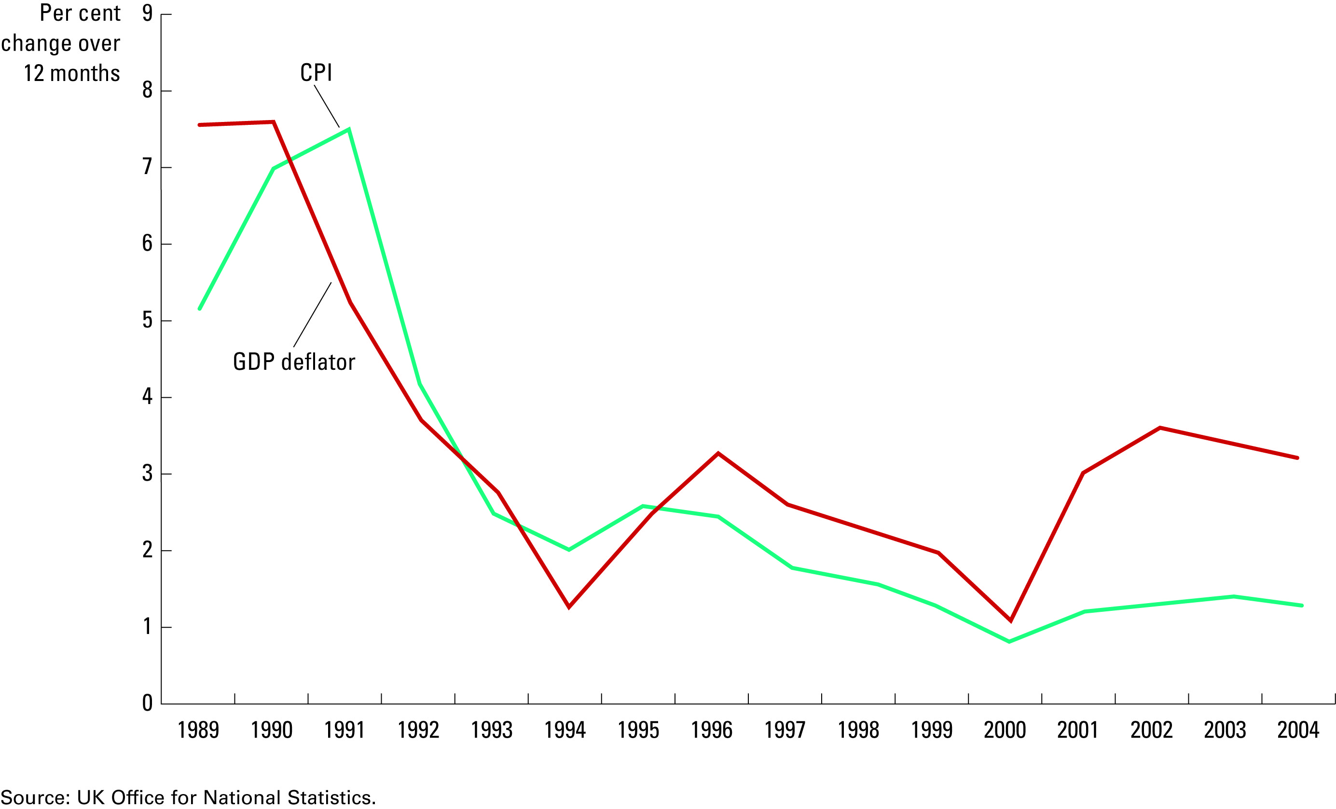
Figure 2 Two Measures of Inflation
Copyright©2010 South-Western

Slide 48
Correcting Economic Variables for the Effects of Inflation
Price indexes are used to correct for the effects of inflation when comparing money figures from different times.
Do the following to convert (inflate) MPs’ salary in 1911 to a figure in 2004 pounds:
Price leve
l in 2004
Salary
=
Salary
×
2004
1911
Price leve
l in 1911
5,040
=
£400
×
=
£20,160
100

Slide 49
Money Figures from Different Times
Do the following to convert (inflate) MPs’ salary in 1911 to a figure in 2004 pounds:
Price leve
l in 2004
Salary
=
Salary
×
2004
1911
Price leve
l in 1911
5,040
=
£400
×
100
=
£20,160

Slide 50
Real and Nominal Interest Rates
Interest represents a payment in the future for a transfer of money in the past.
The nominal interest rate is the interest rate usually reported and not corrected for inflation.
  It is the interest rate that a bank pays.
The real interest rate is the nominal interest rate that is corrected for the effects of inflation.

Slide 51
Real and Nominal Interest Rates
Example:
You borrowed €1,000 for one year.
Nominal interest rate was 15%.
During the year inflation was 10%.
Real interest rate = Nominal interest rate – Inflation
= 15% - 10% = 5%

Slide 52
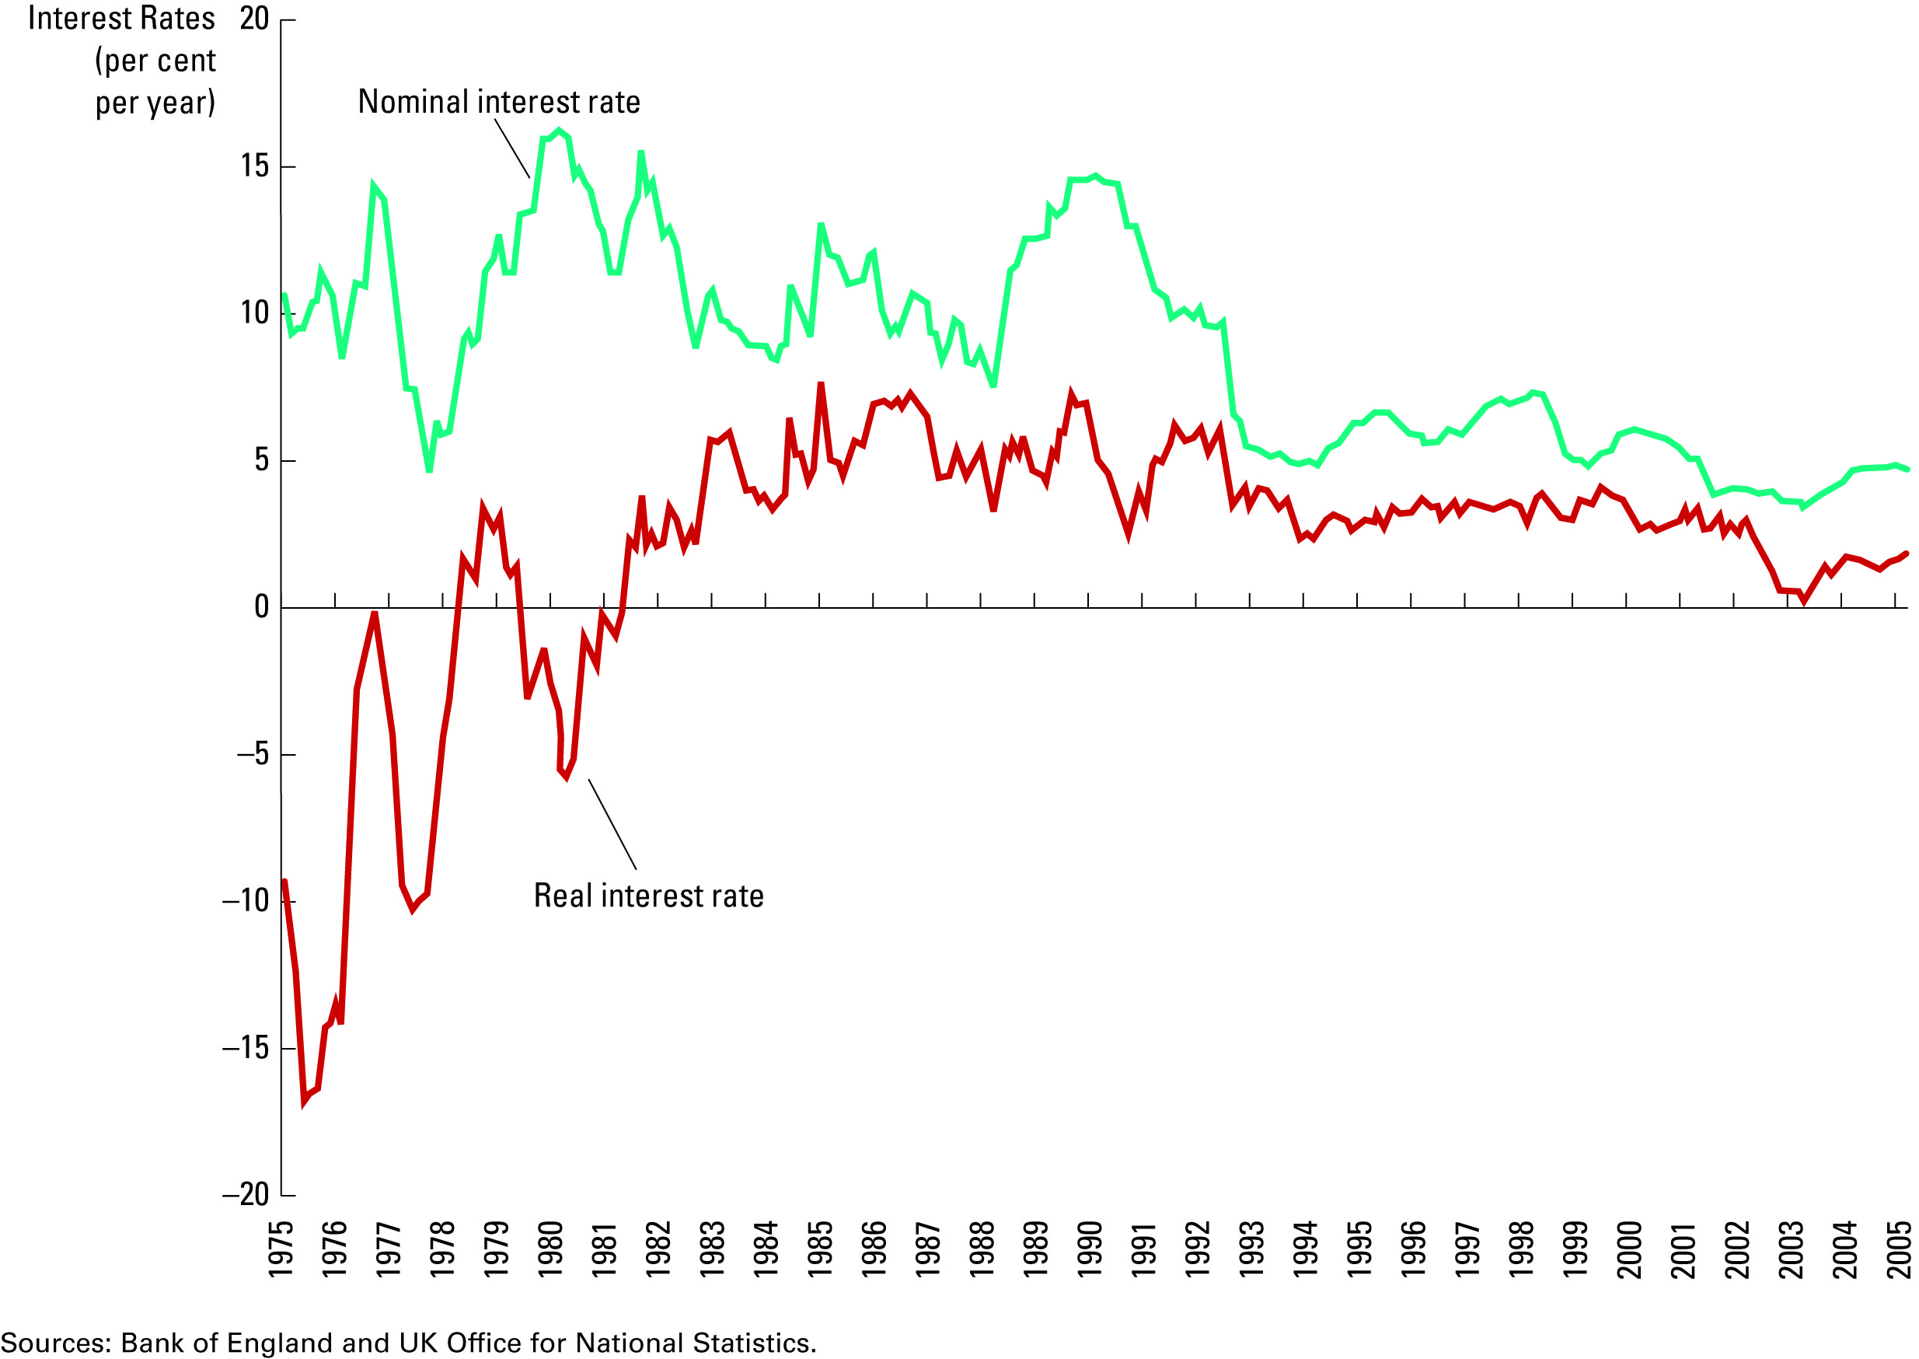
Figure 3 Real and Nominal Interest Rates
Copyright©2010 South-Western

Slide 53
Summary
Because every transaction has a buyer and a seller, the total expenditure in the economy must equal the total income in the economy.
GDP is the market value of all final goods and services produced within a country in a given period of time.
GDP is divided among four components of expenditure: consumption, investment, government purchases, and net exports.
Nominal GDP uses current prices to value the economy’s production. Real GDP uses constant base-year prices to value the economy’s production of goods and services.
The GDP deflator—calculated from the ratio of nominal to real GDP—measures the level of prices in the economy.
GDP is a good measure of economic well-being because people prefer higher to lower incomes.
It is not a perfect measure of well-being because some things, such as leisure time and a clean environment, aren’t measured by GDP.

Slide 54
Summary
The consumer price index shows the cost of a basket of goods and services relative to the cost of the same basket in the base year.
The index is used to measure the overall level of prices in the economy.
The percentage change in the CPI measures the inflation rate.
The consumer price index is an imperfect measure of the cost of living for the following three reasons: substitution bias, the introduction of new goods, and unmeasured changes in quality.

Slide 55
Summary
The GDP deflator differs from the CPI because it includes goods and services produced rather than goods and services consumed.
In addition, the CPI uses a fixed basket of goods, while the GDP deflator automatically changes the group of goods and services over time as the composition of GDP changes.
Money figures from different points in time do not represent a valid comparison of purchasing power.
Various laws and private contracts use price indexes to correct for the effects of inflation.
The real interest rate equals the nominal interest rate minus the rate of inflation.

