Slide 1
3
Saving, Investment, and the Financial System

Slide 2
Revision
What is the importance of capital investment on economy’s productivity?
One way to raise future productivity is to invest more current resources in the production of capital.
How the increase in higher saving rate affects the productivity and income?
An increase in the saving rate leads to rise in capital stock, higher level of productivity and income.
What about the effect on growth in the long run?
Because of the diminishing returns the higher saving rate does not lead to higher growth in the long run.

Slide 3
Saving, Investment and the Financial System
At any time some people want to save some of their income for the future, and others want to borrow in order to finance investments in new and growing businesses. Financial system is what brings these two groups of people together.
Key issues concerning financial system are:
Which are the various institutions that make up the financial system? How do they function?
Which are the basic tools of finance?
How interest rate balances the supply and demand for loanable funds in financial markets?
How the government policies affect the interest rate and, thereby, society’s allocation of scarce resources?

Slide 4
The Financial System
The financial system consists of the group of institutions in the economy that help to match one person’s saving with another person’s investment.
It moves the economy’s scarce resources from savers to borrowers.

Slide 5
Financial Institutions in the Economy
Financial institutions can be grouped into two different categories: financial markets and financial intermediaries.
Financial Markets
  Stock Market
  Bond Market
Financial Intermediaries
  Banks
  Mutual Funds

Slide 6
Financial Markets
Financial markets are the institutions through which savers can directly provide funds to borrowers.
The Bond Market
  A bond is a certificate of indebtedness that
  specifies obligations of the borrower to
  the holder of the bond.
  Characteristics of a Bond
    Term: The length of time until the bond matures.
    Credit Risk: The probability that the borrower will fail to pay some of the interest or principal.
IOU

Slide 7
Financial Markets
The Stock Market
  Stock represents a claim to partial ownership in a firm and is therefore, a claim to the profits that the firm makes.
  The sale of stock to raise money is called equity financing.
    Compared to bonds, stocks offer both higher risk and potentially higher returns.
  Stocks are traded on exchanges such as the London Stock Exchange and the Frankfurt Stock Exchange.

Slide 8
Financial Markets
The Stock Market
  Most newspaper stock tables provide the following information:
    Price (of a share)
    Volume (number of shares sold)
    Dividend (profits paid to stockholders)
    Price-earnings ratio

Slide 9
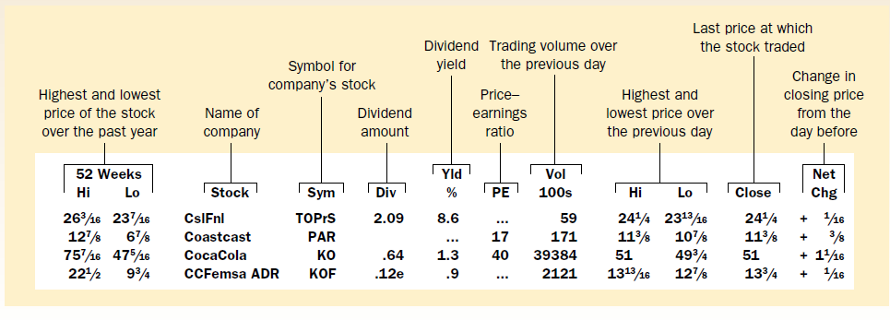
The Stock Market

Slide 10
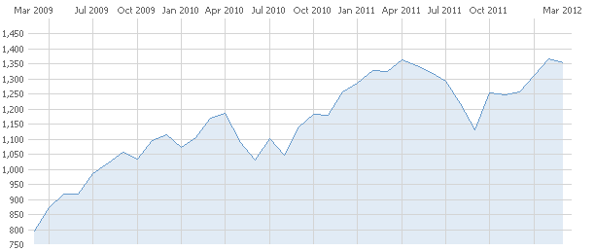
The stock market : S&P 500

Slide 11
Financial Intermediaries
Financial intermediaries are financial institutions through which savers can indirectly provide funds to borrowers.
Banks
  take deposits from people who want to save and use the deposits to make loans to people who want to borrow.
  pay depositors interest on their deposits and charge borrowers slightly higher interest on their loans.

Slide 12
Financial Intermediaries
Investment Funds
  An investment fund is an institution that sells shares to the public and uses the proceeds to buy a portfolio, of various types of stocks, bonds, or both.
    They allow people with small amounts of money to easily diversify.
Other Financial Institutions
  Credit unions
  Pension funds
  Insurance companies
  Loan sharks

Slide 13
The Basic Tools of Finance
Financial system coordinates the economy’s saving and investment – it concerns decisions we make today that will affect our lives in the future.
BUT THE FUTURE IS UNKNOWN!
When a person decides to allocate some saving, or a firm decides to undertake an investment, the decision is based on a guess about the likely future result.
BUT THE RESULT COULD END UP BEING VERY DIFFERENT!

Slide 14
The Basic Tools of Finance
In economics the uncertainty about future result of a current decision is called risk.
Finance is the field of economics that studies how people make decisions regarding the allocation of resources over time and the handling of risk. It deals with questions like:
  How to compare sums of money at different points in time?
  How to manage risk?
  What determines the value of an asset (stock or bond)?

Slide 15
Future Value: Measuring the Time Value of Money
Receiving a given sum of money in the present is preferred to receiving the same sum in the future.
  If r is the interest rate, then in N years an amount of Y today will have future value of:
  X=Y*(1 + r)^{N}
  The amount of money in the future that an amount of money today will yield, given prevailing interest rates, is called the future value.

Slide 16
Present Value: Measuring the Time Value of Money
  Present value refers to the amount of money today that would be needed to produce, using prevailing interest rates, a given future amount of money.
  In order to compare values at different points in time, compare their present values.
  Firms undertake investment projects if the present value of the project exceeds the cost.
  If r is the interest rate, then in N years an amount of Y today will have future value of:
  X=Y*(1 + r)^{N}

Slide 17
Managing Risk
A person is said to be risk averse if she exhibits a dislike of uncertainty.
Individuals can reduce risk choosing any of the following:
  Buy insurance
  Diversify
  Accept a lower return on their investments

Slide 18

Figure 1 Risk Aversion
Utility
Utility gain
from winning
€1,000
Utility loss
from losing
€1,000
0
Current
Wealth
€1,000
wealth
€1,000
loss
gain
Copyright©2010 South-Western

Slide 19
The Markets for Insurance
One way to deal with risk is to buy insurance.
  The general feature of insurance contracts is that a person facing a risk pays a fee to an insurance company, which in return agrees to accept all or part of the risk.

Slide 20
Diversification of Idiosyncratic Risk
Diversification refers to the reduction of risk achieved by replacing a single risk with a large number of smaller unrelated risks.
Idiosyncratic risk is the risk that affects only a single person. The uncertainty associated with specific companies.
Aggregate risk is the risk that affects all economic actors at once, the uncertainty associated with the entire economy.
Diversification cannot remove aggregate risk.

Slide 21
Figure 2 Diversification
Risk (standard
deviation of
portfolio return)
(More risk)
49
Idiosyncratic
risk
20
Aggregate
(Less risk)
risk
0
1
4
6
8
10
20
30
40
Number of
Stocks in
Portfolio
Copyright©2010 South-Western

Slide 22
Figure 3 The Trade-Off Between Risk and Return
Return
(percent
100%
per year)
stocks
75%
stocks
50%
8.3
stocks
25%
stocks
No
stocks
3.1
0
5
10
15
20
Risk
(standard
deviation)
Copyright©2010 South-Western

Slide 23
Asset Valuation
Fundamental analysis is the study of a company’s accounting statements and future prospects to determine its value.
People can employ fundamental analysis to try to determine if a stock is undervalued, overvalued, or fairly valued.
The goal is to buy undervalued stock.

Slide 24
Efficient Markets Hypothesis
The efficient markets hypothesis is the theory that asset prices reflect all publicly available information about the value of an asset.
A market is informationally efficient when it reflects all available information in a rational way.
If markets are efficient, the only thing an investor can do is buy a diversified portfolio

Slide 25
CASE STUDY: Random Walks and Index Funds
Random walk refers to the path of a variable whose changes are impossible to predict.
If markets are efficient, all stocks are fairly valued and no stock is more likely to appreciate than another. Thus stock prices follow a random walk.

Slide 26
Saving and Investment in the National Income Accounts
Recall that GDP is both total income in an economy and total expenditure on the economy’s output of goods and services:
Y = C + I + G + NX
Assume a closed economy – one that does not engage in international trade (NX=0):
Y = C + I + G
Now, subtract C and G from both sides of the equation:
Y – C – G =I
  The left side of the equation is the total income in the economy after paying for consumption and government purchases and is called national saving, or just saving (S).

Slide 27
Some Important Identities
Substituting S for Y - C - G, the equation can be written as:
S = I
For the economy as a whole, saving must be equal to investment.
National saving, or saving, is equal to:
S = I
S = Y – C – G
S = (Y – T – C) + (T – G)

Slide 28
The Meaning of Saving and Investment
National Saving
  National saving is the total income in the economy that remains after paying for consumption and government purchases.
Private Saving
  Private saving is the amount of income that households have left after paying their taxes and paying for their consumption.
  Private saving = (Y – T – C)
Public Saving
  Public saving is the amount of tax revenue that the government has left after paying for its spending.
  Public saving = (T – G)

Slide 29
The Meaning of Saving and Investment
Surplus and Deficit
  If T > G, the government runs a budget surplus because it receives more money than it spends.
  The surplus of T - G represents public saving.
  If G > T, the government runs a budget deficit because it spends more money than it receives in tax revenue.

Slide 30
The Market for Loanable Funds
Financial markets coordinate the economy’s saving and investment in the market for loanable funds.
The market for loanable funds is the market in which those who want to save supply funds and those who want to borrow to invest demand funds.
Loanable funds refer to all income that people have chosen to save and lend out, rather than use for their own consumption.

Slide 31
Supply and Demand for Loanable Funds
Financial markets work much like other markets in the economy.
  The supply of loanable funds comes from people who have extra income they want to save and lend out.
  The demand for loanable funds comes from households and firms that wish to borrow to make investments.
  The interest rate is the price of the loan. It represents the amount that borrowers pay for loans and the amount that lenders receive on their saving.
  The equilibrium of the supply and demand for loanable funds determines the real interest rate.
The interest rate in the market for loanable funds is the real interest rate.

Slide 32
Figure 1 The Market for Loanable Funds
Interest
Rate
Supply
5%
Demand
0
€1,200
Loanable Funds
(in billions of euros)
Copyright©2010 South-Western

Slide 33
Supply and Demand for Loanable Funds
Government Policies That Affect Saving and Investment
  Taxes and saving
  Taxes and investment
  Government budget deficits

Slide 34
Policy 1: Saving Incentives
Taxes on interest income substantially reduce the future payoff from current saving and, as a result, reduce the incentive to save.
A tax decrease increases the incentive for households to save at any given interest rate.
  The supply of loanable funds curve shifts to the right.
  The equilibrium interest rate decreases.
  The quantity demanded for loanable funds increases.
If a change in tax law encourages greater saving, the result will be lower interest rates and greater investment.

Slide 35
Figure 2 An Increase in the Supply of Loanable Funds
Interest
Supply,
S₁
S₂
Rate
5%
1. Tax incentives for
saving increase the
4%
supply of loanable
fund
s . . .
2.
. . . which
Demand
reduces the
equilibrium
interest rat
e . . .
0
€1,200
€1,600
Loanable Funds
(in billions of euros)
3.
. . . and raises the equilibrium
quantity of loanable funds.
Copyright©2010 South-Western

Slide 36
Policy 2: Investment Incentives
An investment tax credit increases the incentive to borrow.
  Increases the demand for loanable funds.
  Shifts the demand curve to the right.
  Results in a higher interest rate and a greater quantity saved.
If a change in tax laws encourages greater investment, the result will be higher interest rates and greater saving.

Slide 37
Figure 3 An Increase in the Demand for Loanable Funds
Interest
Rate
Supply
1. An investment
tax credit
6%
increases the
demand for
5%
loanable fund
s . . .
2.
. . . which
raises the
D₂
equilibrium
Demand,
interest rate . . .
D₁
0
€1,200
€1,400
Loanable Funds
(in billions of euros)
3.
. . . and raises the equilibrium
quantity of loanable funds.
Copyright©2010 South-Western

Slide 38
Policy 3: Government Budget Deficits and Surpluses
When the government spends more than it receives in tax revenues, the short fall is called the budget deficit.
The accumulation of past budget deficits is called the government debt.
A budget deficit decreases the supply of loanable funds.
  Shifts the supply curve to the left.
  Increases the equilibrium interest rate.
  Reduces the equilibrium quantity of loanable funds.

Slide 39
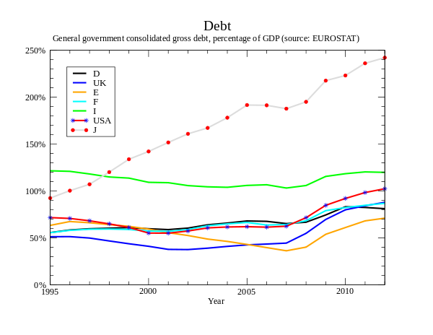
Government debt

Slide 40
Figure 4: The Effect of a Government Budget Deficit
Interest
S₂
Rate
Supply,
S₁
6%
1. A budget deficit
decreases the
5%
supply of loanable
fund
s . . .
2.
. . . which
raises the
equilibrium
Demand
interest rat
e . . .
0
€800
€1,200
Loanable Funds
(in billions of euros)
3.
. . . and reduces the equilibrium
quantity of loanable funds.
Copyright©2010 South-Western

Slide 41
Policy 3: Government Budget Deficits and Surpluses
Government borrowing to finance its budget deficit reduces the supply of loanable funds available to finance investment by households and firms.
This fall in investment is referred to as crowding out.
  The deficit borrowing crowds out private borrowers who are trying to finance investments.
When government reduces national saving by running a deficit, the interest rate rises and investment falls.
A budget surplus increases the supply of loanable funds, reduces the interest rate, and stimulates investment.

Slide 42
Summary
The financial system is made up of financial institutions such as the bond market, the stock market, banks, and investment funds.
All these institutions act to direct the resources of households who want to save some of their income into the hands of households and firms who want to borrow.
Because savings can earn interest, a sum of money today is more valuable than the same sum of money in the future.
A person can compare sums from different times using the concept of present value.
Because of diminishing marginal utility, most people are risk averse.

Slide 43
Summary
The value of an asset, such as a share of stock, equals the present value of the cash flows the owner of the share will receive, including the stream of dividends and the final sale price.
According to the efficient markets hypothesis, financial markets process available information rationally, so a stock price always equals the best estimate of the value of the underlying business.
Some economists question the efficient markets hypothesis, however, and believe that irrational psychological factors also influence asset prices.

Slide 44
Summary
National income accounting identities reveal some important relationships among macroeconomic variables.
In particular, in a closed economy, national saving must equal investment.
The interest rate is determined by the supply and demand for loanable funds.
National saving equals private saving plus public saving.
A government budget deficit represents negative public saving and, therefore, reduces national saving and the supply of loanable funds.
When a government budget deficit crowds out investment, it reduces the growth of productivity and GDP.

