Slide 1
4
Unemployment and Its Natural Rate

Slide 2
Revision
What is the importance of labor on economy’s productivity?
Input per worker defines output per worker
How government could affect labor factor to stimulate growth?
Through investment in human capital
What are the problems with the development of labor factor in the poor and highly populated economies?
Stretching natural resources, diluting the capital stock, brain drain

Slide 3
Unemployment
A job loss means a lower living standard in the present, anxiety about the future, and reduced self-esteem. People who would like to work but cannot find a job are not contributing to the economy’s production of goods and services.
These are the key issues concerning unemployment:
How does the government measure the economy’s rate of unemployment?
What problems arise in interpreting the unemployment data?
How long are the unemployed typically without work?
Why economies always experience some unemployment?
How policymakers can help the unemployed?

Slide 4
How Is Unemployment Measured?
Unemployment may be measured in two ways.
  A monthly survey of households – the Labour Force Survey in the UK; Current Population Survey in US.
  The claimant count.
Based on the answers to survey questions, each adult (aged 16+) is placed into one of three categories:
  Employed
  Unemployed
  Not in the labour force

Slide 5
How Is Unemployment Measured?
Labour Force
  The labour force is the total number of workers, including both the employed and the unemployed.
  A person is considered employed if he or she spent most of the previous week working at a paid job
  A person is considered unemployed if he or she is temporary layoff, is looking for a job, or is waiting for the start date of a new job
  A person is considered not in the labor force if he or she fits neither of the first two categories such as a full-time student, homemaker, or retiree.

Slide 6

Figure 1 The Breakdown of the UK Adult Population in 2004
Employed
(28.4 million)
Labour Force
(29.8 million)
Adult
Population
(47.4 million)
Unemployed (1.4 million)
Economically inactive
(17.6 million)
Copyright©2010 South-Western

Slide 7
How Is Unemployment Measured?
The unemployment rate is calculated as the percentage of the labour force that is unemployed.
Number une
mployed
Unemployme
nt rate
=
×
100
Labour force

Slide 8
How Is Unemployment Measured?
The labour force participation rate is the percentage of the adult population that is in the labour force.
Labour force
particip
ation rate
Labour force
=
×
100
Adult popu
lation

Slide 9
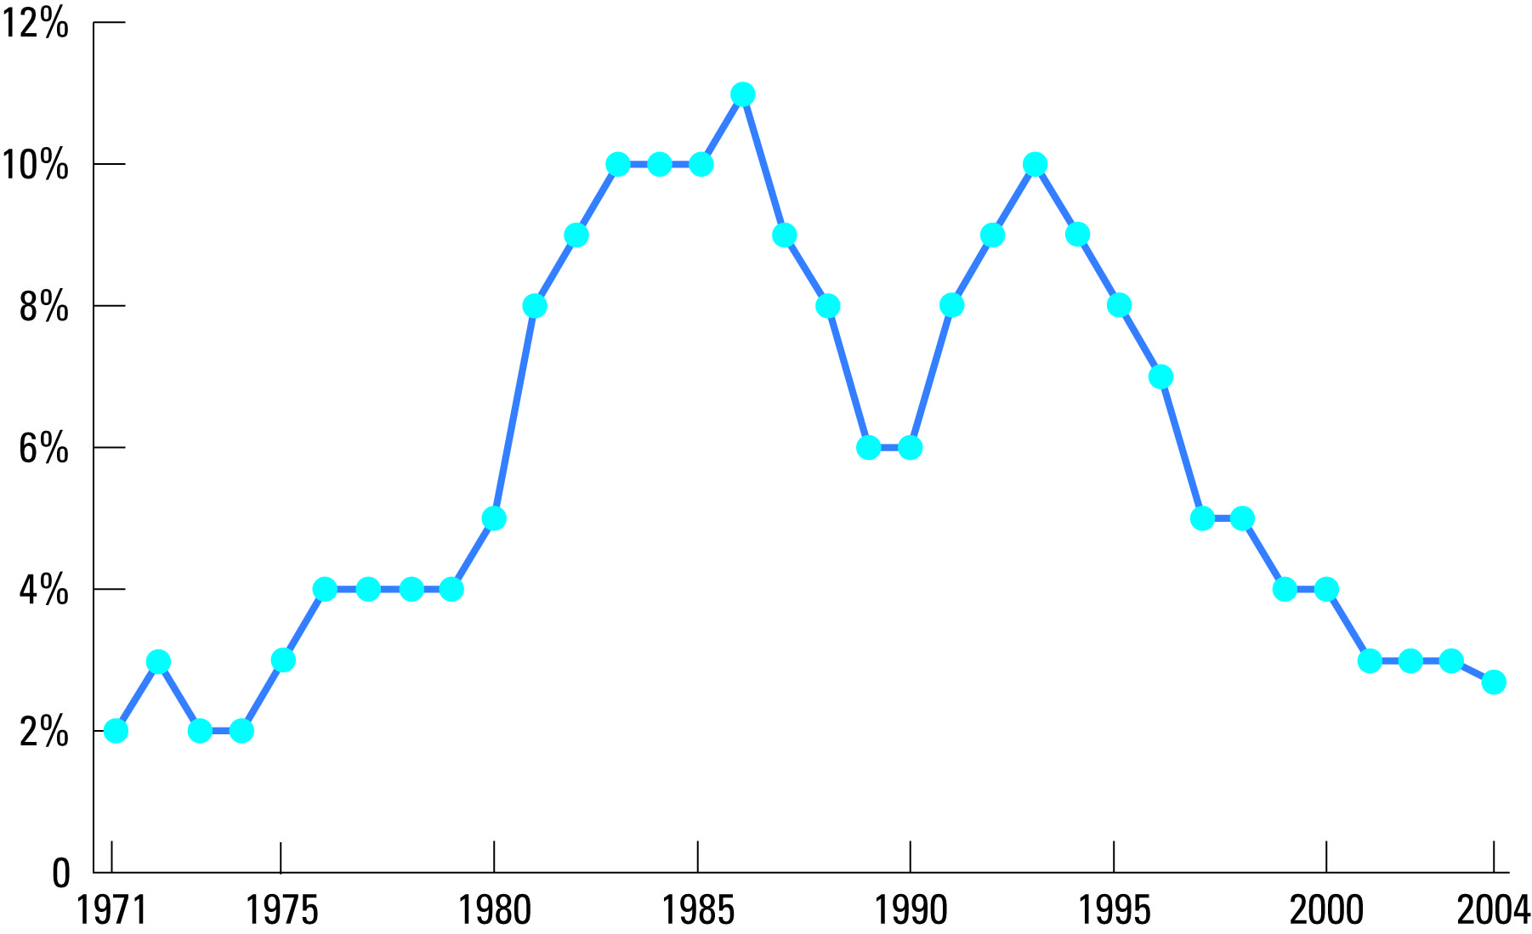
Figure 2 Unemployment Rate Since 1971
Copyright©2010 South-Western

Slide 10
Unemployment rate in OECD countries according to a duration of unemployment
 | Less than 1 month | 1-2 months | 3-5 months | 6-11 months | 12 or more months
2008 Q1 | 0.88 | 1.14 | 1.19 | 0.89 | 1.59
2008 Q2 | 0.93 | 1.17 | 1.23 | 0.94 | 1.53
2008 Q3 | 1.00 | 1.28 | 1.30 | 1.03 | 1.59
2008 Q4 | 1.00 | 1.42 | 1.55 | 1.14 | 1.60
2009 Q1 | 1.04 | 1.50 | 1.86 | 1.49 | 1.81
2009 Q2 | 1.05 | 1.53 | 2.00 | 1.82 | 1.99
2009 Q3 | 1.02 | 1.48 | 1.91 | 2.02 | 2.26
2009 Q4 | 0.96 | 1.48 | 1.87 | 2.01 | 2.48
2010 Q1 | 0.91 | 1.36 | 1.77 | 1.95 | 2.70
2010 Q2 | 0.91 | 1.33 | 1.69 | 1.83 | 2.83
2010 Q3 | 0.93 | 1.34 | 1.59 | 1.74 | 2.99

Slide 11
Identifying Unemployment
The economy always has some unemployment
The amount of unemployment changes from year to year.
The long-run rate of unemployment around which the unemployment rate fluctuates is called the natural rate of unemployment, and the year-to-year deviation of unemployment from its natural rate is called cyclical unemployment.
Natural rate of unemployment is persistent but not constant and varies across the various groups within the population distinct by gender, color of skin, age and education.

Slide 12

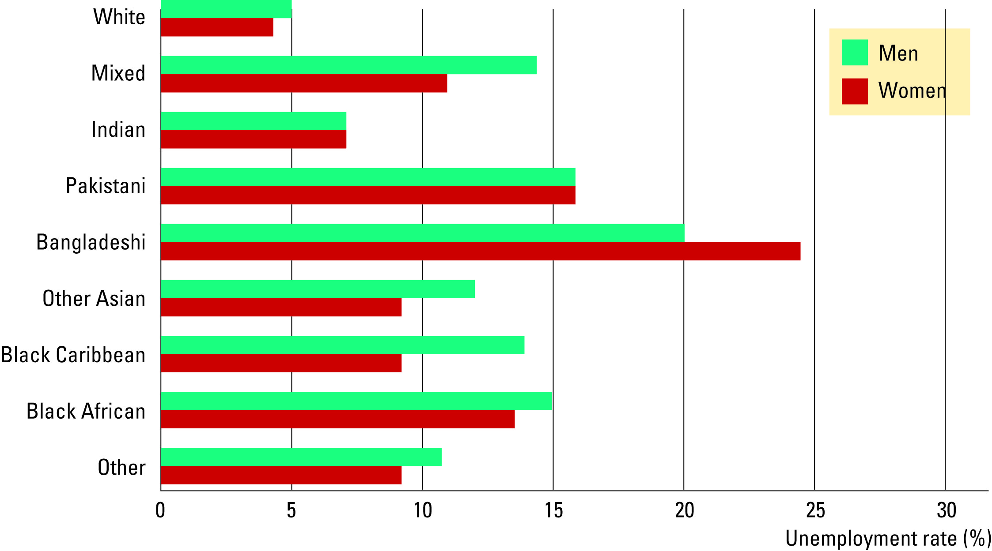
Table 1 The Labour Market Experience of Different Groups
Copyright©2010 South-Western

Slide 13
Identifying Unemployment
Statistics on unemployment and labor-force participation for various groups within the U.S. population:
Women have lower rates of labor force participation than men but once in labor force, women have similar rates of unemployment
  Women’s role in US economy has changed dramatically over the past century – after WW2: women 33%, men 87%; year 1998: women 60%, men 75%
Blacks have similar rates of labor-force participation as whites, and they have much higher rates of unemployment.

Slide 14
Problems with Interpreting the Unemployment Data
It is difficult to distinguish between a person who is unemployed and a person who is not in the labour force.
  More than 1/3 of the unemployed are recent entrants into the labour force:
    Young workers looking for their first job
    Older workers who had previously left the labour force but have now returned to look for work
  Discouraged workers, people who would like to work but have given up looking for jobs after an unsuccessful search, don’t show up in unemployment statistics.
    Almost 1/2 of all spells of unemployment end when the unemployed person leaves the labour force.
  Other people may claim to be unemployed in order to receive financial assistance, even though they aren’t looking for work.

Slide 15
Duration of Unemployment
Most spells of unemployment are short.
Most unemployment observed at any given time is long-term.
Most of the economy’s unemployment problem is attributable to relatively few workers who are jobless for long periods of time.
Example: Suppose an unemployment office with stable 4 unemployed each week, 3 of which unemployed for the whole year, the 4th changes each week.

Slide 16
Explanation of Unemployment
In an ideal labour market, wages would adjust to balance the supply and demand for labour, ensuring that all workers would be fully employed. In reality, however, there are always some workers without jobs, even when the overall economy is doing well.
Unemployment in the long run can be explained as follows:
  It takes time for workers to search for the jobs that are best suited for them. Frictional unemployment refers to the unemployment that results from the time that it takes to match workers with jobs.
  Structural unemployment refers to the unemployment that results when wages are for some reason set above the level that brings demand and supply into equilibrium – minimum-wage laws, unions, efficiency wages.

Slide 17
Job Search
Job search
  the process by which workers find appropriate jobs given their tastes and skills.
  results from the fact that it takes time for qualified individuals to be matched with appropriate jobs.
This unemployment is different from the other types of unemployment.
  It is not caused by a wage rate higher than equilibrium.
  It is caused by the time spent searching for the “right” job.

Slide 18
Frictional Unemployment
Frictional unemployment is a result of:
changes in the demand for labor among different firms
sectoral shifts – changes in the composition of demand among industries or regions
Frictional unemployment is inevitable because the economy is always changing. It takes time for workers to search for and find jobs in new sectors.
At least 10% of U.S. manufacturing jobs are destroyed every year. 3% of newly hired workers leave a job a month after starting because of mismatch.

Slide 19
Public Policy and Job Search
Government programmes can affect the job search time:
  Government-run employment agencies – collect and provide information about job vacancies
  Public training programs – aim to ease the transition of workers from declining to growing industries and to help disadvantaged groups escape poverty
    Advocates of these programs believe that they make the economy operate more efficiently
    Critics question the ability of government to disseminate the right information to the right workers better than market does
  Unemployment insurance – offers workers partial protection against job loss
    increases the amount of search unemployment and reduces the search efforts of the unemployed but it may improve the chances of workers being matched with the right jobs.

Slide 20
Structural Unemployment
Structural unemployment occurs when the quantity of labour supplied exceeds the quantity demanded.
Structural unemployment is often thought to explain longer spells of unemployment.
Reasons for structural unemployment:
  Minimum wage laws
  Unions
  Efficiency wages

Slide 21
Figure 4 Unemployment from a Wage Above the Equilibrium Level
Wage
Surplus of labour
Labour
=
Unemployment
supply
Minimum
wage
W_{E}
Labour
demand
0
L_{D}
L_{E}
L_{S}
Quantity of
Labour
Copyright©2010 South-Western

Slide 22
Minimum Wage Laws
When the minimum wage is set by law above the level that balances supply and demand, it creates unemployment.
Although minimum wages are not the predominant reason for unemployment in the economy, they have an important effect on certain groups with particularly high unemployment rates.
  Minimum wage laws affect only the least skilled and least experienced members of the labour force.

Slide 23
Unions and Collective Bargaining
A union is
  a worker association that bargains with employers over wages and working conditions.
  a type of cartel (i.e. group of sellers acting together in the hope of exerting their joint market power)
    unions are exempt from the antitrust laws because policymakers believe that workers need greater market power as they bargain with employers
In the early 1980s over half of the UK labour force was unionized but this figure fell rapidly over a few years.

Slide 24
Unions and Collective Bargaining
The process by which unions and firms agree on the terms of employment is called collective bargaining.
  Under the threat of strike which would increase firm’s cost more unions reach to agreements with employers to pay higher wages than they otherwise would:
    A strike refers to when the union organizes a withdrawal of labour from the firm.
    Workers in unions reap the benefit of collective bargaining while workers not in unions bear some of the cost.
      Union workers earn about 10-20% more than similar workers who do not belong to unions.
      The differential declines as education level rises.

Slide 25
Are Unions Good or Bad for the Economy?
Critics argue that unions cause the allocation of labour to be inefficient and inequitable.
  Wages above the competitive level reduce the quantity of labour demanded and cause unemployment.
  Some workers benefit at the expense of other workers.
Advocates of unions contend that
  unions are a necessary antidote to the market power of firms that hire workers.
    The company-town – a single firm that does most of the hiring in a geographical region.
  unions are important for helping firms respond efficiently to workers’ concerns and thus keep happy and productive workforce.

Slide 26
The Theory of Efficiency Wages
Efficiency wages are above-equilibrium wages paid by firms in order to increase worker productivity.
The theory of efficiency wages states that firms operate more efficiently if wages are above the equilibrium level.
  It may be profitable for firms to keep wages even in the presence of a surplus of labour because high wage raise the efficiency of a firm’s workers.

Slide 27
The Theory of Efficiency Wages
A firm may prefer higher than equilibrium wages:
  Worker Health: Better paid workers eat a better diet and thus are more productive.
    This explanation is more relevant for firms in less developed countries where inadequate nutrition is a more common problem.
  Worker Turnover: A higher paid worker is less likely to look for another job.
  Worker Effort: Higher wages motivate workers to put forward their best effort.
    Marxist idea of the “reserved army of unemployment”: employers benefit from unemployed who help them discipline those workers who have jobs.
  Worker Quality: Higher wages attract a better pool of workers to apply for jobs.
    Adverse selection: Equilibrium wage would attract only the incompetent workers.

Slide 28
Summary
The unemployment rate is the percentage of those who would like to work but don’t have jobs.
The Office of National Statistics calculates this statistic monthly in the UK.
The unemployment rate is an imperfect measure of joblessness.
In the UK economy, most people who become unemployed find work within a short period of time.
Most unemployment observed at any given time is attributable to a few people who are unemployed for long periods of time.

Slide 29
Summary
One reason for unemployment is the time it takes for workers to search for jobs that best suit their tastes and skills.
A second reason why the economy always has some unemployment are the wages that exceed the equilibrium level.
  Minimum wage laws raise the quantity of labour supplied and reduce the quantity demanded.
  The market power of unions allows them to negotiate higher wages for their members.
  The theory of efficiency wages states that high wages can improve worker health, lower worker turnover, increase worker effort, and raise worker quality.

