Slide 1

10
MONEY AND PRICES IN THE LONG RUN

Slide 2
5
The Monetary System

Slide 3
Revision
What is the macroeconomic role of the financial system?
It moves the economy’s scarce resources from savers to borrowers.
What government could do to affect saving and investment?
By applying different policies related to taxes and public investment:
S = (Y – T – C) + (T – G)

Slide 4
The Monetary System
In a modern society, paying for goods and services by cash, debit card, credit card or cheque is not an odd social custom.
The existence of money makes trade easier!
When economists study monetary policy the following issues need to be taken into account:
  What money is?
  How the central bank controls the quantity of money in circulation?
  What are the long-run effects of changes in the quantity of money on inflation, interest rates, production and unemployment?

Slide 5
The Meaning of Money
Money is the set of assets in an economy that people regularly use to buy goods and services from other people.
Money has three functions in the economy:
  Medium of exchange – the most commonly accepted asset for a buyer to pay to a seller
  Unit of account – the yardstick with which people post prices and record debts
  Store of value – to transfer purchasing power from the present to the future
Liquidity is the ease with which an asset can be converted into the economy’s medium of exchange.

Slide 6
The Kinds of Money
Commodity money takes the form of a commodity with intrinsic value.
  Examples: Gold, silver, cigarettes.
Fiat money is used as money because of government decree.
  It does not have intrinsic value.
  Examples: Coins, currency, current account deposits.
Currency is the paper bills and coins in the hands of the public.
Demand deposits are balances in bank accounts that depositors can access on demand by writing a cheque or using a debit card.

Slide 7

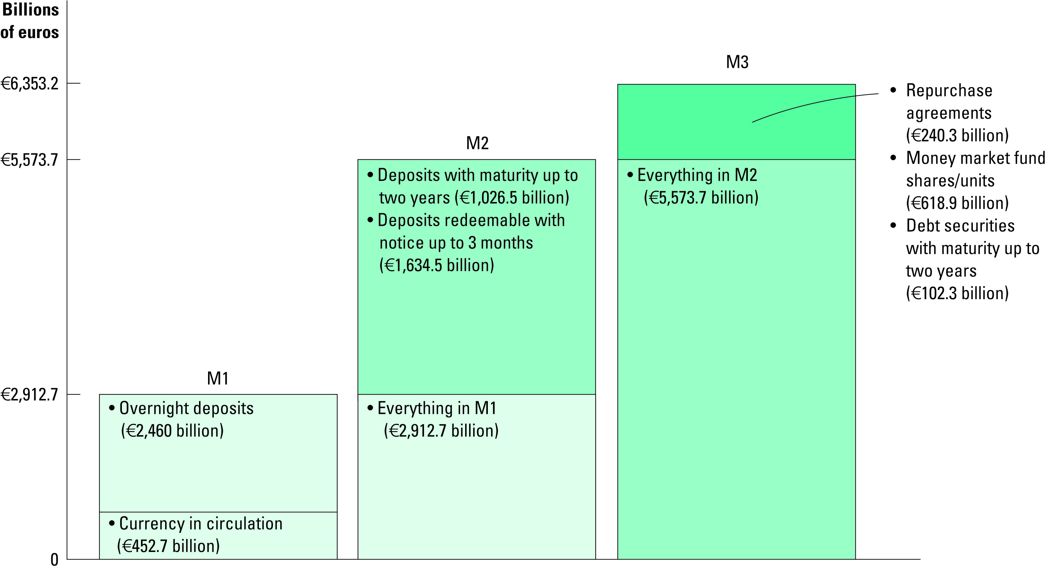
Figure 1 Three Measures of the Money Stock for the Euro Area
Copyright©2010 South-Western

Slide 8
The Role of Central Banks
Whenever an economy relies on fiat money, there must be some agency that regulates the system.
  A central bank is an institution designed to oversee the banking system and regulate the quantity of money in the economy.
Monetary policy is the set of actions taken by the central bank in order to affect the money supply.

Slide 9
The Role of Central Banks
The money supply is the quantity of money available in the economy.
  One of the fundamental principles of Economics is that prices rise when too much money is printed.
  Another of the principles is that society faces a short-run trade-off between inflation and unemployment.
  The regulation of the money supply is therefore a crucially important task.

Slide 10
The European Central Bank and the Eurosystem
1 June 1998 – 11 countries, making up the euro area, decided to enter European Monetary Union (EMU) and have the same currency – EURO
The European Central Bank is the overall central bank of the 17 countries comprising the European Monetary Union.
The primary objective of the ECB is to promote price stability throughout the euro area.
  Inflation Target: Year-on-year increase in prices by close to 2% from below as measured by the annual change in a harmonized index of consumer prices throughout the euro area.

Slide 11
The European Central Bank and The Eurosystem
The Eurosystem is the system made up of the ECB plus the national central banks of the 12 countries comprising the European Monetary Union.
  Executive Board – min. 8-year term – President, Vice-President and 4 other people of high standing in the banking profession
  Governing Council – Executive Board together with the governors of the national central banks – meets every 2 weeks in Frankfurt
An important feature of the ECB and the Euro- system is its independence.

Slide 12
The Bank of England
The Bank of England was founded in 1694 but was given independence in the setting of interest rates only in 1997.
The Bank of England is the central bank of the United Kingdom.
  Monetary Policy Committee (MPC) – Governor (5 yr. term), 2 Deputy Governors, 2 members appointed by Exchequer, 4 members appointed by Chancellor (3 year term)
The Bank of England’s primary duty is to deliver price stability
  Inflation Target (set by UK government): 2% in terms of an annual rate of inflation based on CPI

Slide 13
The Federal Reserve
The Fed was created in 1914.
The Federal Reserve (Fed) is the central bank of the United States.
  Board of Governors - Chairman (4-year term), 6 other members (14-year term) who are all appointed by the US President.
  Federal Reserve System – Federal Reserve Board (in Washington D.C.) and 12 regional Federal Reserve Banks in major U.S. Cities
  Federal Open Market Committee (FOMC) – Board of Governors together with 12 regional presidents who vote on rotation schedule - meets about every 6 weeks in Washington to make monetary policy (set the int. rate, discount rate etc.)

Slide 14
Banks and the Money Supply
The amount of money in the economy includes both currency and demand deposits.
Because demand deposits are held in banks, the behavior of the banks can influence the money supply.
  Reserves are deposits that banks have received but have not loaned out.
  In a fractional-reserve banking system, banks hold a fraction of the money deposited as reserves and lend out the rest.

Slide 15
Money Creation with Fractional-Reserve Banking
  The money supply is affected by the amount deposited in banks and the amount that banks loan.
    Deposits into a bank are recorded as both assets and liabilities.
    The fraction of total deposits that a bank has to keep as reserves is called the reserve ratio.
    Loans become an asset to the bank.
  When a bank makes a loan from its reserves, the money supply increases.

Slide 16
Money Creation with Fractional-Reserve Banking
This T-Account shows a bank that…
  accepts deposits,
  keeps a portion
  as reserves,
  and lends out
  the rest.
  It assumes a
  reserve ratio
  of 10%.
First European Bank
Assets
Liabilities
Reserves
€10.00
Loans
€90.00
Deposits
€100.00
Total Assets
€100.00
Total Liabilities
€100.00

Slide 17
Money Creation with Fractional-Reserve Banking
When one bank loans money, that money is generally deposited into another bank.
This creates more deposits and more reserves to be lent out.
When a bank makes a loan from its reserves, the money supply increases.

Slide 18
The Money Multiplier
First European Bank
Second European Bank
Assets
Liabilities
Assets
Liabilities
Reserves
€10.00
Loans
€90.00
Deposits
€100.00
Reserves
€9.00
Loans
€81.00
Deposits
€90.00
Total Assets
€100.00
Total Liabilities
€100.00
Total Assets
€90.00
Total Liabilities
€90.00
Money Supply = €190.00!

Slide 19
The Money Multiplier
How much money is eventually created in this economy?
  The money multiplier is the amount of money the banking system generates with each unit of reserves.
The money multiplier is the reciprocal of the reserve ratio:
M = 1/R
With a reserve requirement, R = 20% or 1/5,
The multiplier is 5.

Slide 20
The Central Bank’s Tools of Monetary Control
A central bank has three main tools in its monetary toolbox:
  Open-market operations
  Changing the reserve requirement
  Changing the refinancing rate

Slide 21
The Central Bank’s Tools of Monetary Control
Open-Market Operations
  A central bank conducts open-market operations when it buys government bonds from, or sells government bonds to the public:
    When the central bank buys government bonds, the money supply increases.
    The money supply decreases when the central bank sells government bonds.

Slide 22
The Central Bank’s Tools of Monetary Control
The Refinancing Rate
  The refinancing rate is the interest rate the ECB lends on a short-term basis to the euro area banking sector.
    Increasing the refinancing rate decreases the money supply.
    Decreasing the refinancing rate increases the money supply.
  In the USA, the refinancing rate is called the discount rate and in the UK it’s called the repo rate.

Slide 23
The Central Bank’s Tools of Monetary Control
Reserve Requirements
  Reserve requirements are regulations on the minimum amount of reserves that banks must hold against deposits.
    Increasing the reserve requirement decreases the money supply.
    Decreasing the reserve requirement increases the money supply.
  Central banks have tended to change reserve requirements only rarely and the Bank of England no longer sets reserve requirements at all.

Slide 24
Problems in Controlling the Money Supply
A central bank’s control of the money supply is not precise.
A central bank must wrestle with two problems that arise due to fractional-reserve banking.
  The central bank does not control the amount of money that households choose to hold as deposits in banks.
  The central bank does not control the amount of money that bankers choose to lend.

Slide 25
Inflation definition 1/2
Inflation is an increase in the overall level of prices.
Inflation is measured by the inflation rate which is defined as the following:
where P_{t+1} is the price level in period t+1 and P_{t} is the price level in period t ( price level here is primarily measured by CPI)
Inflation is a monetary phenomena , which can be used by excess emission of money into circulation

Slide 26
Inflation definition 2/2
Hyperinflation is an extraordinarily high rate of inflation.
Inflation: Historical Aspects
  Inflation in the UK exceeded 20% per year in the mid-1970s.
  In the late 1990s and early 2000s UK inflation has been low and stable at around 2% per year.
  For long periods in the nineteenth century, some countries experienced deflation, meaning decreasing average prices.
  Hyperinflation refers to high rates of inflation such as Germany experienced in the 1920s.

Slide 27
2009-2010 inflation rates in the EU countries, US and Japan

Slide 28
Money Supply, Money Demand, and Monetary Equilibrium 1/2
The quantity theory of money is used to explain the long-run determinants of the price level and the inflation rate.
Inflation is an economy-wide phenomenon that concerns the value of the economy’s medium of exchange.
When the overall price level rises, the value of money falls.

Slide 29
Money Supply, Money Demand, and Monetary Equilibrium 2/2
The money supply is a policy variable that is controlled by the central bank.
Money demand has several determinants, including interest rates and the average level of prices in the economy.
People hold money because it is the medium of exchange.
  The amount of money people choose to hold depends on the prices of goods and services.
In the long run, the overall level of prices adjusts to the level at which the demand for money equals the supply.
Notes:
Bullet 2: Mankiw has removed the word, “directly”

Slide 30
Money demand function
Intuition tells that demand for money should depend on interest rates. Interest rate is the opportunity cost of holding money balances. When a person holds money balances he forgoes nominal interest which he could earn by depositing money in the bank
When interest rate increases, holding money becomes more expensive since person now forgoes higher interest rate. This leads to decrease of demand for money. Thus demand for money is negatively related to interest rate
It is important to stress that money demand depends on nominal interest rate. If lender expects inflation over the period of the loan he requires higher nominal interest rate so that to cover the loss of purchasing of power of money due to inflation. So, for the lender return on lending is the nominal interest rate
Money demand should also positively depend on real income

Slide 31
Figure 1 Money Supply, Money Demand, and the Equilibrium Price Level
Value of
Price
Money,
Money supply
Level,
P
1
/
P
(High)
1
1
(Low)
3
1.33
/
4
A
/
2
1
2
Equilibrium
Equilibrium
value of
price level
/
4
money
1
4
Money
demand
(Low)
0
(High)
Quantity fixed
Quantity of
by the Fed
Money
Copyright©2010 South-Western

Slide 32
Figure 2 The Effects of Monetary Injection
Value of
Price
Money,
MS₁
MS₂
Level,
P
1
/
P
(High)
1
1
(Low)
1. An increase
3
in the money
1.33
/
2. . . . decreases
4
supply . . .
the value of
3.
. . . and
mone
y . . .
A
increases
/
2
1
2
the price
level.
B
/
4
1
4
Money
demand
(Low)
(High)
0
M₁
M₂
Quantity of
Money
Copyright©2010 South-Western

Slide 33
The Classical Theory of Inflation
The Quantity Theory of Money
  How the price level is determined and why it might change over time is called the quantity theory of money.
    The quantity of money available in the economy determines the value of money.
    The primary cause of inflation is the growth in the quantity of money.

Slide 34
The Classical Dichotomy and Monetary Neutrality
According to Hume and others, real economic variables do not change with changes in the money supply.
  Nominal variables are variables measured in monetary units.
  Real variables are variables measured in physical units.
  According to the classical dichotomy, different forces influence real and nominal variables.
Changes in the money supply affect nominal variables but not real variables.
The irrelevance of monetary changes for real variables is called monetary neutrality.

Slide 35
Velocity and the Quantity Equation
The velocity of money refers to the speed at which the money changes hands, travelling around the economy from wallet to wallet.
V = (P × Y)/M
  Where: V = velocity
    P = the price level
    Y = the quantity of output
    M = the quantity of money
  Rewriting the equation gives the quantity equation: M × V = P × Y

Slide 36
Velocity and the Quantity Equation
The quantity equation relates the quantity of money (M) to the nominal value of output
(P × Y).
The quantity equation shows that an increase in the quantity of money in an economy must be reflected in one of three other variables:
  the price level must rise,
  the quantity of output must rise, or
  the velocity of money must fall.

Slide 37
Velocity and the Quantity Equation
The Equilibrium Price Level, Inflation Rate, and the Quantity Theory of Money
  The velocity of money is relatively stable over time.
  When the central bank changes the quantity of money, it causes proportionate changes in the nominal value of output (P × Y).
  Because money is neutral, money does not affect output.
Hyperinflation is inflation that exceeds 50 percent per month.
Hyperinflation occurs in some countries because the government prints too much money to pay for its spending.

Slide 38
Figure 3 Money and Prices During Four Hyperinflations
(a) Austria
(b) Hungary
Index
Index
(Jan. 1921 = 100)
(July 1921 = 100)
100,000
100,000
Price level
10,000
Price level
10,000
Money supply
1,000
1,000
Money supply
100
1921
1922
1923
1924
1925
100
1921
1922
1923
1924
1925
Copyright©2010 South-Western

Slide 39
Figure 3 Money and Prices During Four Hyperinflations
(c) Germany
(d) Poland
Index
Index
(Jan. 1921 = 100)
(Jan. 1921 = 100)
100,000,000,000,000
Price level
10,000,000
1,000,000,000,000
1,000,000
Price level
10,000,000,000
Money
100,000,000
supply
100,000
Money
1,000,000
10,000
supply
10,000
1,000
100
1
100
1921
1922
1923
1924
1925
1921
1922
1923
1924
1925
Copyright©2010 South-Western

Slide 40
The Inflation Tax
When the government raises revenue by printing money, it is said to levy an inflation tax.
An inflation tax is like a tax on everyone who holds money.
The inflation ends when the government institutes fiscal reforms such as cuts in government spending.
The Fisher effect refers to a one-to-one adjustment of the nominal interest rate to the inflation rate.
According to the Fisher effect, when the rate of inflation rises, the nominal interest rate rises by the same amount.
The real interest rate stays the same.

Slide 41
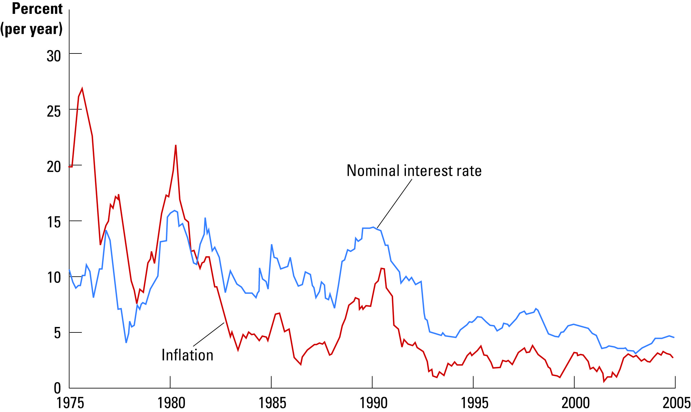
Figure 4 The UK Nominal Interest Rate and the Inflation Rate
Copyright©2010 South-Western

Slide 42
The Costs of Inflation
Does Inflation Cause A Fall in Purchasing Power?
  Inflation does not in itself reduce people’s real purchasing power because inflation in prices goes hand in hand with inflation in nominal incomes.
Inflation is a tax on the holders of money.
  As most taxes it gives people an incentive to alter their behavior to avoid paying the tax.
  This distortion causes deadweight losses for society as a whole.

Slide 43
The Costs of Inflation
Shoeleather costs
Menu costs
Relative price variability
Tax distortions
Confusion and inconvenience
Arbitrary redistribution of wealth

Slide 44
Shoeleather Costs
Shoeleather costs are the resources wasted when inflation encourages people to reduce their money holdings.
Inflation reduces the real value of money, so people have an incentive to minimize their cash holdings.
Less cash requires more frequent trips to the bank to withdraw money from interest-bearing accounts.
The actual cost of reducing your money holdings is the time and convenience you must sacrifice to keep less money on hand.
Also, extra trips to the bank take time away from productive activities.

Slide 45
Menu Costs
Menu costs are the costs of adjusting prices.
During inflationary times, it is necessary to update price lists and other posted prices.
This is a resource-consuming process that takes away from other productive activities.

Slide 46
Relative-Price Variability and the Misallocation of Resources
Inflation distorts relative prices.
Consumer decisions are distorted, and markets are less able to allocate resources to their best use.

Slide 47
Inflation-Induced Tax Distortion
Inflation exaggerates the size of capital gains and increases the tax burden on this type of income.
With progressive taxation, capital gains are taxed more heavily.
The nominal interest earned on savings is treated as income for income tax purposes, even though part of the nominal interest rate merely compensates for inflation.
The after-tax real interest rate falls when inflation rises, making saving less attractive.

Slide 48

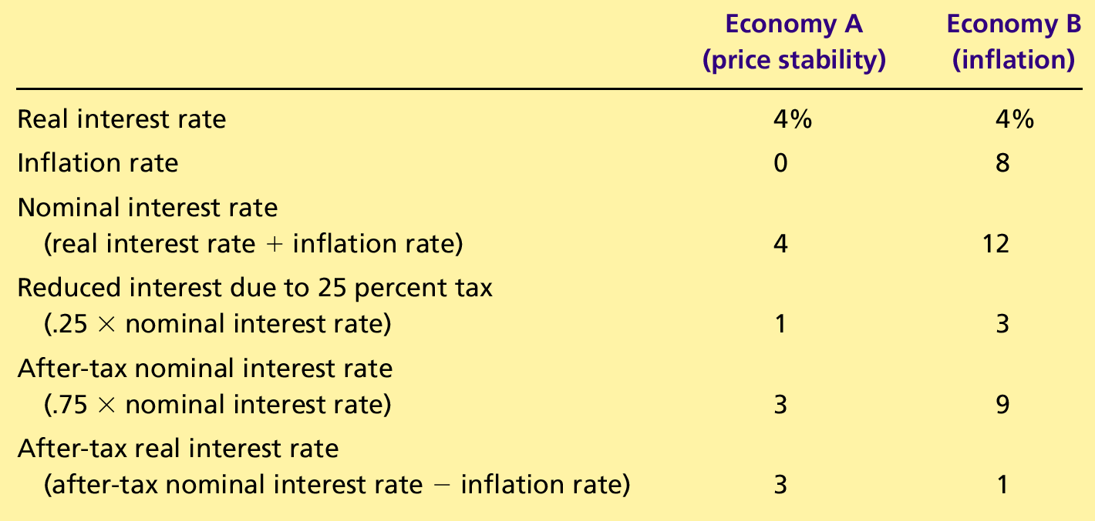
Table 1 How Inflation Raises the Tax Burden on Saving
Copyright©2010 South-Western

Slide 49
Confusion and Inconvenience
When the central bank increases the money supply and creates inflation, it erodes the real value of the unit of account.
Inflation causes money at different times to have different real values.
Therefore, with rising prices, it is more difficult to compare real revenues, costs, and profits over time.
In turn, inflation makes investors less able to sort out successful from unsuccessful firms which impedes financial markets.

Slide 50
A Special Cost of Unexpected Inflation: Arbitrary Redistribution of Wealth
Unexpected inflation redistributes wealth among the population in a way that has nothing to do with either merit or need.
These redistributions occur because many loans in the economy are specified in terms of the unit of account—money.
N.B. Inflation is especially volatile and uncertain when the average rate of inflation is high.

Slide 51
Phillips curve : tradeoff between unemployment and inflation
The connection between unemployment rate and inflation was first observed from UK data by A.W. Phillips and was called Phillips curve.
The Phillips curve represents the inverse relationship between the rate of unemployment and the rate of increase in money wages. It says that the higher is the rate of unemployment, the lower is the rate of increase in wages ( wage inflation )
Let’s define the wage inflation . If we denote by the wage this period and by the wage next period , the rate of wage inflation is given by the following formula :
(1)
The Phillips curve shows that the rate of wage inflation decreases when unemployment rate increases and vice versa

Slide 52
Simple Phillips curve
If we denote the natural rate of unemployment by u* , we can write the simple Phillips curve in the following form:
(2)
where is a constant measuring the responsiveness of wages to unemployment .
The last equation states that wages are falling when the unemployment rate exceeds the natural rate of unemployment and rising when unemployment falls below the natural level of unemployment
Equation (2) is the original Phillips curve. Gradually term Phillips curve started to be used also for the curve relating the rate of increase of prices to the unemployment rate

Slide 53
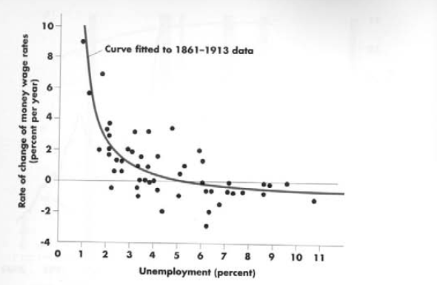
The graphical representation of original Phillips curve

Slide 54
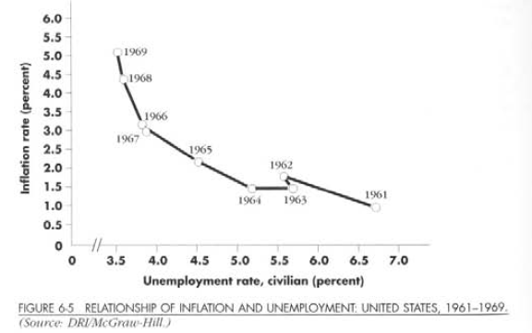
The policy tradeoff
The Phillips curve became the basis of macroeconomic policy analysis. According to it policymakers could have a combination of low unemployment and high inflation such as situation in late 1960’s in US. Or they could still have low inflation by maintaining high unemployment as in the early 1960’s

Slide 55
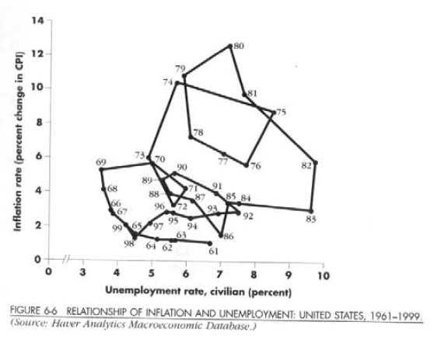
The failure of simple Phillips curve and the role of expected inflation 1/3
After 1960’s the relationship expressed in the original Phillips curve started to fall apart both in Britain and in US .
The problem was that original Phillips did not take into account expected or anticipated inflation

Slide 56
The failure of simple Phillips curve and the role of expected inflation 2/3
When the workers and firms agree over wages , they make an agreement over real wages. So they adjust the nominal wages for any inflation which they expect to happen over the contract period.
Unemployment level depends not on the level of inflation per se , but the excess of actual inflation over what was expected
So now if we talk about the real wages, the excess of wage inflation over the expected rise in prices or in other words the expected inflation is the important thing for both workers and firms. So we can rewrite the original Phillips curve in the following way :
(3)
where is the level of expected inflation

Slide 57
The failure of simple Phillips curve and the role of expected inflation 3/3
If we assume in addition that real wage is constant , it implies that nominal wage inflation rate should be equal to actual inflation rate
Denoting actual inflation rate by , we can rewrite the modern expectations- augmented Phillips curve in the following way:
(4)
Two crucial observations about this new Phillips curve are the following:
a) The change in expected inflation transfers into the same one-to-one change in actual inflation
b) The actual unemployment level equals natural unemployment if actual inflation equals expected inflation

Slide 58
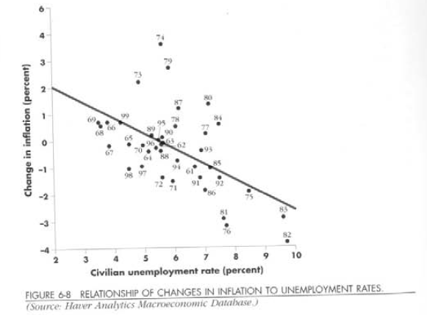
The expectations augmented Phillips curve and the actual data
The modern expectations augmented Phillips curve is plotted in the following graph together with actual data for different years . Now you can see that the expectations augmented Phillips curve corresponds to actual data although not perfectly but quite well

Slide 59
Inflation expectations and short run Phillips curve 1/2
Stylized short-run Phillips curves for the 1980’s and 1990’s for US economy are given on the next slide
Now the Phillips curve intersect the natural level of employment line at the level of expected inflation.
We can see that in 1990’s only 2% inflation rate was expected while in 1980’s around 7 % of inflation rate was expected.
If the level of expected inflation rises the Phillips curve shifts up .

Slide 60
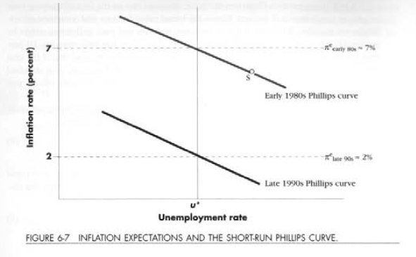
Inflation expectations and short run Phillips curve 2/2

Slide 61
Summary
The term money refers to assets that people regularly use to buy goods and services.
Money serves three functions in an economy: as a medium of exchange, a unit of account, and a store of value.
Commodity money is money that has intrinsic value.
Fiat money is money without intrinsic value.

Slide 62
Summary
It is the function of a central bank to control the money supply through open-market operations, or by changing the refinancing rate, or by adjusting reserve requirements.
When banks loan out their deposits, they increase the quantity of money in the economy.
Because the central bank cannot control the amount bankers choose to lend or the amount households choose to deposit in banks, the central bank’s control of the money supply is imperfect.

Slide 63
Summary
The overall level of prices in an economy adjusts to bring money supply and money demand into balance.
When the central bank increases the supply of money, it causes the price level to rise.
Persistent growth in the quantity of money supplied leads to continuing inflation.
A government can pay for its spending simply by printing more money. This can result in an “inflation tax” and hyperinflation.

Slide 64
Summary
The principle of money neutrality asserts that changes in the quantity of money influence nominal variables but not real variables.
According to the Fisher effect, when the inflation rate rises, the nominal interest rate rises by the same amount, and the real interest rate stays the same.

Slide 65
Summary
Many people think that inflation makes them poorer because it raises the cost of what they buy.
This view is a fallacy because inflation also raises nominal incomes.
Economists have identified six costs of inflation:
  Shoeleather costs
  Menu costs
  Increased variability of relative prices
  Unintended tax liability changes
  Confusion and inconvenience
  Arbitrary redistributions of wealth

