Slide 1
Prospect Theory - complement
J.Skorkovský
ESF-KPH

Slide 2
Prospect versus Utility Theory
Marketers are implicitly interested in how and why people make decision
Having in mind the fact, that we are rational beings :
we have to weigh up the odds
apply laws of probability
make decision
That is a easy world and marketing would be a simple science
BUT
We have to know how and why our behaviour deviates from rational decision models

Slide 3
Prospect versus Utility Theory
Utility Theory :
Two prospects with the same expected utility will be given the same preference by rational decision makers
Prospect Theory :
Outcome of decision-making under condition of gains and loses is not symmetrical
Decision appears to be irrational
When we are in positive domain – risk averse
When we are in negative domain – risk seekers

Slide 4
Prospect theory and marketing implication
How and advertising message is framed
How a new product is positioned
How a new product is priced relative to the competitors and consumers expectations
How a product is priced and the premium a consumer is willing to pay
What markets will respond to what types of offer

Slide 5
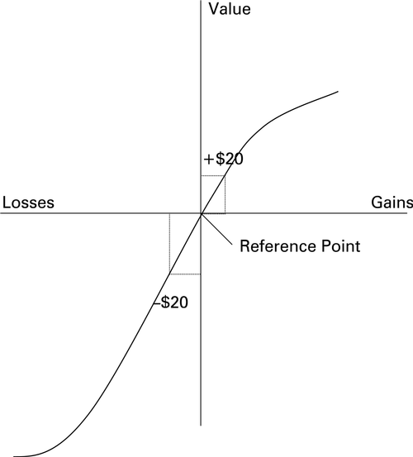
Reference point (area of acceptance)
Gains and losses are valued from
subjective reference point
Displeasure associated with loss is greater
than the pleasure associated with the same
amount of gains
Pleasure = value ( in our case )
Say story about
missing ticket 40 and buying
another one and lost
of two 20 USD bills…
area of acceptance

