Slide 1
Introduction to the Theory of Constraints
J.Skorkovský, PhD.; KPH ESF MU

Slide 2
Measuring the goal (TOC metric)
Net profit (NP=T-OE) : ( T, I and OE will be explained later in this course) -> T=Net Sales – TVC =S-TVC
Cash
Return on Investment (ROI=NP/I)
For a manufacturing enterprise, the goal can also be measured by:
Throughput =T
Inventory = Investment =I
Operating Expenses =OE

Slide 3
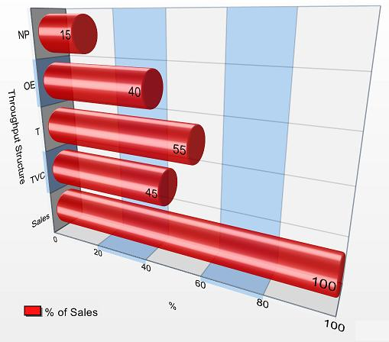
Metrics and their relationships

Slide 4
TOC –required trends
Inventory
Operational Expense
Throughput

Slide 5
T,I,OE,NP and ROI example
NP=T-OE = (S-TVC) - OE
ROI=(T-OE)/I=NP/I
where T=total throughput
A
B
C
D
E
10
13
7
9
11
Only one product
Unit Price (Selling price) = 100 USD
Raw material /one product =35 USD =OE
T/product=100-35=65 (S-TVC)
176 hours/month (contraint of the company)
T=176 * 7 = 1232 parts/month
Monthly T =1232 * 65 USD = 8 080 USD
CCR=Capacity
Constraint Resource=
=weakest link of the chain=
bottleneck

Slide 6
T,I,OE,NP and ROI example
1st suggestion is to optimize B from 13->14 parts per hour
T will not increase ->You cannot produce more than 7 !!!!
Investment to optimize B=5000 USD with depreciation 10 %
OE(month) =(5000 USD * 0,1)/12= 41,67 -> 42 USD
A
B
C
D
E
10
13
7
9
11
CCR=Capacity
Constraint Resource=
=weakest link

Slide 7
T,I,OE,NP and ROI example
T = throughput will not increase
NP (Net Profit) will decrease based on increased OE (41,67 USD /month)
Based on NP decrease ROI is negative
Bad suggestion !!!!!!
A
B
C
D
E
10
13
7
9
11
CCR=Capacity
Constraint Resource=
=weakest link

Slide 8
T,I,OE,NP and ROI example
2nd suggestion is to optimize C from 7->7,1 parts/hour
part of the 2nd suggestion is an extra load of E so it goes from 11->10
Necessary investment is 5000 USD (remains the same)
Increase of the production/month = 0,1*176=17,6 parts
Increase of the company T= 17,6*65 USD= 1 144 USD
A
B
C
D
E
10
13
7->7,1
9
11->10

Slide 9
T,I,OE,NP and ROI example
Necessary investment is 5000 USD = I =Inventory= Investment
Increase of the production/month = 0,1*176=17,6 parts
Increase of the company T= 17,6*65 USD= 1 144 USD
OE/month =(5000 * 0,1)/12= 41,67 -> 42 USD
OE will be increased by 41,67 USD/month
Annual increase of the NP = (T-OE)*12=(1144-42)*12 =13 244 USD
ROI=NP/I = 13 244/5000 = 265 % !!!
T does not measure local efficiencies, except at the constraint
A
B
C
D
E
10
13
7->7,1
9
11->10

