Slide 1
MACROECONOMICS I
Class 10. Financial Crises
May 9th, 2014

Slide 2
Announcements
Final Exam date
HW Assignment #4 is due: May 16th, 2014
Need to schedule our missed class
Project deadline: Before exam
N!B! Project is an individual, not a group assignment

Slide 3
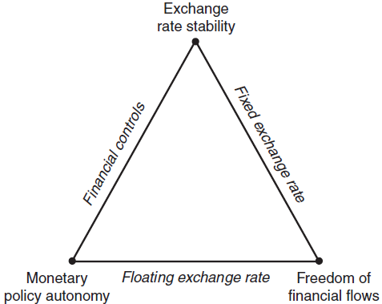
Impossible Trinity
Three desirable objectives that impossible to achieve simultaneously
  Fixed exchange rate regime
  Full capital mobility
  Monetary policy autonomy
  Only 2 objectives out of three
  Can be achieved simultaneously

Slide 4
Impossible Trinity: Case 1
Fixed exchange rate regime + perfect capital mobility
TE The central bank of Argentina maintains a fixed exchange rate for peso against the USD and allow for perfect capital mobility.
What effect would the expansionary monetary policy have on the economy?
M^{s} => i => Withdrawal / Inflow of foreign investment =>
To preserve the exchange rate => Foreign exchange interventions => M^{s}
Supply of the USD
N!B! A central bank loses control over Ms and, in general, over the monetary policy

Slide 5
Impossible Trinity: Case 2
Monetary autonomy + perfect capital mobility
TE The U.S. Fed as a strong monetary authority
What effect would the expansionary monetary supply have on the economy?
M^{s} => i => Withdrawal / Inflow of foreign investment =>
=> the USD depreciates / appreciates
N!B! Sacrificing the exchange rate stability

Slide 6
Impossible Trinity: Case 3
Monetary autonomy + fixed exchange rate
TE The Bank of China maintains a fixed exchange rate of Yuan against the USD.
What effect would the expansionary monetary policy have on the economy?
M^{s} => i => Withdrawal / Inflow of foreign investment =>
=> the USD depreciates / appreciates
N!B! Control over the capital outflow

Slide 7
Defining Financial Crisis
A rapid financial disintermediation caused by financial panic
Financial sector: Banks + Stock market
Key function: financial intermediation – transfer of savings to productive investment
Bank = Illiquid assets (loans) + Liquid liabilities (deposits)
Bank run: savers liquidate their assets in financial institutions due to prospective risks
Depositors lose faith in the quality of assets held by a bank
Self-fulfilling nature (psychology)

Slide 8
Defining Financial Crisis
Financial crisis manifests itself in the following ways:
Banks’ failure
Stock market crushes
Currency crisis (sharp depreciation)
Problems in the banking sector, as a rule, precede the currency crisis
N!B! Crisis originates when the flow of financial capital suddenly stops and reverses

Slide 9
Financial Crises in 1990s
Mexico in 1995
Thailand, Indonesia, and South Korea in 1997-1998
Russia in 1998
Brazil in 1998 –1999
Major prerequisites
  Fiscal deficits
  Capital overshooting
  Excess leverage
  Inefficient supervision of financial systems
Major consequences
  Large swings in Current Account International contagion
  Depreciation of currency
  Drop in output (6- 8 %)

Slide 10
Asian Financial Crises in 1990s
Thailand, Indonesia, South Korea, Philippines, and Malaysia in 1997-1998
Financial liberalization + Fast growth => Massive inflow of foreign capital
Short-term loans to the banks from foreign investors
“Sudden stop” in 1997
Reasons
Risky lending practices (“relationship lending”)
Poor supervision of the financial system
Liquidity crisis
Speculative attacks on exchange rates

Slide 11
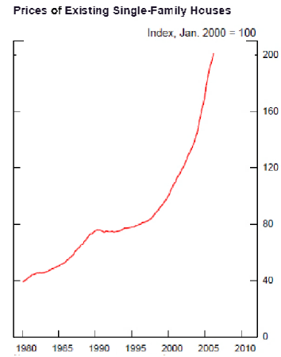
Financial Crisis of 2008-2009
Prelude: Housing bubble
Bubble - a surge in the market caused by speculation
explosion of activity in this market causing overinflated prices
high prices are not sustainable and the prices eventually crush =>
bubble bursts
TE From the late 1990s till 2006, house prices in the US increased by 130 %
Source: www.federalreserve.gov

Slide 12
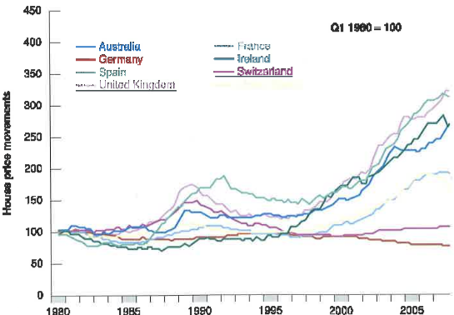
Housing Prices in Other Countries
Source: Blanchard et al, 2011

Slide 13
The Housing Bubble
House prices were driven by
  Psychology: housing prices will be rising in the future
  Low interest rates (Great moderation)
The US inflation was low => low interest rate
House prices are not part of CPI
  Deterioration of lending standards
Increasing share of sub-prime mortgages (no down payment and no documentation)
More people are attracted to the mortgage market => house prices rise

Slide 14
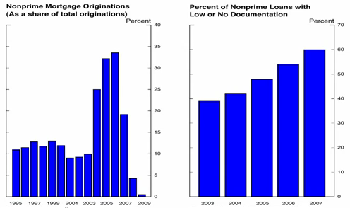
Deterioration of Mortgage Loan Standards
Source: www.federalreserve.gov

Slide 15
Securitization
Banks do not bear higher risks
Mortgages do not remain on the balance of banks
Pooling mortgages and selling them as financial securities
Mortgage-backed securities (MBS)
Selling future streams of income for a lump-sum amount today
Investors cannot check the quality of every mortgage in the financial instrument
Rely on the assessment of rating agencies
=> Weaker quality control

Slide 16
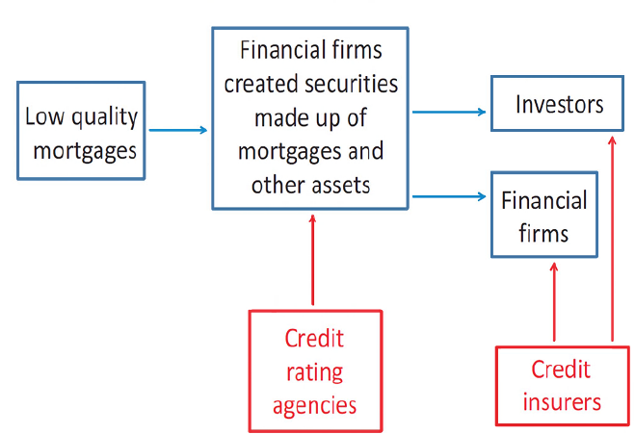
Securitization (Cont.)
Foreign banks
Pension Funds
Investment Companies
Wealthy individuals

Slide 17
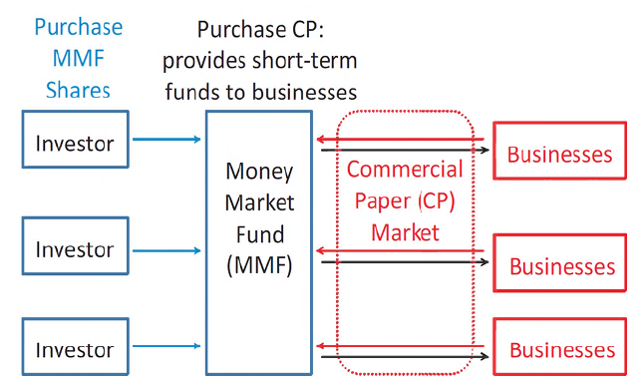
Securitization (Cont.)
Money Markets funds and the commercial paper market

Slide 18
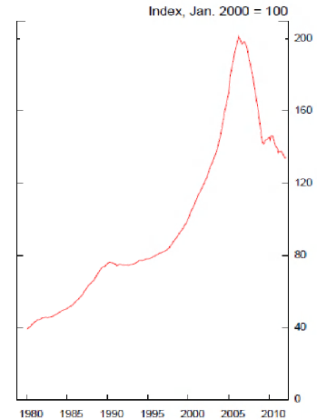
The Consequences of the Bubble Burst
TE The US prices of existing single-family houses
30 % drop in house prices
Households “under water”
Negative wealth from 12 million mortgages out of 55 million
5 million mortgages’ defaults
All mortgage-related securities’ holders suffered losses
But: 30 % drop in house prices could not trigger such massive crisis
Source: www.federalreserve.gov

Slide 19
Vulnerability of the Financial System
Too much leverage (excessive debt)
Leverage ratio = Assets / Own Capital
What happens if the value of assets increases by 20 %?
Returns on assets: 100 % for Bank 1; 400 % for bank 2
Complex financial instruments
Banks’ failure to monitor and manage
Short-term funding (commercial papers)
Gaps in the regulatory structure (no control over important financial firms and investment banks, government sponsored enterprises )
Bank | Assets | Liabilities | Capital | Leverage
Bank 1 | 100 | 80 | 20 | 5
Bank 2 | 100 | 95 | 5 | 20

Slide 20
The Crisis Unfolds
Drop in house prices => Mortgage defaults => Losses for securities’ holders
Complex nature of mortgage-backed securities
Spread all over the financial system and the world
N!B! No one knew where to expect losses from
Great uncertainty in financial markets
Beginning of runs on major financial companies: investors pulling funds from everywhere
Financial companies faces the problems with liquidity
Two possible solutions: file for bankruptcy or search for additional capital inflows

Slide 21
Large Financial Firms Under Pressure
Timeline (2008)
Lehman Brothers
Merrill Lynch
Sep 15th
Bear Sterns March 16th
Wachovia
Oct 3rd
Fannie and
Freddie
Sep 7th
AIG
Sep 16th
Wash Mutual Bank
Sep 25th
Broker-dealer firms
Insurance companies
Government-sponsored enterprises

Slide 22

Next class: Inflation
N!B! Homework assignment # 4 is on the way
Deadline: May 23rd, before the class

