Slide 1
MACRO I
Class1. The Gross Domestic Product
February 21nd, 2014

Slide 2
Course Info
Lecturer: Renata Ivanova
Classes: Friday, 12:00-15:00, room S6
Consultation: Fridays (after the class) or by appointment
Course page: http://is.muni.cz/el/1456/jaro2014/BPE_MAC1/
Textbook: Mankiw, N. G. (2012). Principles of Macroeconomics (any edition)

Slide 3
Class Policies
Class is a laptop and cell phones free zone
Late arrivals will not be tolerated
Active participation is encouraged
***
Assignments
Four homework assignments
Term project
***
Grading
Final grade (100 %) = Midterm (20 %) +HW (20 %) +
+Term Paper (15 %) + Final (40 %) + Class Participation (5 %)

Slide 4
Introduction
Macroeconomic goals
Economic growth (increase in output)
Price-level stability (low inflation)
Full employment (low unemployment rate)
External balance (avoiding trade deficit)
Policy tools
Monetary policy: interest rate and money supply
Fiscal policy: taxes and government spending

Slide 5
Time Dimension
What determines the level of economy’s output ?
Short run: several years
Changes in demand
The IS-LM model (goods + financial markets)
Medium run: a decade
Supply of factors
Aggregate supply- Aggregate demand model (AD-AS)
Long run: several decades/ half a century and more
Technological progress and factors’ accumulation

Slide 6
Czech Republic
Gross Domestic Product
(in current prices)
Year | GDP (mil CZK)
1990 | 632,691
1991 | 815,579
1992 | 925,476
1993 | 1,144,645
1994 | 1,323,328
1995 | 1,533,676
1996 | 1,761,575
1997 | 1,884,924
1998 | 2,061,583
1999 | 2,149,023
2000 | 2,269,695
2001 | 2,448,557
2002 | 2,567,530
2003 | 2,688,107
2004 | 2,929,172
2005 | 3,116,056
2006 | 3,352,599
2007 | 3,662,573
2008 | 3,848,411
2009 | 3,758,979
2010 | 3,799,547
2011 | 3,841,370
2012 | 3,845,926
N!B!
Million = 1,000,000
Billion = 1,000,000,000
Trillion= 1,000,000,000,000
In 2012, GDP of Czech Republic ($):
3,845,926/19.58 = $196,4 billion
Size of the economy
Source: Czech Statistical Office (CSU)

Slide 7
How big is the Czech economy?
Czech Republic: 51st place
Source: IMF statistics database

Slide 8
Gross Domestic Product (GDP)
Production approach
GDP is a market value of all final goods and services produced within an economy in a given period of time.
GDP is a measure of output
Is a single number expressed in monetary units
Why do we care?
Output is correlated with many important variables: standards of living, wages, unemployment, inflation, budget and trade deficit.

Slide 9
Adding Apples to Oranges
TE The US economy output in 2012: 2 airplanes + 5 hamburgers
GDP is a market value of all final goods and services produced within an economy in a given period of time
Market value = Market price
Goods | Quantity (Q) | Unit Price (P)
Airplanes | 2 | $1,000,000
Hamburgers | 5 | $1

Slide 10

Multiple Counts
TE McDonald’s hamburger costs $1
Ingredients used for production (meat, veg., bread) cost $0.5 per hamburger
Contribution to GDP: $1 or $1+$0.5 ?
GDP is a market value of all final goods and services produced within an economy in a given period of time
Final good/service: consumed by the end user and does not require further processing
Intermediate goods: used as inputs for production of other goods
N!B! Some goods can be both final and intermediate
To GDP will be included only $1 (price of a hamburger)
The value of intermediate goods is included in the market price of a final good

Slide 11
Value Added
Gross value added = Production – Intermediate consumption
Increase in value that a business creates by undertaking the production process.
Producer | Price of output | Price of inputs | Value added
McDonalds | $1 | $0.5 | $ 0.5
Farmer | $ 0.5 | $0 | $ 0.5
Total | $1.5 | $ 0.5 | $1
Contribution to GDP
GDP is the sum of value added in the economy during a given period
Firms pay taxes on the value added of their activities (VAT)
Firms report sales

Slide 12

Used Goods
You are buying a Rembrandt’ s painting from
another collector at the price of 1,000,000 Euros
You are buying stuff at your neighbor’s
garage sale for 20 CZK
What is the contribution to GDP?
None
GDP is a market value of all final goods and services produced within an economy in a given period of time
GDP includes only the value of currently produced goods and services
Resale of goods represents a transfer of an asset

Slide 13



GDP vs. GNP (Output vs. Location)
TE Czech Beer Factory operating in Slovakia
GDP is a market value of all final goods and services produced
within an economy in a given period of time
within a country’s boarder
Output of Volkswagen operating in CR is counted in Czech GDP
Gross national product (GNP) is a market value of all final goods and services produced in a given period of time using factors of production owned by the residents of a country

Slide 14
GDP Accuracy
Does not account for
Goods and services not sold in the market (home production, child care)
Underground economy: legal activities hidden from government and illegal activities
Imputed values
Assumption: The level of inaccuracy in GDP calculations is roughly constant from year to year
=> Inaccuracy can be neglected

Slide 15
GDP: Three Equivalent Approaches
Fundamental identity
Total production = Total income = Total expenditure
2. Income method
Def III: GDP is a nation’s total income
3. Expenditure method
GDP is the total expenditure on national output of goods and service

Slide 16


THE CIRCULAR FLOW MODEL OF MARKET ECONOMY
Expenditure ($)
Bicycles
Firms
Households
Labor
Income ($)
The rule of accounting: Expenditure of buyers = Income of sellers

Slide 17
The Circular Flow Model
Assumptions
  A closed economy (no international trade)
  No government
  No savings
Injections
  Government spending (G)
  Exports (EX)
  Investments (I)
Leakages
  Taxation (T)
  Imports (IM)
  Savings (S)

Slide 18


GDP: Expenditure Approach
Group I: Households
Group II: Businesses
Group III: Government
Group IV: Foreign sector

Slide 19
GDP: Expenditure Approach (Cont.)
The National Income Account Identity for an open economy
Y – total output (production)

Slide 20
GDP of Czech Republic: Expenditure Approach
Expenditure category | Czech Republic | ?
Consumption | 71.1% | 26.9%
Investment | 23.3% | 35.3%
Net export | 5.6% | 37.8%
GDP | 100% | 100%
Source: Czech Statistical Office. Ministry of development planning and statistics

Slide 21
GDP: Three Equivalent Approaches (Cont.)
TE Consider an economy consisting of two firms
Firm 1: Steel producer
Revenues from sale: €100
Wages: €80
Profit: €20
Firm 2: Car manufacturer
Revenues from sale cars: €200
Wages: €70
Profit: €30
What is the GDP?
Production approach:
€200
Income approach:
€80+ €20 + €70+ €30 = €200
Expenditure approach:
€200
Value added approach:
€100+ (€200- €100) = €200

Slide 22
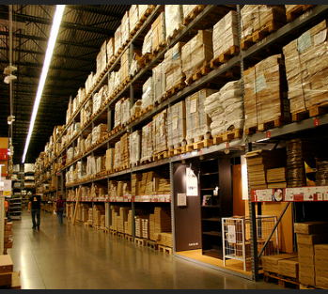
Treatment of Inventories
Goods produced in a certain period but not sold
TE A farm fails to sell milk and the milk spoils
Is GDP affected?
Spoiled milk is not sold – no effect on consumer expenditure
The farm does not obtain addition revenue
The farm’s revenue after subtracting wages shrinks
=> Neither total expenditure, nor total income are affected
TE The milk is put into inventory to be sold latter
Is GDP affected?
The farm “purchases” milk for its inventory – total expenditures are affected
The farm gets additional revenue => additional profit => income is affected
Later sale out of inventory is treated as a sale of used goods
NO
NO

Slide 23
Services and Imputations
Housing services
Home owners pay a “rent” to themselves
Included in homeowner expenditures and income
Imputed rent: how much it would cost to rent out the owner’s dwelling unit
In the case of no imputations, what effect would the increase in house ownership have on GDP?
Government services (Police officers, politician, etc.)
Wages are used as a value of service
GDP would decline

Slide 24
Summary
GDP is a measure of aggregate output
Approaching from production or income side
Aggregate production = Aggregate income = Aggregate expenditure
THREE EQUIVALENT APPROACHES
GDP as the total expenditure on final goods output
GDP as a sum of value added
GDP as a sum of income
  In a given period of time
  In a particular economy

Slide 25
Which of the following will be counted in GDP?
A purchase of the “Principles of Economics” textbook for our course. After the course, you sell your text book to a friend who will take the course next semester.
.
The value of the teaching service provided by a lecturer to students
Your haircut made by a friend
A purchase of aprons by restaurant chefs
A house constructed in 1950 and sold in 2012
Sale of the last year fashion collection by ZARA
A purchase of tires by an automobile manufacturer for the installation on a new line of cars

Slide 26
Comparison Over Time
What are the reasons for such increase in GDP?

Slide 27
Real GDP
Nominal values: expressed in current prices
Nominal GDP in 2011-2012
=> Changes in quantity produced or/and prices of goods
Real values: expressed in constant prices
The base year approach: Fixing prices by choosing a base year (2011)
N!B! Nominal GDP = Real GDP in the base year

Slide 28
GDP of Czech Republic
What is the base year?
Year | Nominal GDP | Real GDP
2000 | 2,269,695.00 | 2,550,148.00
2001 | 2,448,557.00 | 2,629,135.00
2002 | 2,567,530.00 | 2,685,643.00
2003 | 2,688,107.00 | 2,786,789.00
2004 | 2,929,172.00 | 2,918,955.00
2005 | 3,116,056.00 | 3,116,056.00
2006 | 3,352,599.00 | 3,334,815.00
2007 | 3,662,573.00 | 3,526,071.00
2008 | 3,848,411.00 | 3,635,344.00
2009 | 3,758,979.00 | 3,471,494.00
2010 | 3,790,880.00 | 3,557,216.00
2011 | 3,823,401.00 | 3,621,908.00
2012 | 3,845,926.00 | 3,584,924.00

Slide 29
Real GDP (Cont.)
TE Consider again the pizza-producing economy
Real GDP (100=2005): Real GDP in 2005 prices
N!B! Change in the base year will lead to different levels of real GDP
Year | Q | P ($) | Nominal GDP | Real GDP (100=2005) | Real GDP (100=2000)
2000 | 10 | 5
2005 | 10 | 8
2012 | 15 | 10
50
80
50
80
80
50
150
120
75

Slide 30
GDP Growth Rate
Percentage change in the quantity of goods produced from year to year
Growth rate
Year | Q | P ($) | Nominal GDP | Growth rate (%)
2010 | 10 | 5 | 50 | --
2011 | 10 | 8 | 80 | 60
2012 | 15 | 10 | 150 | 87.5
Nominal GDP growth rates reflect changes in both Q & P

Slide 31
GDP Growth Rate (Cont.)
Year | Q | P | Nominal GDP | Growth rate (%) | Real GDP (100=2005) | Growth rate (%)
2010 | 10 | 5 | 50 | -- | 80 | --
2011 | 10 | 8 | 80 | 60 | 80 | 0
2012 | 15 | 10 | 150 | 87.5 | 120 | 50
Will the real GDP growth rates be affected by the change in the base year?
NO

Slide 32
GDP Growth Rate (Cont.)
TE Multiple goods
 | Pizza |  | Haircuts |  | Nominal GDP ($)
Year | Q | P ($) | Q | P($)
2011 | 10 | 5 | 5 | 3 | 65
2012 | 15 | 10 | 10 | 5 | 200
TE Real GDP
TE Real GDP growth rate

Slide 33
Real GDP: The Chain-Weighted Approach
The value of output expressed in base year (constant) prices
Any changes in real GDP are due to changes in quantity of the output only
Issues with the base year approach
  The GDP growth rate is affected by the choice of the base year
What year to be used as the base year?
In practice, the base year is changed every 5 years and GDP is recalculated
What are the consequences? => Economic performance is different
C-W approach updates prices every year => more accurate

Slide 34
Real GDP: The Chain-Weighted Approach (Cont.)
Three steps procedure
Calculating change in real GDP between year t and year t+1
Step 1.
  Use year t as a base year => Real GDP => growth rate
  Use year t+1 as a base year => Real GDP => growth rate
Step 2. Calculate the average of two growth rates
=> Chain-weighted real GDP growth rate

Slide 35
Real GDP: The Chain-Weighted Approach (Cont.)
Step 3. Construct the real GDP index
  Chose an arbitrary base year: 2011
  Nominal GDP in the base year is equal to real GDP
  Chain-weighted real GDP in the following year
N!B! For the years before the base year
Chain to the base year: in order to calculate next year real GDP, we need to know the previous year figure

Slide 36
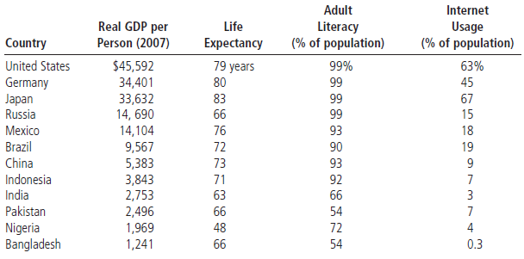
GDP as a Measure of Well-Being (Cont.)
Source: Mankiw , G. (2011). Principles of Economics
N!B! GDP is correlated with a well-being indicators, but is an imperfect measure of the well-being itself

Slide 37
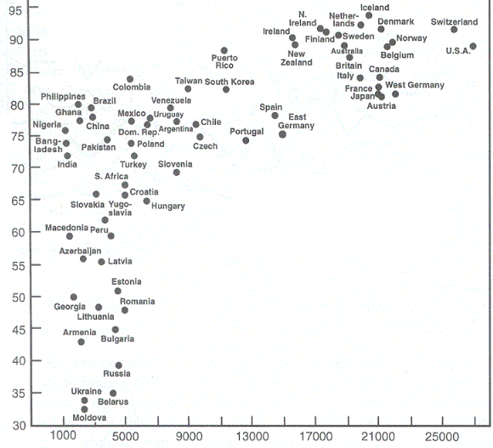
Happiness index
Income per capita (USD)

Slide 38

Next class: Economic Growth
N!B! Reading Assignment: Textbook + Handout

