Slide 1
MACROECONOMICS I
Class 11. Inflation
May 16th, 2014

Slide 2
Announcements
Final Exam: May 30th, 10:30 – 12:30, S6
HW Assignment #4 is due: May 23rd
Project deadline: May 30th, before exam
N!B! Project is an individual, not a group assignment

Slide 3
Recent Financial Crisis
Financial crisis (panic): depositors lose faith in the quality of bank’s assents and withdraw their deposits
Self-fulfilling
Recent crisis was a classical financial panic in broader institutional setting
Trigger: Housing bubble burst
Drop in housing prices by 30 %
Deterioration of lending standards => sub-prime mortgages
Complex nature of mortgage-backed securities (MBS)

Slide 4
Securitization
Government-sponsored enterprises (GSE)
Fannie Mae
Freddie Mac
Banks
Mortgage holders
Established by the Congress
Largest packagers of MBS
Guarantees against the loss
Inadequate capital

Slide 5
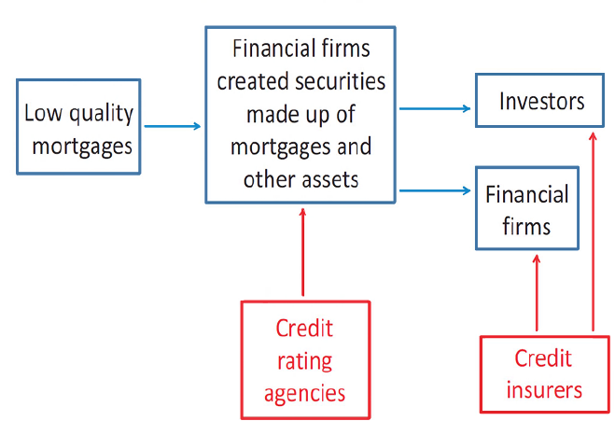
Securitization (Cont.)

Slide 6
Recent Financial Crisis
Default of mortgages + mortgages under water => losses for the holders of MBS
Subprime mortgages were distributed throughout the financial system
=> Uncertainty in the financial markets
Runs on financial companies => investors pulled funding from any firm thought to be vulnerable to losses
Two possibilities: acquire funding or file for bankruptcy

Slide 7
Large Financial Firms Under Pressure
Peak of the crisis (2008)
Lehman Brothers
Merrill Lynch
Sep 15th
Bear Sterns March 16th
Wachovia
Oct 3rd
Fannie and
Freddie
Sep 7th
AIG
Sep 16th
Wash Mutual Bank
Sep 25th
Bear Sterns: Forced sale
Fannie and Freddie: Liabilities guaranteed by the US Treasury
Lehman Brothers: Files for bankruptcy
Merrill Lynch: Acquisition by the Bank of America

Slide 8
The Role of the FED
Central bank as a lender-of-last-resort
Providing commercial banks with overnight liquidity (a discount window)
Fed extended its liquidity provisions on other financial institution
Providing liquidity backed by a collateral
Financial institutions will have access to liquid assets => panic will be calmed
Macroeconomic stability
Quantitative easing – purchase of large-scale assets (government guaranteed)
Affecting the long-run interest rate

Slide 9
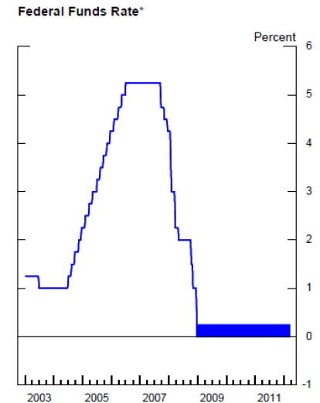
Liquidity Trap
Source: www.federalreserve.gov

Slide 10
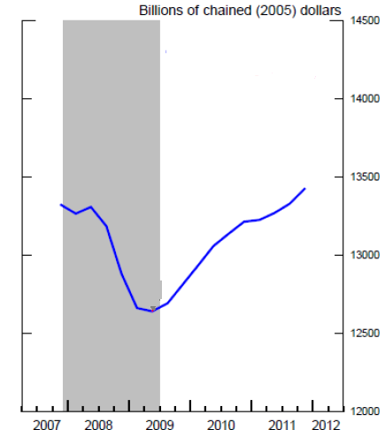
Real Economic Consequences
In the US:
Reduced credit flows, high borrowing costs, falling assets values
Contraction of spending and output
GDP fell by more than 5 %
8.5 million people lost jobs
Unemployment increases to 10 %
Official recession: December 2007 – June 2009

Slide 11
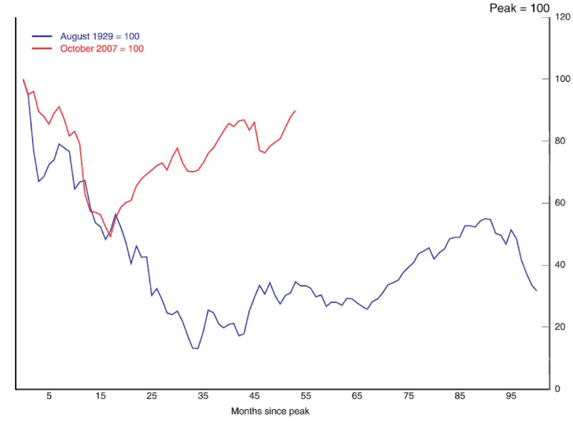
Comparison to the Great Depression
Stock market

Slide 12
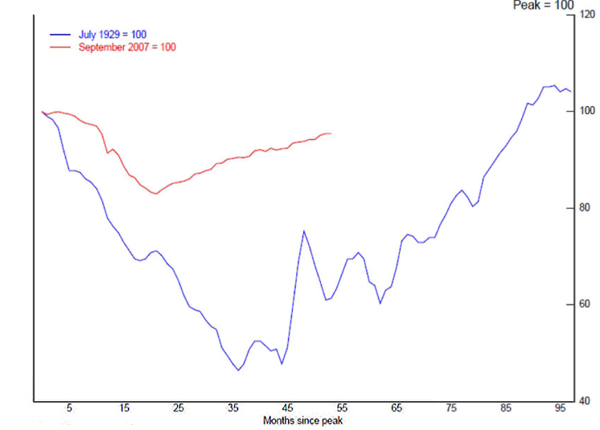
Comparison to the Great Depression
Industrial production

Slide 13
International Contagion
The key transmission channel: international trade
Drop in C, I and Y => Drop in demand for imports
The US economy accounts for 13 % of total world imports
US major trading partners
EU (17 %), China (16 %), Canada (16 %), Mexico (10 %)
The effect was amplified in countries (the UK and Ireland) where domestic banks suffered similar problems as the US banks.

Slide 14
The Role of Policy
Fiscal policy
Expansion: Governments increase spending to compensate the drop in C and I
Increase in budget deficit, higher taxes
Government investments into infrastructure (Long-term)
Monetary policy
Expansion: Interest rates are pushed to 0 %
Liquidity trap
Monetary policy is inefficient => waiting for the results of fiscal expansion
The key role of a central bank as a lender-of-last resort
Providing liquidity (short-term collateralized loans) to financial institutions
Central banks buy the assets commercial banks want to sell (quantitative easing or LSAP), government-guaranteed securities only
=> Cost of borrowing will not change (increase)

Slide 15
Introducing Inflation
An ongoing rise in the general level of prices over a period of time
Price shock – one-time increase in prices
Inflation implies the fall in the overall purchasing power of the currency
Deflation - a fall in the general price level over a period of time
Danger: psychology of falling prices
Stagflation - a combination of inflation and recession

Slide 16
Inflation in the United States
Source: BEA

Slide 17
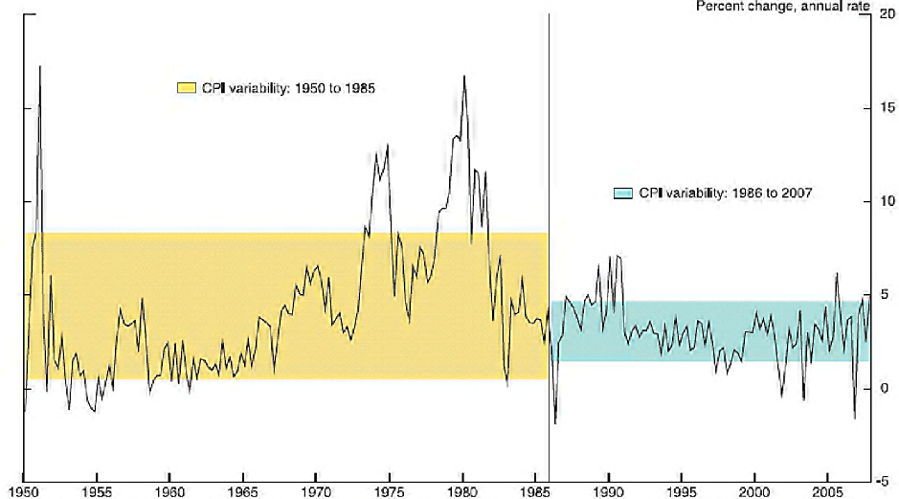
Inflation in the United States
Source:BEA

Slide 18
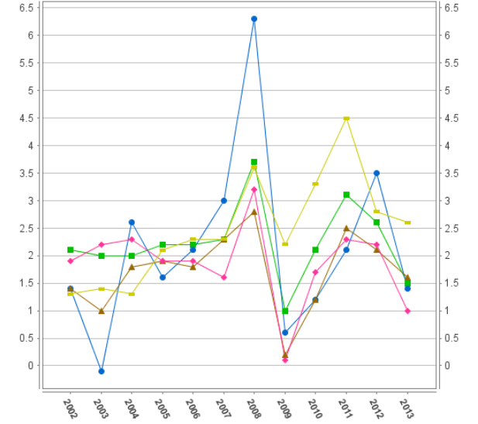
Inflation in Europe
Source: Eurostat

Slide 19
Measuring Inflation
Price indexes
  Consumer Price Index (CPI)
  Personal Consumption Expenditures (PCE)
  Producer Price Index
  GDP Deflator
  Employment Cost Index
  Which measure of inflation to use?

Slide 20

Consumer Price Index (CPI)
The average price of a fixed basket of goods and services
A representative household: housing, food, clothing, transportation, medical care, entertainment, education
A single number which indicates a change in the
households’ standards of living relative to base year
Each category of goods in the CPI enters with a weight
CPI is only a rough approximation
European analog: a Harmonized Index of Consumer Prices (HICP)

Slide 21
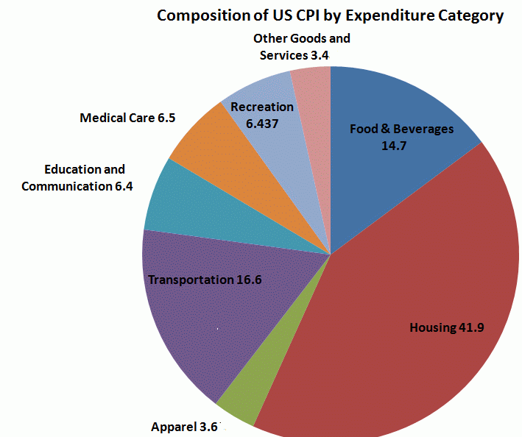
CPI Components
Source: BLS

Slide 22
Consumer Price Index (Cont.)
CPI with respect to the base year
Inflation rate using CPI
TE CPI₂₀₀₀=120 implies that in year 2000 it takes $120 to purchase a representative basket of goods that $100 purchased in the base year
Current comparison for the US: 1982-1984

Slide 23
Alternative Inflation Measures
Measurement issues with CPI: changes in consumption habits + substitution bias
Producer Price Index - average changes in the prices domestic producers receive for their output
Personal Consumption Expenditure – all domestic consumption of durable and non-durable goods and services targeted toward individuals and households
GDP deflator : measure the overall inflation
Core inflation: Price indexes excluding food and energy products
Assessing the overall (long-term ) trends in price changes due to the monetary policy

Slide 24
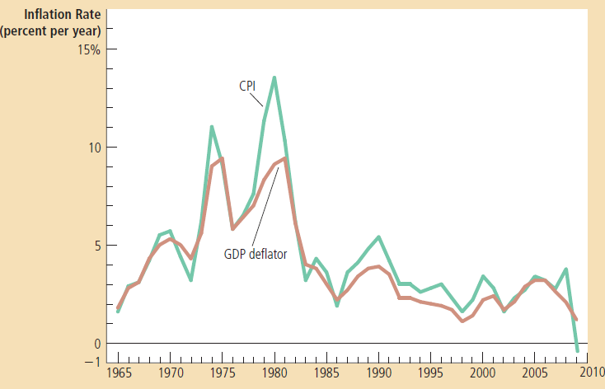
CPI vs. GDP Deflator
Source: Mankiw, 2012

Slide 25
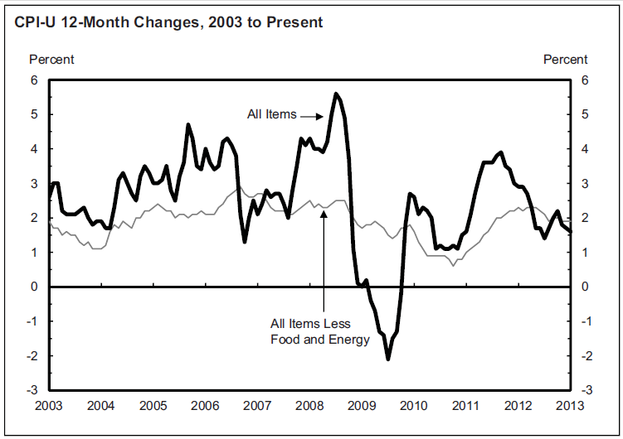
Inflation rate vs. Core Inflation rate in the US
Source:BEA

Slide 26
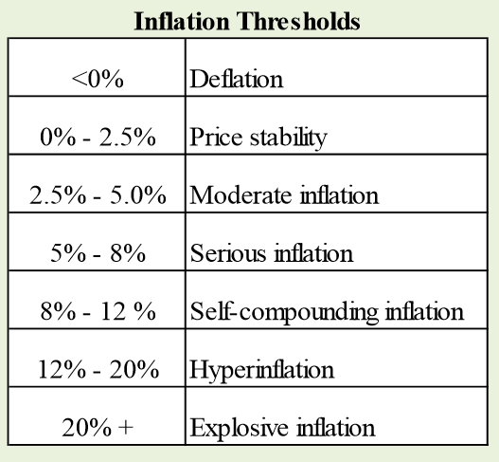
Classification
N!B! Inflation thresholds are arbitrary

Slide 27
Types of Inflation: Deflation
Deflation - a fall in the general price level over a period of time
Deflation leads to recession
Psychology of falling prices => shifting consumption from present to future
AE => Prices => AE => Y
Increases real value of debt (real interest rate): burden on borrowers
AE => Y
Discourage new borrowings and makes existing borrowers worse off
Redistribution of wealth from borrower to lender
3. Reduced employment: Sticky wages => increase in costs of labor => unemployment => AE
TE The US during the Great Depression and Japan in 1990s

Slide 28
Types of Inflation: Hyperinflation
Hyperinflation – monthly inflation rate greater than 50 %
Germany after the W W I: 322 % per month
Hungary after the WW II: 19 000 % per month
Zimbabwe (2008): 79,600,000,000 % per month
Causes: extremely rapid growth of the money supply
Monetarization of the government debt
Self-perpetuating: The public is trying to spend the money quickly in order to avoid the inflation tax; the government responds to higher inflation with even higher rates of money issue
Transfer of wealth from public to the government
Moving away from money transactions to barter
Dollarization as a remedy

Slide 29
Aggregate Demand-Aggregate Supply Model
Relationship between prices and output (AD-AS Model)
Two-way causation:
Prices determine output level
Increase in prices => Contractionary effect on the economy
2. Output level determines prices
Output moves toward full capacity => Increase in prices
Determining the equilibrium price level

Slide 30
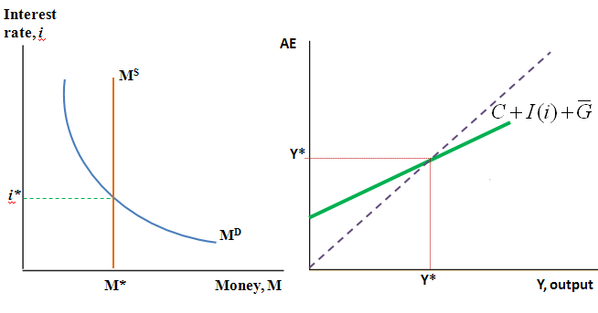
Equilibrium in Goods and Money Markets
For a particular price level (P)
Prices enter M^{D}
Show graphically how Y* and i* change due to increase and decrease in prices

Slide 31
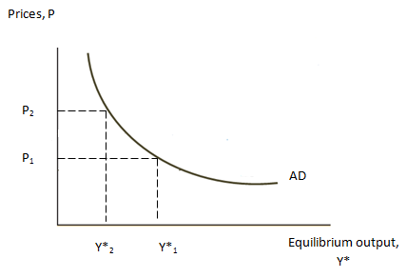
AD-AS Model
Aggregate demand (AD) curve: For any price level, what is Y* and i*
Effect of prices on Y*

Slide 32
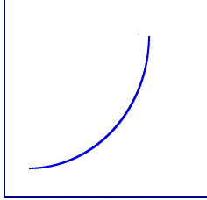
AD-AS Model (Cont.)
Aggregate supply (AS) curve: For each Y*, there is only one level of prices that would be sustainable
Higher Y* puts an upward pressure on prices (through inputs market)
P
Y^{F}
Y

Slide 33
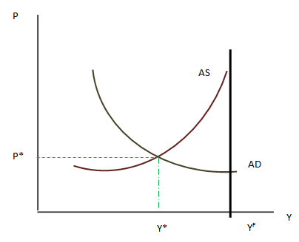
AD-AS Model: The Equilibrium
Equilibrium: Y* and P*

Slide 34
AD-AS Model: Movement Toward Equilibrium
Equilibrium: Y* and P*
P`
Y`

Slide 35
AD-AS Model: Expansionary Policy
Expansionary policy leads to inflation
Demand-pull inflation
Shifts of the AD curve
Part of the effect is eaten by inflation
The size of two effects depends on how close the economy is to the Y^{F}
Economy is coming out of recession (expansionary policy)
Economy is booming (expectations)

Slide 36
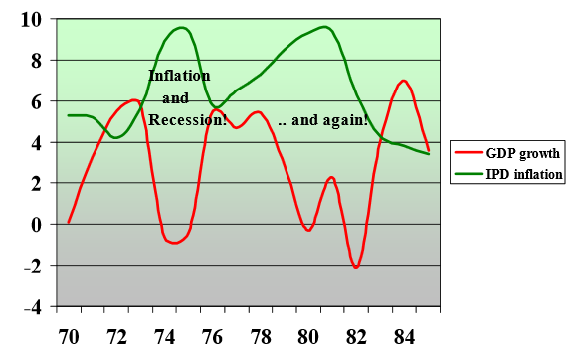
AD-AS Model: Stagflation
Cost-Push inflation: increase in the costs of production independent of demand
Shifts of the AS curve => Low Y* and higher prices
Expansionary monetary policy => higher inflation and lower output
%
Source:BEA

Slide 37
Causes of Inflation
Keynesian school
Key assumption: sticky prices
Demand-pull inflation: increase in aggregate demand
Cost-push inflation: increase in the costs of production independent of demand
Monetarists
Key assumption: flexible prices
“Inflation is always and everywhere a monetary phenomenon” (M. Freedman)
Inflation is a consequence of a more rapid money supply than increase in output
An increase in money supply would lead only to the increase in prices rather than output expansion

Slide 38
The Quantity Theory of Money
Velocity
Accounting identity:
Velocity - the number of times per year the average currency unit turns over in transactions for final goods and services
TE. The US nominal GDP in 2012 was $14 trillion, but the amount of money in circulation in 2012 was only $1 trillion.
What is the velocity?
Money in circulation
(cash + checks)
GDP

Slide 39
The Quantity Theory of Money (Cont.)
Increase in money supply should be balances by changes in other component
Velocity is relatively constant
Increase in money supply => Increase in nominal GDP
Which component of the nominal GDP changes?

Slide 40
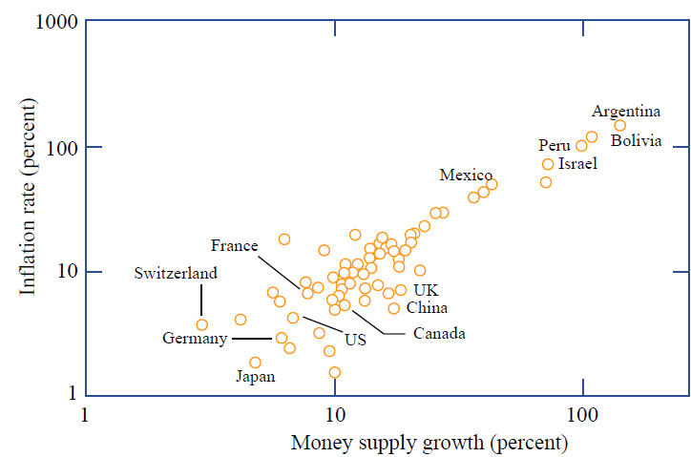
Average Inflation Rates & Money Supply Growth
Source: Mankiw, 2012

Slide 41
Costs of Inflation
Fall in the real value of savings
Fall in net exports
Fall in investment expenditures
Fall in GDP
Increase in unemployment
Redistribution of real income (decreasing liabilities of debtors and assets of creditors in real terms)

Slide 42
Inflation expectations
Anticipated inflation – business and individuals adjust their actions based on inflation expectations
Unanticipated inflation – portion of inflation businesses and households cannot predict
Random redistribution of wealth

Slide 43

Next class: Unemployment
Handout

