Slide 1
MACROECONOMICS I
Class 2. National Accounts (Cont).
Introduction to Economic Growth
February 28th, 201

Slide 2
Class Outline
Real GDP: Chain-weighted approach
GDP deflator
Introduction to economic growth

Slide 3
GDP: Three Equivalent Approaches
1. Production approach (value-added)
2. Income approach
3. Expenditure approach
Why are they equivalent ?

Slide 4


THE CIRCULAR FLOW MODEL OF MARKET ECONOMY
Expenditure ($)
Bicycles
Firms
Households
Total production =
=Total income =
=Total expenditure
Labor
Income ($)
The rule of accounting: Expenditure of buyers = Income of sellers

Slide 5
GDP by the Expenditure Approach
Expenditure category | Czech Republic | Qatar | China
Consumption | 71.1% | 26.9% | ?
Investment | 23.3% | 35.3% | ?
Net export | 5.6% | 37.8% | ?
GDP | 100% | 100%
Source: Czech Statistical Office. Qatar Ministry of development planning and statistics.

Slide 6
GDP by the Expenditure Approach
Expenditure category | Czech Republic | Qatar | China
Consumption | 71.1% | 26.9% | 49.1%
Investment | 23.3% | 35.3% | 48.3%
Net export | 5.6% | 37.8% | 2.6 %
GDP | 100% | 100% | 100%
Source: Czech Statistical Office. Qatar Ministry of development planning and statistics.

Slide 7
GDP Variations
Nominal
Real
Seasonally adjusted
PPP adjusted
Expressed in current prices
Expressed in constant prices
GDP
Removing seasonal pattern
Adjustment for differences in standards of living

Slide 8
Seasonally Adjusted GDP
Quarter-to-quarter fluctuations
A pronounced seasonal pattern:
Steady growth over the year - peaking in Q4 - sharp drop in Q1
Source: IMF Financial Statistics Database

Slide 9
PPP Adjusted GDP
Comparing the standards of living (GDP per capita) across countries
Converting GDP into common currency using currency exchange rates
Issues:
1. Variation of exchange rates
2. Difference in prices of basic goods
Solution: using a common set of prices which reflects the purchasing power
Purchasing power parity: The price of a typical basket of goods is equal across countries being converted into the common currency

Slide 10
Real GDP: The Chain-Weighted Approach
GDP growth rate:
The growth rate is affected by the choice of the base year
What year to choose?

Slide 11
Real GDP: The Chain-Weighted Approach
TE
 | Popcorn |  | Movies
Year | Q | P ($) | Q | P($)
2010 | 10 | 5 | 5 | 3
2011 | 15 | 10 | 10 | 5
2012 | 10 | 15 | 12 | 10
Real GDP (100=2010)?
Real GDP growth rate?

Slide 12
Real GDP: Example (Cont.)
 | Popcorn |  | Movies |  | Real GDP growth rate
Year | Q | P ($) | Q | P($)
2010 | 10 | 5 | 5 | 3 | ---
2011 | 15 | 10 | 10 | 5 | 60 %
2012 | 10 | 15 | 12 | 10 | -20%
Real GDP (100=2011)

Slide 13
Real GDP: Example (Cont.)
 | Popcorn |  | Movies |  | Real GDP growth rate
Year | Q | P ($) | Q | P($)
2010 | 10 | 5 | 5 | 3 | ---
2011 | 15 | 10 | 10 | 5 | 62 %
2012 | 10 | 15 | 12 | 10 | -16%
Real GDP (100=2012)

Slide 14
Real GDP: The Chain-Weighted Approach
Three step procedure: Step 1
 | Real GDP growth rate (100=2010) | Real GDP growth rate (100=2011) | Real GDP growth rate (100=2012)
Year
2010 | --- | --- | ---
2011 | 61 % | 60% | 62%
2012 | -19% | -20% | -16%

Slide 15
Real GDP: The Chain-Weighted Approach
Three step procedure: Step 2
 | Real GDP growth rate (100=2010) | Real GDP growth rate (100=2011) | Real GDP growth rate (100=2012)
Year
2010 | ---
2011 | 61 % | 60% | 62%
2012 | -19% | -20% | -16%

Slide 16
Real GDP: The Chain-Weighted Approach (Cont.)
Three step procedure: Step 3
GDP^{CW}₂₀₁₁= GDP₂₀₁₀ (1+g^{R}₂₀₁₁)
GDP^{CW}₂₀₁₂= GDP^{CW}₂₀₁₁ (1+g^{R}₂₀₁₂)
In order to calculate next year real GDP, we need to know the previous year figure
If we start from year 2011, real GDP for 2010 is
GDP^{CW}₂₀₁₀= GDP₂₀₁₁ /(1+g^{R}₂₀₁₁)

Slide 17
The GDP Deflator
Changes in the overall price level between the base year and the current year
The price of output relative to ithe price in a base year
GDP Deflator(t) = Nominal GDP (t)/Real GDP(t)
It is an index
Equals to 1 or 100 in the base year
Its level has no economic interpretation
Removes the inflation out of nominal GDP

Slide 18
The GDP Deflator (Cont.)
US GDP deflator (100=2005)
GDP Deflator (2006) = 103
Increase in overall prices by 3 % relative
to the base year
GDP Deflator (2000) = 88.7
Year | Deflator
2000 | 88.723
2001 | 90.727
2002 | 92.196
2003 | 94.135
2004 | 96.786
2005 | 100
2006 | 103.231
2007 | 106.227
2008 | 108.582
2009 | 109.529
2010 | 110.993
2011 | 113.359
2012 | 115.36
Increase in overall prices between 2000 and 2005 by 11.3 % compared
N!B! Deflator shows the change in prices relative to the base year

Slide 19
The GDP Deflator (Cont.)
Year | Deflator | Inflation rate
2000 | 88.723 | 2.17
2001 | 90.727 | 2.26
2002 | 92.196 | 1.62
2003 | 94.135 | 2.10
2004 | 96.786 | 2.82
2005 | 100 | 3.32
2006 | 103.231 | 3.23
2007 | 106.227 | 2.90
2008 | 108.582 | 2.22
2009 | 109.529 | 0.87
2010 | 110.993 | 1.34
2011 | 113.359 | 2.13
2012 | 115.36 | 1.77
Inflation – a change in aggregate price level from one year to another

Slide 20
GDP as a Measure of Well-Being
GDP does not account for:
Non-marker transactions
Leisure
Improved product quality
Distribution of income
Quality of environment
Depletion of resources
Developed by Simon Kuznets in 1930 for BEA as a tool which allows to monitor the effect of government policy

Slide 21
Data Sources
Czech Republic: Czech statistical office
Český statistický úřad (CSU)
www.czso.cz
Czech National Bank: Global Economics Outlook
USA
U.S. Bureau of Economic Analysis (BEA)
www.bea.gov
European Union
Directorate General on Economic and Financial Affairs of the European Commission
http://ec.europa.eu/economy_finance/eu/index_en.htm
OECD
www.oecd.org

Slide 22
Long Run: Economic Growth
Definition: Increase in real GDP per capita
Two aspects
Changes in GDP per capita within one country over time
Tremendous differences in GDP per capital across countries
The World Bank Classification based on GNP per capita
Low income: < $1,005
Middle income: $1,006 –$12,000
High income: >$12,000

Slide 23
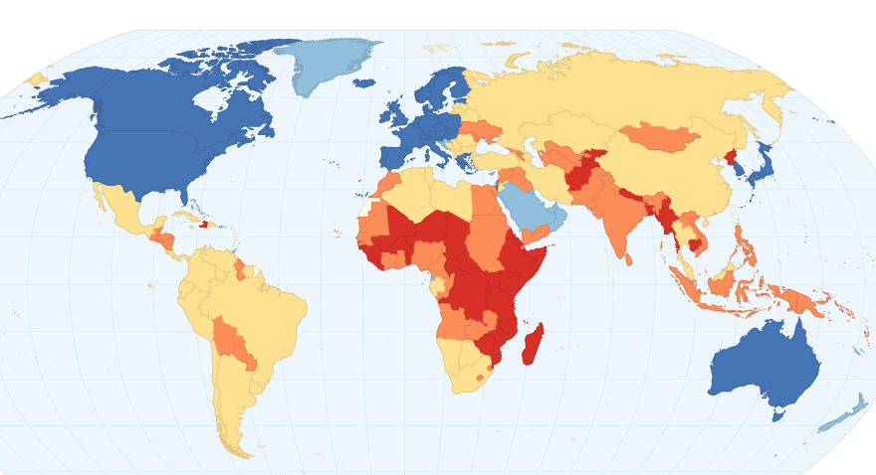
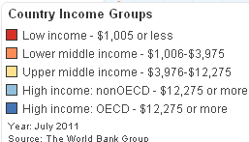
Cross-Country Income Differences

Slide 24
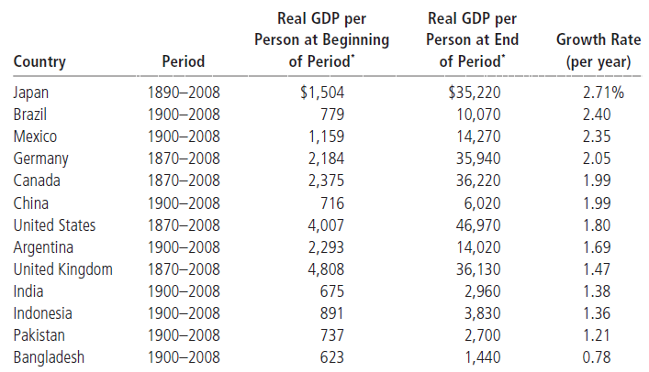
Economic Growth
Changes over time
Source: Mankiw (2011)

Slide 25
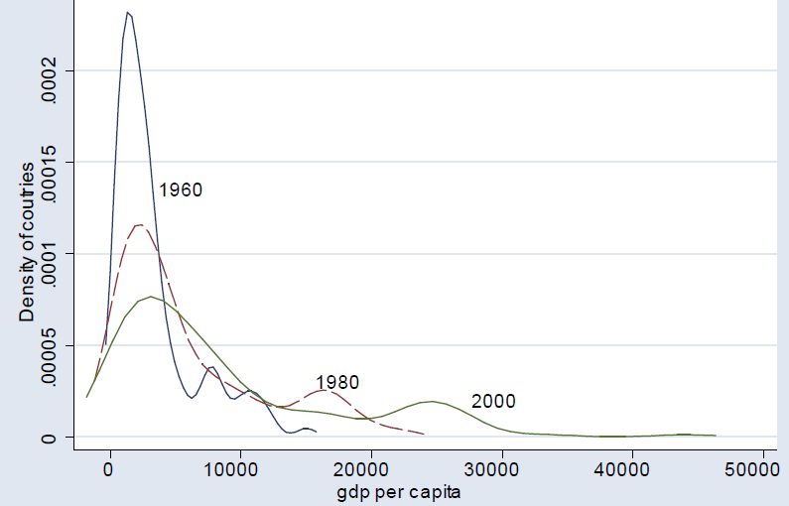
Economic Growth (Cont.)
Distribution of countries according to PPP-adjusted real GDP per capita
Distribution shift to the right => Increasing inequality across countries
Source: Acemoglu, D. (2009)

Slide 26
Economic Growth (Cont.)
How can the US be 32 times richer than Bangladesh?
Different growth rate
TE If we take two countries with the same GDP per capita
One country is growing at 2 % per year
Another country is not growing (0% per year)
In 200 years

Slide 27
The evolution of GDP per capita, 1960-2010
Log GDP
USA
UK
S. Korea
Botswana
Singapore
Guatemala
India
Nigeria

Slide 28
Logarithmic Scale
If GPD per capita grows at a constant rate of 2 % per year, the value of GDP per capita increases by larger and larger increments over time
TE
X
Exponential growth
Time

Slide 29
Logarithmic Scale (Cont.)
The same proportional increase in GDP per capita is represented by the same vertical distance on the scale (constant growth rate)
LogX
Linear
growth
Time

Slide 30
Fundamental Causes
The factors potentially affecting why societies make different technology and capital accumulation choices
Geographical differences
Nature, physical, ecological, and geographical environment
Institution
Laws, regulations, enforcement of property rights
Culture
Values, preferences, and believes
Luck (multiple equilibrium): divergent passes of the economies which are otherwise identical

Slide 31

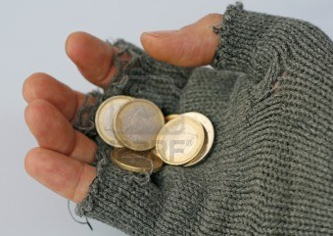

The Vicious Circle of Poverty
Low output and income
GDP
Low savings
POVERTY
Scarce investment capital
Scarce jobs,
Poor capital

Slide 32






Breaking the Cycle
Better institutions
Higher output
GDP
ECONOMIC GROWTH
Investment
capital
Better jobs,
Technology

Slide 33
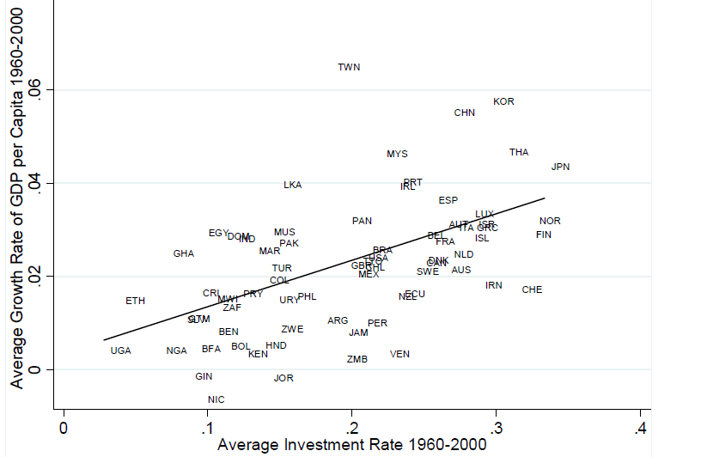
Correlates of Economic Growth
Investment in physical capital
Source: Acemoglu, D. (2009)

Slide 34
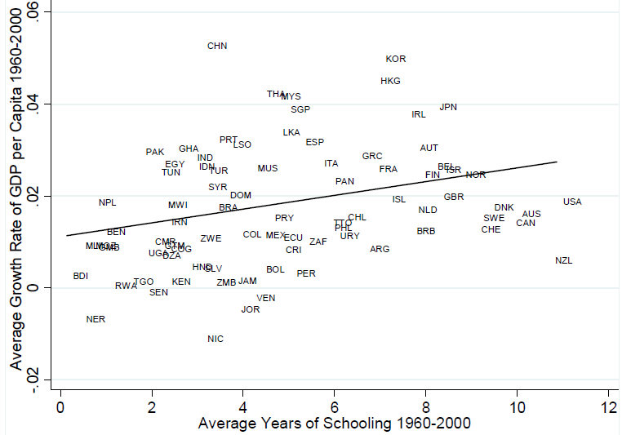
Correlates of Economic Growth (Cont.)
Investment in human capital
Source: Acemoglu, D. (2009)

Slide 35
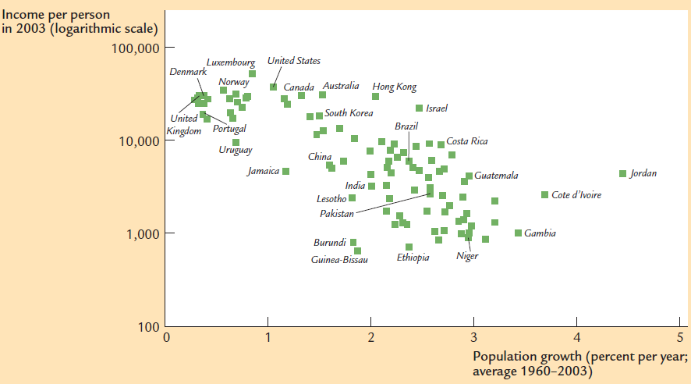
Economic and Population Growth

Slide 36
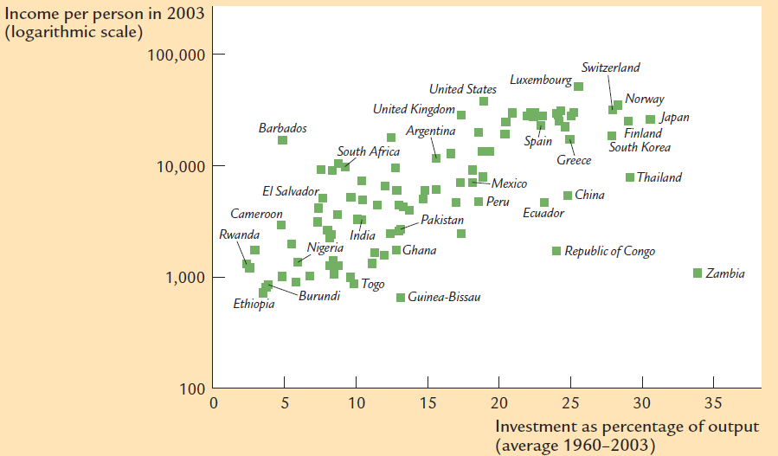
Savings and Economic Growth

Slide 37

Next class: Solow-Swan Growth Model
N!B! Reading Assignment: Handout “Theories that don’t work”

