Slide 1
MACROECONOMICS I
Class 4. The Solow-Swan Model (Cont.)
March 14th, 2014

Slide 3
The Solow-Swan Model: Population Growth
Labor force is growing at a constant rate n:
L_{t+1}=(1+ n)L_{t}
What happens to Capital/Labor ratio (k)?
It is affect by investment (+), depreciation (-), and population growth (-)
Law of motion for k?
k_{t+1}= sf(k_{t})+(1- ẟ - n)k_{t}

Slide 4
Solow-Swan Model: Population Growth (Cont.)
Economies with high rates of population growth will have lower GDP per capita
Government policy response?

Slide 5
Population Growth: Summary
Steady state:
Population growth increases Y and K (level effects)
N!B! Both Y and K grow in the steady state at the rate n, but k* and y* are constant
Population growth reduces k* and y*
Population growth consists of natural population increases + migration

Slide 6
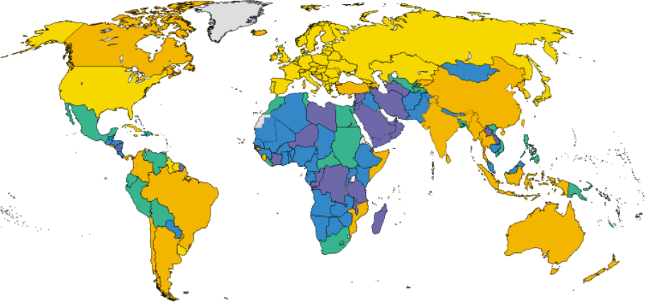
Population Growth Rates, 1985-1995
Source: The World Bank

Slide 7
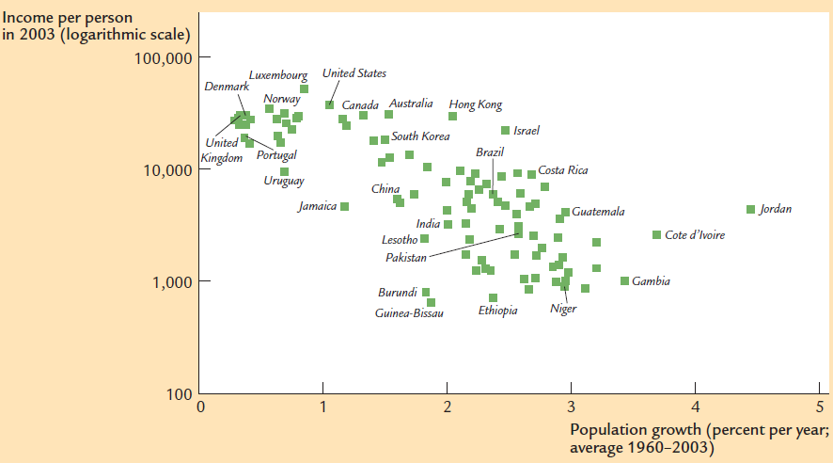

Slide 8
The Role of Technological Progress
Technological change, increase in factor productivity
Larger output for given quantities of capital and labor
State of technology (A)
How does technological progress translates into larger output?
Labor-augmenting technological progress
Effective labor
A as labor efficiency
TP reduced number of workers needed to produce the same output
TP increases output using the same number of workers

Slide 9
The Solow-Swan Model with Technological Progress
Technology is improving every year at the exogenous rate (g)
Production function: GDP per effective labor

Slide 10
The Solow-Swan Model with Technological Progress (Cont.)
From GDP per effective labor to the GDP per capita?
GDP per effective labor
Capital per effective labor
We are interested in GDP per capita

Slide 11
The Solow-Swan Model with Technological Progress (Cont.)
Steady state: Constant levels of capital and output per effective worker

Slide 12
The Solow-Swan Model: Technological Progress (Cont.)
Capital and output per effective worker are constant in steady state
What about per capita variables?
GDP per capita grows at the rate of technological progress (sustainable growth)
Balanced growth path: growth of variables at the same rate
Per capita variables (capital, output and consumption) grow at a constant rate g
Per effective labor variables are not growing in the steady state
N!B! Solow model explains 60 % of cross-country variation of the GDP per capita by differences in savings rate and population growth

Slide 13
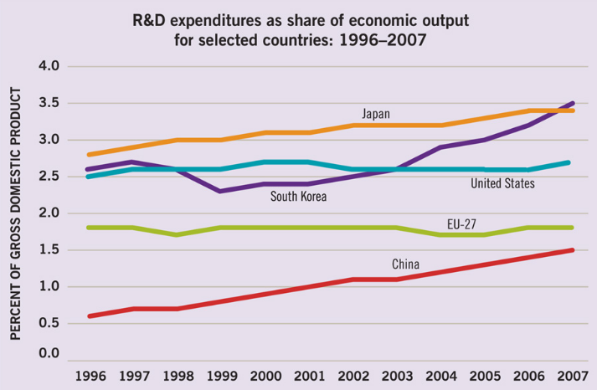

Slide 14
Growth Accounting
Real GDP per capita growth rate for Czech Republic in 2011 was 1.7 %
Real GDP per capita growth rate for the USA in 2012 was 2.2 %
How much of this growth is due to the factors’ accumulation and/or technology?
Growth accounting: breakdown of observed growth of GDP into changes in inputs and technology
Contribution of technology as a residual

Slide 15
Growth Accounting (Cont.)
Capital (K) increases by 1 unit
What is the effect on output Y?
Marginal product of capita (MP_{K})
TE Capital stock increased by 10 units and MP_{K} =0.1. What is the impact on GDP?
unit

Slide 16
Growth Accounting (Cont.)
Labor (L) increases by 1 unit
What is the effect on output Y?
Marginal product of labor (MP_{L})
TE Labor force increases by 10 units and MP_{K} =0.3.
units

Slide 17
Solow Residual
Accounting for the increase in all components
How to account for the technological change?
Calculate it as a residual
Solow Residual: the left-over growth of output when growth attributed to the changes in labor and capital is subtracted

Slide 18
Solow Residual (Cont.)
Where do we get marginal products of capital and labor?
Mathematical manipulations
Transforming changes to growth rates
GDP growth rate
Unobservable technological change (g)

Slide 19
Solow Residual (Cont.)
Share of capital in output
Share of labor in output
N!B! Key assumption: Factors of production are paid their marginal product
Wages and rental rate of capital reflect productivity of factors

Slide 20
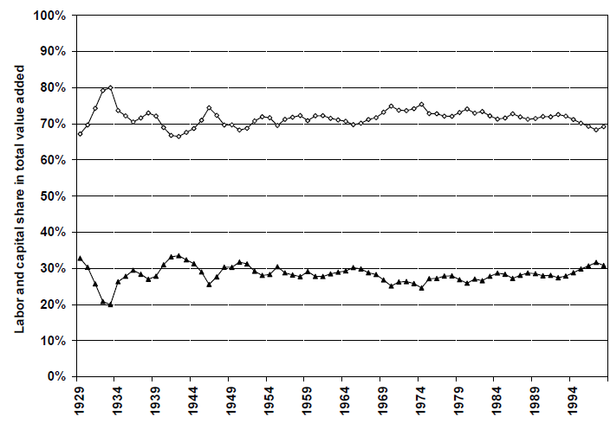
Historical Factor Shares
Labor (2/3)
Capital (1/3)
Source: Acemoglu, 2009

Slide 21
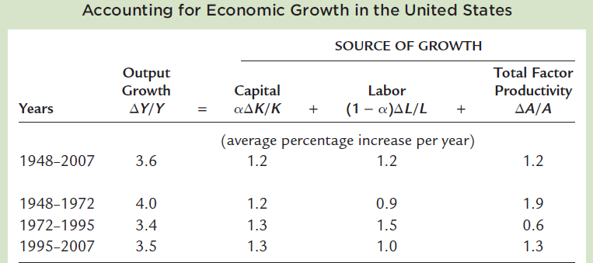
Source: Mankiw, 2009

Slide 22
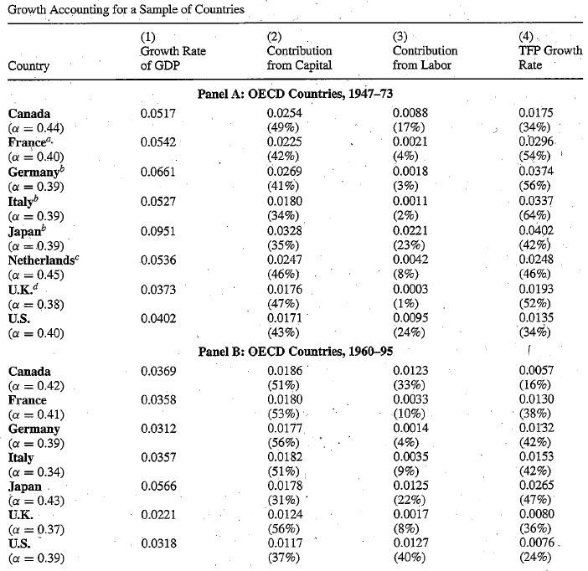

Slide 23
The Asian Growth Miracle?
A. Young (1995) QJE
Exceptional growth due to changes in TFP or factor accumulation?

Slide 24
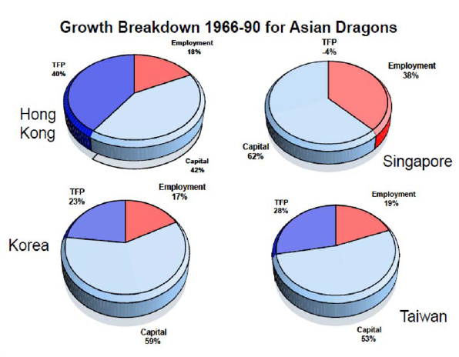

Slide 25
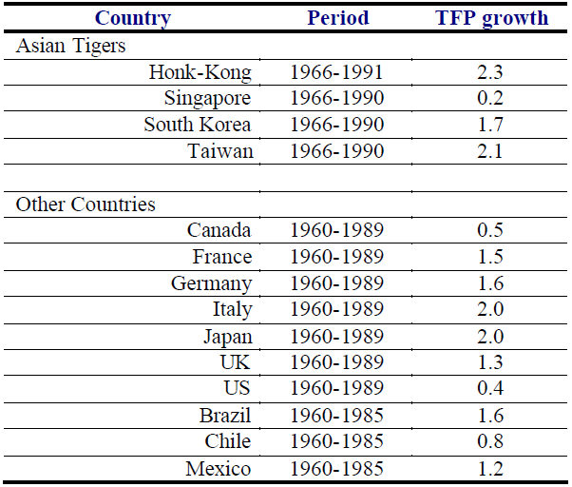
The Asian Growth Miracle?
The miracle was bound to stop
Exceptional growth due to the factors accumulation?
Conclusion?

Slide 26
Asian Tigers: Performance After 1990s
Real GDP growth rate
Source: IMF World Economic Outlook Database

Slide 27
Asian Tigers: Performance After 1990s
Country | Average growth rate 1990-2012 (%)
Hong Kong | 3.9
Singapore | 5.9
South Korea | 5
Taiwan | 4.8

Slide 28
Global Slowdown in Economic Growth
GDP per capita growth rate (% per year)
Country | 1948-1972 | 1972-1995 | 1995-2010
Canada | 2.9 | 1.8 | 1.6
France | 4.3 | 1.6 | 1.1
Germany | 5.7 | 2 | 1.3
Italy | 4.9 | 2.3 | 0.6
Japan | 8.2 | 2.6 | 0.6
UK | 2.4 | 1.8 | 1.7
USA | 2.2 | 1.5 | 1.5
Source: Mankiw (2013)
What are the reasons?

Slide 29
Theories Explaining Disparities in Development
Fundamental causes
Geography: geographical concentration of poverty and prosperity
Tropical climate: lazy people, diseases, and poor agricultural lands
Counter examples: Botswana, Nogales
Culture: beliefs, values, ethics, trust, cooperation
Counter examples: North and South Korea
Ignorance of policy makers: poor policies
Transfer of resources to a small powerful group

Slide 30
The Institutional Hypothesis
Countries differ in economic success because of different institutions (rules)
Laws, regulations, enforcement of property rights and social norms
Extractive institutions: concentration of power in the hands of elite
Inclusive institutions: inclusive markets and opportunities
Free choice of occupation, education, constrained and broadly distributed power
Institutions => Incentives to acquire education, start a business and innovate

Slide 31
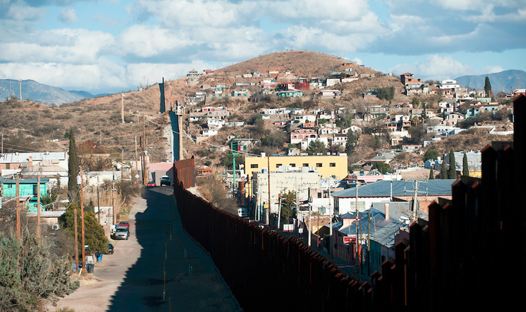
Nogales

Slide 32
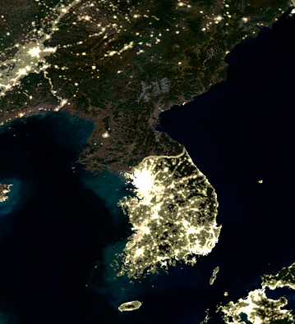

Slide 33
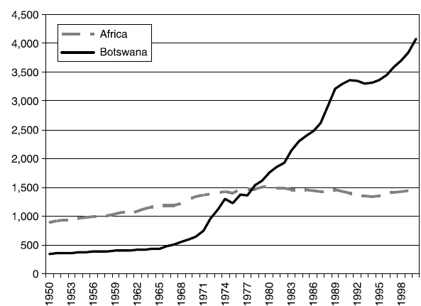
African Growth Miracle
GDP per capita

Slide 34
Next class: Business cycles
N!B! Homework is due next week before the class

