Slide 1
MACROECONOMICS I
Class 8. The Open Economy
April 18th, 2014

Slide 2
Midterm Exam: Grades

Slide 3





Total Income =Total Spending
EX
Open Economy
IM
Goods Markets
G
Firms
T
Households
I
S
Factor Markets

Slide 4
The Balance of Payments (Czech Republic)
millions USD | IV. Q 2013 |  | millions USD | IV. Q 2013
A. Current Account | -504 |  | C. Financial Account | 9903
Trade balance | 1902 |  | Direct investment | 126
Exports | 35600 |  | Abroad | -728
Imports | -33698 |  | In the Czech Republic | 854
Balance of services | 741 |  | Portfolio investment | 1667
Credit | 6148 |  | Assets | -20
Debit | -5407 |  | Liabilities | 1687
Income balance | -3949 |  | Financial derivatives | 109
Credit | 1493 |  | Assets | 357
Debit | -5442 |  | Liabilities | -248
Current transfers | 802 |  | Other investment | 7999
Credit | 1816 |  | Assets | 174
Debit | -1014 |  | Liabilities | 7825
B. Capital Account | 1072 |  | Total, Groups A through C | 10471
Credit | 1099 |  | D. Net errors and omissions, valuation changes | -958
Debit | -27 |  | Total, Groups A through D | 9513
Total, Groups A plus B | 568 |  | E. Change in reserves (-increase) | -9513

Slide 5
The Balance of Payments (BoP)
International accounting record (accounting tool)
All international transactions of a country over a period of time
(year/ quarter/ month)
A list of all ways national currency is coming in or going our of a country
Compiled by a central bank or finance ministry
In the US: The US Bureau of Economic Analysis (BEA) http://www.bea.doc.gov
In Czech Republic: Czech National Bank www.cnb.cz
N!B! Any transaction enters the BoP twice:
Credit (+): receipt from foreigners;
Debit (-): payment to foreigners

Slide 6
The Balance of Payments (Cont.)
Three components
N!B! The fundamental BoP identity:
Current account (CA)
Financial account (FA)
Capital account (KA)
Imports/Exports + Income receipts/payments
BoP Accounts
Sales/purchases of financial assets
Capital transfers

Slide 7
The Balance of Payments (Czech Republic)
millions USD | IV. Q 2013 |  | millions USD | IV. Q 2013
A. Current Account | -504 |  | C. Financial Account | 9903
Trade balance | 1902 |  | Direct investment | 126
Exports | 35600 |  | Abroad | -728
Imports | -33698 |  | In the Czech Republic | 854
Balance of services | 741 |  | Portfolio investment | 1667
Credit | 6148 |  | Assets | -20
Debit | -5407 |  | Liabilities | 1687
Income balance | -3949 |  | Financial derivatives | 109
Credit | 1493 |  | Assets | 357
Debit | -5442 |  | Liabilities | -248
Current transfers | 802 |  | Other investment | 7999
Credit | 1816 |  | Assets | 174
Debit | -1014 |  | Liabilities | 7825
B. Capital Account | 1072 |  | Total, Groups A through C | 10471
Credit | 1099 |  | D. Net errors and omissions, valuation changes | -958
Debit | -27 |  | Total, Groups A through D | 9513
Total, Groups A plus B | 568 |  | E. Change in reserves (-increase) | -9513

Slide 8
The Balance of Payments (USA)
billion USD | IV. Q 2013 |  | billion USD | IV. Q 2013
A. Current Account | -80 |  | C. Financial Account | 174
Trade balance | -172 |  | Direct investment | -18
Exports | 405 |  | Abroad | -86
Imports | -577 |  | To the U.S. | 68
Balance of services | 58 |  | Portfolio investment | -41
Credit | 173 |  | Assets | -133
Debit | -115 |  | Liabilities | 92
Income balance | 65 |  | Financial derivatives | -3
Credit | 206 |  | Assets
Debit | -141 |  | Liabilities
Current transfers | -31 |  | Other investment | 236
Credit | 1 |  | Assets
Debit | -32 |  | Liabilities
B. Capital Account | -146 |  | Total, Groups A through C
Credit | n.a. |  | D. Net errors and omissions, valuation changes | -9
Debit | n.a. |  | Total, Groups A through D
Total, Groups A plus B | -226 |  | E. Change in reserves (-increase) | 95

Slide 9
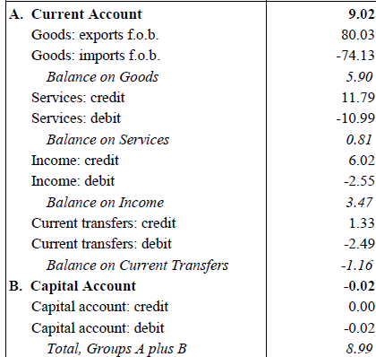

China’s Balance of Payments, 2011

Slide 10
The Trade Balance
A net flow of goods and services
The main component of the Current Account
Net Flow of Goods = Exports (EX) – Imports (IM)
Trade balance surplus: Exports > Imports
Trade balance deficit: Exports < Imports
Balanced trade: Exports = Imports => NX=0
What affects the trade balance of a country?
Consumers’ preferences;
Prices and exchange rate;
Government regulation;
N!B! Trade balance is the largest component of the CA

Slide 11
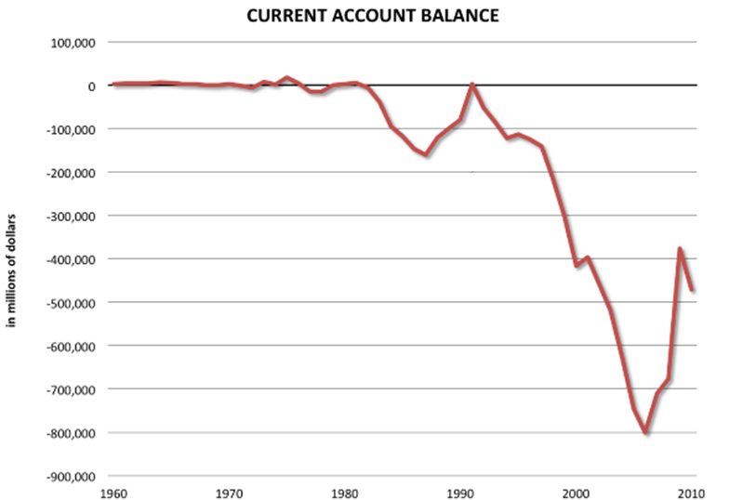
The US Current Account Balance
Source: www.bea.gov

Slide 12
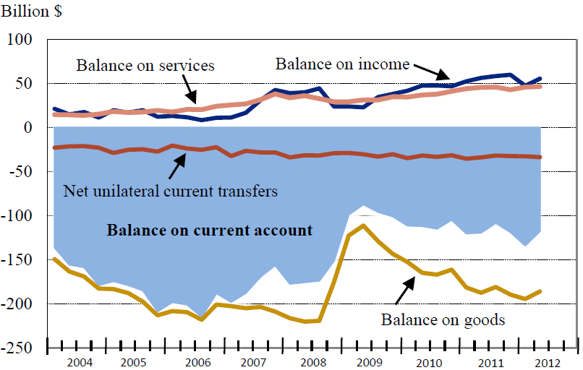
The US Current Account Balance & Its Components
Source: www.bea.gov

Slide 13
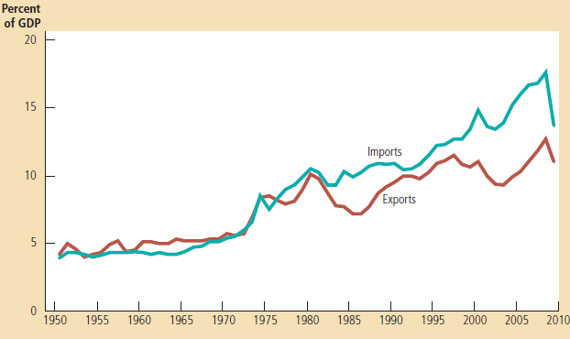
The US Imports and Exports as a share of the US GDP
Source: Mankiw, 2011
What can we say about the trade balance of the US?

Slide 14
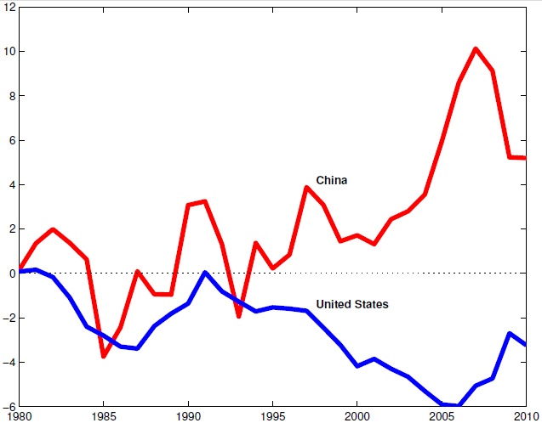
Current Account Balance as a % of GDP in China and the United States
Source: S. Schmitt-Grohe & Uribe, 2012

Slide 15
Financial Account
Acquisition of assets in one country by residents of another
Changes in country’s net foreign assets position
By types of investments
Financial Assets
FDI
Derivatives
Other
Portfolio Investment
Reserve Assents
Debit/ Assets (-): Purchases of foreign securities
Credit/ Liabilities (+): Sales of assets to foreigners

Slide 16
The Balance of Payments (Czech Republic)
millions USD | IV. Q 2013 |  | millions USD | IV. Q 2013
A. Current Account | -504 |  | C. Financial Account | 9903
Trade balance | 1902 |  | Direct investment | 126
Exports | 35600 |  | Abroad | -728
Imports | -33698 |  | In the Czech Republic | 854
Balance of services | 741 |  | Portfolio investment | 1667
Credit | 6148 |  | Assets | -20
Debit | -5407 |  | Liabilities | 1687
Income balance | -3949 |  | Financial derivatives | 109
Credit | 1493 |  | Assets | 357
Debit | -5442 |  | Liabilities | -248
Current transfers | 802 |  | Other investment | 7999
Credit | 1816 |  | Assets | -174
Debit | -1014 |  | Liabilities | 8173
B. Capital Account | 1072 |  | Total, Groups A through C | 10471
Credit | 1099 |  | D. Net errors and omissions, valuation changes | -958
Debit | -27 |  | Total, Groups A through D | 9513
Total, Groups A plus B | 568 |  | E. Change in reserves (-increase) | -9513

Slide 17
Double-Entry Bookkeeping
Each transaction enters the BoP twice
once with positive sign (Credit)
once with negative sign (Debit)
Entries into the CA are balances by entries into FA or CA and vs.
TE A Czech resident buys a SONY MP3 player from Japan for 2000 CZK
Czech CA: The Czech resident imports a player worth 2000 CZK
Debit (-) : Import of goods
Czech FA: A Japanese resident (SONY) is getting a Czech asset (currency) worth 2000 CZK
Liability (+): Other investment (sold currency as an asset)

Slide 18
Back to Trade Deficit
What does it mean that the US is running a trade deficit?
US dollars leave the country and they are not used to:
  Purchase the US goods/ services
  Payments to the US investments
  Unilateral transfers
N!B! The US dollars are the legal tender only in the United States
The US dollars are traded in the foreign exchange market for a national currency
The US dollars are invested into the US assets (stocks, bonds, securities, property)
The US dollars are kept in a bank (purchase of the US currency)

Slide 19
Net Capital Outflow (NCO)
The difference between:
The purchase of foreign assets by domestic residents
The purchase of domestic assets by foreigners
If NCO > 0: capital is flowing out of the country
If NCO < 0: capital is flowing into the country
The big fact of accounting
Net Exports = Net Capital Outflow

Slide 20
The Net International Investment Position
Trade surplus: Foreign currency is used to buy foreign assets
Trade deficit: Imports are financed by selling the domestic assets
The US dollars invested into the US assets ≡ The US is borrowing dollars
Trade deficit ≡ Borrowing (investment) from abroad
Trade surplus ≡ Lending (investment) to abroad
The Net International Investment Position (NIIP): CA=ΔNIIP
If NIIP > 0 => creditor nations
If NIIP < 0 => debtor nations
A country’s overall fiscal responsibility

Slide 21
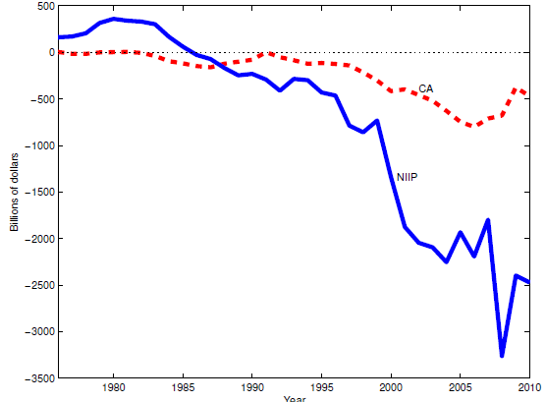
The US CA and NIIP
Source: www.bea.gov

Slide 22
National Savings and Investment Identity
Domestic Savings Domestic Investment
+ = +
Inflows of Foreign Capital Government Borrowing
S – I = NX
Trade deficit: an extra source of money flowing into the economy
an extra source of capital which can be borrowed
What are the possible causes of a current account deficit?
Supply of financial capital
Demand of financial capital

Slide 23
National Savings and Investment Identity(Cont.)
Domestic Savings Domestic Investment
+ = +
Inflows of Foreign Capital Government Borrowing
Possible causes for Current Account deficit:
Economy is running a large budget deficit ( in government borrowing)
A surge of domestic investments ( inflow of foreign investments)
A sharp drop in private savings rate ( inflow of foreign savings)
N!B! For the identity to hold, at least one should happen, or a combination of three
Conclusion: Macroeconomic factors are driving the trade deficits

Slide 24
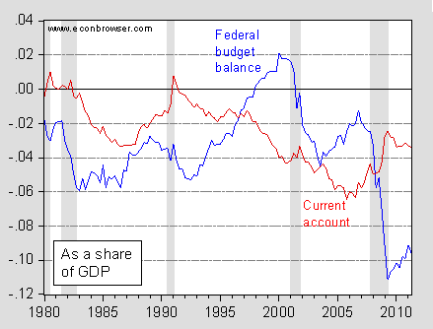

Slide 25
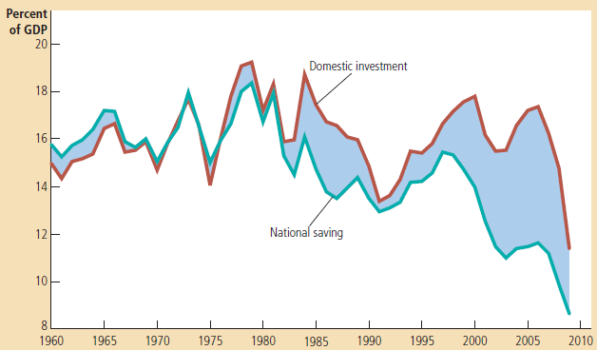
The US Net Capital Outflow
Source: Mankiw, 2011
=> Very low domestic savings in the US

Slide 26
Exchange Rate (ER)
A price of one currency in terms of another
Comparison of prices of goods/services produced in different countries
Two representation of ER
Direct (American): a price of foreign currency in terms of national currency
Exchange rate between CZK & US dollar: 1 USD = 18 CZK
Indirect (European): a price of national currency in terms of foreign currency
Exchange rate between CZK and US dollar: 1 CZK = 0.05 USD

Slide 27
The Foreign Exchange Market (FOREX)
Supply of CZK Demand for CZK
FOREX
Czech investors in the foreign markets
Foreign firms selling in the Czech market
Foreign investors in Czech Republic
Czech firms selling abroad (exporters)
Czech tourist travelling in the US
US tourists travelling to Czech Republic

Slide 28
The Foreign Exchange Market (Cont.)
Financial centers: London, New York, Japan, Frankfurt, and Singapore
The US dollar is a vehicle currency (80 % of foreign exchange)
Other major currencies: Euro and Japanese yen
Daily volume of FOREX is around 4 trillion USD
“Cross-rates”: exchange rates between non-dollar currencies
Major participants
Commercial banks: the exchange of deposits denominated in different currencies; interbank trading (90 %).
Corporations: making or receiving payments in different currencies
Central banks: foreign exchange interventions
Nonbank financial institutions: insurance companies, pension funds, etc.

Slide 29

Changes in Exchange Rates
TE The price of Levi’s jeans for Czech consumers
The exchange rate: 1 USD = 18 CZK
The price of Levi’s jeans in CZK
A NEW exchange rate: 1 USD = 15 CZK
A depreciation of USD against CZK (a fall in CZK price of the USD)
N! B! All else equal, a depreciation of a country’s currency makes its goods
cheaper for foreigners
$45

Slide 30
Changes in Exchange Rates (Cont.)
The exchange rate: 1 USD = 18 CZK
The price of Levi’s jeans in CZK
A NEW exchange rate: 1 USD = 20 CZK
=> An appreciation of the USD against CZK (an increase in CZK price of the USD)
N!B! All else equal, an appreciation of a country’s currency makes its goods
more expensive for foreigners
$45

Slide 31
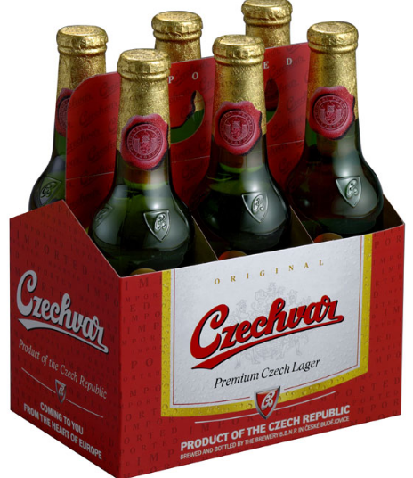
Changes in Exchange Rates (Cont.)
TE The price of Czech beer for American consumers
The exchange rate: 1 USD = 18 CZK
The price of Czech beer in the US dollars
A NEW exchange rate: 1 USD = 15 CZK
An appreciation of the CZK against the USD
The Czech beer becomes more expensive for the US consumers
100 CZK

Slide 32
Changes in Exchange Rates (Cont.)
TE The price of Czech beer for American consumers
The exchange rate: 1 USD = 18 CZK
The price of Czech beer in the US dollars
A NEW exchange rate: 1 USD = 20 CZK
A depreciation of the CZK against the USD
The Czech beer becomes cheaper for the US consumers
100 CZK

Slide 33

Winners and Losers
How do the exchange rate movements affect participants of FOREX?
 | Strong CZK (appreciation) | Weak CZK (depreciation)
A Czech tourist abroad
An American tourist in Czech Rep.
A foreign firm exporting to Czech Rep.
A Czech exporting firm
A foreign investor in Czech Rep.
A Czech investor abroad

Slide 34
Winners and Losers (Cont.)
N!B! The gain or loss from the exchange rate movements depends on whether you are a buyer or a seller!
Macroeconomic consequences
A strong currency encourages foreign investments
A strong currency causes a trade deficit : cheaper imports and expensive exports
A strong currency encourages the inflow of the foreign capital

Slide 35

Next class: The open economy (Cont.)
N!B! Reading Assignment: Textbook + Handout

