Slide 1
MACROECONOMICS I
Class 9. The Open Economy (Cont.)
April 25th, 2014

Slide 2
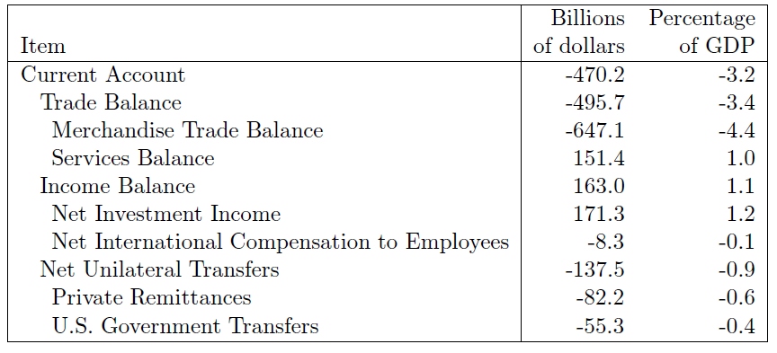
Krugman (2006). CSI: Trade Deficit
Where is the puzzle?
The U.S. Current Account, 2010
Source: www.bea.gov

Slide 3
Current Account Deficit: Review
Difference between exports and imports of goods and services of a country
Difference between national savings and investment
Capital-poor countries => low savings => CA deficit is ‘natural’
Is current account deficit bad?
(-)Liabilities to the rest of the world => Need to repay (solvency)
(+)Additional source of capital for domestic investment needs => faster GDP growth
Sustainability of CA deficit (USA, Australia, New Zealand, African countries)
Reversal of CA deficit : sharp reduction in CA deficit ( by 3 % of GDP in one year)
Sudden stop – abrupt and major reduction in capital flows to a country that has been receiving large volumes of foreign capital
Potential causes of the reversal: Overvalued real exchange rate; inadequate foreign exchange reserves; higher interest rates in industrial countries

Slide 4
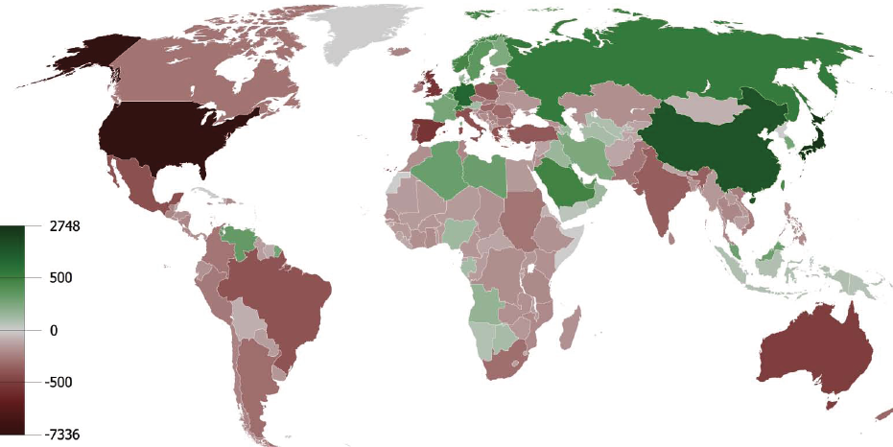
The sum of current account balances in billions of U.S. dollars, 1980 - 2008

Slide 5
Rating (2011) | Country | CA balance (billions USD)
1 | Saudi Arabia | 252
2 | Germany | 219
3 | Russia | 198
4 | China | 155
5 | UAE | 80
6 | Kuwait | 72
7 | Qatar | 72
187 | Australia | -57.1
188 | France | -57.2
189 | Canada | -62
190 | India | -91
191 | UK | -93
192 | USA | -440
Source: WTO, 2012

Slide 6
Rating (2011) | Country | CA balance (% of GDP)
1 | Brunei | 39
2 | Kuwait | 38
3 | Qatar | 29
4 | Azerbaijan | 20
187 | Zimbabwe | -20
188 | Burndi | -23
189 | Liberia | -31
190 | Mowambique | -40
Source: WTO, 2012

Slide 7
Exchange Rates: Review
A price of one currency in terms of another
Direct representation: a price of foreign currency in terms of national currency\
Changes in exchange rate
Depreciation/Devaluation of one currency against another currency
Appreciation/Revaluation of one currency against another currency
The gain or loss from the exchange rate movements depend on whether you are a buyer or a seller!

Slide 8
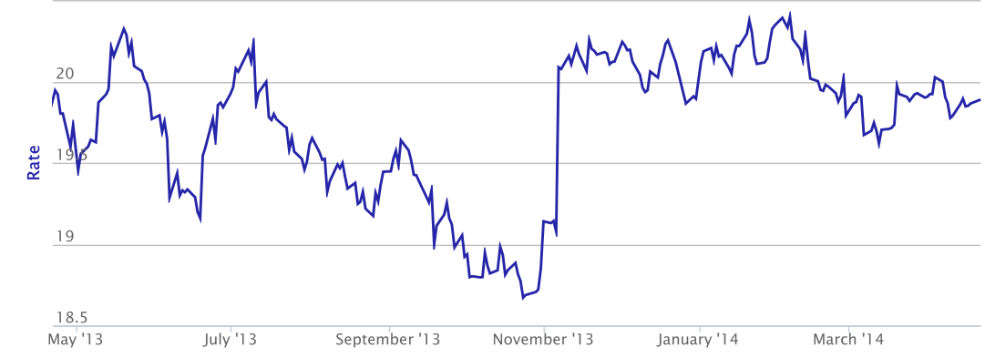
Exchange Rate USD/CZK Dynamics (1 year)
Source: Czech National Bank
Last year…
Is Czech Koruna appreciating/depreciating against the U.S. dollar?

Slide 9
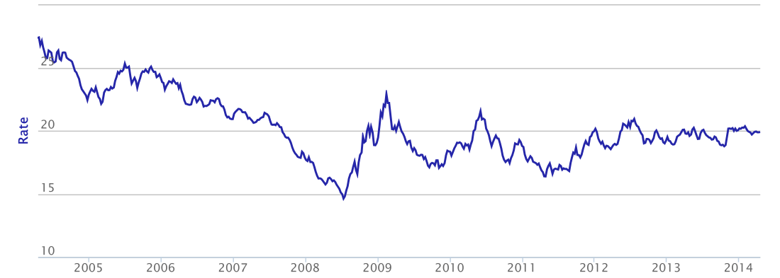
Exchange Rate USD/CZK Dynamics: 10 years
Source: Czech National Bank
Last 10 years…
Is Czech Koruna appreciating/depreciating against the U.S. dollar?

Slide 10

Winners and Losers
How do the exchange rate movements affect participants of FOREX?
 | Strong CZK (appreciation) | Weak CZK (depreciation)
A Czech tourist abroad
An American tourist in Czech Rep.
A foreign firm exporting to Czech Rep.
A Czech exporting firm
A foreign investor in Czech Rep.
A Czech investor abroad

Slide 11


Markets for Foreign Currency
Nominal exchange rate (23/04/2014): 1 € = 1.38 $ or 1$ = 0.72 €
Market for U.S. Dollars in Europe
Market for Euros in the U.S.
S$
S€
US residents
0.72
1.38
European residents
D€
D$
Q_{e}
Q$
Q_{e}
Q€
Exchange rate is driven by exports, imports, and capital flows

Slide 12

Exchange Rate in the Short Run
Changes in demand
Increase in the US household income => Increasing demand for imports
Increases in the European interest rate => Increasing demand for European assets
Inflation in the US =>
European goods are relatively cheaper
Speculations among US investors
about increase in the value of €
Market for Euros in the US
S€
1.5
1.38
Outcome: Appreciation of €
or
Depreciation of dollar
D`€
D€
Q_{e}
Q`_{e}
Q€

Slide 13
Exchange Rate in the Short Run(Cont.)
Changes in supply
Increase in European household income => Increasing demand for imports
Increases in the US interest rate => Increasing demand for American assets
Inflation in Europe=>
American goods are relatively cheaper
Speculations among European
investors about increase in the value
of $
Market for Euros in the US
S€
S`€
1.38
1.10
Outcome: Depreciation of €
or
Appreciation of USD
D€
Q_{e}
Q`_{e}
Q€

Slide 14
Macroeconomic Consequences
Expansionary monetary policy of the ECB => the EU interest rate ?
Market for US Dollars in Europe
Market for Euros in the US
S`$
S$
S€
0.90
0.72
1.38
1.10
D€
D$
D`€
Q`_{e}
Q_{e}
Q$
Q`_{e}
Q_{e}
Q€
IR_{Europe} => D€ => S$ => $ appreciates and € depreciates

Slide 15
Changes in Interest Rates (Cont.)
The effect of the expansionary monetary policy on the aggregate demand in EU?
M^{S} => i => C & I => Y
=> i => Euro depreciates => Exports & Imports => NE => Y
Effect for the US?

Slide 16
Currency Speculations (EU speculators)
Expectation that the value of a currency would increase/decrease in the future
Market for US Dollars in Europe
Market for Euros in the US
S$
S€
0.90
S`€
0.72
1.38
D`$
1.10
D€
D$
Q_{e}
Q`_{e}
Q$
Q`_{e}
Q_{e}
Q`_{e}
Q€
Expectation of value of $ => D$ => $ appreciates => S € => € depreciates

Slide 17
Currency Speculations: Consequences
The effect of speculations on the aggregate demand in the US?
USD appreciates => Exports & Imports => NE => Y
Effect for the EU economy?

Slide 18
Exchange Rate and the Government
Monetary policy tool
Foreign exchange interventions: the purchase and sale of currencies in FOREX by a country’s monetary authority (central bank)
Fixed (pegged)
Crawling peg
Flexible (floating)
Managed float (dirty float)
The ER target level
The ER target level is changed frequently
The ER in horizontal bands (hybrid)
The ER is determined by the market

Slide 19
Flexible Exchange Rate Regime
Free float: a market-determined exchange rate with no attempt of the government to influence its value
No explicit direct macroeconomic policy exchange rate target level
No institutional commitment to influence the path
The policy targets output and inflation
TE the US and the Euro area

Slide 20
Fixed Exchange Rate Regime
Fixed ER: Central bank is committed to maintain a particular exchange rate value and pegs this rate by means of interventions in the foreign exchange market
Central bank willingly trades currencies at a fixed exchange rate
Sources: Foreign exchange reserves

Slide 21
Fixed Exchange Rate Regime(Cont.)
Market for Euros in the US
S`€
S€
Government intervention: demands € at the fixed rate
1.38
1.10
D€
D`€
Q`_{e}
Q_{e}
Currency devaluation (depreciation)/ revaluation (appreciation)
Q€

Slide 22
Fixed Exchange Rate Regime(Cont.)
Potential Danger
The regime collapses when the central bank runs our of the foreign exchange reserve
Macroeconomic consequences: changes in money supply => ?
Sterilization (neutralization) of the negative impact of the foreign exchange interventions by open market interventions
Changes in interest rate and prices

Slide 23
Fixed Exchange Rate Regime(Cont.)
Sterilized vs. Non-sterilized foreign exchange interventions
TE Government intervention: Buying € out or circulation
Non-sterilized: M^{S} => i => Y
Prices
Sterilized: purchase or sale (?) of government bonds

Slide 24
Speculative Attacks on Currencies
A speculator is expecting the depreciation of the currency in the future
Possible under the fixed exchange rate regime
TE Thai baht
A fixed exchange rate between USD and Thai Baht maintained in Thailand
A speculator borrows 100 Thai baht
The exchange rate: 1 USD = 10 Thai baht
Speculators borrow baht and start selling them in exchange of USD
=> Pressure on Baht to depreciate
Thai government runs out of foreign reserves and allows baht to float => depreciation
New exchange rate: 1 USD = 20 Thai baht
Profit of speculators: $5
Possible when the interest rates on borrowing in Thailand are low
Immediate reaction to attack– increase in interest rates

Slide 25
Types of Fixed Regime
Currency board: all currency in circulation is backed by the government’s holding of foreign currency reserves
Anchor currency (stability and international acceptability)
TE Hong Kong: a fixed exchange rate 1 USD= 7.75 Hong Kong Dollars
Currency board as the monetary institution: printing money backed by USD
Central bank loses its monetary policy instrument
The money supply is determined by the balance of payment position
Interest rate and inflation in a currency board country are roughly the same as in anchor currency country
Objectives: fight inflation, stable macroeconomic environment without exchange rate risks.
Argentina 1991-2001 (USD) ; Estonia (1992-2011); Latvia since 1994 (basket); Bulgaria (since 1997)

Slide 26
Currency Board: Argentina
TE Argentina maintained the currency board during 1991-2002 keeping fixed exchange rate between peso and the USD
Starting from 1995, the USD sharply appreciated against other major currencies. What effect did the appreciation of the US dollar have on Argentina economy and on the market of Argentina export agricultural products (wheat and meet)?
Argentina abandoned the currency board in 2001 and made adjustment of its exchange rate. What type of adjustment (devaluation or revaluation of peso) in a situation of the US dollar appreciation you would recommend for Argentina after the end of the currency board regime?

Slide 27
Types of Fixed Regimes (Cont.)
Dollarization
A choice of a country to circulate the currency of another country as its sole legal tender, without a separate national currency
Reasons: hyperinflation or lack of credible institutions
TE Hyperinflation in Zimbabwe in 2007-2008
Monthly inflation rate 79,600,000,000 %
Withdrawal of the national currency from circulation and replacement by anchor currency from official reserves
Advantages:
Disadvantages:
Informal dollarization (currency substitution): a foreign currency is circulating in a country long with its domestic currency.

Slide 28
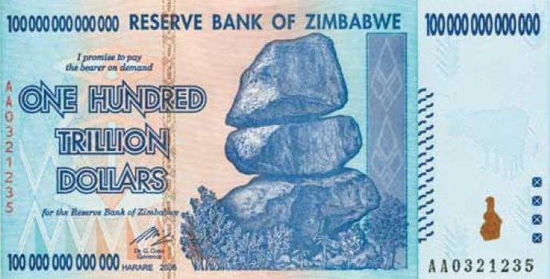
Hyperinflation in Zimbabwe in 2007

Slide 29
Managed Float (Dirty Pegg)
ECB wants to maintain a stable euro exchange rate in a range
Independent float with active interventions: Majority of developing countries
S€
1.45
1.40
1.27
1.10
D`€
D``€
D€
Market for Euros in the US
Q_{e}
Q`_{e}

Slide 30
CA Balance and Exchange Rate
Case study: China vs. USA
Currencies: Chinese Yuan and the US dollar
FOREX: a market for US dollar in China; a market for Yuan in the US.
The U.S. produce and export airplanes
China produces and exports smartphones.
US consumers buy Chinese smartphones and pay for them in dollars. Chinese enterprises or government buy American airplanes and pay for them in Yuan.

Slide 31
CA Balance and Exchange Rate (Cont.)
A U.S. consumer buys a Chinese smartphone for 200 dollars.
Illustrate graphically the effect of this purchase on FOREX.
What effect this purchase would have on the value of both currencies (appreciation /depreciation)?
***
Chinese Airlines purchase an airplane from the US at the price of 1.000.000 Yuan.
Illustrate graphically the effect of this purchase on FOREX.
What effect this purchase would have on the value of both currencies (appreciation/depreciation)?

Slide 32
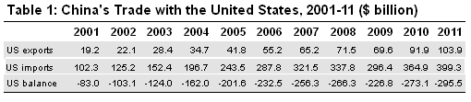
CA Balance and Exchange Rate (Cont.)
Using the table, provide evidence for the existence of trade imbalances in the US with China.
What effect such high and long-lasting demand for the Chinese imports from the US consumers should have on the FOREX and the values of the US dollar and Chinese Yuan? Is it really the case?

Slide 33
CA Balance and Exchange Rate (Cont.)
Explain what type of the foreign exchange market intervention by the Chinese government may contribute to sustaining a large trade deficit between China and the US. Hint: China is the largest foreign owner of the US government bonds.
If the exchange rate regime in the US and China was a free float (no government interventions), what would happened to the US trade deficit?

Slide 34
CA Balance and Exchange Rate (Cont.)
During 1994-2005, the exchange rate of the US dollar in China was fixed
1 USD =8.6 Yuan
During 2005-2007: 1 USD =6.2 Yuan.
Since that, the exchange rate remains unchanged
Economists claim that the Chinese currency must appreciate by 40 % in order to reflect real economic conditions.

Slide 35
Real Exchange Rate
Nominal ER: an amount of national currency you pay to get a unit of foreign currency
Real ER: unit of foreign item for the units of domestic item (competitiveness)
A rate at which we can trade goods and services of one country for that of another
Measuring RER by a simple representative good:
TE Price of French car is equal 10.000 Euros
Price of equivalent Japanese car is 2.800.000 yen
Comparing prices of two cars: converting into common currency
Nominal exchange rate: 1 euro = 140 yen
Price of French car = 1.400.000 yen
Price of Japanese car = 2.800.000 yen
=> One Japanese car = Two French cars

Slide 36
Real Exchange Rate (Cont.)
Measuring RER using a basket of representative goods
The overall price levels: P (home country) and P* (foreign country)
Real ER = Nominal ER (P*/ P)
Three determinants: P, P* and nominal ER
Aggregation to a national price level:
P_{CZK}- a price level in Czech Rep (in CZK)
P$ - a price level in the US (in $)
How many Czech baskets are needed to buy one US basket of goods
A real exchange rate appreciation and depreciation

Slide 37
The Exchange Rate in a Long Run
The Purchasing Power Parity (PPP) exchange rate
Equalizes the prices of traded goods across countries
A unit of any currency should buy the same amount of goods in all countries
The Law of One Price
In competitive markets, identical goods sold in different countries must sell for the same price expressed in terms of the same currency
No transportation costs and trade barriers (tariffs)
TE US dollar exchange rate w/r to CZK: 1 USD = 20 CZK
Levi’s jeans sold in the US for $ 45 should be sold in Czech Republic for 900 CZK
N!B! PPP is a hypothesis

Slide 38
The Exchange Rate in a Long Run (Cont.)
Arbitrage: buying goods in a cheap country and selling in expensive
TE A price of gold in New York is 100 USD per ounce
A price of gold in London is 100 EUROs per ounce
Existing exchange rate: 1 EURO = 1.3 USD
A person is buying gold in New York and sells it in London
100 EURO x 1.3 USD/EURO = 130 USD
Profit: 30 USD
In the long run: the prices of gold would adjust (be equalized in two locations)

Slide 39
The Purchasing Power Parity (PPP) ER
The World Bank International Comparison Program
A basket of internationally traded goods (oil, rice, TV sets, etc.)
The PPP ER: buying the same basket of goods with the same costs
If PPP holds, what is the real exchange rate?
The price levels are measured by CPI or GDP Deflator

Slide 40
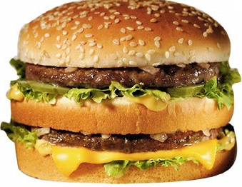
The Big Mac Index: Testing the Law of One Price
Constructed by The Economist since 1986
The Big Mac PPP
The ER that makes burgers cost the same everywhere
TE A Big Mac price in China: 10.5 Yuan /burger
A Big Mac price in the US: 3.1 USD/burger
The implied PPP:
The market exchange rate
Conclusion: The Yuan is 58 % “undervalued” against the dollar

Slide 41
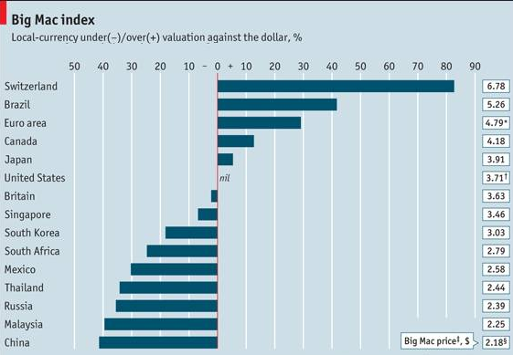
Overvalued currencies
Undervalued currencies
Source: The Economist, 2010

Slide 42

Next class: Financial crises
N!B! Reading Assignment: Textbook + Handout
Watch for the Homework #3!

