Slide 1
Installation of MS Dynamics NAV 2009
Concise installation manual

Slide 2
Location of the resource files
Using eduroam connection- 8-10 minutes
https:/is.muni.cz/auth/do/econ/soubory/katedry/kph/MS_Dynamics_NAV.7z
For installation of MS Dynamics NAV 2009 R2 see next slide and following slides (recomended!!!)
From PC in computer rooms)
programs(\\esetw) (Q:) MS_Dynamics_NAV\ .. all files in this directory (folder)
OR
programs(\\nas01) (Q:) MS_Dynamics_NAV\ .. all files in this directory (folder)
approx size of the files : 2 GB

Slide 3
Installation MS Dynamics NAV 2009 R2
https://is.muni.cz/auth/do/econ/sm/42726033/43203933/MS_NAV_2009_R2_An.zip
https://is.muni.cz/auth/do/econ/sm/42726033/43203933/MS_NAV_2009_R2_Cz.zip
After upload of the files with English versions of MS Dynamics NAV
After unzip operation See next slide please

Slide 4
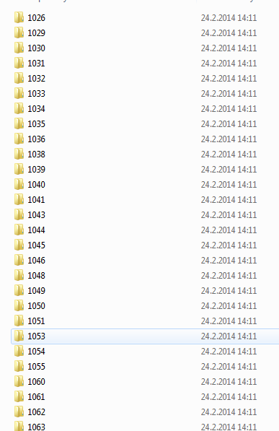
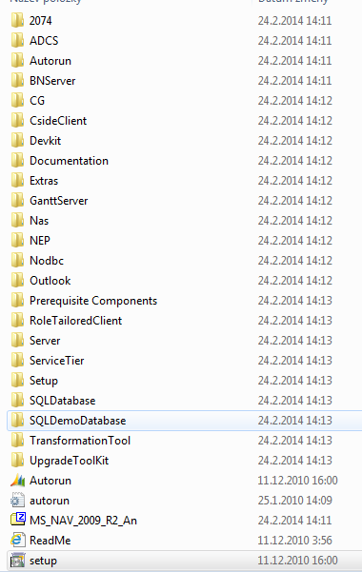
Installation I.
You will se all these folders in the folder to where you extracted (unziped ) all files)

Slide 5
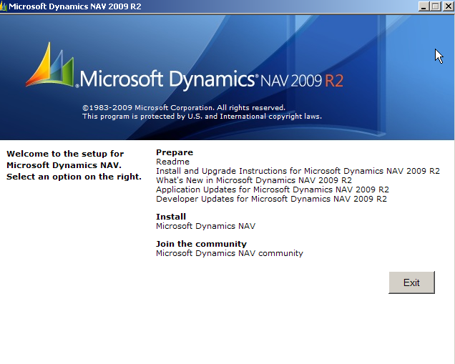
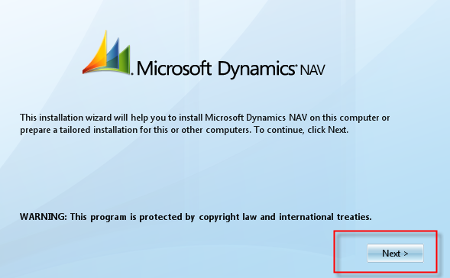
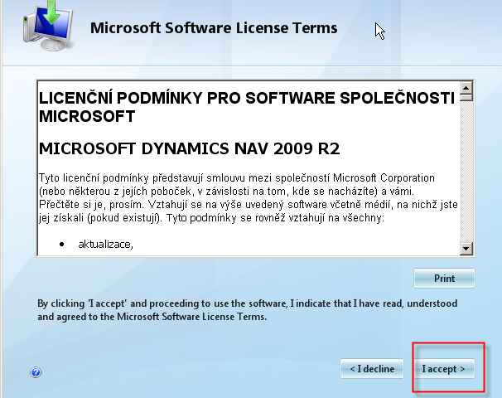
Installation II.

Slide 6
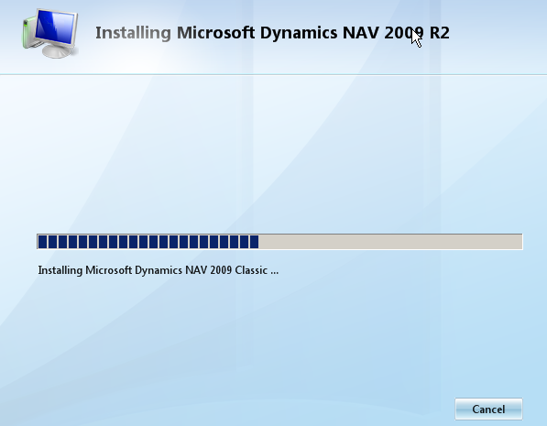
Installation III.

Slide 7
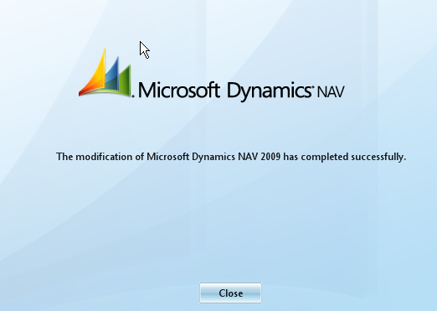
Installation IV.

Slide 8
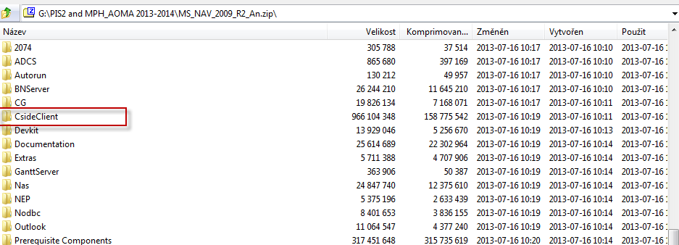
Installation V.
Another possibility to install :
You have firstly unwrap CsideClient subdirectory to prepared empty folder

Slide 9
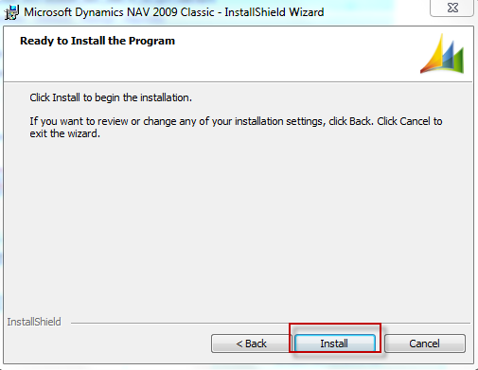
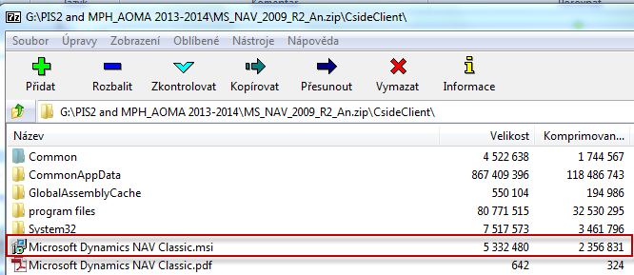
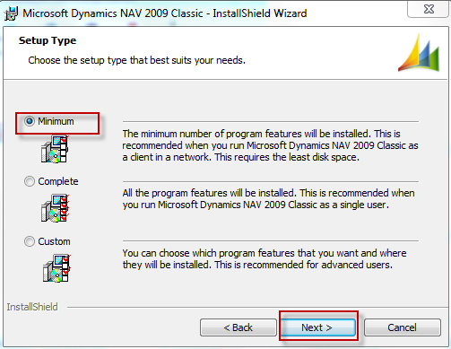
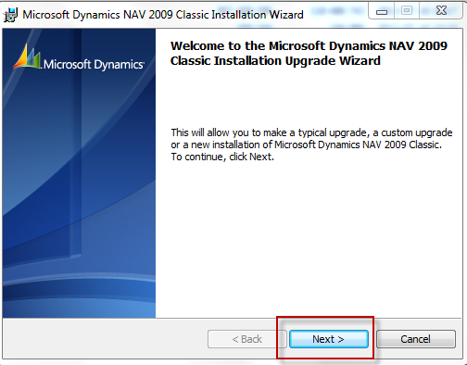
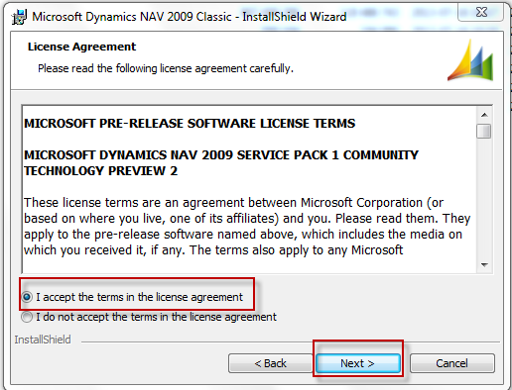
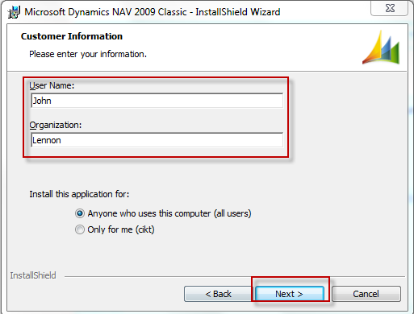
Installation MS Dynamics NAV 2009 R2
Copy of CsideClient in
prepared folder
Option Minimum means Typical

Slide 10
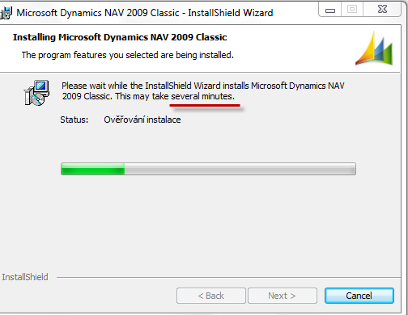
Installation MS Dynamics NAV 2009 R2
Checking installation

Slide 11
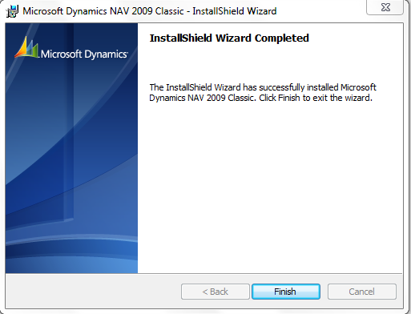
Installation MS Dynamics NAV 2009 R2

Slide 12
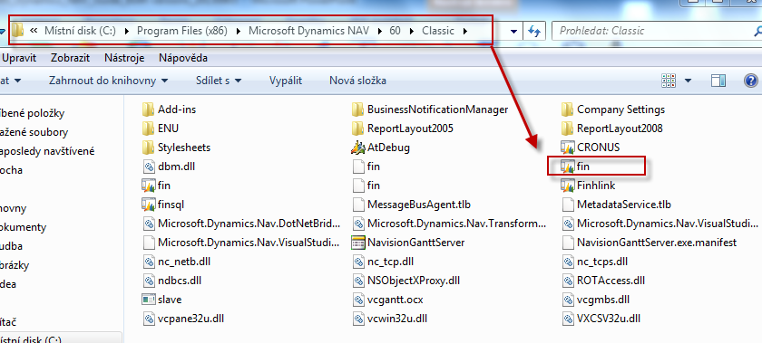
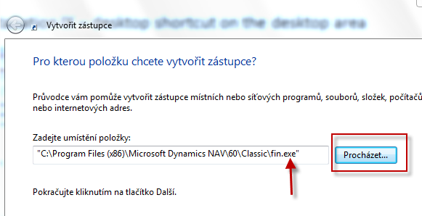
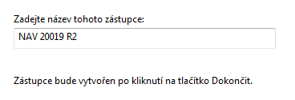
Installation MS Dynamics NAV 2009 R2
Installation IX – desktop shortcut on the desktop area
Right mouse button on desktop area find by browsing fin.exe file specified
Named it
Finish it
Browse

