Slide 1
MPV_COMA Communication and Managerial Skills Training
Seminar 4
Ing. Daria Borovko

Slide 2
Content
Negotiation
  Preparation
  The Persuasion Tools Model
Communication at workplace
Intercultural communication
  Cultural dimensions
  Cultural orientation
  Cultural awareness
  Stereotypes

Slide 3
Negotiation
a careful exploration of your position and the other person's position, with the goal of finding a mutually acceptable compromise that gives you both as much of what you want as possible.
People's positions are rarely as fundamentally opposed as they may initially appear
Source: http://www.mindtools.com/CommSkll/NegotiationSkills.htm

Slide 4
Negotiation: Preparation
Goals
Trades
Alternatives
Relationships
Expected outcomes
The consequences
Power
Possible solutions
Source: http://www.mindtools.com/CommSkll/NegotiationSkills.htm

Slide 5
Negotiation: Preparation
Goals:
  What do you want to get out of the negotiation?
  What do you think the other person wants?
Trades:
  What do you each have that the other wants?
  What are you each comfortable giving away?
Alternatives:
  What alternatives do you have if you don’t reach agreement? Are these good or bad?
  How much does it matter if you do not reach agreement?
  Does failure to reach an agreement cut you out of future opportunities?
  And what alternatives might the other person have?
Source: http://www.mindtools.com/CommSkll/NegotiationSkills.htm

Slide 6
Negotiation: Preparation
Relationships:
  What is the history of the relationship?
  Could or should this history impact the negotiation?
  Will there be any hidden issues that my influence the negotiation?
  How will you handle these?
Expected outcomes:
  What outcome will people be expecting from this negotiation?
  What has the outcome been in the past, and what precedents have been set?
The consequences:
  What are the consequences for you of winning or losing this negotiation?
  What are the consequences for the other person?
Source: http://www.mindtools.com/CommSkll/NegotiationSkills.htm

Slide 7
Negotiation: Preparation
Power:
  Who has what power in the relationship?
  Who controls resources?
  Who stands to lose the most if agreement isn't reached?
Possible solutions:
  Based on all of the considerations, what possible compromises might there be?
Source: http://www.mindtools.com/CommSkll/NegotiationSkills.htm

Slide 8
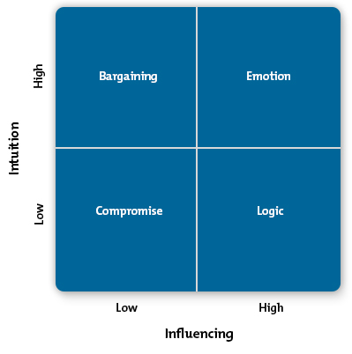
Negotiation
The Persuasion Tools Model
Source: http://www.mindtools.com/pages/article/newCS_80.htm

Slide 9
Communication at workplace
Word games
Rumors

Slide 10
Intercultural communication
"Culture is more often a source of conflict than of synergy. Cultural differences are a nuisance at best and often a disaster.„
G.Hofstede.

Slide 11
Intercultural communication
Hofstede's cultural dimensions
Power Distance Index (PDI)
Individualism versus Collectivism (IDV)
Masculinity versus Femininity (MAS)
Pragmatic versus Normative (PRA)
Indulgence versus Restraint (IND)

Slide 12
Intercultural communication
Hofstede's cultural dimensions
Power Distance Index (PDI)
  – the degree to which the less powerful members of a society accept and expect that power is distributed unequally.
Application:
In a high PD country such as Malaysia, you would probably send reports only to top management and have closed-door meetings where only select powerful leaders were in attendance.

Slide 13
PD | Characteristics | Tips
High PD | Centralized companies. Strong hierarchies. Large gaps in compensation, authority, and respect. | Acknowledge a leader's power. Be aware that you may need to go to the top for answers
Low PD | Flatter organizations. Supervisors and employees are considered almost as equals. | Use teamwork. Involve as many people as possible in decision making.

Slide 14
Intercultural communication
Hofstede's cultural dimensions
Individualism versus Collectivism (IDV)
  refers to the strength of the ties people have to others within the community.
  Application:
  Central American countries (low IDV) – a marketing campaign that emphasized benefits to the community or that tied into a popular political movement would likely be understood and well received.

Slide 15
IDV | Characteristics | Tips
High IDV | High valuation on people's time and their need for freedom. An enjoyment of challenges, and an expectation of rewards for hard work. Respect for privacy. | Acknowledge accomplishments. Don't ask for too much personal information. Encourage debate and expression of own ideas.
Low IDV | Emphasis on building skills and becoming masters of something. Work for intrinsic rewards. Harmony more important than honesty. | Show respect for age and wisdom. Suppress feelings and emotions to work in harmony. Respect traditions and introduce change slowly.

Slide 16
Intercultural communication
Hofstede's cultural dimensions
Masculinity versus Femininity (MAS)
  refers to how much a society sticks with, and values, traditional male and female roles.
Application:
If you were to open an office in Japan (high MAS), you might have greater success if you have a strong male contingent on the team.
In Sweden (low MAS), on the other hand, you would aim for a team that was balanced in terms of skill rather than gender.

Slide 17
MAS | Characteristics | Tips
High MAS | Men are masculine and women are feminine. There is a well defined distinction between men's work and women's work. | Be aware that people may expect male and female roles to be distinct. Advise men to avoid discussing emotions or making emotionally based decisions or arguments.
Low MAS | A woman can do anything a man can do. Powerful and successful women are admired and respected. | Avoid an "old boys' club" mentality. Ensure job design and practices are not discriminatory to either gender. Treat men and women equally.

Slide 18
Intercultural communication
Hofstede's cultural dimensions
Uncertainty Avoidance Index (UAI)
  the degree to which the members of a society feel uncomfortable with uncertainty and ambiguity.
Application:
when discussing a project with people in Belgium (high UAI), you should investigate the various options and then present a limited number of choices, but have very detailed information available on your contingency and risk plans.

Slide 19
UAI | Characteristics | Tips
High UAI | Very formal business conduct with lots of rules and policies. Need and expect structure. Sense of nervousness spurns high levels of emotion and expression. Differences are avoided. | Be clear and concise about your expectations and parameters. Plan and prepare, communicate often and early, provide detailed plans, and focus on the tactical aspects of a job or project. Express your emotions through hand gestures and raised voices.
Low UAI | Informal business attitude. More concern with long term strategy than what is happening on a daily basis. Accepting of change and risk. | Do not impose rules or structure unnecessarily. Minimize your emotional response by being calm and contemplating situations before speaking. Express curiosity when you discover differences.

Slide 20
Intercultural communication
Hofstede's cultural dimensions
Pragmatic versus Normative (PRA)
describes how people relate to the fact that so much that happens around us cannot be explained.
Application:
people in the U.S. and U.K. don't value tradition as much as many others, and are therefore likely to be willing to help you execute the most innovative plans as long as they get to participate fully

Slide 21
LTO | Characteristics | Tips
High LTO Long Term Orientation (Normative) | Family is the basis of society. Parents and men have more authority than young people and women. Strong work ethic. High value placed on education and training. | Show respect for traditions. Do not display extravagance or act frivolously. Reward perseverance, loyalty, and commitment. Avoid doing anything that would cause another to "lose face."
Low LTO (Pragmatic) | Promotion of equality. High creativity, individualism. Treat others as you would like to be treated. Self-actualization is sought. | Expect to live by the same standards and rules you create. Be respectful of others. Do not hesitate to introduce necessary changes.

Slide 22
Intercultural communication
Hofstede's cultural dimensions
Indulgence versus Restraint (IND)
  Indulgence – allowing relatively free gratification of basic drives related to enjoying life and having fun.
  Restraint – suppressing gratification of needs and regulates it by means of strict social norms.

Slide 23
Intercultural communication Cultural Differences
Orientation to time
Monochronic/polychronic
Context of communication
High-context/low-context
Future vs Present vs Past Orientation

Slide 24
Intercultural communication Orientation to time
Monochronic
Polychronic
Tend to do one thing at a time
Are not easily distracted
Commit to work
Place importance on deadlines
Stick to plans
Value and respect privacy
Do several things at the same time
Are sensitive to distractions
Commit to relationships
Place less importance on deadlines
Change plans often and easily
Value connection

Slide 25
Intercultural communication Context of communication
Low-context
High-context
things are fully (though concisely) spelled out
things are made explicit
more responsibility is placed on the listener
communication is much more is implicit or communicated in indirect ways
vulnerable to communication breakdowns

Slide 26
Intercultural communication
Future vs Present vs Past Orientation
Past-oriented cultures
  tradition
  direct their efforts and resources and invest them in what already exists.
  prefer old age to youth
Present-oriented cultures
  prefer short-term benefits and immediate results
Future-oriented cultures
  more abstract, more imaginative, more creative
  invest efforts and resources in an ephemeral vision
  more likely to have a youth cult

Slide 27
Intercultural communication
Cultural Awareness
What values does this culture embrace? How do those values compare with those of your culture?
How do people make decisions, conduct relationships, and display emotion?
How does this culture treat time and scheduling?
What are the social rules and boundaries surrounding gender?
How does this culture display and respect power? Which authority figures are revered?
How do individuals relate to their employers?
How do people in this culture communicate? How direct are they in what they say and mean?

Slide 28
Intercultural communication
Common Cross-Cultural Mistakes
Food
  talking during a meal
  how much you eat
  eating habits
Body Language and Gestures
Clothing and Color
  removing your shoes before entering a home
  Attention to clothing
  Color of clothing
Personal Space

Slide 29

Intercultural communication Quiz on Intercultural Competence
Laughter in Japan can be a sign of confusion, insecurity or embarrassment true or false?
True

Slide 30
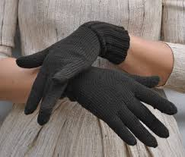
Intercultural communication Quiz on Intercultural Competence
Wearing gloves in Russia when shaking hands is considered polite true or false?
False

Slide 31
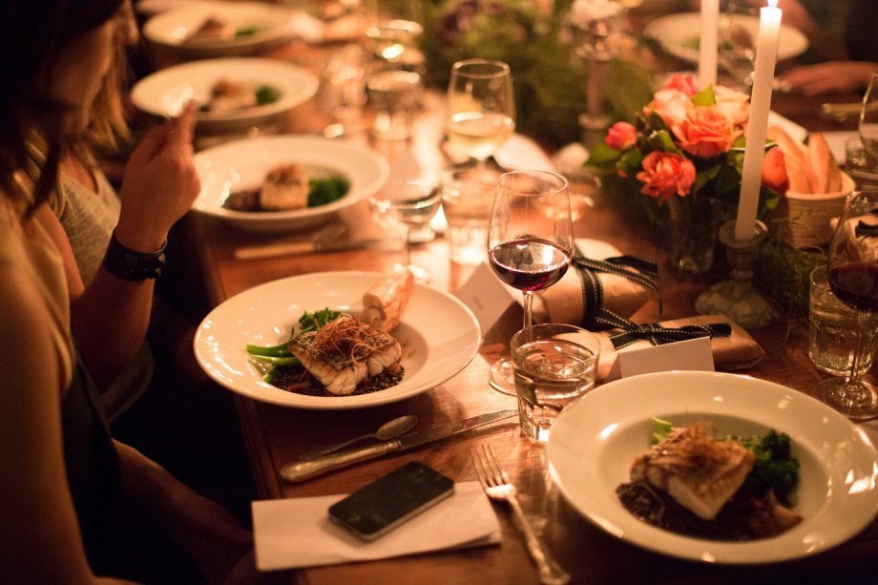
Intercultural communication Quiz on Intercultural Competence
Leaving right after dinner in Central America is considered well-mannered as it means you’ve been well fed true or false?
True

Slide 32
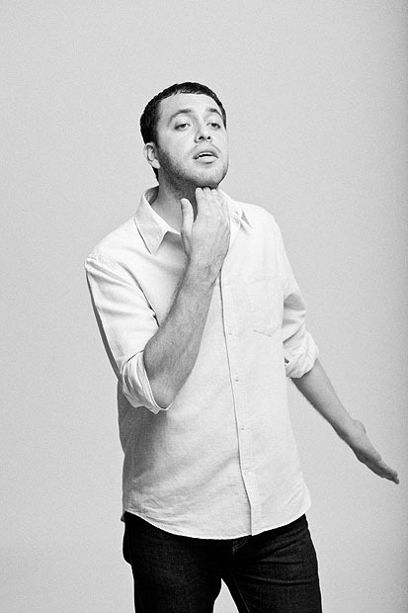
Intercultural communication Quiz on Intercultural Competence
In Brazil, flicking your fingers under your chin is a sign of disgust true or false?
False

Slide 33

Intercultural communication Quiz on Intercultural Competence
If you want to show your respect for an elder in Africa, do not look them directly in the eye true or false?
True

Slide 34
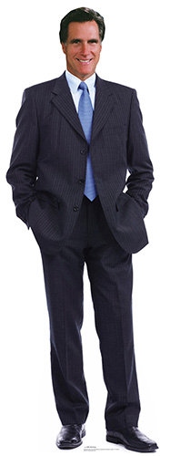
Intercultural communication Quiz on Intercultural Competence
Keeping your hands in your pockets while negotiating in Russia is rude true or false?
True

Slide 35
Intercultural communication
Gestures
Gestures across cultures
http://www.youtube.com/watch?v=pxoB6MhmbIg

Slide 36
Intercultural communication Stereotypes
Prejudice -> Stereotypes -> Discrimination
Prejudice – an opinion or judgment formed without sufficient examination/ before becoming aware of the relevant facts of a case.
Stereotype – a thought that may be adopted about specific types of individuals or certain ways of doing things
Discrimination – prejudicial treatment of an individual based on their actual or perceived membership in a certain group or category

Slide 37
Intercultural communication Stereotypes
Cultural Diversity Examples: Avoid Stereotypes while communicating
http://www.youtube.com/watch?v=XUO59Emi3eo

Slide 38
Sources (negotiation part):
Win win negotiation
http://www.mindtools.com/CommSkll/NegotiationSkills.htm
The Persuasion Tools Model
http://www.mindtools.com/pages/article/newCS_80.htm

Slide 39
Sources (intercultural communication part):
The Hofstede Centre
http://geert-hofstede.com/dimensions.html
Hofstede's Cultural Dimensions
http://www.mindtools.com/pages/article/newLDR_66.htm
Avoiding Cross-Cultural Faux Pas
http://www.mindtools.com/pages/article/cross-cultural-mistakes.htm
Quiz on Intercultural Competence
https://suite101.com/a/quiz-on-intercultural-competence-a24543

Slide 40
Thank you for attention!

