Slide 1
Introduction to MS Dynamics NAV IX. (Transfers Orders)
Ing.J.Skorkovský,CSc.
MASARYK UNIVERSITY BRNO, Czech Republic
Faculty of economics and business administration
Department of corporate economy

Slide 2
Transfers and locations
Benefits
  Direct control of transfers : where (locations )do we have what (items) at any moment..
  Responsibility of workers in warehouse (Pickers and Pullers)
  Responsibility of drivers
  Setup enables item tracking (batches, lots)
  Better calculation of transport times due to specification of inbound and outbound handling times as well as time of delivery depending on setup of shipping agent services

Slide 3
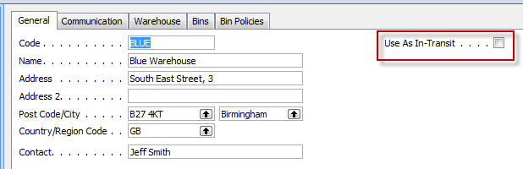
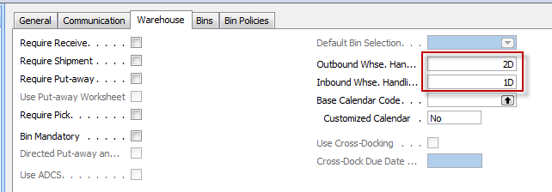
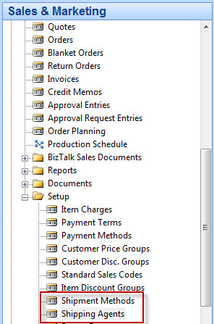
Locations and setup shipment

Slide 4
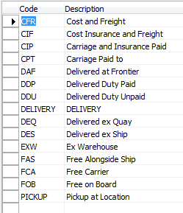


Setup shipment
Shipment methods
Shipment agents

Slide 5
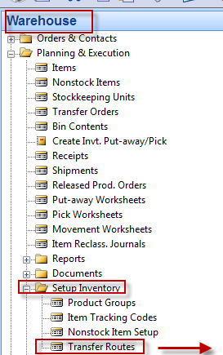
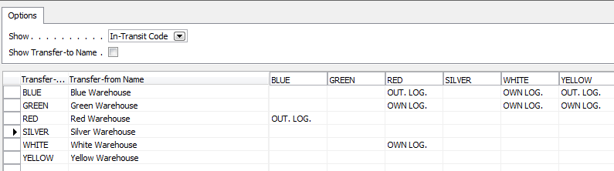
Agent services and Transfer routes
Agent services
Transfer Routes

Slide 6
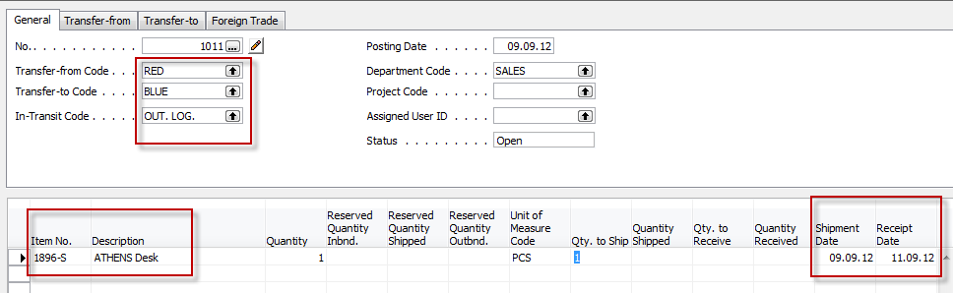
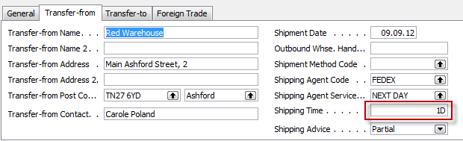
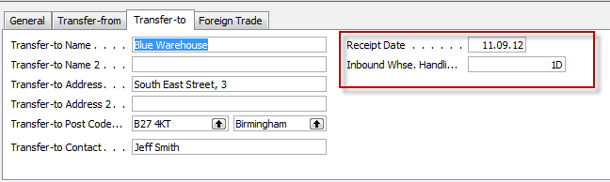
Transfer order
Next day (1 D ) + Inbound Whse.Handling Time (1D) =2D ->9.9.12+2D=11.9.2012

Slide 7
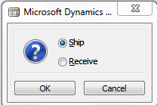
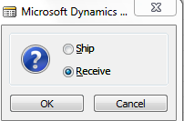
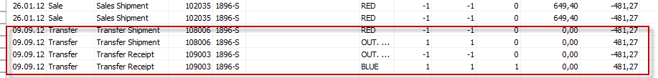
Posting TO (2 times F11)
Item Ledger Entries
The time is same instead of having two dates 9.9.12 and 11.9.12. The reason
is as follows : both movement were posted same date !!

Slide 8
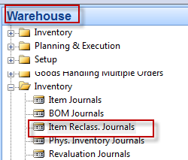
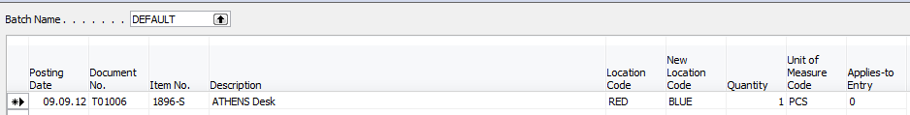
Transfer by use of Item Reclass.Journal
F11
Item Ledger Entries

Slide 9

End of the section IX.

