Slide 1


Tasks, problems and real South African project
Masaryk University
Faculty of Economics and Administration,
Department of Corporate Economy
Ing.J.Skorkovský,CSc.

Slide 2
Your main task (not organised set of processes)
Load-despatch
Purchase Order
Reporting
Statistics
Consumption registration
Production Output registration
Inventory value
calculation
Output check
Delivery
Production Planning
Sales Order
Component replenishment
Transfer
to
Production
Put-away
Cross-docking
Input check
Finished
goods to
Inventory
Picking from
Inventory
Invoicing
Payment

Slide 3
Your main task (organised set of processes)
Sales Order
Production Planning
Component replenishment
Purchase Order
Input check
Consumption registration
Transfer
to
Production
Picking from
Inventory
Inventory value
calculation
Put-away
Production Output registration
Inventory value
calculation
Cross-docking
Finished
goods to
Inventory
Load-despatch
Payment to
Vendor
Inventory value
calculation
Shipment
Invoicing
Output check
Payment from
Customer
Reporting
Statistics

Slide 4





Your main task (possible problems, bottlenecks,..)
Sales Order
Production Planning
Component replenishment
Purchase Order
Input check
Consumption registration
Transfer
to
Production
Picking from
Inventory
Inventory value
calculation
Put-away
Production Output registration
Inventory value
calculation
Cross-docking
Finished
goods to
Inventory
Load-despatch
Payment to
Vendor
Inventory value
calculation
Shipment
Invoicing
Output check
Payment from
Customer
Reporting
Statistics

Slide 5

Your main task
Search - HOW ??? Measure impacts –HOW ??? and Destroy – HOW ??? And improve - HOW ???
Cause->Effect relations

Slide 6
Methods (not sorted so far )
Theory of Constraints
Critical Chain (DBR)
Ishikawa Fishbone Diagram (Total Quality Management)
Pareto Analysis , ABC, EOQ, Six Sigma and Ishikawa
OLAP (On-Line Analytic Processing)
Kepner –Tregoe methodology
MaxMax and MaxMin (Hurwitz)
SWOT, BOSTON and Gartner Magic matrices
ERP Statistics and Reporting
Little´s law
Yield Management
Linear programming
Balanced Scorecard
Production algorithms (MRP,MRP-II, JIT,APS)
And many, many more…..

Slide 7
BS and OM
BS and OM – slide from Balanced Scorecard show (will be presented again in BS context)
Finances – how should we look to our shareholders ?
Customers – how should we look to our customer ?
Processes – at which business processes must we excel ?
Learning and Growing – how will we sustain our ability to change and improve ?
Project management
Theory of constraints
Production
Linear programming
Total quality
management
Product postitioning
Business Intelligence
Workflow
Critical chain
Drum –buffer-rope
MRP-MRP-II,JIT,APS
Cutting, blending
Pareto, ishikawa
Boston Matrix
Gartner QM
Decision
making
CONWIP
Logistics
Yield management
Kepner-Tregoe
EOQ, ABC
Hurviwtz
Little´s law
Prospect theory
Notes:
To show methods, area of use and grouping of these methods

Slide 8



Simplified diagram of ERP usage
DB
ERP
Transaction = Entries
Partners
ERP
Information
Information
(trends)
Enterprise
Reports
Forms
Decision
Knowledge of methods for process management and used metrics
Key decision
Key knowledge

Slide 9


Basic problem I. (one of many)
..and at the same
time a minimum information which could be used for decision making !!!!
We have
a huge data
quantity

Slide 10
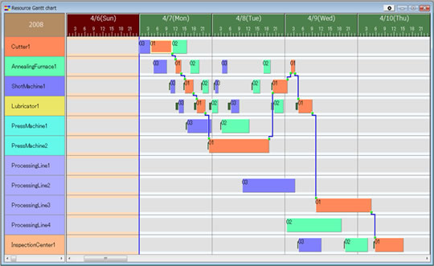



Basic problem II. (we need reliable data )
To solve it we should use finite capacity scheduling (APS)- will be presented later
T1+T2=X
Opt=Min(X)
T2
Op1
T2 = 0
Op1
Op2
Op2
Op3
Op3
T1 = 0
T1

Slide 11
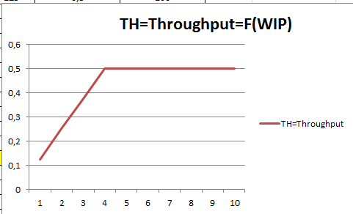
Basic problem III.
Will be explained in Little´s law presentation

Slide 12
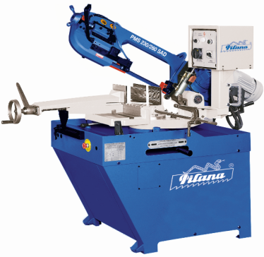
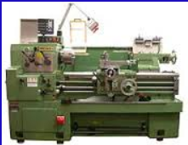
Basic problem IV.
Black
White
White
Black
(Black ->White, Setup time=60 minut)
(White->Black, Setup time = 20 minut)

Slide 13
Basic problem V-I.(availability of components)
Op1
A0
20 pcs A7 and 20 pcsA8
A1
A2
Op2
10 pcs A4 adn 10 pcs A5
(will be delivered in T1+X time )
A3
T0
Lead time A6
Op3
A4
A5
T1
A6
Op1
A7
A8
X= slack
Op2
T1
T1+X
Op3

Slide 14
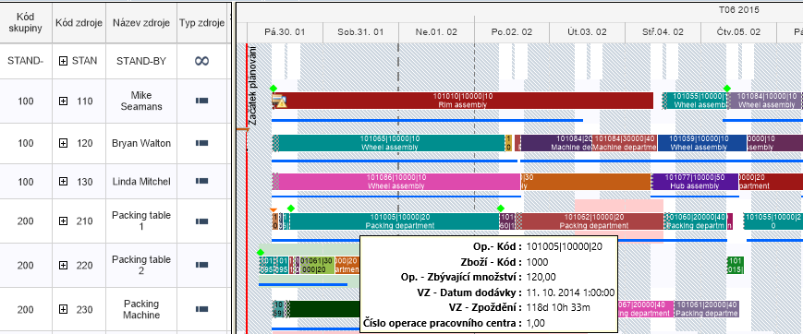
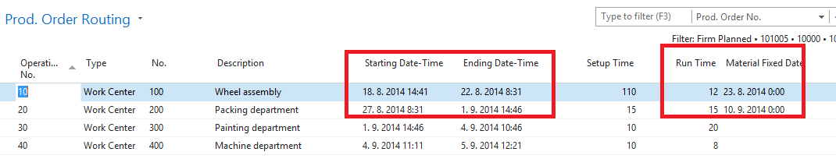
Basic problem V-II. (availability of components )
APS result ->18.8.->23.8. a 27.8.->10.9

Slide 15
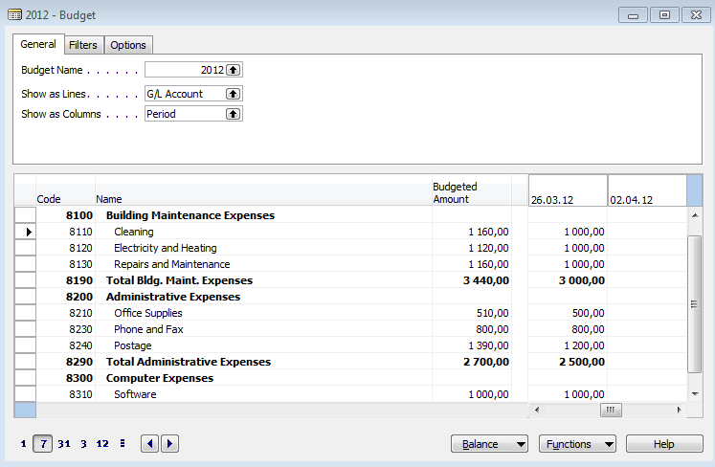
Basic problem VI-I. (over budget)

Slide 16
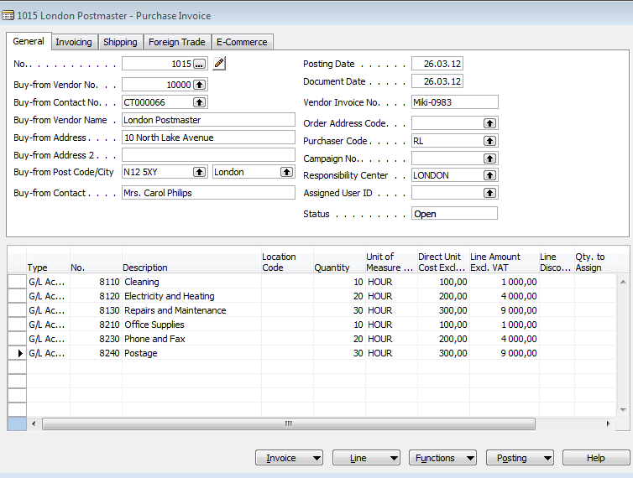
Basic problem VI-II. (over budget)

Slide 17
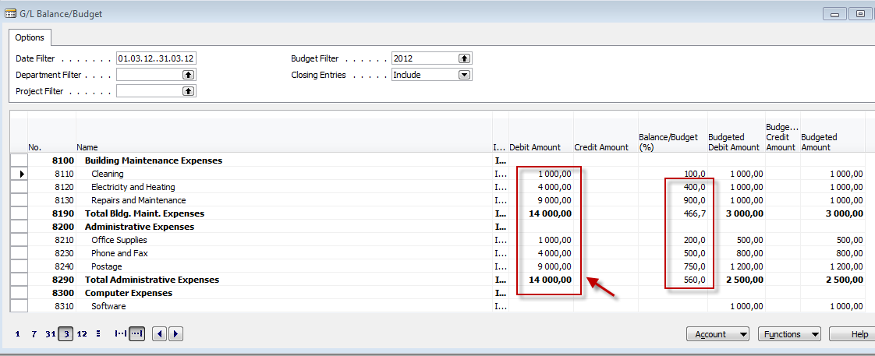
Basic problem VI-III. (over budget)

Slide 18
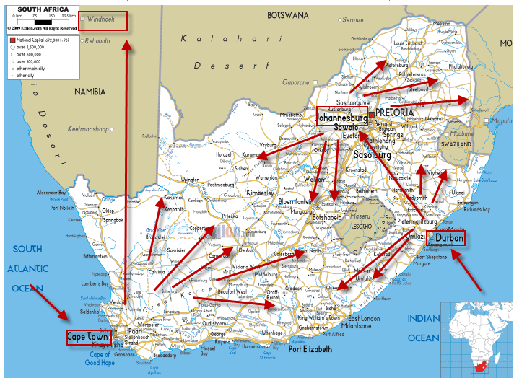
Wholesale-paper-warehouse management-ERP

Slide 19
Basic business specification
100 000 Tones per Year
Carbonless papers
Cast coated papers and Board
Coated papers
House brands
Office papers
5000 locations in HQ and 40 000 M2 warehousing space
50000 customers
90 vehicles
FEC trading (Forward Exchange Contracts)
Hundreds of employees
Heterogeneous IT system with every day synchronization of data in HQ and subsidiaries
High volume-low margin type of business
Products

Slide 20
Basic requirement
One database only (MS SQL)
Modern IT technology ensuring :
  Fast access to data providing on-line information any time
  Easy upgrades
  Mobile technologies (BAR code readers,..)
  Quick response to business partner requirements
  Multidimensional analytic tool->reporting to support decision making process
  Efficient warehousing (inbound and outbound operations)
  On-line reporting (warehouse status, accounting, cost control,…..)

Slide 21
Isolated Data Islands
Marketing
& Sales
Islands
Accounting
Island
Marketing
Management
Production
Island
Customer
Orders
Accounting
Sales Representatives
Customers
Banks
Replenishment planning - Vendors
Island of
Deliveries
Quality
Management
Island
Quality Management
Inventory -warehousing
21

Slide 22
One Solution One Database All Microsoft
Management
Marketing
Warehouse
(pickers and pullers)
Customer
support
Internal Sales
(paper shop)
Reporting
One Company
Database
Accounting
Sales Representatives
Customers
Credit limits, rebates, consignment stock
FEC, transport,..
Purchase-Vendors
Shareholders
Planning

Slide 23
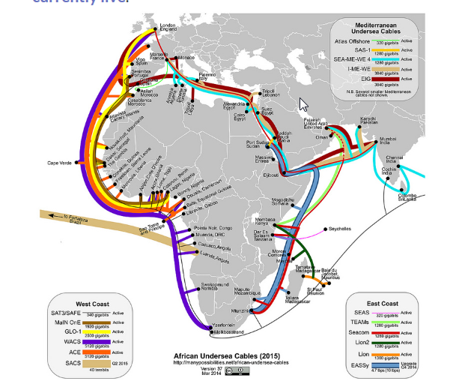
Communications limits (band width, stable connection…)

Slide 24
Efficient warehousing –(only a few examples)
Receipt bins (area where lorries are unloaded)
Put-away to bins (racks) based on zones definition
Capacities of the bins (racks) – (weight, size)
Cross docking (from inbound are directly to outbound area)
Transfer between location (HQ and subsidiaries)
Picking slips (from rack to shipment area)
Shipments area (bins, cages)
Transport planning
Credit limits and overdue payment check
Invoices, Credit memos,….
Claim management

Slide 25
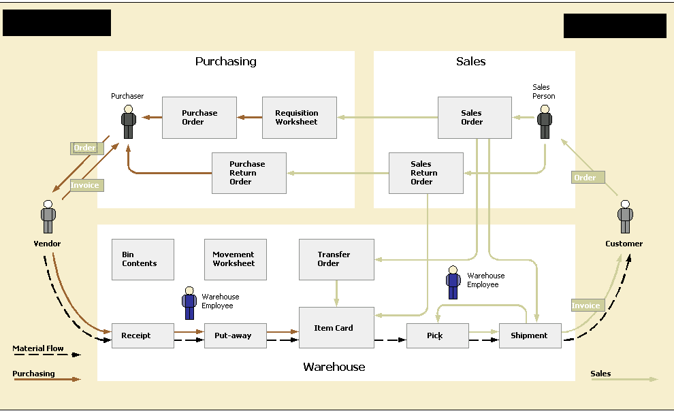
Warehousing

Slide 26
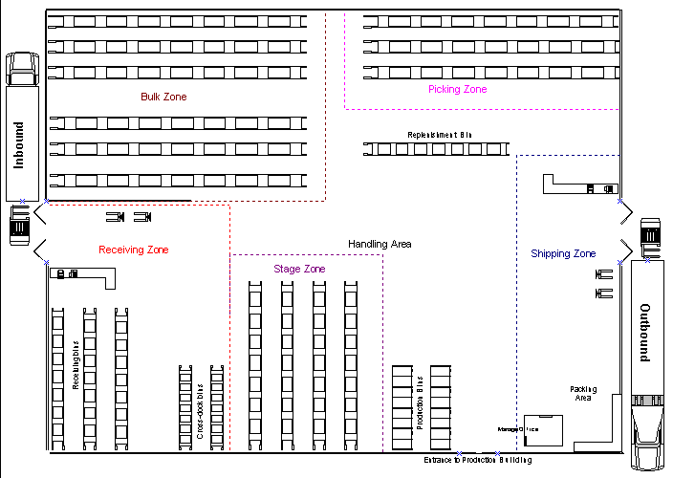
Warehousing

Slide 27
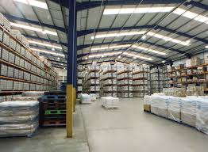

Slide 28
Project management
Project Management
Budget <->Quote and contract
Planning of resources and task control
Planning tools – see following slides
Reporting (time-capacity usage, costs,…)
Change management
Project Risks
Consignment stock
CPM,PERT,CCPM – will be mentioned later

Slide 29
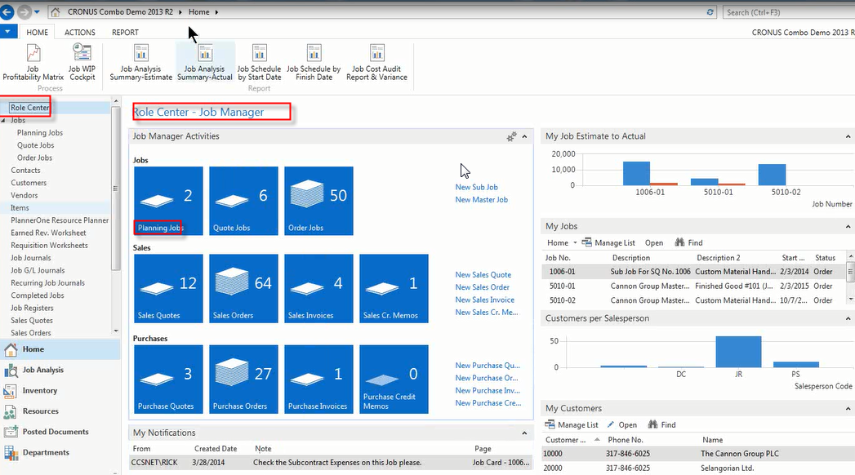
Resource Planner tool
Notes:
See web site www.plannerone.com

Slide 30
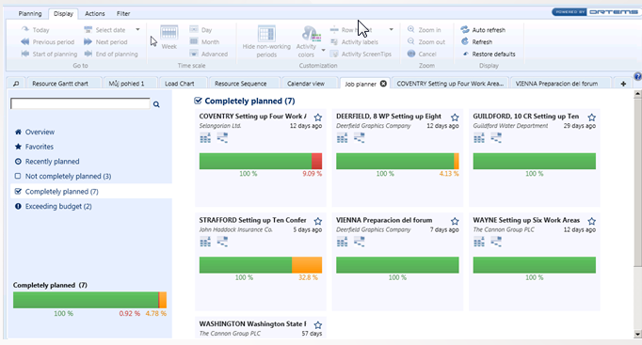
Resource Planner tool
Notes:
See web site www.plannerone.com

Slide 31
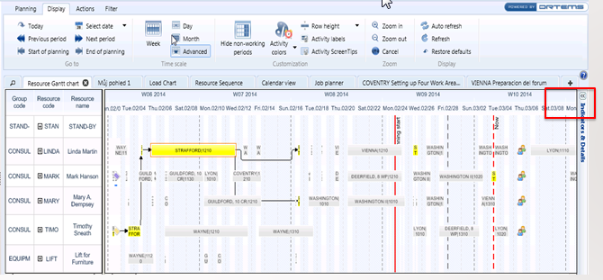
Resource Planner tool

Slide 32
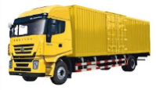
Consignment stock (benefits)
= palette
Requests
Customer
Wholesaler
Transfer
Customer
Remaining
stock
Partial invoice after 1 month
(one palette)
Wholesaler
Partial invoice after 2 months
(one palette)
Final invoice after 3 months

Slide 33
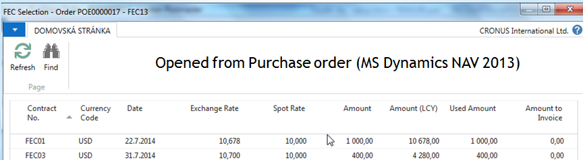
Forward Exchange Contract (home study only)
A special type of foreign currency transaction. Forward contracts are agreements between two parties to exchange two designated currencies at a specific time in the future. These contracts always take place on a date after the date that the spot contract settles, and are used to protect the buyer from fluctuations in currency prices.
Opened from Purchase order (MS Dynamics NAV 2013)

Slide 34
Staff training
Project Management
Study materials
Key users – roles, processes
Training :planning
Examination
Change management

Slide 35
Project Management
Project Management
Budget (financial and resource capacities)
Data transfers (old sysetm- >new system)
Setup of the ERP system (MS Dynamics NAV)
Tests
Evaluation od customized solution
Change management
Sharp start
Closing project –evaluation

Slide 36
Steps in the model based problems solving process
Formulate problem
Define goal
Create model
Experiments
Real system
Use
knowledge
Evaluate model
Gain
knowledge
Verification of validity
Model application
Formulate cognition
* Source : Nyhuis,Wiendahl, Fundamentals of Production Logistics

Slide 37
Implementation
Project Management
Data transfer
Setup of the system
Role Tailored Clients- profiles, Approvals
Tests
Evaluation
Change management
Sharp start (Namibia and SA)
Closing project
Next stages

Slide 38


