Slide 1
MEDIA ECONOMICS
Jana rozmarinová

Slide 2
Mass media
Diversified media technologies that are intended to reach a large audience by mass communication
http://www.sciencedaily.com/articles/m/mass_media.htm

Slide 3
Mass media
Broadcast (radio, television)
Publishing
Print media (newspapers, magazines, books, etc.)
Recorded music
Cinema, films
Outdoor media (billboards)
Internet media – many mass media services (websites, blogs)

Slide 4
We will concentrate on
Broadcast in general (radio, television)
Particularly television
Internet media

Slide 5
Media
Media -economic entities which work within economic context to produce and sell media content to consumers
Operate with a variety of business models and value- creation processes and in a wide variety of settings
Sold vs. Free
Financed via advertising (none, some or all income), state and private subsidy

Slide 6
Media Economics
Explores the specific application of economics laws and theories to media industries and firms
examines theoretical economic questions and practical economic questions to media of all types

Slide 7
Media economics
How economic and financial pressures affect:
The kinds of media available in society
Content of the media
Culture, politics and society as a whole

Slide 8
Broadcasting

Slide 9
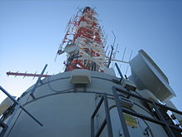
Broadcasting

Slide 10
Broadcasting
A diverse range of radio and television services for entertainment, educational and informational purposes.
Includes:
program production
Program selection for networks and local stations
Program delivery
Funding of this whole process

Slide 11
Broadcasting
A key sector in modern society, not only economically but, more than most industries, culturally, socially and politically.
Is subjected to government regulation more than other cultural sectors

Slide 12
Broadcast regulation
Should broadcast be regulated?
Arguments for and against
Group discussion

Slide 13
Broadcast regulation. Market failures
Program diversity / Tendency to homogeneity
Competition, funding from advertiser reduce programme diversity and neglect minority tastes, duplicating popular programs
Monopolistic market
Asymmetric information (advertising)

Slide 14
Broadcast regulation. Market failures
Social and political effects
Externality
Merit goods
E.g. programme with explicit violence
Induces (influence) actual violence from some viewers (externality)
Immoral even if not affecting people’s behavior (merit good)

Slide 15
Broadcast regulation. Policy
Objectives:
Reduce signal interference
Increase programme diversity
Prevent private monopolies
Increase desirable social and political context

Slide 16
Broadcast regulation Policy
Instruments
Control of access and introduction of new technology in broad casting
Fiscal subsidy
Regulation of ownership
Regulation of programme content

Slide 17
Broadcast regulation Policy
Licensing (to reduce signal interference)
Public broadcasting (diversity of programmes social and political concerns)
Principal -agent problem’ people are unable to transmit preferences easily to public broadcaster
Political interference

Slide 18
Broadcasting - television
has become a commercial mass medium by the 1950s, competing for audiences with radio and other media

Slide 19
Television – specific features
Non – exhaustibility
Programme content can be used repeatedly without additional cost
With few incremental costs content can be translated into other languages and reach wider audience
Low cost of distribution
Non-excludability – Free rider problem

Slide 20
Television. Specific features
Non-exhaustibility & Non excludability
Result in protection of intellectual property becoming relevant issue
Solution: content protected by copyright

Slide 21
Television. Funding
Advertisers
Tax payers (government subsidies)
Viewers (fees)

Slide 22
Television - Government regulation
Licensing
Public broadcasting
Problem political influence:
License for set period, apply for license renewal
Influencing public broadcasters through funding

Slide 23
According method of financing we distinguish:
Commercial media
No commercial media
public broadcast media

Slide 24
Dual system
The coexistence of public and private operators on the basis of state granted and controlled broadcasting licenses

Slide 25
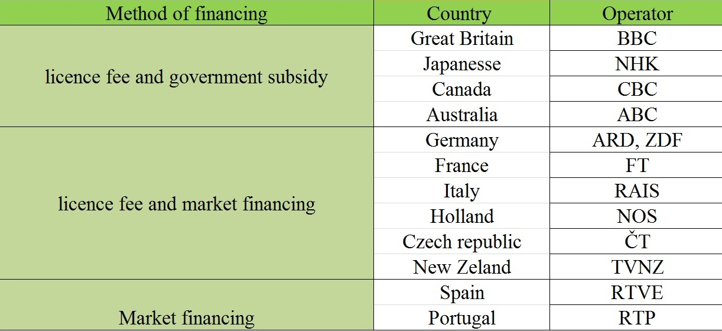
Models of financing public medias

Slide 26
Neil Postman
Famous media theorist and cultural critic
Works: Amusing Ourselves to Death, Informing Ourselves to Death, Technopoly: The Surrender of Culture to Technology

Slide 27
„Television is our culture's principal mode of knowing about itself. Therefore - and this is the critical point -how television stages the world becomes the model for how the world is properly to be staged. It is not merely that on the television screen entertainment is the metaphor for all discourse. It is that off the screen the same metaphor prevails. (92)”
Neil Postman, Amusing Ourselves to Death

Slide 28
Internet culture
Rapid expansion of the Internet = rapid expansion of culture?
No. The commercial purpose prevails.
Free supply – guiding principle of the Internet

Slide 29
Cultural goods – selling of books and e-books, CDs, videos
Internet is used to offer product from personal MP3 libraries = violation of copyright restrictions

Slide 30
Clearing the obstacles between artists and audience?
Internet – direct interpersonal relations, free from intermediaries
= lower cos at both ends of the supply chain
Anyone is able to access the information on Web (order book, songs), but the idea dealing directly with consumer is fantasy

Slide 31
Method of finance
Charging users a network access subscription fee
Advertising

Slide 32
Internet platform for
e-commerce, online media, financial trading, social networking and other Activities
Feature of last two decades: dramatic growth
Amazon , opened 1995, today annual revenue over thirty billion of dollars,
Google – started 1998, today over billion dollars
Facebook – hundreds millions of users

Slide 33
Some economics cost has became lower
the cost of creating and distributing certain types of products and services
the cost of collecting and using data on consumer preferences and behavior
Big distinction to traditional industries:
Internet firms often have very low costs of serving additional user
Facebook, for example, grew to over 500 million users with less than 500 engineers (1 engineer to every million users!)

Slide 34
Distinction to traditional industries:
Internet firms often have very low costs of serving additional users numbers above is scale, or scalability
Facebook, for example, grew to over 500 million users with less than 500 engineers (1 engineer to every million users!)
Customization
Rapid innovation
creation of new products and ideas

Slide 35
Internet culture
Internet was supposed to bypass entry barriers into cultural industry
However, without promotion, a cultural good, even free, have difficulties to find an audience

Slide 36
„Nothing could be more misleading than the idea that computer technology introduced the age of information. The printing press began that age, and we have not been free of it since.” Neil Postman

Slide 37
Sources
A handbook of cultural economics. Edited by Ruth Towse. Cheltenham: Edward Elgar, 2003

