Slide 1
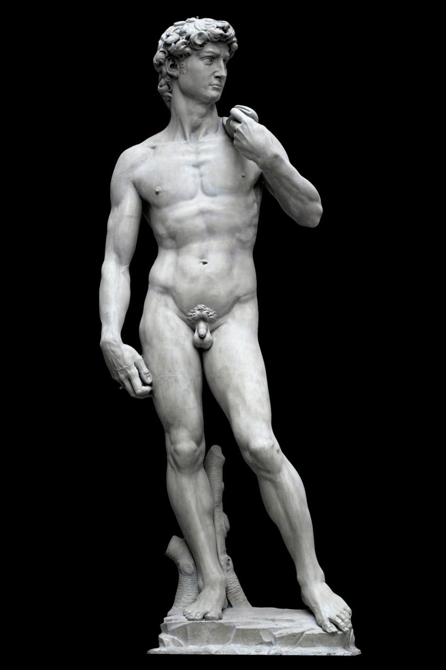
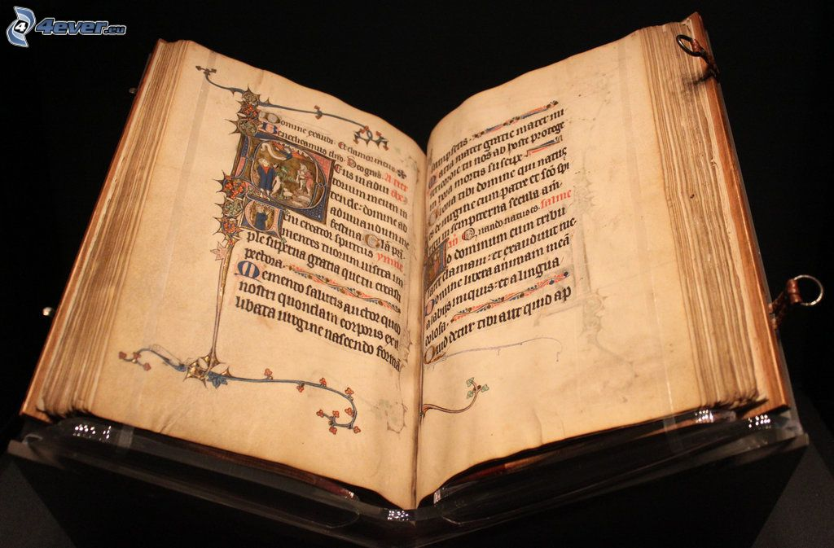
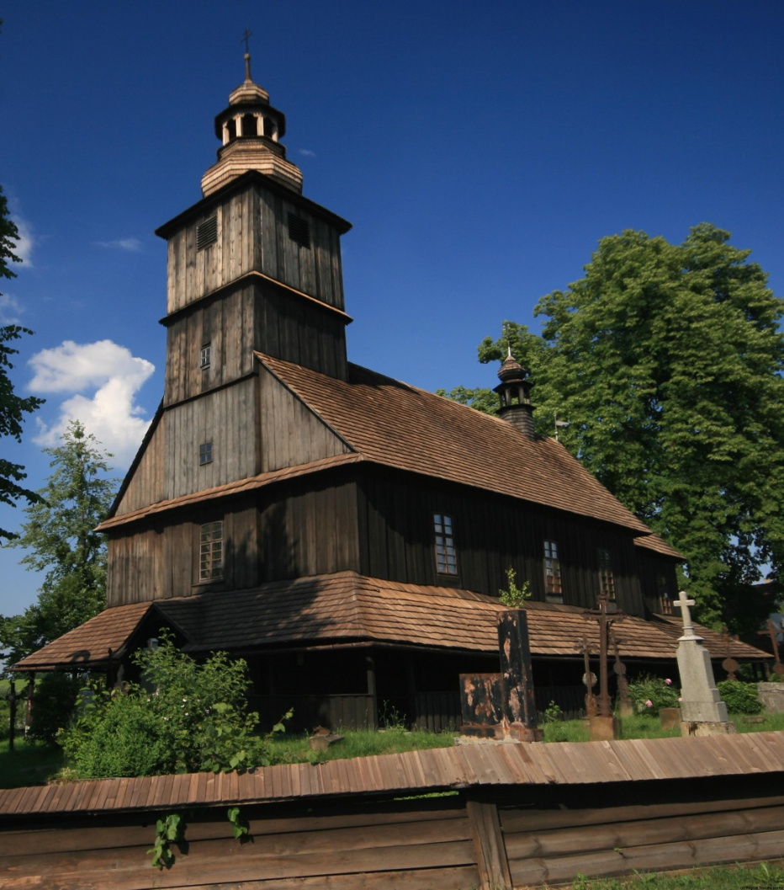

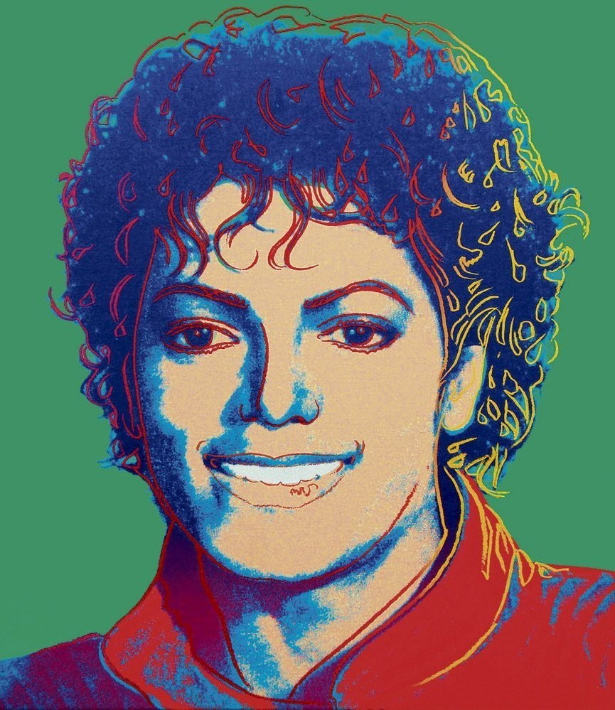
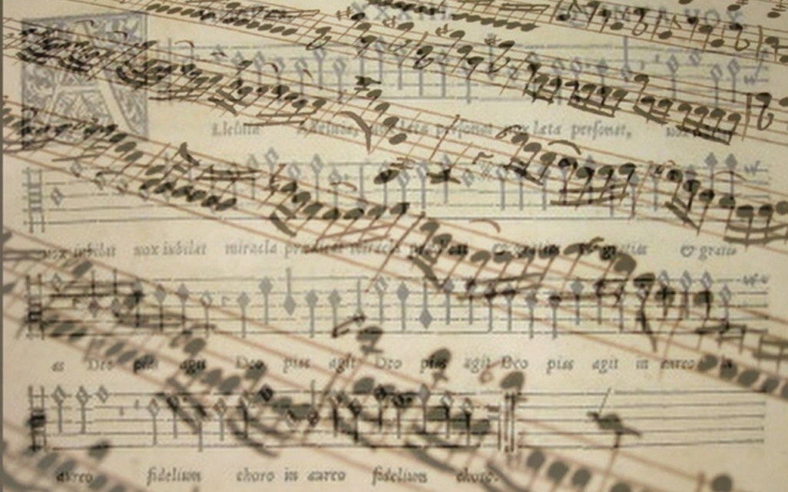
Culture and Mass Media Economy
Basic information
Ing. Vojtěch Müllner

Slide 2
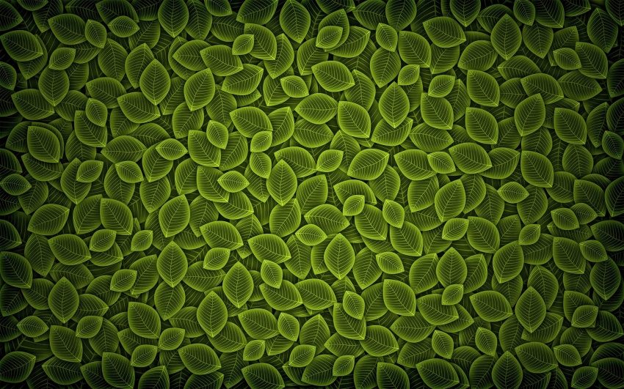

Contacts
Ing. Vojtech Müllner
  Contact: 347683@mail.muni.cz
  Office no. 416
Ing. Jana Rozmarinová
  Contact: 450924@mail.muni.cz
  Office no. 416
Please contact us befor each consultation

Slide 3
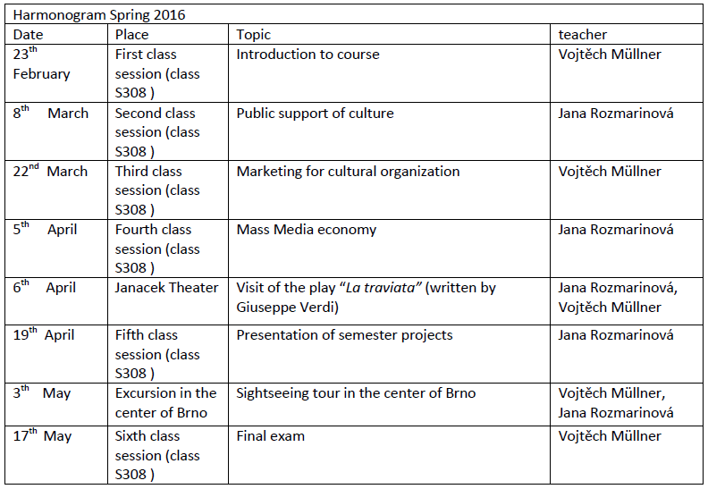
Schedule

Slide 4
Voluntary part of Culture and Mass Media Course
First session - Introduction to course
Second session - Public support of culture
Third session - Marketing for cultural organization
Fourth session - Mass Media economy
!! Final exam will be written from these topics!!

Slide 5
Mandatory part of Culture and Mass Media Course
Write and hand out semestral work
Present main points from semestral work
Sightseeing tour in the center of Brno
Visit of the play “La traviata”
Visit permanent exibition in Moravian gallery
Write a final exam

Slide 6
Semestral work
Student must hand out seminar work in paper form untill 3th May. The topic and outline of the seminar work will be available in the information system (www.is.muni.cz)
Topic: „Financial issue and support of culture in my country“

Slide 7
Presentation of semestral work
Presentation (19th April)
The presentation of seminar work will be on 19th April in room S308
Each student will present his seminar work during short presentation.
Presentation could be with or without PowerPoint support (it is up to each student)
Minimal duration of presentation is 4 minutes and maximal duration of presentation is 6 minutes
Student have to be able answer some question from audience

Slide 8
Sightseeing tour in the center of Brno
Tour will be in time of class session
  Date:3th May
Sightseening tour will be realize in any weather
Duration of sightseening tour will be aproximatly 90 minutes
You will get basic information per email

Slide 9
Visit of the play “La traviata”
“La traviata” is play written by Giuseppe Verdi
Important information
  Date and time :6th April in 19:00
  Meeting time and place: 18:30 in front of Janacek Theatre
  Dress code: decent clothes or formal clothes
Each student buys ticket by himself (reservation are available on web sites http://online.ndbrno.cz/ndbrno/main/list/titledetail/90046-la-traviata )
  Don’t forget to buy ticket in time because the OFFER IS LIMITED

Slide 10
Visit permanent exibition in Moravian gallery
Each student must visit by himself permanent exhibition in Moravian gallery during spring semester). The permanent exhibitions are for free. Each student must bring ticket to satisfy this condition till 3th May. (http://www.moravska-galerie.cz/moravska-galerie/navsteva-mg/vstupne.aspx?lang=en )

Slide 11
Final exam
To set the test must student fulfill obligatory part of course Culture and Mass Media Economy
The final test will be written on 17th May in classroom S308
The test consists of 20 multiple choice questions (only one question is right). Total time for writing the test is 30 minutes

Slide 12
Final exam (cont.)
Evaluation of the test is as follows:
Total points in % | grade
100%-95% | A
94% - 85% | B
84% - 75% | C
74% - 65% | D
64% - 60% | E
<60% | F

