Slide 1
Institutions and Economic Development
Correlation And/Or Causality?
Recent Empirical Approaches

Slide 2
Empirics of Institutions - why?
Recent years witnessed a soaring interest in empirically assessing the effect of institutions on long-run economic development/growth
Research provides an important step forward since the seminal work by North and Thomas
Empirical challenges partially resolved, but new challenges emerged
We are going to critically examine empirical approaches used in economics to estimate the role/impact/effect of institutions on various econmic outcomes

Slide 3
Institutions – what, why?
Institutions are rules of the game in a society or, more formally, are the humanly devised constraints that shape human interactions (North 1990, page 3)
Main points:
  Humanly devised
  Set constraints
  Shape incentives
The economic concept of institution is defined as constraints placed by law and social norms on human behavior
These constraints help to reduce transaction costs

Slide 4
Institutions – what, why?
It is a broad cluster which includes many sublevels, e.g. property rights, contract enforcement
Formal institutions: codified rules by law, e.g. in the constitutions
Informal institutions: not legally codified, based on social norms (or conventions), accepted and expected standards of behaviour
Informal institutions are based on culture, the set of beliefs and values passed from generation to generation

Slide 5
Institutions – what, why?
Why do we (should we) care?
Vast differences in economic prosperity among countries
  E.g. income per capita in sub-Saharan countries is on average 1/20th of per capita income in the United States
Why???
Standard answer offered by economists:
  Differences in physical capital
  Differences in human capital
  Differences in technology

Slide 6
Institutions – what, why?
North and Thomas (1973) argue that we need to distinguish between proximate causes versus fundamental causes of prosperity
Proximate causes are capital, technology
Fundamental causes are can be
  Institutions
  Geography
  Culture
fundamental causes proximate causes economic development

Slide 7
Institutions – an empirical problem
The issue with institutions is that they are endogenous and develop in tandem with other determinants of economic development
Institutions can be different because of
  Geography
  Culture
  Other factors
An old story by Montesquieu:
  Geography determines human attitudes
  Human attitudes determine both economic performance and political system
  So institutions can be also determined by human attitudes

Slide 8
Institutions – an empirical problem
Why is it a problem?
Causality vs Correlation
To estimate a causal relationship between institutions and economic development
Y_{i}=α + β*x_{i} + γ*institutions_{i} + ε_{i}
Assuming that cov(x_{i}, ε_{i})=0, argument made earlier implies that cov(institutions_{i}, ε_{i})≠0
=> we can’t interpret the estimated coefficient of γ as a causal relationship between institutions and economic development, but only as a correlation

Slide 9
Solutions
Various approach which attempt to isolate plausibly exogenous sources of variation of institutions
Two main strategies:
  Finding institutions which exogenously vary across space because of
    Geography
    Historical events
  Instrumental variable estimation techniques
    Finding a variable z_{i} which is highly correlated with a variable proxying institutions and not correlated with ε_{i}
    cov(z_{i}, ε_{i})=0; can’t be tested (often called exclusion restrictions)
    cov(z_{i}, institutions_{i}) ≠ 0; can be tested
  Combination of point 1 and point 2

Slide 10
AJR (2001): Colonial Origins of Comparative Development
Attempt to examine and establish a causal relationship between institutions and per capita income
To do that, they need a source of exogenous variation in institutions
Main arguments rest on:
Different types of colonization policies created different set of institutions
The colonization strategy was influenced by the feasibility of settlements
The colonial institutions persisted after independence

Slide 11
AJR (2001)
Two extremes of colonization strategies:
  Extractive institutions to transfer resources from the colony to the mother country which led to the creation of extractive institutions e.g. coerced labor, slavery, monopolies, legal discrimination
  Inclusive institutions which replicated European institutions more conducive for economic growth
The colonization strategy was influenced by mortality rates expected by the first European settlers (feasibility of settlement)

Slide 12
AJR (2001)
Potential mortality of settlers
Colonization strategy
Past colonial institutions
Current institutions
Current performance

Slide 13
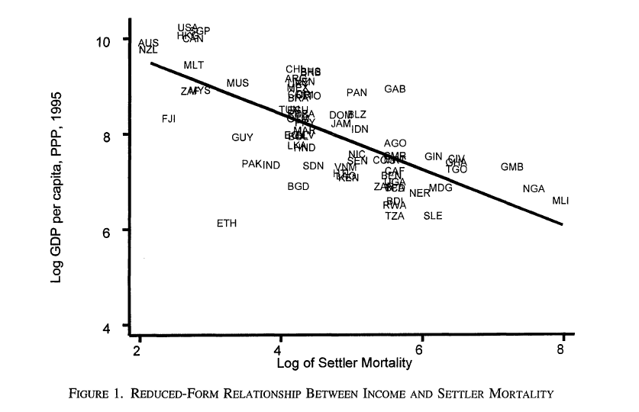
AJR (2001)

Slide 14
AJR (2001)
Assumption of exogeneity of settlers’ mortality (exclusion restriction):
  Conditional on other controls, the settlers’ mortality rates have no effect on GDPpc today other than through institutional development
  The main concern is that mortality rates of settlers are correlated with current disease environment which can have a direct effect on economic performance
  If it was a case, settlers mortality would be assigning the effect of disease on income to institutions
  AJR argue it is not the case as diseases were fatal for the Europeans but not so much for the indigenous population

Slide 15
AJR (2001)
Persistence of colonial institutions
  Setting up and enforce institutions is costly – if the costs were sunk by the colonial powers, then it may not be beneficial for the elites after independence to change them
  Gains from extractive institutions may depend on the size of the ruling elite; if the elite is small (often the case), it has no incentive to switch to ‘inclusive institutions’
  If irreversible investments which are complementary to a particular set of institutions were made, those who made them are more likely to make those institutions to persist

Slide 16
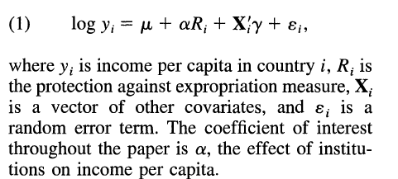
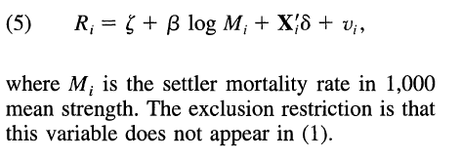
AJR (2001)
Variables capturing institutions:
  Index of protection against expropriation
cov(ε_{i}, ν_{i})=0

Slide 17
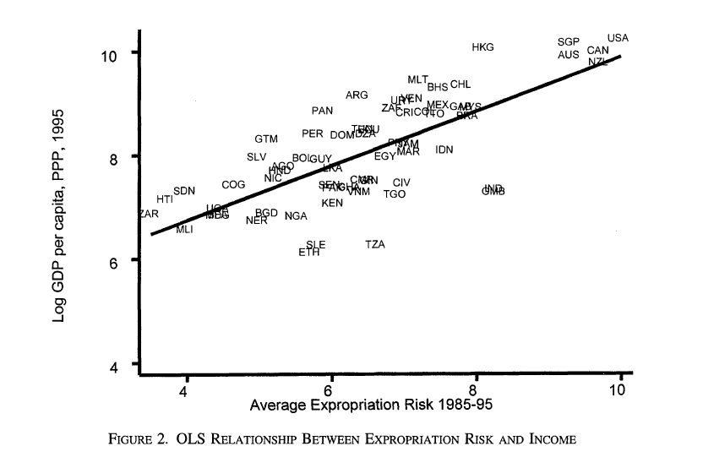
AJR (2001)

Slide 18
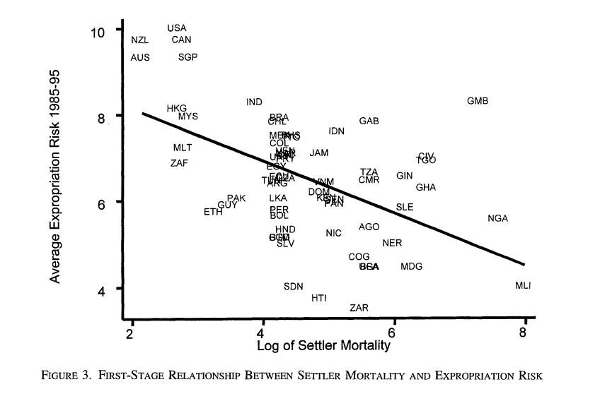
AJR (2001)

Slide 19
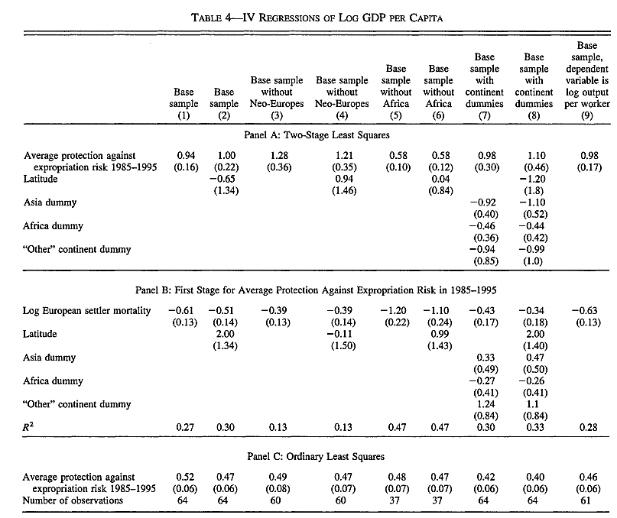

Slide 20


Other studies
Dell, M (2014): Path Dependence in Development: Evidence from the Mexican Revolution, mimeo Harvard
  impact of insurgency on income, labor force, public employees, education
  Instrumental variable approach in which insurgency is instrumented with severity of drought
cov(ε_{ms}, μ_{ms})=0

Slide 21


Other studies
Iyer, Lakshmi (2010): Direct versus Indirect Colonial Rule in India: Long-Term Consequences, The review of Economics and Statistics 92(4), 693-713
  Effect of direct vs indirect rule of the British empire on various economic outcomes in India
  Problem of endogeneity of direct British rule
  Doctrine of annexation – annex an Indian territory is a ruler died without a natural heir
cov(ε_{i}, u_{i})=0

Slide 22
Geography and history as a source of exogenous variation
Assumption of ‘exclusion restriction’ can’t be tested => there is a scope for ‘residual’ endogeneity
Geography and history can provide a much ‘cleaner’ way of estimating a causal impact of institutions on various economic outcomes
Two papers will be discussed:
  Basten, C., and Frank Betz (2013): Beyond Work Ethic: Religion, Individual and Political Preferences, American Economic Journal: Economic Policy 5, 67-91
  Dell, M. (2010):the Persistent Effects of Peru’s Mining Mita, Econometrica 78(6), 1863-1903

Slide 23
BB (2013)
Examine the effect of Reformed Protestantism (relative to Catholicism) on preferences for leisure, redistribution, and intervention in the economy
Use data from Switzerland which allows for within-country correlation and considerable geographical and institutional variation => concentrate on institutionally homogenous part of South-Western Switzerland (Vaud and Fribourg)
Argue that Reformation led to exogenous variation in religion

Slide 24
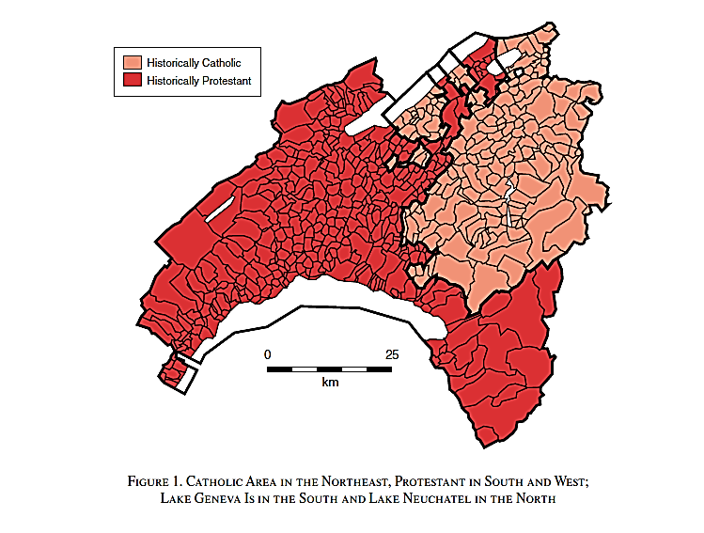

Slide 25
BB (2013)
Exogeneity of religion is historically argued:
  Homogenous until the early 16th century
  Then split into two parts – one belonged to Berne, the other to Fribourg
  Both imposed different religion: Berne Protestant, Fribourg Catholic
  Homogeneity of both regions before the adoption of Protestantism is crucial for a valid causal analysis
  Problem with the main explanatory variable – share of Protestants – changes discontinuously at the historical border between Catholic and Protestant parts
  At the same time, it is exogenous change, offering us a possible instrument – distance to the historical border

Slide 26
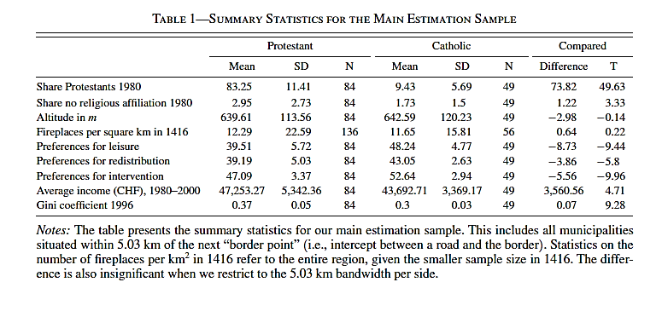

Slide 27
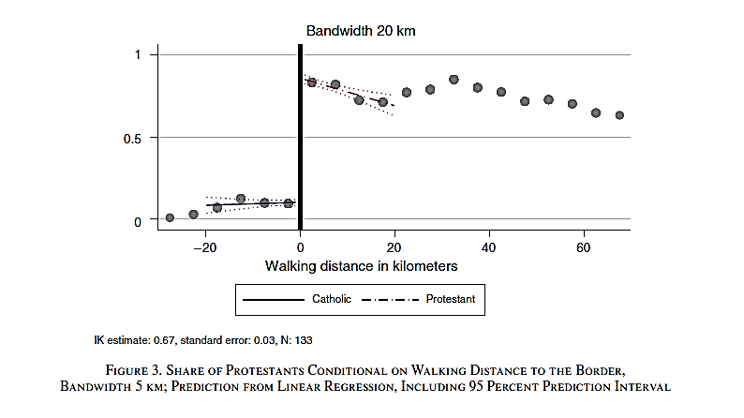

Slide 28
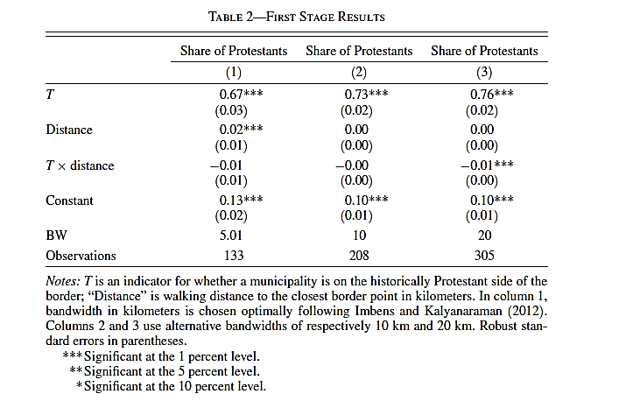

Slide 29
