Slide 1
EOQ
Jaromír Skorkovský
KPH-ESF-MU Brno, Czech Republic
Brno, 2015

Slide 2
Simple questions -qualifications
Type of material
Raw material
Semi-products (WIP)
Final products
Questions :
How much do we have to order (order quantity=Q)
When do we have to order (question related to Reorder Level=Reorder Point)

Slide 3
Demands
Type of demands
Deterministic – known demand
Probabilistic
Under risk (distribution of demand is known)
Under uncertainty (distribution of demand is not known)
Lead time (time between placing order and getting items)

Slide 4
Costs
Order Costs = $C_{o}$
Transport
People work
Inspection cost
Reject costs
Follow up costs
Cost of item = C
Purchase cost

Slide 5
Costs
Inventory Holding Cost= Carrying Costs = $C_{C}$
Cost of space
Cost of guarding
Cost of obsolete items
Special equipment
Pilferage (act of item stealing)
Cost of capital (most important )
Backorder Cost = $C_{bo}$
Lost of goodwill

Slide 6
Costs
Backorder Cost = $C_{bo}$
Lost of goodwill
Lost of opportunity
Cost of additional capacity
Cost of rescheduling and rework
Lost of sales

Slide 7
EOQ model 1
Prerequisites
Single item only
Continuous demand =D
No stock shortage
Instantaneous shipment
Lead time= constant
Q
D
D
time
T
T
Notice, that inventory never goes below zero; shortages do not exist !!

Slide 8
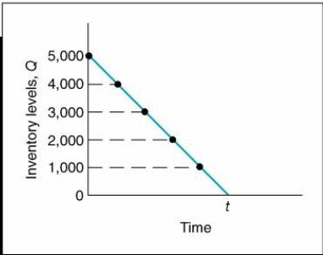
Carrying cost (will be presented -see next slide)
Resource- Taylor- Wikipedia
Average inventory (carrying) cost = $\frac{Q}{2 }$
To verify this relationship, we can specify any number of points values of Q over the entire time period, t , and divide by the number of points. For example, if Q = 5,000, the six points designated from 5,000 to 0, as shown in shown figure, are summed and divided by 6:

Slide 9
EOQ model 1
Annual demand /year = D
Number of orders/year = $\frac{D}{Q}$
Total order cost = $\frac{D}{Q}$ * $C_{o}$ ,where $C_{o}$=order cost
Average inventory (carrying) cost = $\frac{Q}{2 }$
Total holding (carrying) cost = $\frac{Q}{2 }$ * $C_{C}$, Where $C_{C}$=carrying cost
Cost of the item = D*C
Total cost = TC= $\frac{D}{Q}$ * $C_{o}$ + $\frac{Q}{2 }$ * $C_{C}$ + D*C (non-linear function with one variable)
$\frac{dTC}{dQ}$ = - $\frac{D}{Q^{2 }}∗C_{o}$+ $\frac{{Cc}_{}}{2}$ =0
Q=EOQ=$√\frac{2DC_{o}}{C_{C}}$

Slide 10
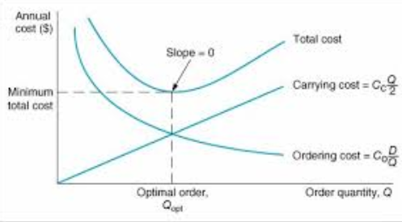
EOQ

Slide 11
Děkujeme za Vaši pozornost a čas

