Slide 1
Kepner-Tregoe Methodology
Skorkovský
Department of business economy
Developed by Charles H. Kepner and Benjamin B. Tregoe in the 1960s.

Slide 2

Apollo 13 – Houston, Houston, do you read me ? We have a big problem….!
The Apollo 13 team is famous for bringing back the astronauts stranded in space by solving difficult and complex problems. The teams solving the problems has used the Kepner-Tregoe (KT) methodology !

Slide 3
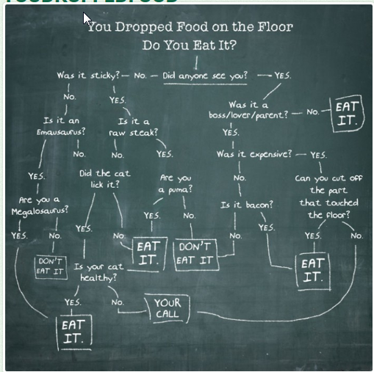
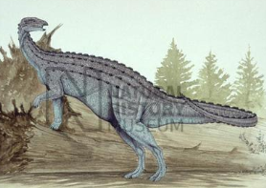
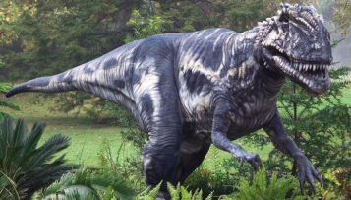
Decision Analysis –serious one
Sticky- lepkavý
Lick – olíznout

Slide 4
What is it K-T methodology ?
Kepner Tregoe is used for decision making .
It is a structured methodology for gathering information and prioritizing and evaluating it.
It is very detailed and complex method applicable in many areas, which
is much broader than just idea selection.
It is called also a root cause analysis and decision-making method.
It is a step-by-step approach for systematically solving problems, making decisions, and analyzing potential risks.

Slide 5
Access situation (situation appraisal)
Identify concerns (problems) by listing them
Separate the level of concern (importance, magnitude, level of influence)
Set the priority level to measure seriousness of impacts (influence), urgency and growth potential
Decide what action to take next (step by step approach)
Plan for who is involved, what they will be doing, where they will be involved, when it happened and the extent of involvement (magnitude)

Slide 6

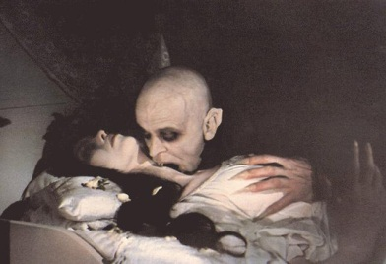
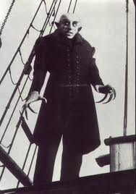
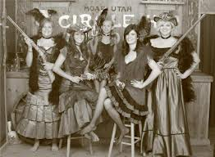

WHO WHAT WHEN WHERE EXTENT

Slide 7
Make decision (A choice between two or more alternatives)
Identify what is being decided (o čem se bude rozhodovat)
Establish and classify objectives (main ones, minor ones,..)- cíle
Separate the objectives into must (must to have) and want (nice to have) categories (we have to assign importance factors from 1-10, where 10 is the most important want objective) and assign criterion rating (weights)
Generate the alternatives (we can do it that way or we can take another way as well)
Evaluate the alternatives by scoring the wants against the main objective – see next slides
Review adverse (harmful) consequences of your corrective steps (risk evaluation, risk assessment)
Make the best possible choice what to do

Slide 8
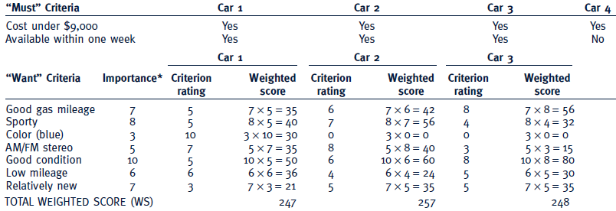
Criteria rating
See similar example on the next slide
Importance can be understood as a Satisfaction score,
meaning desirable but not essential.
Criteria rating is related to want criteria and every car property

Slide 9
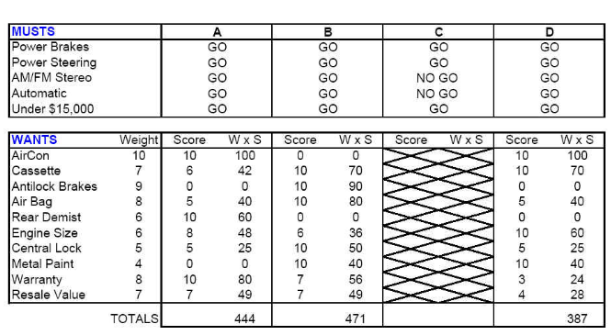
Which car to buy ?
Criterion rating
Importance score, meaning
desirable but not essential.
go to slide 34 and back

Slide 10
See the Upcoming (approaching, next to come) and Potential Opportunity=solution=řešení)
List the potential opportunities O{op1, op2 ,..,opN}
Consider the possible(suitable)solution (e.g. the second one)
Take the action to address the likely cause/solution
Prepare actions to enhance(vylepšit) likely (possible) effects

Slide 11
Uncover and handle problems
(problem analysis)
State the problem (definition and description of the problem)
Specify the problem by asking what is and what is not
Develop possible causes of the problem (similar to CRT)
Test and verify possible causes
Determine the most probable cause (root cause)
Verify any assumptions (předpoklady, domněnky,..)
Try the best possible solution and monitor what will be a situation after applied correctives step

Slide 12
Description
WHERE
and WHERE NOT
WHERE
and WHERE NOT
Priority
(urgency)
Priority
(urgency)
Description
Description
Problem 1
Problem N
Causes
Situation
Causes
Situation
What
WhereWhenExtent
What
WhereWhenExtent
Big
problems
Solution (corrective action) 1
Solution (corrective action) 1
Solution (corrective action) X
Solution (corrective action) Y
Problem 1´
Problem N´
Smaller
problems

Slide 13
Decomposition, priorities and causes
Sub-problem 1
Priority1
Problem 1
Sub-problem N
Priority N
Problem 1
Sub-problem 1
Cause 1
Problem 2
Sub-problem N
Cause N
Problem 2

Slide 14
Example of problem manifestation (decrease of performance)
Change
performance
Planned performance
Unfavourable deviation
  What do we see, hear, feel,
  taste, or smell that tells us
  there is a deviation?
Real performance
time
Change
Final effect of the = PROBLEM (e.g. server crashed)
  Then we have to ask : What, Where, When, and to what Extent –Size (how much, how many)?

Slide 15
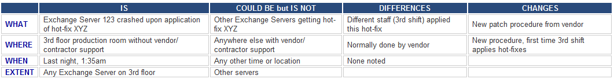
Server crashed !!!! (home study !!!)
Server crashed (this is a very poor problem definition)
The e-mail system crashed after the 3rd shift support engineer applied hot-fix XYZ to Exchange Server 123 (better definition of the problem)
History (and best practice) says that the root cause of the problem is probably due to some recent change. WHAT, WHERE, WHEN and EXTENT will be shown on next slides

Slide 16
Test the Most Probable Cause
(home study !!!)
Clarifying problem Analysis (example)
We have to ask (where Qi =QUESTION i) :
Question IS IS NOT
What (identify) Q1 Q2
Where (locate) Q3 Q4
When (timing) Q5 Q6
Extent (magnitude) Q7 Q8
See next slides

Slide 17
Problem Analysis - What
Is
Is Not
What specific object(s) has the deviation?
What is the specific deviation?
What similar object(s) could have the deviation, but does not? (It did not happen)
What other deviations could be reasonably observed, but are not? (It did not happen)
Example for Is :
1. What specific object IS related to the defect?
Inventory Valuation Objects in database A
2. What specifically is the defect (deviation)?
Inventory Adjustment does not work
1-> see setup of the database and see differences
2->see algorithm used for calculation and parameters used.
You can see , that in production calculation it dose not work
Example for Is Not :
1. What specific object IS NOT related to the defect?
Inventory Valuation Objects in database B
2. What specifically is not the defect (deviation)?
1 -> Setup has another parameters On
2-> Algorithm is used also for production where not error
occurs

Slide 18
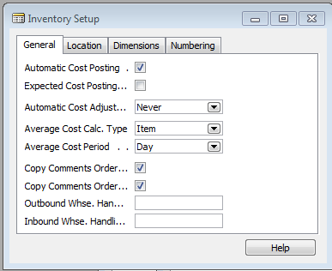
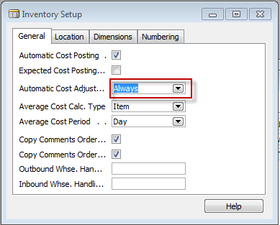
See two MS Dynamics Setup screens
(related to the problem specified recently)

Slide 19


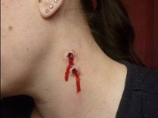


Problem Analysis - What
Is
Is Not
What specific object(s) has the deviation?
What is the specific deviation? - bites on the neck
What similar object(s) could have the deviation, but does not? (It did not happen)
What is the specific deviation? but does not? (It did not happen) – bites, anemia
Example for Is :
1. Nice young girl´s neck and strange
look of anemic person
Girl with garlic in her hands
No bites
Zaftig
Example of Is Not :

Slide 20
Another example for What IS and What IS NOT
Example I.
Customer X and Customer Y both use product B but only to customer X was sent the wrong product so the object IS Customer X , but IS NOT Customer Y
Example II.
IS girl visited Dracula lower castle without a bunch of garlic, but IS NOT not the one having bunch of garlic and visiting Špiberk castle in Brno

Slide 21
Problem Analysis - Where
Is
Is Not
Where is the object when the deviation is observed? (geographically)
Where is the deviation on the object?
Where else could the object be when the deviation is observed, but is not?
Where else could the deviation be located on the object, but is not?
Example for Is :
Old castle in the mountains (Romania)
Where IS : Romanian Carpathian mountains
where it is very easy to meet a lot of vampires
there
Example for Is Not
1. Brno castle Špilberk
Where IS NOT possible to meet vampires
(only lovers and children and seniors)

Slide 22
Problem Analysis - When
Is
Is Not
When was the deviation observed first (clock and calendar time)?
When since that time has the deviation been observed?
When, in the object’s history or life cycle, was the deviation observed first?
When else could the deviation have been observed first, but was not?
When since that time could the deviation have been observed, but was not?
When else, in the object’s history or life cycle, could the deviation have been observed first, but was not?
See example next slide

Slide 23
Example for When and IS and IS NOT
Customer X and Customer Y both use product B but only customer X was sent the wrong product if Salesman Tony was on holiday in this time and Salesman Mustafa was in charge, so the object IS Salesman Mustafa , but IS NOT Salesman Tony

Slide 24
Problem Analysis - Extent
Is
Is Not
How many objects have the deviation?
What is the size of a single deviation?
How many deviations are on each object?
What is the trend?
  Occurrences?
  Size?
How many objects could have the deviation, but don’t?
What other size could a deviation be, but isn’t?
How many deviations could there be on each object, but are not?
What could be the trend, but isn’t?
  Occurrences?
  Size?

Slide 25
Problem Analysis
Confirm True Cause
What can be done to verify any assumptions made?
How can this cause be observed at work?
How can we demonstrate the cause-and-effect relationship (e.g. Current Reality Tree or Ishikawa Fishbone Diagram)?
When corrective action is taken, how will results be checked?

Slide 26
Let’s Look At Some Problems!

Slide 27
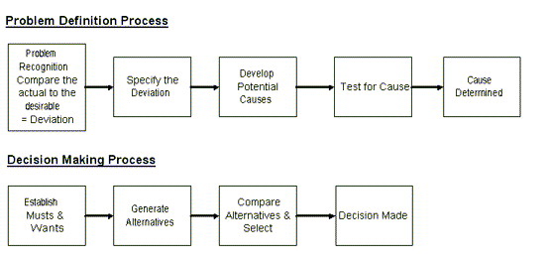
Systematic Problem Solving and Decision making Overview

Slide 28
Planning the Next Steps
Problem Analysis
    Do we have a deviation?
    Is the cause unknown?
    Is it important to know the cause to take effective action?
If the answer is YES to ALL three, than you have a big problem, Huston !!!

Slide 29
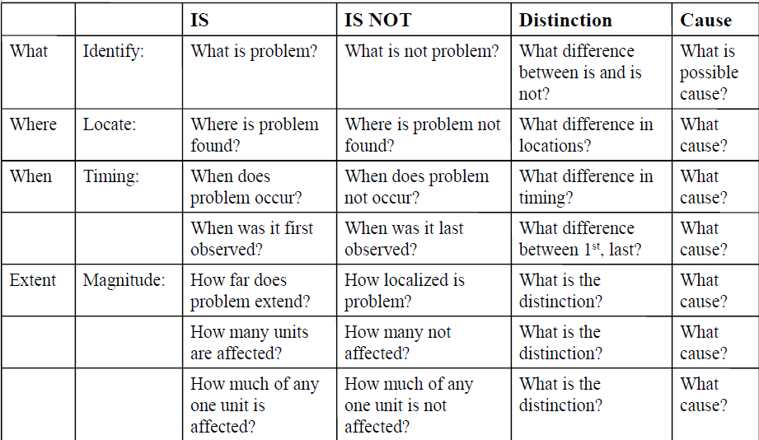
Problem analysis table template
(Home study)

Slide 30
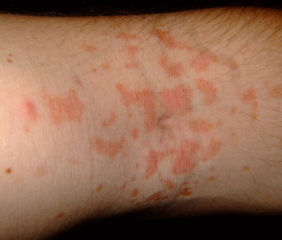
Problem description (example)
On a new model of airplane, flight attendants develop rash on arms, hands, face (only those places). It only occurs on flights over water.
Usually disappears after 24 hours. No problems on old planes over those routes.
Does not affect all attendants on these flights, but same
number of attendants get it on each flight. Those who get rash have no other ill effects.
No measurable chemicals, etc., in cabin air.
Rash arm ->

Slide 31
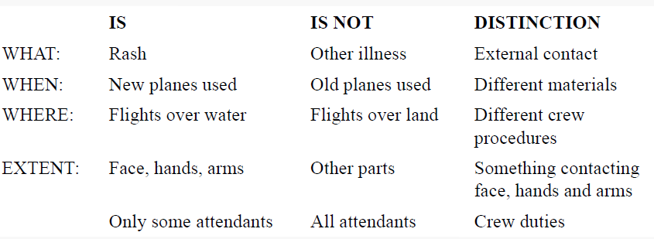
Problem analysis real table
Distinction=Difference

Slide 32

Results ????

Slide 33
Tree of the casual relationships I –example
Decline of revenue due to :
Lower merchantability of the items
    New competitors
    Change of the customer preferences
    Poor (not sufficient) quality of the item
  Restriction of capacity production
    Downtime due to machine failure, obsolete machinery, irregular maintenance
  Change of the legislation (change of the health rules)
See tree

Slide 34
Revenue decline
Decline of
demand
Lower production
    Change of the
    customer preferences
Decrease of production capacity
New competitors
Lower quality
Machinery downtimes
…
…
Change of the health rule
…
    Machinery is liable
    to breakdowns
…

Slide 35
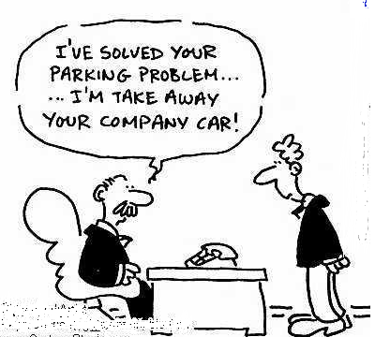
Let’s Look At Some Problems again!

Slide 36
Decision making process
Problem definition
Requirements identification
Goal establishment
Evaluation criteria development
Select decision –making tool
Apply tool (K &T, Pros-Cons,…)
Check

Slide 37
Step 1 and Step 2
Step 1 Problem: Pick a replacement vehicle for the motor pool fleet
The definition of the problem dictates the requirements. As the vehicle is for a motor pool, the requirements will differ from those for a family car, for example.
Step 2 Requirements:
1. Vehicle shall be made in U. S. A.
2. Vehicle shall seat at least four adults, but no more than six adults
3. Vehicle shall cost no more than $28,000
4. Vehicle shall be new and the current model year

Slide 38
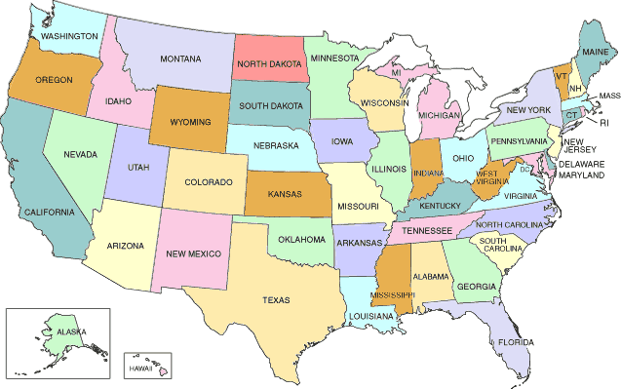
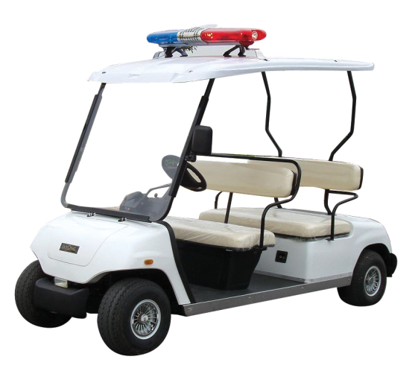
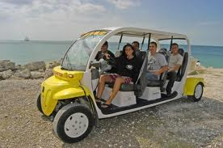

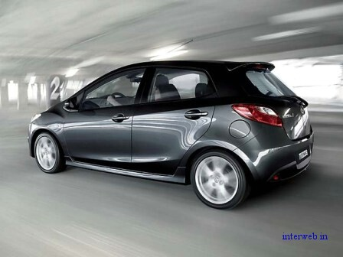
Min
Max 28000 USD
Max
New car
(current model)

Slide 39
Step 3 and Step 4
Step 3 Goals:
· Maximize passenger comfort
· Maximize passenger safety
· Maximize fuel-efficiency
· Maximize reliability of the car
· Minimize investment cost
Step 4 Alternatives:
There are many alternatives but the requirements eliminate the consideration of a number of them:
Requirement 1 eliminates the products not manufactured in the USA
Requirement 2 eliminates vans, buses, and sports cars (Ferrari no !!!!)
Requirement 3 eliminates high-end luxury cars
Requirement 4 eliminates used vehicles

Slide 40
Step 5
Step 5 Criteria:
“Maximize comfort” will be based on the combined rear seat leg and shoulder room. (Note: front seat passenger leg and shoulder room was found to be too nearly the same to discriminate among the alternatives.) 5
“Maximize safety” will be based on the total number of stars awarded by the National Highway Traffic Safety Administration for head-on and side impact. 10
“Maximize fuel efficiency” will be based on the EPA fuel consumption for city driving. 7
“Maximize reliability” will be based on the reliability rating given each vehicle by a consumer product testing company. 9
“Minimize Cost” will be based on the purchase price. 10
Weighted criteria vector C(5,10,7,9,10) are values assigned by decision makers !!!!

Slide 41
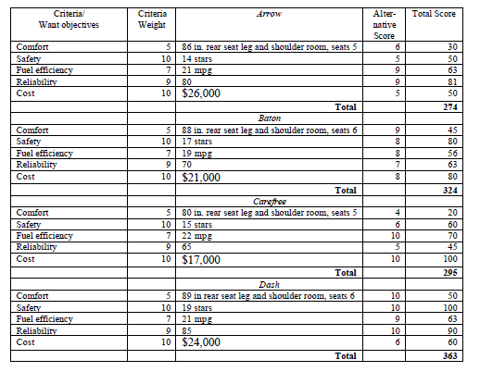
Kepner-Tregoe table
(for 4 cars : Arrow, Baton, Carefree and Dash)

Slide 42
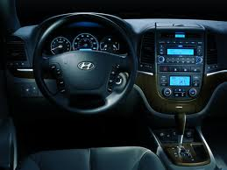
Last step – Validation (check)
Last Step Validate Solution:
The totals of the weighted scores show that the Dash most nearly meets the wants/goals (or put another way, has the most “benefits”). Dash meets all the requirements and solves the problem !!!
Go back to slide 9

Slide 43
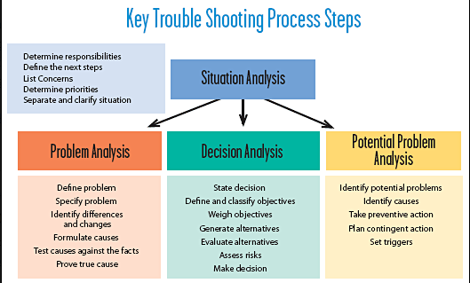

Slide 44
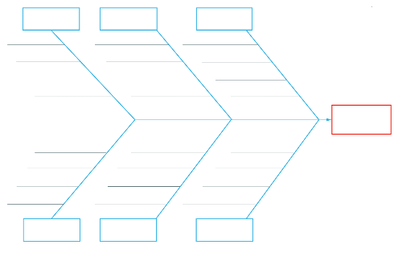
CRT-Ishikawa
12
3
1
2
4
3
7
OR
4
7
2
12
CRT
2
6
1
6
1
Root problem
3
4
Requirement
Prerequisite
 | 1 | 2 | 3 | 4 | 6 | 7
John | 8 | 7 | 4 | 3 | 5 | 6
Caroline | 9 | 5 | 7 | 8 | 5 | 6
Mean | 8,5 | 6 | 5,5 | 5,5 | 5 | 6
P1
Alternative 1
R1
1
EC
Conflict
1
= Nature (see, forest, mountains, jungle, river,..)
R2
P2
Alternative 2
2
= Hotel type
Root problem contrary
3
= Amenities (pool, golf course, wellness,.. )
4
= Period (spring, summer, fall, winter).
Alternative means how to solve problem and what kind of pay-off you will get

Slide 45
Alternatives
Requirement
Prerequisite
P1
Alternative 1
R1
Alternative /Market | SOHO | Medium size | Big player
A1 | 6000000 | 7000000 | 12000000
A2 | 2000000 | 4000000 | 9000000
A3 | 800000 | 1300000 | 4000000
A4 | 200000 | 800000 | 1000000
1
EC 1
Conflict
R2
P2
Alternative 2
Requirement
Prerequisite
P1
Alternative 3
R1
1
EC 2
Conflict
Alternative 4
 | SW Package
A1 | King Kong
A2 | SW Kings
A3 | Accounting Devils
A4 | Hamsters
R2
P2

Slide 46
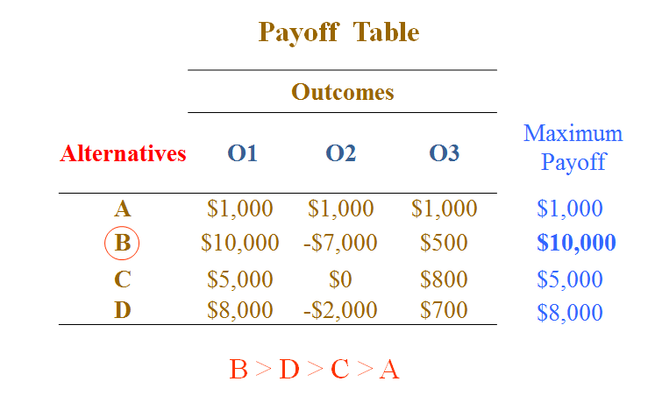
One possible solution Decision making methods without probabilities (MaxiMax and MaxiMin) – 1st slide-explanantion
  MaxiMax is the rule for the optimist. A slogan for MaxiMax might be "best of the best" - a decision maker considers the best possible outcome for each course of action, and chooses the course of action that corresponds to the best of the best possible outcomes

Slide 47
MaxiMin Payoff
Select the alternative which results in the maximum of minimum payoffs; a pessimistic criterion
Payoff Table
 | Outcomes
Alternatives | O1 | O2 | O3
A | $1,000 | $1,000 | $1,000
B | $10,000 | -$7,000 | $500
C | $5,000 | $0 | $800
D | $8,000 | -$2,000 | $700
Minimum Payoff
$1,000
-$7,000
$0
-$2,000
A > C > D > B

Slide 48
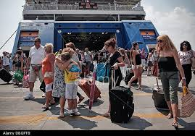
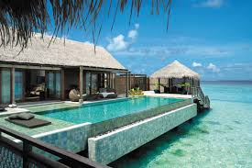
Make decision (A choice between two or more alternatives)
Identify what is being decided (e.g. how many rooms I have to order if I am owner of the travel agency)–see next slide (in this case K-T method is not considered)

Slide 49
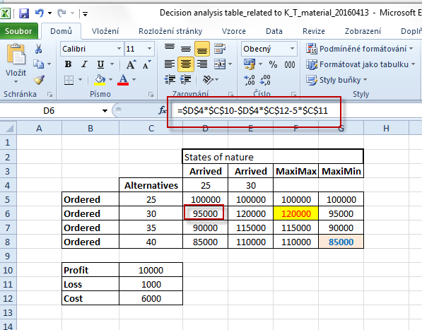
Decision making without probability
Hotel industry simple example (placed ordered-> alternatives and how many
of them will really arrive)

Slide 50
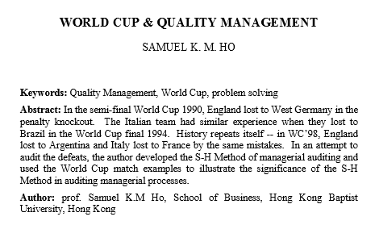
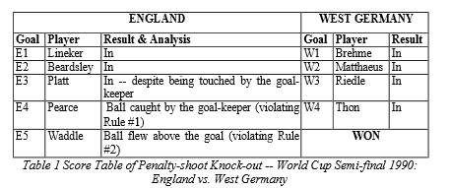

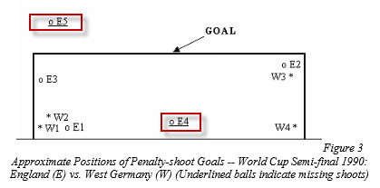


Slide 51
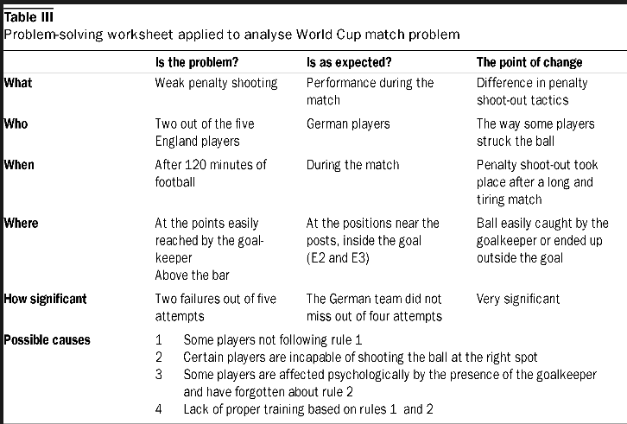
Example of analysis- use of questions

Slide 52
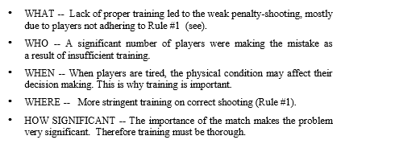

Slide 53

Thanks for Your attention

