Slide 1
Presentation Skills
Jan Řezáč
04/04/2016

Slide 2

Presentation and storytelling
Think back about the last time you had to present:
How did you feel?
What was your goal?
What would you improve?
Notes:
2
Personal opening
Opening statement: take 30 seconds to think of the last times you had to present something. How was it? how did it go? What would you do better?
Then slide questions
extra questions:
Why

Slide 3

Why presentation skills?
People love stories
Transfering a message
Inspiring an audience
How can we learn it?
Practise
Study
Observe
Get and use feedback
Notes:
3
Why and how
Why presentation skills?
People love story’s
Transfering a message
Inspiring an audience
How can we learn it?
Practise
study
observe
get and use feedback
People love listening to stories. It is the most natural and VERY enjoyable thing.
Remember how you liked stories as a child? That is, how you should speak again.
By telling something, you are GIVING your audience another perspective, and making their world richer.
If you have a passion - you have a story.
(other place, remove?)

Slide 4
Overview
Aristoteles
  Ethos
  Pathos
  Logos
Feedback
Lots of practise
Notes:
So how are we going to practise it in this session:
Biggest part will be practising
Why do we emphasize practising? Presentation is for the most part a soft skill. You can read about it all you want but you have to do it. Environments in groups, with constructive feedback to each other are the best way to practize presentation skills.

Slide 5
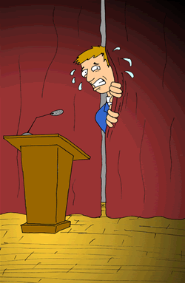
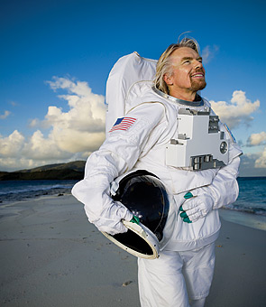
Fear of speaking in public
Number 4 biggest fear of people
Every single person is nervous when he/she has to talk for a big audience
Richard Branson owns a multibillion brand… But is scared of talking in public
What about your fear of speaking in public?
Notes:
Before we start practising:
Research (western research, either they are pussys or here are the same fears) says its the number 4 biggest fear (just before terrorism) of people in life (let’s work on that)
Example of Richard Branson -> representation of his on multibillion brand but….. Is affraid of public speaking.
http://www.entrepreneur.com/article/223760
Everyone has his own personal demons, but experts seem to agree that two of the most common phobias are fear of flying and of public speaking. I am lucky: Flying has never bothered me, but on the other hand, several of my hot-air balloon trips ended in some pretty terrifying landings, so I can certainly relate. (everyone has its fears)
I first realized that I would have to face my fears when the late Sir Freddie Laker coached me to make myself the public face of our new airline. I remember thinking, "That's easy for you to say," because I was utterly terrified.
Probably the best advice I was ever given about appearing on TV or public speaking was, "Just try to imagine you're in a living room having a chat with someone." This approach helped me a great deal, though an apology may still be in order for those who sat through my earlier efforts. (things that help overcome his fear)
Whenever possible I now try to arrange for less structured question-and-answer sessions rather than traditional 25-minute speeches. It's not only less nerve-racking for me, but I also find that audiences get a lot more out of a session when they can jump in with questions rather than sitting there thinking, "I wish he'd talk about XYZ.“ (changing the setting to make it more confortable)
A friend's 5-year-old son once dubbed our daily lessons in the pool, "Uncle Richard's drowning classes," but I have never lost a student. Last week I helped three adults learn to swim. First you help your students to overcome their fear of putting their mouths and noses underwater. Once they get past this obstacle, you next coax them to hold their breath underwater for a little while. When your students are joyously blowing bubbles, they're on their way. (You can get over every fear by getting out of your confort zone)
Franklin D. Roosevelt was right on target about phobias when he said, "The only thing we have to fear is fear itself." Hiding from fear only makes it stronger. So enlist allies if necessary and face your fears with a battle cry of, "Screw it. Let's do it!" You will be amazed at what you can accomplish -- both at work and at play. (you can overcome every fear)

Slide 6
Dealing with nerves
 Calm yourself from the inside
 Practice deep breathing
 Drink water
 Smile
 Use visualization techniques
imagine that you are delivering your presentation to an audience that is interested, enthused, smiling, and reacting positively. Alternatively, imagine only one person.
 Speak more slowly than you would in a conversation
 Move around during your presentation

Slide 7
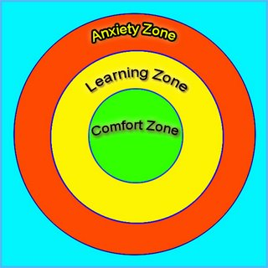

Guidelines for this session
Notes:
A possitive and open environmentwith proactive helps
This is a safe environment so you can focus on learning.
Make it a safe environment for others so they can get out of their confort zone and learn as much as possible
Learning and practice means putting yourself open for feedback and taking it as advice.
Its not about how good you are, its about getting better.

Slide 8
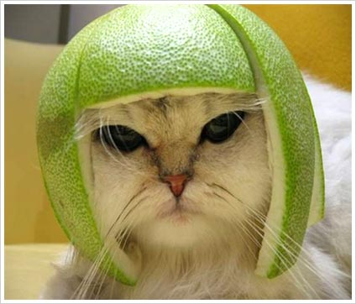
Warm-up exercise!
Let’s make a crazy story:
Notes:
Filling up a story.
Fascilitator starts a story. 1 of the audience takes the end sentence. Everybody in between, one by one takes a position in the story. In the end there should be a fun/good story!

Slide 9
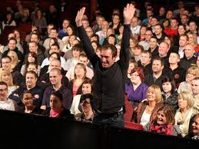
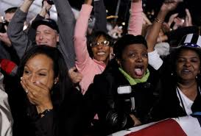
What makes a presentation a good presentation?
Inspiring?
Expressive?
Good content?
Enthousiastic?
Clear?
Good feeling?
Notes:
Inspiring? Expresive? Good content? Enthousiastic? Clear? Good feeling?
Get towards aristoteles structure

Slide 10
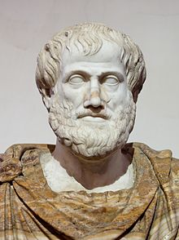
Aristoteles´ Advice
Good speech has three sides:
    Ethos (nonverbal communication)
    Pathos (language techniques you use)
    Logos (facts that you say)
Brilliant presentation embraces all 3 angles.
Notes:
Aristiteles structured it in the following way:
Discussion/example of how important non-verbal, intonation and content are but that they can not miss each other and it depends on the situation.

Slide 11
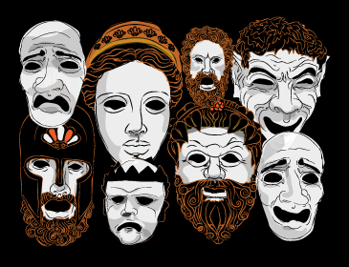
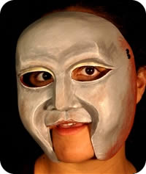
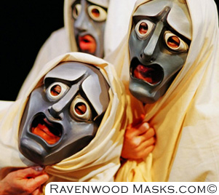
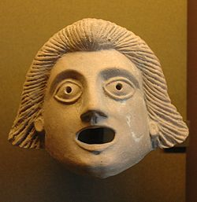
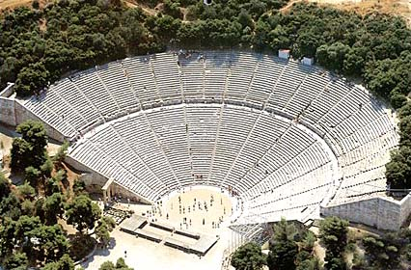
Ethos = The way you come across to the audience
Ethos is the way the speaker shows s/he is a skilled presenter.
Expert, involved, qualified, ethical
Important:
Work on your own style!
Notes:
Greek charakters

Slide 12
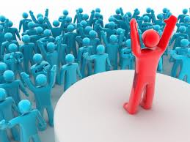
Ethos → Ways to influence
Posture
Hands
Arms
Breathing
Facial expression
Eyes
Movement around the room
Notes:
1st part of aristoteles!

Slide 13
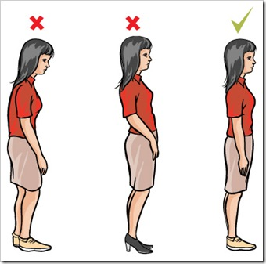
Posture (how we hold our bodies)
Develop own style
Adapt to different situations
head
Movements
hands
Notes:
13
important to use a style that fits me (make it personal)
Different situations, examples: speach for professors or at kid’s birthday party.
How do you hold your head?
what movements do you make?
what do you do with your hands?
Imagine, that someone is holding you by your head, and taking away some of your weight.
I personally prefer to walk, but it is preferable to stand on your toes than heels (that creates a distance).
Movements of your hands hold information too, use it well!
Make it a note.

Slide 14
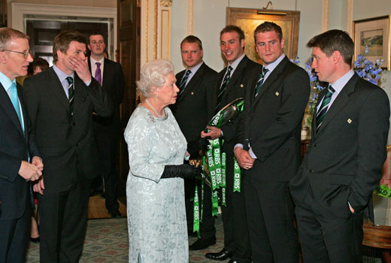
The Power is in your posture
Notes:
Situation: meeting the queen and the non-verbal communication going on.
Hands are imporant part of your appearance.
Open hands -> hounesty, truth, loyalthy
Closed or hidden hands -> not caring (onverschillig), closed, not willing to participate

Slide 15
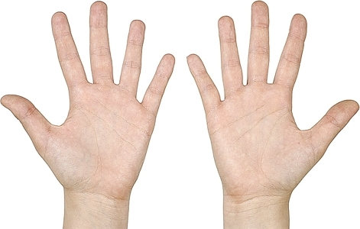
What to do with hands?
It is best if they are relaxed, natural and flexible.
Make them part of your voice.
Things you can do include counting, pointing at things or relating to audience.

Slide 16
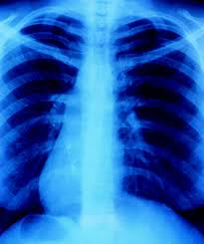
Breathing
It is important because you can speak well only when you breath correctly.
Training here can make a huge improvement in quite a short time.
One of the most important skills is capacity of your lungs.
Under stress (like when you speak in public) is your capacity halved.
Notes:
16
You can speak only when you breath out.
If you breath out usually for 20 seconds, than under stress in 10. And that is too little for fluent sentences.
Try it for a while!
Correct technique is to breath in belly, than in chest, breath out chest and breath out from belly

Slide 17
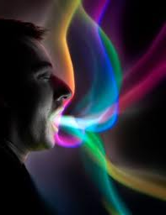
Exercise
Breath in, than breath out and make a sound for 20 seconds!

Slide 18

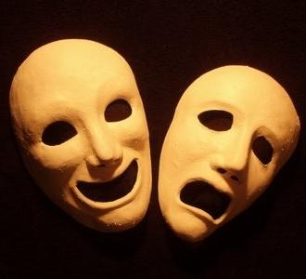
Facial expression
Smile improves your image
Open mouth improves your voice
Facial expression improves understaninding
Notes:
The more you smile, the more the audience likes you.
The more you open your mouth, the better they hear you.
The more are facial expression same with what you say, the more they understand.

Slide 19

Eye contact
Eye contact is crucial in social interaction
Look straight in the eye or not?
Lighthouse method: Around 1-2 seconds to Everybody in the room
Notes:
Looking strait in the eye: pro: polight, interested, positive. Con: can make people unconfortable
Lighthouse method: Around 1-2 seconds, from person to person (not more) To Everybody in the room
Show wrong ways of eye contact like:
Staring to long to a person
missing the sites of a group
staring down
staring over the group

Slide 20
Movement around the room
When you present, the room is your playground
move around
change the setting
use objects
Notes:
Goal is to achieve your goal better or make yourself feel bettter in the room and present better

Slide 21
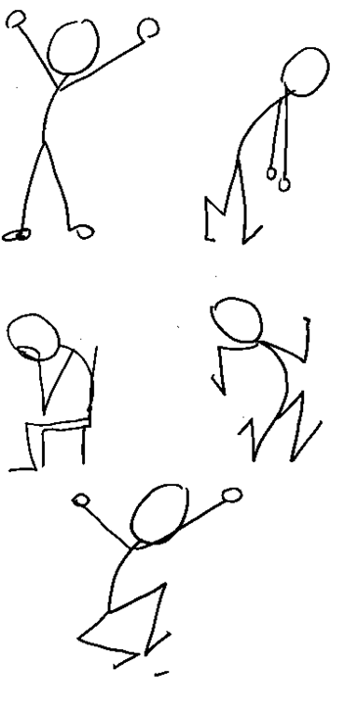
Ethos - recap
Relaxed, flexible, confident body movements
Deep breathing.
Positive facial expression and eye contact
Room is yours!

Slide 22
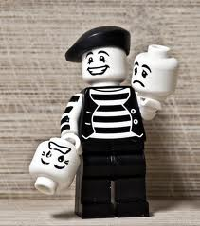
Exercise – body movement

Slide 23
Exercise – beginning of speech
Come in front of the class, take a good posture, breath in, and say the beginning:
  „I am here to tell you the best story ever.“
  And thats it :-) Prepare for next round – think of your own good, creative beginning.

Slide 24

First group exercise
Each person gets a random object which he/she has to sell to the group in one minute.
Content is not important, try to be expressive.
Notes:
Split group up in 6-11 persons
Also body movement exersize for more moving body!!

Slide 25

Pathos (language techniques)
Rule of three
Pauses in your speech
Intonation
Metaphor
Analogy

Slide 26
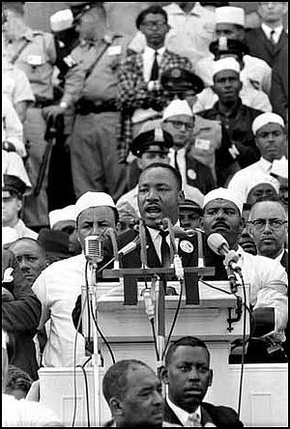
Time for some inspiration...
https://www.youtube.com/watch?v=gevdV4LvipQ; 1:30

Slide 27

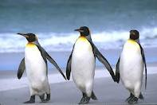
The Rule of Three
Have you noticed how often we put on slides precisely three facts?
It is a good number. Two is too little. Four is too much, and people forget.
Good speakers use it often. But of course - if you have four things to say, say them!

Slide 28

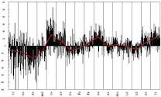
Pauses and intonation
It is ABSOLUTELY NORMAL to have a 3 seconds pause.
You can organise your thoughts, or use the pause to build tension.
For experienced – work on your intonation. use your voice to target keypoints.

Slide 29

Power of repeating
Think about what message/feeling should stick in people’s mind after the session.
Say what you want at the beginning.
Repeat it at the end.
Notes:
29
Add goal like in jans slide

Slide 30
The dictionary defines a "metaphor" as a figure of speech that uses one thing to mean another and makes a comparison between the two. For example, Shakespeare's line, "All the world's a stage," is a metaphor comparing the whole world to a theater stage. Metaphors can be very simple, and they can function as most any part of speech. "The spy shadowed the woman" is a verb metaphor. The spy doesn't literally cast his shadow on the woman, but he follows her so closely and quietly that he resembles her own shadow.
A simile, also called an open comparison, is a form of metaphor that compares two different things to create a new meaning. But a simile always uses "like" or "as" within the phrase and is more explicit than a metaphor. For example, Shakespeare's line could be rewritten as a simile to read: "The world is like a stage." Another simile would be: "The spy was close as a shadow." Both metaphor and simile can be used to enhance writing.
An analogy is a bit more complicated. At the most basic level, an analogy shows similarity between things that might seem different -- much like an extended metaphor or simile. But analogy isn't just a form of speech. It can be a logical argument: if two things are alike in some ways, they are alike in some other ways as well. Analogy is often used to help provide insight by comparing an unknown subject to one that is more familiar. It can also show a relationship between pairs of things. This form of analogy is often used on standardized tests in the form "A is to B as C is to D."

Slide 31
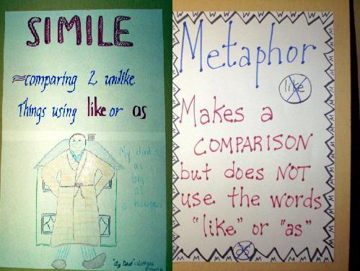

Slide 32
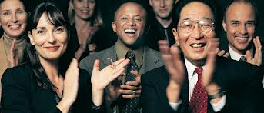
The spice of speech
A metaphore helps many times to describe a concept with different terms.
You can explain an unknown process by making an analogy to a known process.
There are other techniques (simile, allegory, hyperbole). All of these make your speech much more interesting to audience
Notes:
Change text layout, check content metaphor on the internet

Slide 33

Metaphores - examples
Her hair is blond. – Her hair is the purest gold.
It was very difficult problem. - It was a Gordian knot.
“A Porsche is not a car. It is the best engineered executive toy in the world.“
Notes:
Change text layout, check content metaphor on the internet

Slide 34
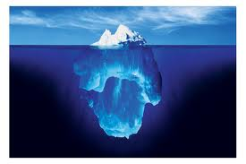
Analogy - definition
Analogy is a cousin to the metaphor.
Metaphor describes just one attribute, that is similar.
If you use the similarity to describe another attributes, it becomes an analogy.
Notes:
Change text layout, check content metaphor on the internet

Slide 35

Analogy - examples
Traffic system in Bangkok and blood distribution in the body can have similar problems.
What is the structure of atoms? Just look at the stars and planets.
Was the bank of justice broken, as Luther said?
Notes:
Change text layout, check content metaphor on the internet

Slide 36

Metaphors and analogy - exercise
Try individually to describe the following with „the spice of speech“.
Go as a tourist into Syria.
Our attachment to the internet
Dentist´s work.
Marriage after 30 years.
Your area of expertise.
Something else.
Notes:
layout

Slide 37

Pathos - Recap
Rule of 3 works. Try it.
Your voice can change with words you say. Do not forget pauses and intonation.
Analogies and metaphores make complex issues look easy like a piece of cake.

Slide 38

Logos (facts)
Usually, you know much more about the situation than your audience.
Difficult part is choosing and simplifying the information you want to say.
Also important is order in which you will present information

Slide 39
Structure of Presentation
All presentations should have an Introduction, a Main Part, and a Conclusion
There are broadly two ways to structure your powerpoint
Academic (Ted talks audience) and Consulting (for executives)

Slide 40
Academic presentation
Introduction: describes current situation, makes people pay attention;
Main part: systematically provides facts, interprets them, suggests a solution;
Conclusion: a summary or a call to action

Slide 41
Consulting presentation
Introduction: Provides the executive summary including a call to action;
Main part: States all reasons leading you to your conclusion at first, than provides detail for those;
Conclusion: presents alternative, possibly credentials

Slide 42
Feedback
Looking in the mirror in an unbiased way

Slide 43
Self
awareness
Development
Learning
Breaking
a
pattern

Slide 44
Feedback structure
1.Observation
2. Effect
3. Reaction
  Behaviour?
  How does it come across?
  Which effect does it have?
  What feeling did it give you?
  Were you aware?
  What is your opinion?
  Future?

Slide 45
Feedback rules
Giving feedback:
Stay subjective! What you think is an opinion, not a fact. „I think that...“
Stay specific! Say what happened and when, so the person can learn.
Stay positive! Helps best to say, what can be improved instead of what went wrong.
Show respect
Like a mirror, not an advisor
Getting feedback:
Let people finish talking
Try to understand
There is no need to defend yourself

Slide 46
You can give feedback on...
What feeling did you get?
Intonation, posture?
What information do you remember?
Did the speaker look relaxed?
And be positive! It takes courage and skills to speak in public

Slide 47
Final exercise
Now, give us your story (two minutes)!
Best story of your life, your dream...or perhaps something you expect to present soon
Practise in pairs – tell each other your story and work with feedback.
Notes:
In groups like other exersize (6-11)
5 minutes for preparing
5 minutes to talk it over
presenting + feedback 4 minutes each (40 minutes)

Slide 48

Recap presentation skills
Audience LOVES speakers and speeches. Perfection is unnecessary, passion is the key.
Good posture, gestures and breathing are incredibly helpful.
Metaphore and analogy are sharp and necessary tools for every speech.

Slide 49
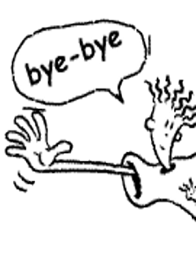
Thank you for your attention

