Slide 1
Negotiation – Basic Tips
Jan Řezáč
02/05/2016

Slide 2
Content
BATNA
Anchoring
Heuristics
Model Example – multicultural negotiation

Slide 3
Best Alternative to a Negotiated Agreement
The strategy calls for an alternate plan if the talks start to go out of control
An example is for a buyer to request information from more suppliers before commiting
BATNA should include costs, feasibility, impact and consequences of your alternative

Slide 4
Anchoring
Anchoring means that first perception lingers in mind, affecting later perceptions and decisions
A typical example are companies setting price artificially higher, so they present normal price as a „discount“ compared to the initially high price
This phenomenon holds even if the first anchoring number is completely random, and has a surprisingly large effect

Slide 6
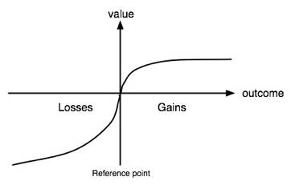
Heuristics
Heuristics (in psychology) is a practical method to solve problems or calculations not guaranteed to be optimal or perfect
A typical example of people using heuristics is them trying to avoid losses
This is useful to negotiatiors, as they might try to frame all decisions in positive way

Slide 7
Sources:
Getting to Yes: Negotiating Agreement Without Giving In, Roger Fisher and William L. Ury. 1981
Kahneman, D.; Tversky, A. (1979). "Prospect Theory: An Analysis of Decision under Risk". Econometrica 47 (2): 263–291.
Negotiation Genius: How to Overcome Obstacles and Achieve Brilliant Results at the Bargaining Table and Beyond, Deepak Malhotra, Max H. Bazerman, 2008

