Slide 1
Gartner Magic Quadrant Tool
J.Skorkovský
Department of Business Economy

Slide 2

Agenda related to MQ Matrix
Positioning Technology Players Within a Specific Market
Giving you a wide-angle view of the relative positions of the market's competitors
Helps to digest how well technology providers are executing against their stated vision

Slide 3




MQ Matrix
Challengers
Leaders
Ability to execute
Niche players (gap in the market)
Visionaries
Completeness of vision

Slide 4
MQ Matrix explanation
Leaders execute well against their current vision and are well positioned for tomorrow.
Visionaries understand where the market is going or have a vision for changing market rules, but do not yet execute well.
Niche Players focus successfully on a small segment, or are unfocused and do not out-innovate or outperform others
Challengers execute well today or may dominate a large segment, but do not demonstrate an understanding of market direction.

Slide 5
MQ Matrix
„A“ better than „B“ and „B“ Better than“C“
Challengers
Leaders
Ability to execute
A
B
Niche players
C
Visionaries
Completeness of vision

Slide 6
MQ Matrix
Using colors in order to show progress (Red =bad, Green = good)
Challengers
Leaders
B
A
Ability to execute
B
A
Niche players
C
Visionaries
Completeness of vision

Slide 7
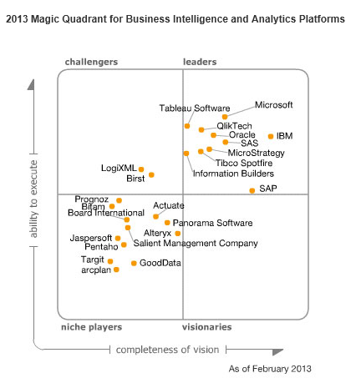
MQ for BI

Slide 8
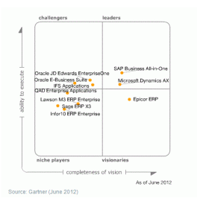
MQ for ERP

