Slide 1
Introduction to MS Dynamics NAV XXI. (Accounting Schedule)
Ing.J.Skorkovský,CSc.
MASARYK UNIVERSITY BRNO, Czech Republic
Faculty of economics and business administration
Department of corporate economy

Slide 2
Accounting Schedules
Benefits
  User defined templates used to get reports
  Programming services necessary to create required specific reports are not used – lower costs and faster access to important data
  You can use Account schedules to analyse figures in G/L accounts or to compare G/L entries with G/L budget entries
  By employing user-defined rows and columns, you can decide exactly which figures you wish to compare and how !!
  This means that you can create as many customized financial statements as you want without using the Report Designer.

Slide 3
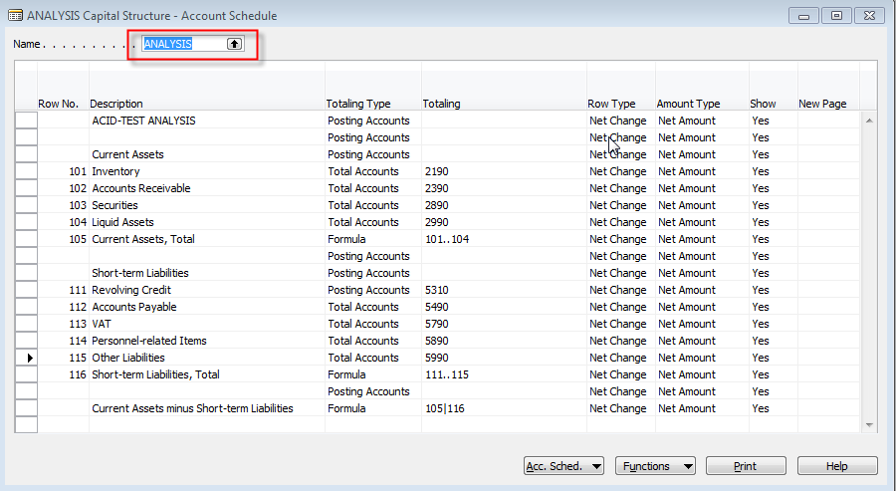
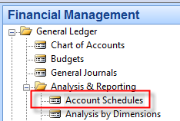
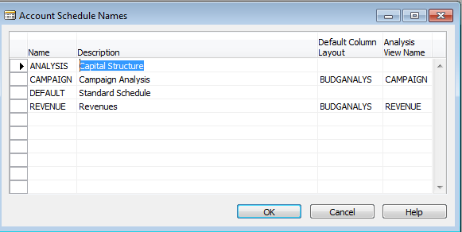
Example of already designed report

Slide 4
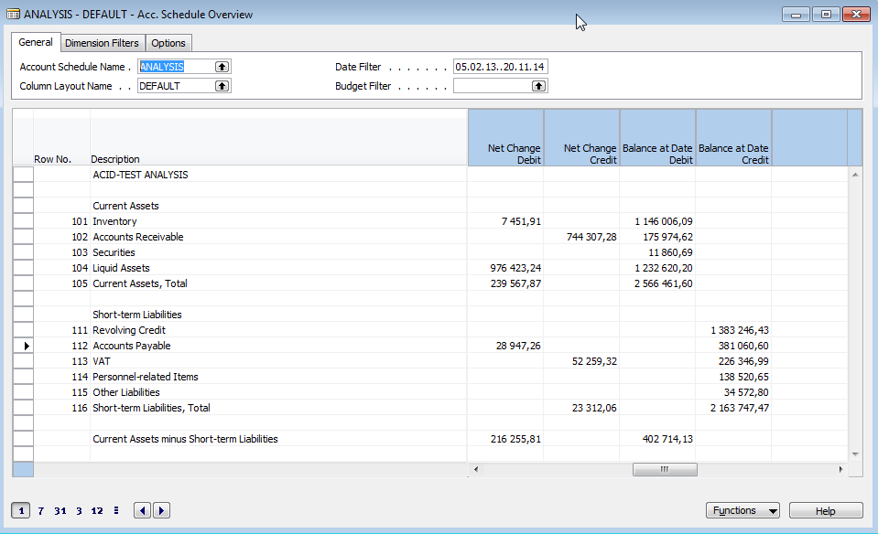
Data display I.
Use button Account Schedule and Option Overview
Modify Date filter From - To

Slide 5
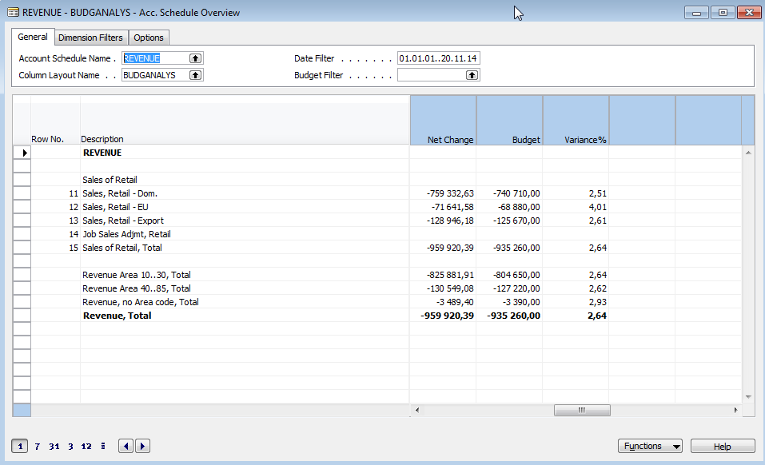
Data display II.
Use button Account Schedule Name = Revenue
Use Column Layout Name = BudgAnalys

Slide 6
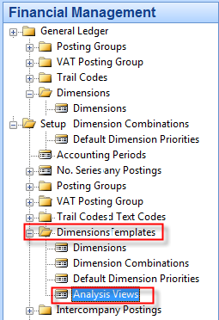
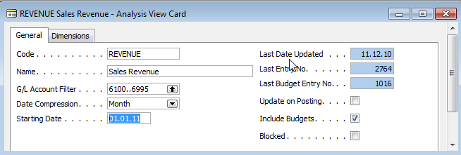
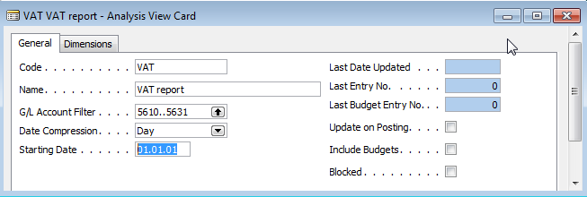
Creation of simple report
F3

Slide 7
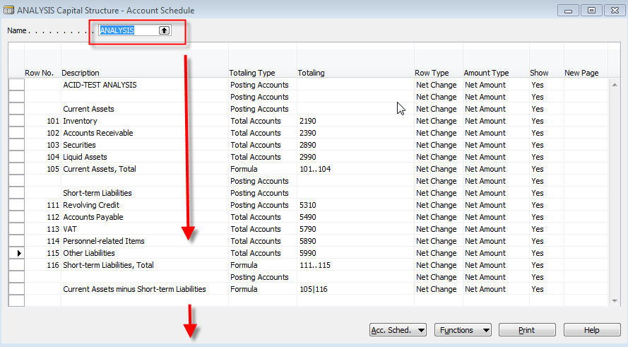
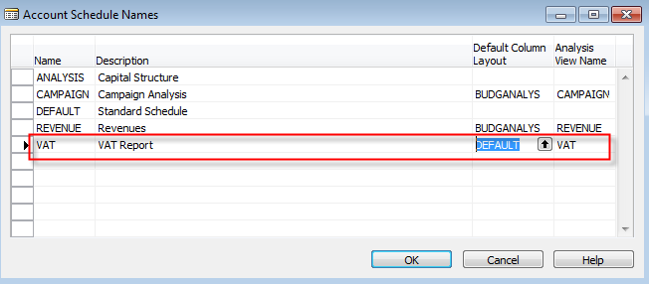
Creation of simple report

Slide 8
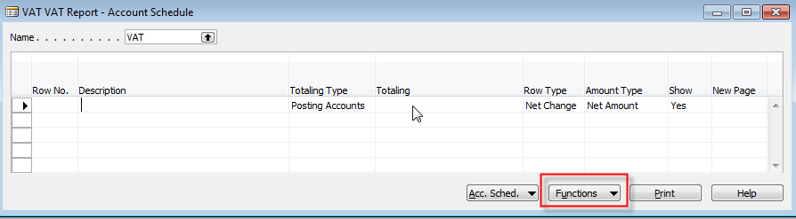
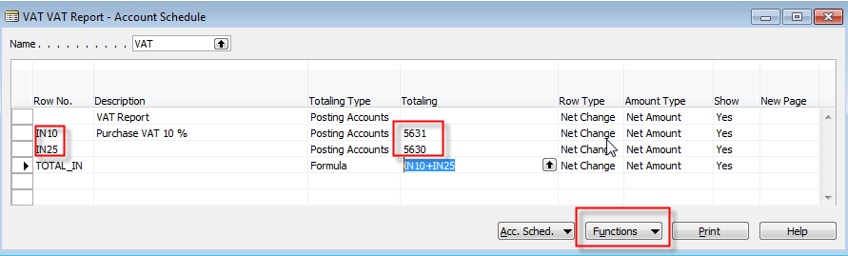
Creation of simple report
Enter Accounts by use of Function from Chart of accounts and rewrite account . In the row columns enter your variables (e.g. IN1O and IN25 for VAT10% and VAT 25%) Add line formula to calculate total

Slide 9
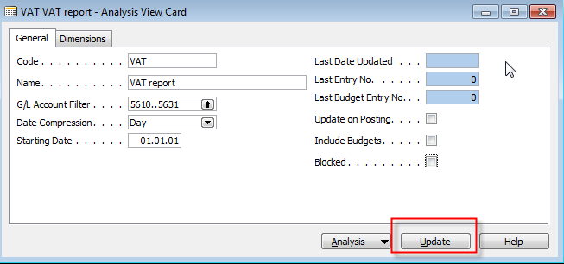
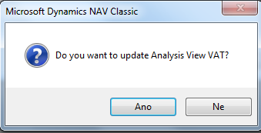
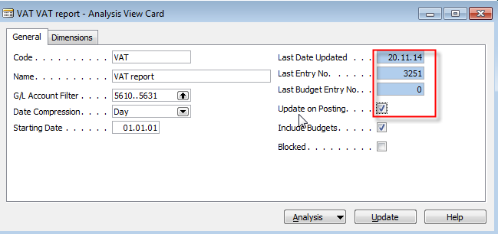
Creation of simple report

Slide 10
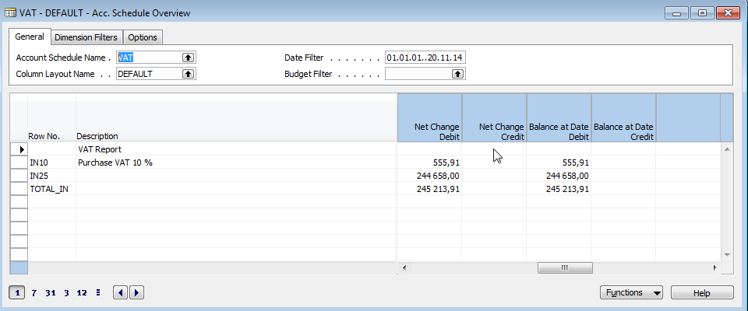
Creation of simple report

Slide 11
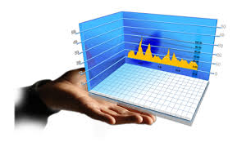
End of the section XXI.

