Slide 1
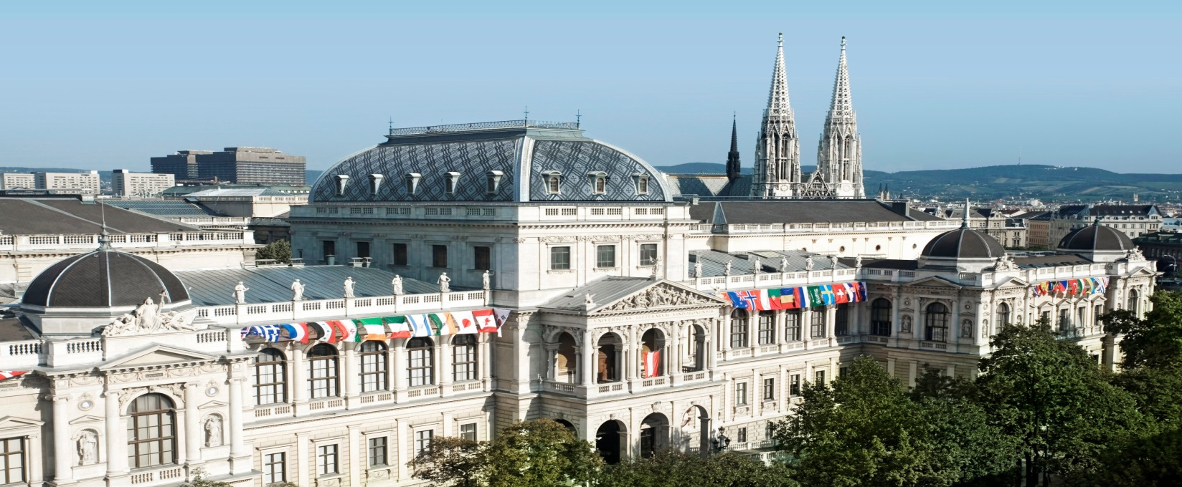
Applying Knowledge Management and Responsibility:
Gödel in Context [Ideas for a New Enlightenment]
(Re-Combining Theories and Practices for a European Competitive Advantage)
Univ.-Prof. Dr. Rainer Born rainer.born@jku.at / rainer.born@univie.ac.at

Slide 2
Thesis one (justified empirically and theoretically):
One cannot simply reduce the (re-) production of, for instance, entrepreneurial success (nor the parameter values to measure it) to the application of simple rules/routines (or the instantiation of algorithms) in such a way, that some user of those rules does not need to enrich their own BACKGROUND KNOWLEDGE (provided one is not just interested in short-term success or in faking success) to use those rules properly.
Learning is essential! – The assumption of an universal common sense can prove problematic.

Slide 3
Knowledge Management has amongst other things two main tasks:
1.) To identify, make explicit and document the knowledge considered
to explain and thus to be considered responsible for successful problem solutions
(in production and any other relevant contexts).
2.) To find persuasive arguments to translate relevant knowledge to the
Management in order to successfully enable and support managerial decisions.
Thesis 2)
In consequence we must not simply identify the routines inherent in 1 & 2 and
apply them mechanically, i.e. without corrective reflection. We need to establish,
build up or create extra knowledge for use.

Slide 4
Reflection(s)
„This sentenze contains three mistackes.“ !
Can you put your finger on the third mistake ?

Slide 6
3 Postulates (Axioms)
1) Fuzzy Concepts:
Our concepts (in use) are necessarily fuzzy (Limits of Aristotelian Logic).
2) Incompleteness of Maps, Models and Theories:
Our maps, models and theories are necessary incomplete and only locally and approximately true to the facts – local applicability vs. generalizability. – Decisions resting upon incomplete information.
3) Non Literally action guiding: Our theoretical explanations and insights are not literally action guiding, i.e., our explanations should not be considered as literally descriptive action guiding suggestions, and we should provide a corrective leeway (by reflection, dialogue and understanding the simplifications inherent in our maps of the world).

Slide 7
E
E
K
F
Implicit Explanatory Core Idea

Slide 8
EXPERTISE
E
E
Scissors of
Knowledge & Life (Meaning)
K
F
ROUTINES
Folk Knowledge
Implicit Explanatory Core Idea

Slide 9
EXPERTISE
E
E
Dialogue
Scissors of
Knowledge & Life (Meaning)
K
F
ROUTINES
Folk Knowledge
Implicit Explanatory Core Idea

Slide 10
„The map is not the territory!“
(Alfred Korzybski, Gregory Bateson)

Slide 11
Notes:
Es geht um den Bezug der (Land-) Karte zur Wirklichkeit…
Cf. Richard Nisbet: Geography of Thought
Die Geographie (auch Geografie, griechisch γεωγραφία geografia) oder Erdkunde ist die Wissenschaft, die sich mit der räumlichen Struktur und Entwicklung der Erdoberfläche befasst, sowohl in ihrer physischen Beschaffenheit wie auch als Raum und Ort des menschlichen Lebens und Handelns.^{[1][2]} Sie beschreibt und erklärt darüber hinaus, wie sich der Geographische Raum und die Vorgänge an der Erdoberfläche auf den Menschen auswirken. Sie entwickelt Konzepte zum Verständnis und zur Lösung von Problemen zwischen Mensch und Umwelt. Sie bewegt sich dabei oft an der Nahtstelle zwischen den Naturwissenschaften und den Sozialwissenschaften.
Gegenstand der Geographie ist die gesamtheitliche Erfassung, Beschreibung und Erklärung der Strukturen, Prozesse und Wechselwirkungen in der Geosphäre. Die isolierte mathematisch-physikalische beziehungsweise biologische Erforschung ihrer Einzelerscheinungen ist jedoch Gegenstand anderer Geowissenschaften

Slide 12
Question(s)
Can we turn all this into Rules (for a mindless) application, usable independently of any experiential knowledge ?
Preconception of universal common sense – Example Ford vs Toyota?
What kind of extra Knowledge is missing, what explains the so called initial successes of digitalization ?

Slide 13
Basic Metaphor
Man is not [just] a didactic being,
but one that lives and acts and influences.
J. W. v. Goethe
Understanding the relation between local knowledge (expertise) and the world as a chance for realizing/actualizing a new competitive/survival advantage
Why (according to Hilary Putnam / Harvard) should we need a new (3rd) enlightenment) ?

Slide 14
Re-Combining Theories and Practices – by Creating an European Competitive Advantage
(Creativity and Innovation via Activating Expertise, Background-Knowledge and Autonomy in „Thinking and Doing“)
Meaning is a means to come to terms with reality.
Crowding out the Meaning of meaning, means to replace the explanatory construction of meaning by an unreflected „processing of information“ – we need to reintegrate pre-knowledge and experience into the use of algorithms/rules to creatively activate means of correction in view of the formal incompleteness of our theories, models and maps to support evolution and create new solutions to survive and adopt in an ever changing environment and world.

Slide 15

Some Metaphors !

Slide 18
Impossible Connections

Slide 19
Nine-points-problem and solution:
How to step out of the system !
Original task:
Connect the 9 points with one line but without lifting your pencil from the paper !
Proposal:
Imbed the 9 points into a constructed “solution-space” of 16 points !

Slide 20
„Our heads are round to allow our thoughts to change direction“
(Francis Picabia)
Stepping out of the system to support „Creativity and Innovation“
Illustration:
A masochist approaches a sadist and pleads to be tortured but the sadist says: "NO!“
Humour versus documentation?

Slide 21
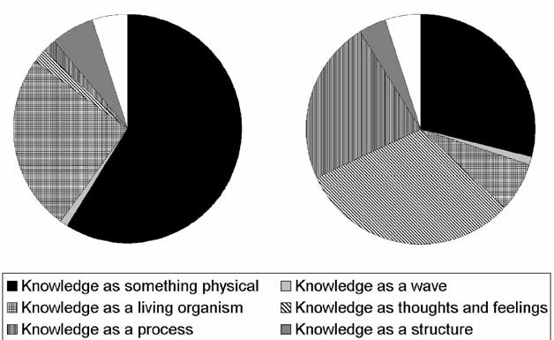
Process
Thoughts and Feelings
Generations of Knowledge Management:
Difference in metaphors between Davenport & Prusak (1998) and
Nonaka & Takeuchi (1995) (Andriessen, 2006).

Slide 23
E
E
Scissors-of-Life & Knowledge &
Meaning as Sense Making
K
F

Slide 24
EXPERTISE
E
E
Dialogue
Scissors of
Knowledge & Life (Meaning)
K
F
ROUTINES
Folk Knowledge
Implicit Explanatory Core Idea

Slide 25
“What Turing disregards completely is the fact that MIND, in its use, is not static, but constantly developing, i.e., that we understand abstract terms more and more precisely as we go on using them, and that more and more abstract terms enter the sphere of our understanding.”
Kurt Gödel, 1972
(Some Remarks on the Undecidability Results. In: Coll. Works, Vol. 2, p. 306)

Slide 26
What Turing disregards completely is the fact that MIND, in its use, is not static, but constantly developing, i. e. that we understand abstract terms more and more precisely as we go on using them, and that more and more abstract terms enter the sphere of our understanding. -- Kurt Gödel, 1972
“The idea that everything in the world has meaning is, after all, precisely analogous to the principle that everything has a cause, on which the whole of science rests.” (Letter to his Mother : Gödel 1961)

Slide 27
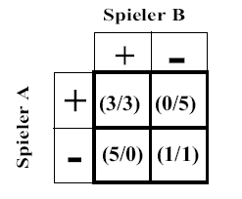
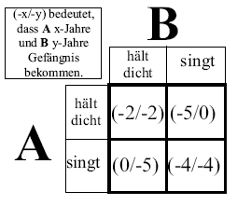
Kurzfassung des Zwei-Personen Gefangenen-Dilemmas (ohne Wiederholung)
Shortcut of the two-person prisoners‘ dilemma (without repetition)
Dsecription vs Explanation // Prediction
(-x/-y) means A gets x-years & B gets y-years of imprisonment
Player B
cooperates
defects
cooperates
Player A
defects
canonical benefit-/pay-off matrix in the
two-person prisoners dilemma without repetition
canonical benefit-/pay-off matrix in the
two-person prisoners dilemma without repetition
benefit-matrix for real prisoners
And their dilemma
benefit-matrix for real prisoners
and their dilemma
If both confess, they will get 4 years imprisonment each
[in the pay-off or evaluation-matrix: (-4/-4)].
Adding +5 to each number yields the solution (right picture).
‚+‘ means „cooperating“, ‚-‘ means to
„defect“.
Short version: A and B have comitted a crime
and are imprisoned but cannot be proven to be
guilty. There are however facts that could get
them into jail for just two years [ (-2/-2) in the
matrix above] (i. e. if none confesses). If one
acts as prime testimonial he will be free but
the other will be imprisoned for 5 years [(0/-5)
or (-5/0)].
If both confess, they will get 4 years imprisonment each
[in the pay-off or evaluation-matrix: (-4/-4)].
Adding +5 to each number yields the normed solution (right picture).
‚+‘ means „cooperating“, ‚-‘ means to
„defect“.

Slide 28

These are the days of quick trips, disposable diapers, throwaway morality, one night stands, overweight bodies, and pills
that do everything from
cheer, to quiet, to kill.
George Carlin's The Paradox of Our Time-Fiction!
Written AFTER THE DEATH OF HIS WIFE!

Slide 29

It is a time when there is much in the showroom window and nothing in the
stockroom. A time when technology can bring this letter to you, and a time
when you can choose either to share this insight, or to just hit delete.
George Carlin's The Paradox of Our Time-Fiction!
Written AFTER THE DEATH OF HIS WIFE!

Slide 30

Communication
between you and me relies on assumptions, associations, communalities and the kind of AGREED SHORTHAND, which no-one could precisely define but which everyone would admit to exist.

Slide 31

That is one reason why sometimes it is an effort to have a proper conversation in a foreign language.

Slide 32

Even if I am quite fluent, even if I understand the dictionary definitions of words and phrases, I cannot rely on a shorthand with the other party, whose habit of mind is subtly different from my own.

Slide 33

Nevertheless, all of us know of times when we have not been able to communicate in words a deep emotion and yet we know we have been understood.
J. Winterson

Slide 34
The End
Thanks for not going to sleep / Otherwise, hope you had a peaceful time !

Slide 35
Spezial Folien (Selektion)

Slide 36
The Road Not Taken
Robert Frost, 1874 - 1963
. . .
Two roads diverged in a wood, and I --
I took the one less traveled by,
And that has made all the difference.
Stopping by Woods on a Snowy Evening
. . .
But I have promises to keep,
and miles to go before I sleep,
and miles to go before I sleep.

Slide 37
What Turing disregards completely is the fact that MIND, in its use, is not static, but constantly developing, i. e. that we understand abstract terms more and more precisely as we go on using them, and that more and more abstract terms enter the sphere of our understanding. -- Kurt Gödel, 1972
“The idea that everything in the world has meaning is, after all, precisely analogous to the principle that everything has a cause, on which the whole of science rests.”
(Gödel 1961)

Slide 38
Overview// Techniques of KM & Mechanisms of Cooperation
(knowledge)-
Evaluation
(measurements)
H;
result orientation
aim
(- formulation)
F(P) = S
R = F(Q)
process-organisation
D
professionalism
Info & Comm.-technologies
[Information]
knowledge]
Personal effectiveness
leading-systems
M
modeling
design
produce
internalising
implement
exchange
E
development
distribution
Reputation
Indirect reciprocity
multilevel selection
Knowledge
A
Use application Umsetzung
C
Evaluation
Spatial Selection
[data /documentation]
[Ethics / Morals / Wisdom]
Anknüpfungs-kontext /
- Bereich
Repetition
Direct reciprocity
saving
identification
Kin—
selection
externalising
assess
saving
socialising
observe
applying
K
F
Controling
market orientation
B
People orientation
management of people
Culture of an enterprise
Q
P
[starting-] (-situation)
client orientation
(final state / aim)
(knowledge-) gathering

Slide 39
COST STRUCTURE
[9]
[5]
REVENUE STREAMS
Conditionality
{E, F, K, M} =:
H;
S
argumentation
R
mental models/
multilevel selection
personal mastery/
reputation
VALUE PROPOSITION(S)
M
[6]
[3]
E
[2]
meta-knowledge/structure
models/explanations
(spatial selection)
expertise (communication)
KEY RESOURCES
5th DISCIPLIN
CHANELS
KNOW WHAT / COGNITION
team learning/repetition
(SYSTEMS THINKING)
Peter Senge
shared vision/meaning/
kin-selection
KNOW HOW / EMOTIONS
K
[7]
[4]
F
routines/rules /
regulations/heuristics
Measures for
(corrective)
acting
user/folk knowledge
KEY ACTIVITIES
CUSTOMER RELATIONSHIPS
KEY PARTNERSHIPS
CUSTOMER SEGMENTS
[8]
problem(s)
P
Q
solution(s)
[1]
Causality
39
Canvas Method embedded

Slide 40
Practical relevance of
Industrial Commons:
The sum of the local
optimizations
(the combination of the
two dimensional maps)
is not an optimal result
for the whole as such.
[We need bilateral
cooperation and
corrections
via e. g. dialogue!]
H +
S
R
Emotion
A
C
Simplifications
Analysis
P
Q

Slide 41
M
(creating and explaining the
meaning of road-marks)
E
E
COMMONS
Dialogue
Scissors of Life
K
F
F*
Q??
[Q*]
Q?
P
ACTIONS
Q*
Q
[Q]
41

Slide 42
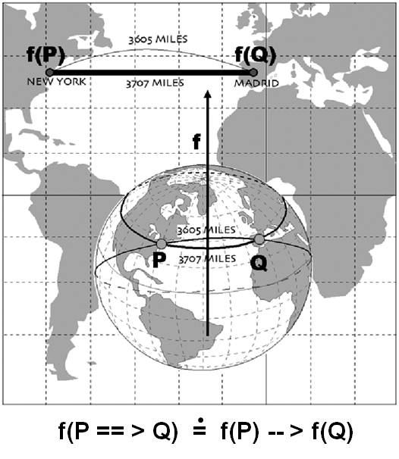
Latitude
Local approximization:

Slide 43
Some Introductury Remarks: The Third Industrial Revolution
„…traditional, hierarchical organization of economic and political power will give way to lateral power organized nodally (m.e.) across society.“ [Rifkin, J. (2011). The Third Industrial Revolution, NY, p. 5].
„…today, however, the collaborative power unleashed by the merging of Internet technology and renewable energies is fundamentally restructuring human relationships, from top to bottom to side to side, with profound implications for the future of society.“ (ibid.) [e.g., network economics ].
Which problems should be
(re-) solved?

Slide 44
Industrial Commons
„are the R&D manufacturing infrastructure, know-how, process-development skills, and engineering capabilities embedded in firms, universities, and other organizations that provide the foundation for growth and innovation in a wide range of industries “
[Pisano, G., & Shih, W. (2012). Producing Prosperity. Boston: Harvard University Press, p. 3].

Slide 45
Turings „Universal Machine“ (1936/37) and von Neumann’s implementation of it [in modern computers] are direct offsprings of Gödel’s ideas ! -- George Dsyon : Turing’s Cathedral (The Origins of the Digital Universe) pp106/7 London/Penguin, 2012
p107: Where does meaning [knowledge/epistemology] come in? If everything is assigned a number, does this diminish the meaning of the world? ... What Gödel (and Turing) proved is that formal systems will, sooner or later, produce meaningful statememts whose truth can be proved only [from] outside [of] the system itself. ... It proves ... that we live in a world where higher meaning[-s] exists.
What Turing disregards completely is the fact that MIND [and especially KNOWLEDGE], in its use, is not static, but constantly developing, i. e. that we understand abstract terms more and more precisely as we go on using them, and that more and more abstract terms enter the sphere of our understanding. -- Kurt Gödel, 1972
(Some Remarks on the Undecidability Results. In: Feferman, Coll. Works [of Gödel] vol 2, p 306)

Slide 47
Levels of Reflection

Slide 48
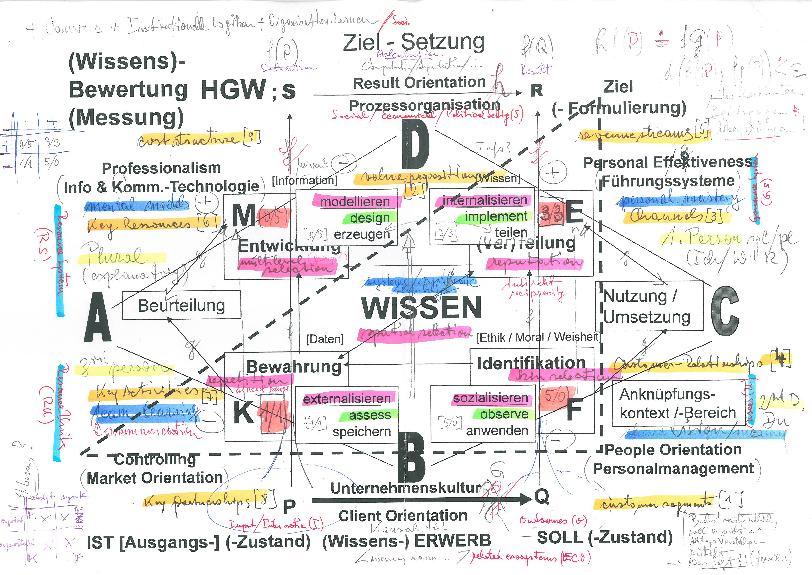

Slide 49
On Applying LIR++
  Improving interdisciplinary discourse, understanding knowledge and transfer of expertise: One can achieve not only a better way of understanding each other but one can also improve the culture of dialog and mutual ways to deal with errors and reflect the limits of any “rule system”, i.e., any method to generate results.
  How the idea of proactive, constructive dialogue can lead to local improvements of knowledge nodes in a network patchwork of knowledge: The point is that in/between small and therefore survey-able units common aims and insights (by means of sharing expertise) can lead to local mutual corrections of and within knowledge nodes and thus can help to prevent an excessive overuse/exploitation of resources as a consequence of maximizing local profit unreflectively.

Slide 51
Practical Consequences
  Questioning and correcting the unrestricted action guiding use of local correspondences between causal relations P ➔ Q in (segments of) reality and logical (or conditional) relations f(P) → f(Q) in language (Gregory Bateson: “The map is not the territory”; see also Haridimos Tsoukas)
  Overcoming this (locally valid or successful) identification as a source of insufficient scientific/practical achievements by plain practitioners
  Re-establishing dialogue as a means for evaluating and correcting actions, i.e., as mediator between the micro- and macro- level

Slide 52
M
(creating and explaining the
meaning of ROAD MARKs)
E
E
E*
COMMONS
Dialogue
Scissors of Knowledge & Meaning
K
F
F*
Q??
[Q*]
Q?
P
ACTIONS
Q*
Q
[Q]
52

Slide 53
Local Approximization(s):
„Managerial Rationalizations“
COMPUTATION / ARGUMENTATION
INFORMATION PROCESSING
H +
f(P)
f(Q)
M
MAPS
E
A
DE-CONTEXTUALISATION
C
Aspects of Simplification
SIMPLIFICATION
MAPPING
f
f
INTERPRETATION
Aspects of Re-Application
K
RE-CONTEXTUALISATION
F
Cognition
Emotion
P
Q
REAL / CAUSAL
CONNECTIONS
[P]
[Q]
THE TERRITORY
NEW CASES OF
APPLICATION
CATEGORIZATION
.
„If, then …“ f (P ==> Q) = f (P) --> f (Q) „If, then …“

Slide 54
H +
COMPUTATION / ARGUMENTATION
f(P)
f(Q)
A
INFORMATION / KNOWLEDGE
C
P
REAL / CAUSAL
CONNECTIONS
Q
CATEGORIZATION
NEW CASES OF
APPLICATION
54

Slide 55
The Core:
Rationalizations
H +
S
COMPUTATION / ARGUMENTATION
R
f(P)
f(Q)
g
A
F
C
f
f
P
h
Q
REAL / CAUSAL
CONNECTIONS
CATEGORIZATION
NEW CASES OF
APPLICATION
g after f (P) . f after h (P)
[ f(P) = S & h(P) = Q ]
⁼
55

