Slide 1
Introduction. Requirements,Communication processes
Jan Řezáč
22/02/2016

Slide 2
Today
Introduction
Course requirements
Your input
Bonus topic: The Art of Listening

Slide 3
What will you study here?
Communication processes
Basic communication skills
Assertiveness and its significance
Effective presentation
Personality communication types
Negotiating
Practice > Listening

Slide 4
Course requirements
Lectures are NOT mandatory
Seminars ARE mandatory. There is one absence allowed.
Short presentation at one of the seminars
Final test (after the course ends, date will be announced)

Slide 5
Contacts
Regarding seminars (attendance, tasks), please contact ms Kucharova
Regarding lectures (theory, topics), please write me: 216776@mail.muni.cz
For official matters, we prefer email. My contact hours are the Mondays right after we have lectures.
Lecture time: 16:20 - 17:50. The last lecture is on 20th March, 16:20-19:30.

Slide 6
What is communication?
Communicator
Communication Channel/Codes
Communicant

Slide 7
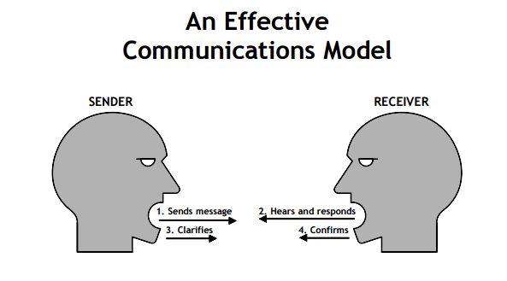
Basic theory
Communication is not only transfer of knowledge, but a social interaction
Important is both How and What we communicate, verbally and non-verbally

Slide 8
What makes for effective communication?
“I know that you believe you understand what you think I said, but I am not sure you realize that what you heard is not what I meant!”

Slide 9
Structure of an Interaction
Intention of the speaker
How speaker understands what s/he is saying
Content of the interaction
How listener understands what was said
Impact on the listener

Slide 10
What bad things can happen?
Thought
Thought
Impact
Intent
Coding
Trans-mission
Decoding

Slide 11
What bad things can happen?
Thought
Thought
Impact
Intent
Coding
Trans-mission
Decoding
Unclear message
Ambivalent meaning
Unknown concepts
Noise
Distractions
Loss of
attention
Selective attention,
Biases due to attitude difference,…

Slide 12
Your First Date with Your Crush
Imagine – you sit in a nice restaurant on a first day with your crush.
How do you communicate?

Slide 13
Your First Date with Your Crush II.
One of the biggest differences between communication with your crush and with your mother is the amount of effort you put to listening.
Deep focus on listening makes you a better partner in conversation.

Slide 14
The Listening Dilemma
We speak at a rate of about 150 words per minute (wpm).
We can hear at a rate of about 1,000 wpm
What do we do with this time?

Slide 15
Listening as a Skill and an Exercise
Because we can listen when we need, it is a skill to be practiced and improved.
It is one of the examples of things we can do better, resulting in better relationship in the workplace and beyond.
Possible homework: Start at two minutes of concentrated listening, and continue.

Slide 16
First Activity – Split into pairs.
Your task: to tell an example of
Something interesting what happened to you today.
Some (ideally job related) problem you face.
90-120 seconds
For listeners: completely focus on what is the other person saying.

Slide 17
How to be a Good Listener
Why we listen - the other persons spends time to talk to us.
Answer – Seeking or request for truth, information or knowledge
We should ask questions to which we do not already know the answer, and make a relationship based on curiosity and interest in the other person.

Slide 18
Can we ask good questions?
The issue: We value task accomplishment over relationship building. For this reason we TELL.
Consequence: Communication is often bad. Subordinates know lots of things that would make the place work better or safer that they for various reasons do not say.
We fail to notice how often even our questions are just another form of telling—rhetorical or just testing whether what we think is right.

Slide 19
What happens when we tell and ask questions?
Telling puts the other person down. It implies that the other person does not already know what we are telling and that the other person ought to know it.
honest,
open,
vulnerable,
curiosity-driven
leading,
rhetorical,
embarrassing,
statements in the form of questions

Slide 20
The Question and Listening Practice:
Identify a (business) problem on which to focus
Take 2 minutes to write down a problem you own. It should be a condition you are comfortable talking about in this small group of people.
If it is a complex problem, please make it easy enough to talk about in a few minutes.

Slide 21
The Question and Listening Practice:
Problem Owner --> Uses questions asked to begin to better grasp the Situation.
Questioner -->Practices Inquiry only to support the Problem Owner with grasping the Situation.
5 minutes: Problem Owner briefly describes the problem / condition for which s/he has responsibility to improve.
7 minutes: Questioner Practices Inquiry – asking questions only

Slide 22
Recommended Literature (non-mandatory list of good COMA related books)
Thinking, Fast and Slow;Daniel Kahneman
Mistakes Were Made (But Not by Me); Carol Tavris, Elliot Aronson
Never Split the Difference: Negotiating As If Your Life Depended On It; Chris Voss
What Got You Here Won't Get You There: How Successful People Become Even More Successful; Marshall Goldsmith
Interpersonal Conflict, William Wilmot; Joyce Hocker
Always read carefully

Slide 23
Your input
Questions about this lesson.
Suggestions for next lessons.

Slide 24
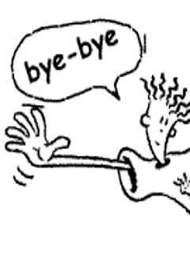
Thank you for your attention

