Slide 1
Assertiveness
Jan Řezáč
21/03/2016

Slide 2
ASSERTIVENESS
In Latin assere means claim, affirm, emphasize, declare
When you are: Self-confident, responsible for myself, respect others, listen to them, cooperate with them. Assertiveness is often linked to self-esteem.
In the field of psychology and psychotherapy, it is a learnable skill and mode of communication.

Slide 3
ASSERTIVENESS
is the quality of being self-assured, cooperative and confident without being aggressive or passive.
Mostly, understand others, cooperate, find the
consensus, also to be able to say NO and resist pressure
passive behaviour: sometimes the way we react and respond to others can make us feel inadequate, guilty or regretful.
aggressive behaviour: we may also feel angry and critical of others during conversations.
assertive behaviour: is expressing your thoughts, emotions, beliefs and opinions in an honest and appropriate way.

Slide 4
Assertiveness and Rights
Assertiveness can be described as a way to balance the rights of the two parties involved.
A G G R E S S
More
Yours
A S S E
N O N
Importance
Rights
I VE
R T I VE
- A S S E R T I V E
Less
Theirs

Slide 5
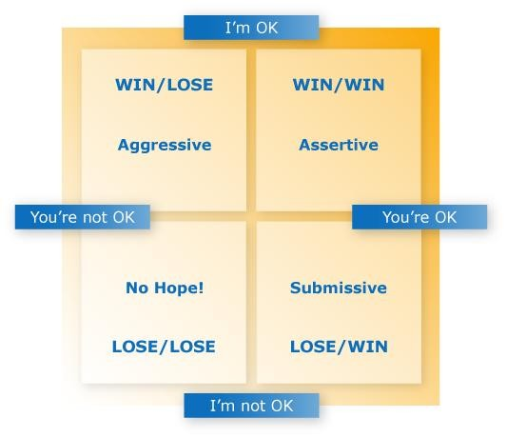
Zdroj:
http://www.alchemyformanagers.co.uk/topics/U7FcjfSSxK3jHuCS.html

Slide 6
FOR EXAMPLE…
Examples
Aggressive
  you exert your right to have ideas and opinions at the expense of the other person’s rights. You might even behave as if the other person’s rights don’t matter.
Assertive
  you exert your rights freely, but at the same time recognise the other person’s rights to be heard, to take pride in what they do, etc.
Non-Assertive
  you put foremost other person’s rights, to the extent that you forego some, or all of your rights to express ideas or influence events.

Slide 7
Examples
Aggressive
  “I don’t know how you’ve got the nerve to give me this sort of stuff for signing. It’s full of mistakes.”
Assertive
 “Jane, I’d like you to re-do this document as there are several mistakes in it.”
Non-Assertive
 “I know it’s probably my fault in not writing very clearly, but is there, any chance at all you could find a spare minute to just change one or two small things on this letter for me?”
Or you find an excuse not to pursue changes in the document at all.

Slide 8
Exercise 1: Aggressive, Passive or Assertive?
Threats and intimidation
    Aggressive
Never sharing your ideas
    Passive
Accepting compliments comfortably
    Assertive
Manipulating
    Aggressive
Not saying no (when you should)
    Passive
Not saying yes (when you want to)
    Passive

Slide 9
Exercise 1: Aggressive, Passive or Assertive?
Sarcasm
    Aggressive
Using “I need, I want, I feel” statements to express your needs, wants, feelings, or concerns
    Assertive
Over apologizing
    Passive
Respecting the opinions and needs of others
    Assertive
Withdrawal
    Passive
Blaming
    Aggressive

Slide 10
Exercise 1: Aggressive, Passive or Assertive?
Believing in own opinion and right to be heard
    Assertive
Easily intimidated by others
    Passive
Violating others’ rights and boundaries in an effort to get what she wants
    Aggressive
Using “I” statements to get the message across
    Assertive
Worrying about others getting angry
    Passive

Slide 11
WHAT DRIVES BEHAVIOUR
Inner Dialogues can affect the way we respond, for
example:
Aggressive “If people produce rubbish, I have every right to tell them so”. “She obviously doesn’t care. That’s typical of young people today.” “This reflects badly on me, and I won’t stand for it.”
Assertive “This may be uncomfortable for us both, but we can handle it.” “She has the right to make mistakes, but the responsibility to correct them.” “I want her to know the effect her errors have on other people.”
Non-Assertive “I don’t want to make a scene or upset our working relationship.” “I’m sure these are unintentional errors – I’ll let it go this time.” “I know she’s very busy, so I expect that’s why these mistakes happened.”
Being aware of these Inner Dialogues can help us consider our response and adjust behaviour to be assertive!

Slide 12
ASSERTIVE PEOPLE
feel free to express their feelings, thoughts, and desires;
are also able to initiate and maintain comfortable relationships with other people;
have control over their anger. This does not mean that they repress this feeling; it means that they control anger and talk about it in a reasoning manner;
are willing to compromise with others, rather than always pursuing their own way
tend to have good self-esteem;
enter friendships from an 'I understand my needs. I see your needs' position".
know their rights;

Slide 13
Assertive rights
Several counterintuitive examples:
Right not to give excuses
Right to take responsibility
Right to make mistakes
Right to change opinion
Right to assess how responsible you are for others
Right to say „I don´t know and I don´t understand
Right to make illogical decisions
Right not to give a damn.

Slide 14
Exercise:
A colleague is going to be on the lunch break longer than s/he should be and asks you to take over.
You don’t like that she asked that from you.

Slide 15
Exercise
During meeting two your colleagues are discussing while you are presenting a report.

Slide 16
Exercise
Your subordinate asks for holiday on Thursday, because her brother is coming. But it is the end of the quarter and you necessarily need her at the workplace.

Slide 17
ASSERTIVE TECHNIQUES I
Fogging
  Fogging is a useful technique if people are behaving in a
manipulative or aggressive way.
  Fogging is so termed because the individual acts like a 'wall of fog' into which arguments are thrown, but not returned.
  involves agreeing with any truth that may be contained within statements, even if critical. By not responding in the expected way, in other words by being defensive or argumentative, the other person will cease confrontation as the desired effect is not being achieved.
○
Find more at: http://www.skillsyouneed.com/ps/assertiveness-
techniques.html#ixzz2vpzAfket

Slide 18
FOGGING
Example Situation
“What time do you call this? You're late! I'm fed up with you letting me down all the time.”
Fogging response:
“Yes, I am later than I hoped to be and I can see
this has annoyed you.”
“Annoyed? Of course I'm annoyed, this has left me waiting for ages. You really should try to think about other people a bit more.”
Fogging response:
“Yes, I was concerned that you would be left waiting for almost half an hour.”
“Well... why were you late?”

Slide 19
ASSERTIVE TECHNIQUES II
The Stuck Record Technique
  It involves repeating what you want, time and time again, without raising the tone of your voice, becoming angry, irritated, or involved in side issues.
  It employs the key assertive skill of calm persistence.
  It also allows you to keep your strengths and also focus on the issue.

Slide 20
THE STUCK RECORD TECHNIQUE
Example Situation
Imagine that you are returning something that is faulty to
a store. The conversation may go as follows.
“I bought these shoes last week and the heels have fallen off. I would like a refund please.”
“It looks like they've been worn a lot and these shoes were only designed for occasional wear.”
Stuck Record technique response:
“I have only had them a week and they are faulty. I would like a refund please.”
“You cannot expect me to give you your money back after
you've worn them out.”
Stuck Record technique response:
“The heels have fallen off after only a week and I would like a refund please.”
○

Slide 21
ASSERTIVE TECHNIQUES III
Positive enquiry is a simple technique for handling positive comments such as praise and compliments.
People often struggle with responding to praise and compliments, especially those with lower self-esteem as they may feel inadequate or that the positive comments are not justified.
Positive enquiry is used to find out more details about the compliment or praise given, and agree with it.

Slide 22
POSITIVE ENQUIRY
Example Situation
Sender:
“You made an excellent meal tonight, it was delicious!”
Receiver:
“Thanks. Yes, it was good. What did you like about it in particular?”
This is different from a passive response that may
have been:
"It was no effort" or "It was just a standard recipe"

Slide 23
ASSERTIVE TECHNIQUES IV
Negative Enquiry
The opposite of positive enquiry is negative
enquiry.
Negative enquiry is a way to respond to more negative exchanges such as receiving criticism.
Negative enquiry is used to find out more about critical comments and is a good alternative to more aggressive or angry responses to criticism.
It helps to work with negative feelings on both sides of the conversation.

Slide 24
NEGATIVE ENQUIRY
Example Situation - Negative Enquiry
Sender:
“That meal was practically inedible, I can't remember the last time I ate something so awful”
Receiver:
“It wasn't the best, exactly what didn’t you like
about it?”
This is different from an aggressive response that
may have been:
"How dare you, I spent all afternoon preparing that meal" or "Well that's the last time I cook for you"

Slide 25
ASSERTIVE TECHNIQUES V - NO
Why is it difficult to say No?
If I say no,they may feel hurt or injected
If I say no this time, they may not like me anymore
If I say no this time,they may never ask again
It might not change anything if I say no
They would say ‘yes’ to me (and so I will feel guilty if I refuse them)
I can’t say no, because I feel sorry for them

Slide 26
HOW TO SAY „NO“ ASSERTIVELY
Start your reply with a clear ,firm,audible ‘no’.
Do not justify or make excuses. Giving a reason is different from over-appologizing.
Feel that you have a right to say no.
Once you have said ‘no’ , do not stay around waiting to be persuaded to change your mind. Make a definite closure by changing the subject,walking away, continuing with what you were doing, whatever is appropriate.

Slide 27
HOW TO SAY „NO“ ASSERTIVELY II
Remember you are saying ‘no’ to that particular
request, not rejecting the person.
If the request takes you unaware or you have not sufficent time to think when asked,you can always say, ‘I will let you know’ in order to make time to think about what you want to say.
Take responsibility for saying no. Do not blame
the other person for asking you.
Ask for more information if you need it in order
to decide whether you want to say ‘yes’ or ‘no’.

Slide 28
Final exercise
You bring your car to a garage for service. You ask the mechanic to call and let you know how much it will cost before doing the work. He doesn't call and when you call him he tells you he has already done the work and your bill is $2500. It is too much.
At a daily briefing with the team, Your manager comes up with an idea, which you yourself had mentioned to her only 3 days ago. The problem was that she indicated that it was her idea. You are annoyed about this, and want to tackle her after the briefing.
You want to go to the department meeting. Your manager says to you: “As everyone can’t go the meeting, would you mind staying and answering the phone.” You do mind.
Your own scenario.

Slide 29
WHY IS IT DIFFICULT TO SAY „YES“
I don’t deserve it.
They might not really mean it.
I am not really sure that is what I want.
I don’t have enough information.

Slide 30
HOW TO SAY „YES“ ASSERTIVELY
Say ‘yes’ clearly and definitely.
Identify why you would find it difficult.
Examine thoughts realistically and ask yourself.
Clarified thoughts first, then reaffirm your desire to say ‘yes’.

Slide 31
What are the benefits of behaving assertively?

Slide 32
Be assertive, change your thinking
http://www.youtube.com/watch?v=XI5XBKZZBIc
Tips for being assertive
http://www.youtube.com/watch?v=ubSL1tFmgDc
Training videos good!:
http://www.youtube.com/watch?v=kW6_U4e5DVI&lis t=PL1ACDDEFDD444060B
http://www.youtube.com/watch?v=HVF2bg_BMqk
Good web page:
http://www.psychologytoday.com/basics/assertiveness

Slide 33
THE INTERPERSONAL CIRCUMPLEX
THEORY AND MODEL
model for conceptualizing, organizing, and assessing interpersonal behavior, traits, and motives (Wiggins, 2003),
was initially inspired by Harry Stack Sullivan (1953) and later realized as a model by Timothy Leary (1957).
These theories suggest that we can understand people's personality in social situations by using only two basic personality trait dimensions. The two traits can have many names depending on the specific theory but here we will conceptualize them as agency and communion.

Slide 34
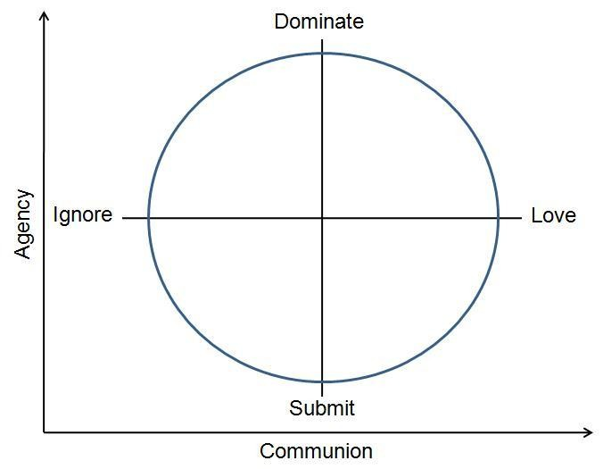
INTERPERSONAL CIRCUMPLEX MODEL
Source: http://webspace.ship.edu/tosato/interpc.htm

Slide 35
ELECTRONIC SOURCES
http://www.skillsyouneed.com/ps/assertiveness- techniques.html#ixzz2vpzAfket
http://webspace.ship.edu/tosato/interpc.htm
Business Communication http://stu.westga.edu/~ahinson1/abed6107/busine ss_comm_index.htm

Slide 36

Thank you for your attention

