Slide 1
Primary activities

Slide 2
Inbound logistics
part of business operations for manufacturing firm involving the processes of recieving , storing and distributing raw materials for use in production.
modern approach defines the inbound marketing
cover anything that company orders from suppliers: tools, raw materials and office equipment
Use the similar marketing methods: research of suppliers, choice of the convenient supplier, regime and terms of delivery nad payment of supplies, and so on.

Slide 3
Material flow
Information flow

Slide 4
Inbound marketing mix
Informational and communication mix
Mix of products and services
Pricing and contractory mix
Logistic mix
Informational and communication mix
Gaining the information from the potential suppliers and communication with the participants on the market (in the area of purchased doods and servises, suppliers, prices, terms of delivery and payment and so on.
Gained information need to be actual and sufficiently detailed.
Sources of these information are the firm documents such as: accounting, statistics, (operative evidence of individual purchase of the technical department and manufacturing departement.)

Slide 5
The ground of communication mix is in perfect information about suppliers such as:
Research of suppliers
Choice of supplier
Communication during the process of ordering and contractation
Communication during the delivery of goods
Communication after the delivery
Evaluation of the supplier and decision concerning the following customer supply relationship.

Slide 6
Product mix and mix of services
Product mix is based on the decision in these area:
Qualitative parametres of each individual product and its substitutes.
Wide and deep of purchased product line and assortment
The choice of material depends on the specifics and norms demanded by the end users and consumers. (national and international norms).
Purchase alternatives: own production, cooperation, leasing

Slide 7
Princing and contractory mix
We find the optimal terms for our company , based on the real and actual information concenring the suppliers
Suppliers compete each other in the area of products, quality, terms of delivery terms of payment .
We assume also the discounts and rebate and eventually surcharge ( for extra services)
Contractory mix includes the decision concerning the way of ordering deliveries. It can be ordering by samples (e.g. fair trade , exhibition) or standard ordering ( e.g.repeated order, longterm cooperation within suppliers )
The economic and administration burden is based on the form of purchase order.

Slide 8
Logistic a delivery mix
Is conected with the decision about purchase realization and its final delivery to the company.
Decision include these :
The distribution channel
Bulk of delivery , period of ordering, the solution for the unpredictable problems
Logistic transport in the company : transport , way of manipulation, size of the package, storing, handling and so on.
Technology and organization of logistic processes

Slide 9
Activities of procurement management
The goal of PM :
Right quality
Right amount
Right time
Right vendors
Right cos
Right terms

Slide 10
Right quality
Value analysis – process for assesing the performance of a product or service relative to its cost. Performance includes any quality characteristic that is important to the buyer.
Helpful when comapring products

Slide 11
Right quantity
Need for sales forecasting or demand forecasting ( sugar, butter before Xmas)
Rely on inventory data – information on the number of such items the businessalready has in stock
Purchase quantity may be influeced by vendors ( wholesalers sell in very large batches)

Slide 12
Timing purchases
Using the sales and inventory data
Periodic reordering – items that are used or sold at a relatively constant rate
Nonperiodic reordering – for items used at irregular time intervals
Lead time- period between starting an activity and realizig its result
Depends also on seasonal factors, cash flow and tax consequences

Slide 13
Choosing the right vendors
Depends on numerous factors such as:
Price
Quality
Lead time
Location
Delivery and shipping opitions
Reliability
Customer service
You can choose to work with a large number of vendors or develop close working relationship with a small number of vendors.

Slide 14
Getting the right price
In the case of large or expensive purchase buyers ask several vendors to provide a price quotes showing what they would charge to fill the order.
quantity discount- discount given to buyers for purchasing a large qunatity of a product or service from a vendor. ( The larger the order, the larger the quantity discount)
Volume buying ( buying in bulk) means purchasing a large quantity from vendor, typically to také advantage of aquantity discount.
A trade discount – discount given to resellers who are in the same trade, industry or distribution chain as a vendor. Often vary with quantity purchased.

Slide 15
Getting the right payment terms
B2C demand the payment at the time of purchase.
B2B- purchases are often handled differently – extra time to pay for purchase (30-60days)
Trade credit – is the extended payment time given by one business to another business for purchased goods or servises.
Cash discount is a discount given to buyers who pay for purchases in cash, either at time of purchase or within a set time period after purchase.

Slide 16
The process of purchasing
Product specification – detailed description of the characteristics ( size, shape, capability, etc.) of a product.
Purchase order – document issued by a buyer to a vendor thet lists the items to be purchased, thei rquantities and prices, terms of payment and delivery.
Invoice ( bill of sale)- document issued by a vendor to a buyer on fulfillement of purchase order.
Packing slip – list of all items in shipment.

Slide 17
Managing inventory
Inventory is the amount of merchandise a business has available for sale at given time.
Inventory level – quantity of merchandise
Inventory value – the monetary value of merchandise
Main task of managing inventory is :
Not too little, not too much
Knowing when to restock certain items, what amounts to purchase or produce, what price to pay – as well as when to sell and at what price – can easily become complex decisions ( Investopedia.com)
Small businesses will often keep track of stock manually and determine reorder points and quantities using Excel formulas. Larger businesses will use specialized enterprise resource planning (ERP) software. The largest corporations use highly customized software as a service (SaaS) applications ( Investopedia.com)
Appropriate inventory management strategies vary depending on the industry

Slide 18
Reasons for keeping an inventory
There are five basic reasons for keeping an inventory
Time - The time lags present in the supply chain, from supplier to user at every stage, requires that you maintain certain amounts of inventory to use in this lead time. However, in practice, inventory is to be maintained for consumption during 'variations in lead time'. Lead time itself can be addressed by ordering that many days in advance.
Seasonal Demand: demands varies periodically, but producers capacity is fixed. This can lead to stock accumulation, consider for example how goods consumed only in holidays can lead to accumulation of large stocks on the anticipation of future consumption.
Uncertainty - Inventories are maintained as buffers to meet uncertainties in demand, supply and movements of goods.
Economies of scale - Ideal condition of "one unit at a time at a place where a user needs it, when he needs it" principle tends to incur lots of costs in terms of logistics. So bulk buying, movement and storing brings in economies of scale, thus inventory.
Appreciation in Value - In some situations, some stock gains the required value when it is kept for some time to allow it reach the desired standard for consumption, or for production. For example; beer in the brewing industry

Slide 19
Inventory examples ( wikipedia.org)
Inventory examples
While accountants often discuss inventory in terms of goods for sale, organizations - manufacturers, service-providers and not-for-profits - also have inventories (fixtures, furniture, supplies, etc.) that they do not intend to sell. Manufacturers', distributors', and wholesalers' inventory tends to cluster in warehouses. Retailers' inventory may exist in a warehouse or in a shop or store accessible to customers. Inventories not intended for sale to customers or to clients may be held in any premises an organization uses. Stock ties up cash and, if uncontrolled, it will be impossible to know the actual level of stocks and therefore impossible to control them.
While the reasons for holding stock were covered earlier, most manufacturing organizations usually divide their "goods for sale" inventory into:
Raw materials - materials and components scheduled for use in making a product.
Work in process, WIP - materials and components that have begun their transformation to finished goods.
Finished goods - goods ready for sale to customers.
Goods for resale - returned goods that are salable.
Stocks in transit.
Consignment stocks.
Maintenance supply.

Slide 20
Costs associated with inventory ( wikipedia.org)
There are several costs associated with inventory:
Ordering cost
Setup cost
Holding Cost
Shortage Cost

Slide 21
Planning inventory investment – start -up
Calculating inventory level for business start –up- do not have previous sales data on which to base inventory-level decision.
For start-up enterpreneurs conduct market reserach, analyze their competition and develop a marketing plan and pricing strategy before they go into business.Proper planning allows new business owners to make reasonable estimates about expected sales during the first weeks or months after start-up.
They also know how much cash and storage space they can devote to inventory.
From all this information, they can estimate how much inventory they should have for opening day.

Slide 22
Planning inventory investment- ongoing business
Ongoing business kepps good records that rely on many data-sources for inventory-planning purposes. These include sales and cost data, vendor lead times, and loses of inventory due to damage or other reasons.
Inventory managers can use this data to predict predict how inventory levels are going to decrease over time and decide when to reorder merchandise.

Slide 23
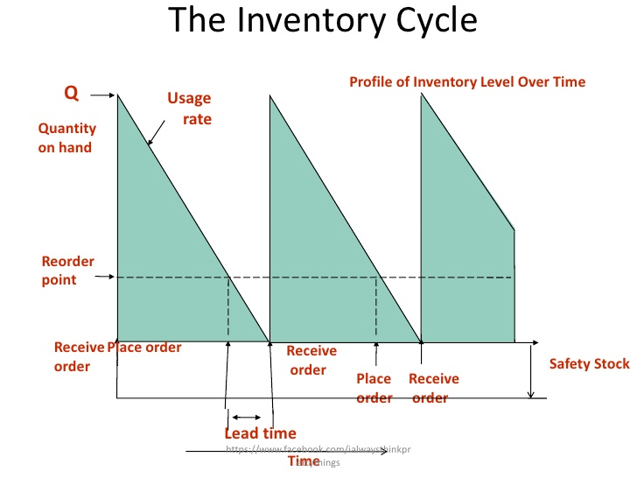

Slide 24
Safety stock - a level of extra stock that is maintained to mitigate risk of stockouts (shortfall in raw material or packaging) due to uncertainties in supply and demand. Adequate safety stock levels permit business operations to proceed according to their plans.Safety stock is held when there is uncertainty in demand, supply, or manufacturing yield; it serves as an insurance against stockouts.
Safety stock is an additional quantity of an item held in the inventory in order to reduce the risk that the item will be out of stock, safety stock act as a buffer stock in case the sales are greater than planned and/or the supplier is unable to deliver the additional units at the expected time( wikipedia.org)

Slide 25
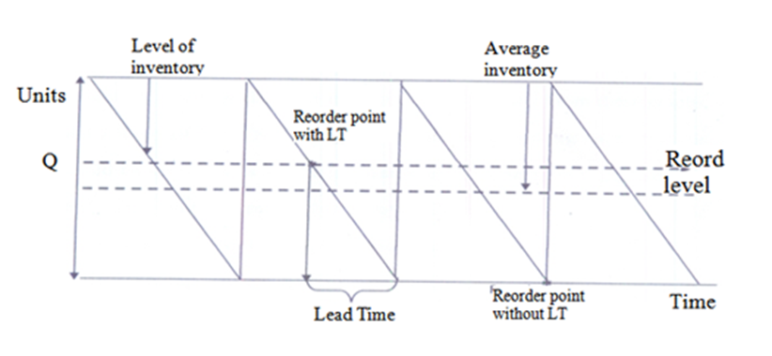
The reorder point (ROP, reorder level) is the level of inventory which triggers an action to replenish that particular inventory stock. It is a minimum amount of an item which a firm holds in stock, such that, when stock falls to this amount, the item must be reordered. It is normally calculated as the forecast usage during the replenishment lead time plus safety stock

Slide 26
Principle of inventory proportonality
Inventory proportionality is the goal of demand-driven inventory management. The primary optimal outcome is to have the same number of days' (or hours', etc.) worth of inventory on hand across all products so that the time of runout of all products would be simultaneous. In such a case, there is no "excess inventory," that is, inventory that would be left over of another product when the first product runs out. Excess inventory is sub-optimal because the money spent to obtain it could have been utilized better elsewhere, i.e. to the product that just ran out.
The secondary goal of inventory proportionality is inventory minimization. By integrating accurate demand forecasting with inventory management, rather than only looking at past averages, a much more accurate and optimal outcome is expected.
Integrating demand forecasting into inventory management in this way also allows for the prediction of the "can fit" point when inventory storage is limited on a per-product basis

Slide 27
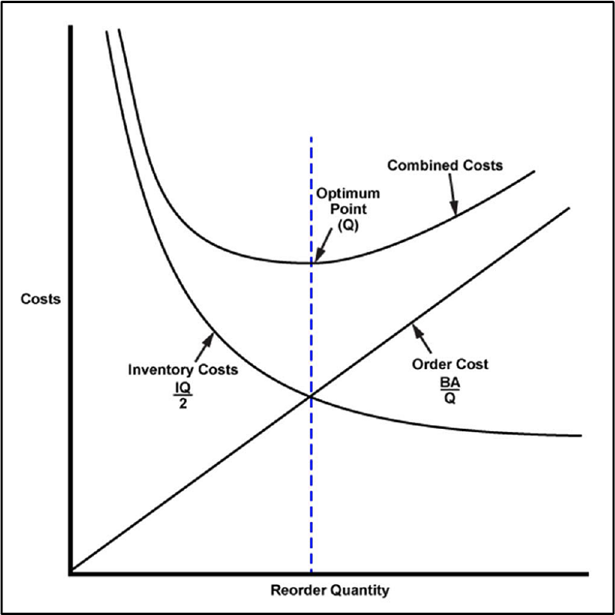

Slide 28
EOQ- Economic Order Quantity
EOQ concerns the inventory costs of a single item
EOQ does not provide varying lot sizes to match projected variations in demand
EOQ is based on average demand
Assumptions:
Demand is konown and constant, without seasonality
Order processing costs are known and constant
Cost per unit are constant
The entire lot is delivered at one time
The holding cost rate is known and sonstant.
Total holding cost are a linear function and depend on holding cost rarate and quantity ordered.

Slide 29
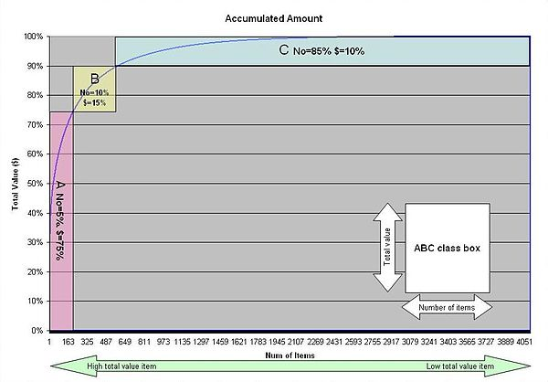
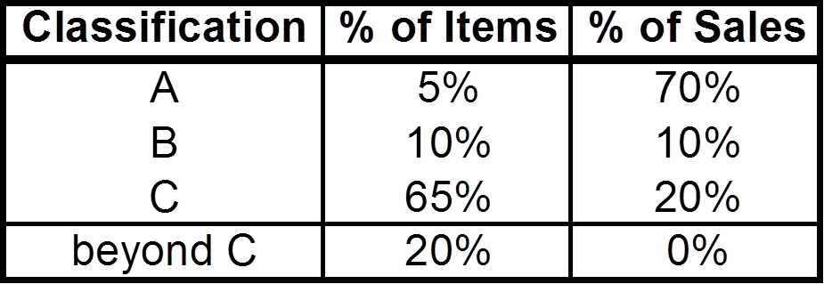
ABC inventory classification

Slide 30
ABC inventory classification
A-items are goods which annual consumption value is the highest. The top 70-80% of the annual consumption value of the company typically accounts for only 10-20% of total inventory items.
C-items are, on the contrary, items with the lowest consumption value. The lower 5% of the annual consumption value typically accounts for 50% of total inventory items.
B-items are the interclass items, with a medium consumption value. Those 15-25% of annual consumption value typically accounts for 30% of total inventory items.
(Collignon, Joannes Vermorel, February 2012)

