Slide 1
Business finances and commercionalization
Source:https://sbir.nih.gov/sites/.../Commercialization-Plan_clean.docx

Slide 2
The commercialization plan should offer a clear and concise description of the proposed work’s market potential and the planned path to commercialization
The Commercialization Plan should illustrate your vision for the enterprise and how the proposed innovation fits into the future market.
This goal could be achieved through clearly articulating a compelling value proposition for your intended customer.

Slide 3
Central goal is for the company to create value for its chosen customers. Value is created by meeting customer needs. A company needs to define itself not by the product it sells, but by the customer benefit provided

Slide 4
5 C’s
1) Customer Needs | What needs do we seek to satisfy?
2) Company Skills | What special competence do we possess to meet those needs?
3) Competition | Who competes with us in meeting those needs?
4) Collaborators | Who should we enlist to help us and how do we motivate them?
5) Context | What cultural, tech and legal factors limit what is possible?

Slide 5
Keep in mind:
1. Customers are sensitive to price
2. Economies of scale are important
3. An adequate production capacity should be available
4. Threat of competition should be addressed

Slide 6
Parts of the plan
Value of the project, expected incomes and impacts
Company overview
Market customer and competition
Intellectual property protection
Finance plan
Production and marketing plan
Revenue stream

Slide 7
Value of the project, expected incomes and impacts
What is important?
  Commercial and societal benefits
  Competitive advantage over existing technology
Outline:
  Overall goal/objective
  The product, the problem it solves, and benefits
  History/past data suggesting a problem
  The advantages compared to competing products or services
  Recent advancements
  Commercial application
  Market potential, future markets, new research
  Non-commercial impact

Slide 8
Company overview
What is important?
  Relevant commercialization capabilities of your team
  Product lines that show successful market implementation
Company information including:
  Corporate objectives
  Core competencies
  Present size, products/services with significant sales
  History of previous Federal and non- Federal funding
  Regulatory experience
  How the company plans to develop from a small technology R&D business to a successful commercial entity

Slide 9
Market, customer and competition
What is important?
  Know your market and market needs
  Identify main customer bases
  Know your competition
  Look into what similar competition has done and amount of the total market they are attracting
  Reiterate the need for the product and address your competitive advantage
  Consider if collaboration/ partnering is strategically smart for you and if so explain why
  Describe your market and sales strategy

Slide 10
Market, customer and competition
Company analysis
  Corporate strengths and weakness need to be understood. Assessing product/company fit requires an understanding of the finances, R&D capacity, manufacturing capacity, and other assets of the firm.

Slide 11
Market, customer and competition
Competitive Analysis:
  Identify both current and potential competitors. Competitor’s strengths and weaknesses must be understood to seek differentiating possibilities.
  It is very important that you understand and know the competition.

Slide 12
Market, customer and competition
Collaborator Analysis:
  Two key collaborators are the retailers and suppliers. With respect to the trade, the firm must understand their cost structure; expectations about margins and allocations of task; support and training requirements; and the nature of their relationship with the firm’s competitors.

Slide 13
Market, customer and competittion
Context Analysis:
  Politics, regulation, law, and social norms are not fixed features of the marketing landscape, but factors to consider and monitor for signs of disruption

Slide 14
Intellectual property protection
This section should summarize how the company will protect the intellectual property that enables commercialization of its products while keeping competitors at bay
List current patents or describe how the company plans to protect the IP

Slide 15
Finance plan
Start off with estimations of raised financing broken out by the different phases. The assumptions in phase II/III should identify the timing of the financial event(s) and milestones the company hopes to achieve in the forecasted time period. These should clearly describe the timing and financial needs to commercialize the product, process or service

Slide 16
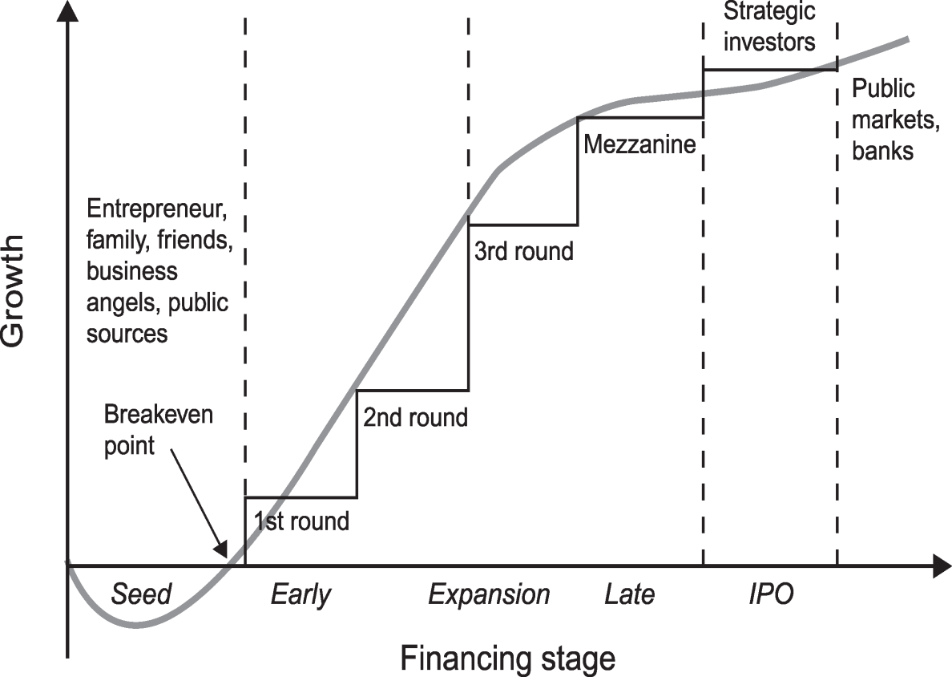

Slide 17
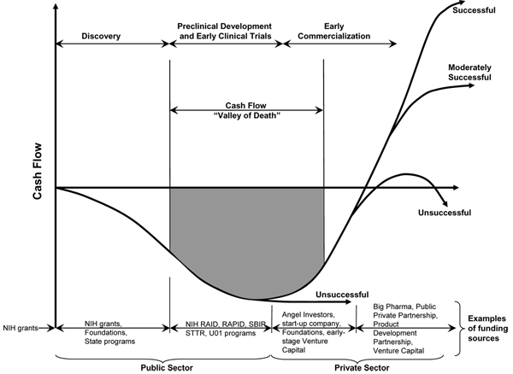

Slide 18
Source of funding:
private investors or “angels”; venture capital firms; investment companies; joint ventures; R&D limited partnerships; strategic alliances; research contracts; sales of prototypes (built as part of this project); public offering; state finance programs etc.

Slide 19
Production and marketing plan
Describe how the production of your product/process/service will occur. Describe each step involved with taking your product to the market to sell which may include plans for licensing or internet sales.
4P’s
  1. Product
  2. Place (Channels of Distribution)
  3. Promotion (Communications Strategy)
  4. Pricing

Slide 20
Production and marketing plan
Important questions:
1. Which potential buyers should the company attempt to serve?
2. How much customization should the firm offer in its programs, i.e. at which point on the market continuum will the firm construct plans:
Mass Market - Market Segments – Market Niches – Individuals

Slide 21
Production and marketing plan
Product: Should not be the thing itself but rather the total package of benefits obtained by the customer. After introducing a new product to the market there should be a process of Product Life Cycle Management where the company continually tries to learn more about consumers from their reactions to the introduced product.
Place: The marketing channel is the set of mechanisms or networks from which a company takes their product to market with its customers for a variety of tasks.
Promotion: Determining the appropriate ways to communicate with customers to foster awareness, knowledge about its features, interest in purchasing, likelihood of trying the product and or repeat purchasing.
Pricing: The value of the product can come from the customers perception or the actually product.

Slide 22
Revenue stream
This section describes exactly how you plan to make money selling your product.
A clearly laid out explanation on how you plan to generate a revenue stream may incorporate many tools such as revenue model estimations, charts, and graphs to display timeline goals. If a market is large and fragmented enough a potential option would be to partner with other companies with a proven history of generating revenue. Also take note of whether the company is a well-diversified company that has multiple products with few shared risk factors, or if the company is developing a single product where the risks may be more centralized.

Slide 23
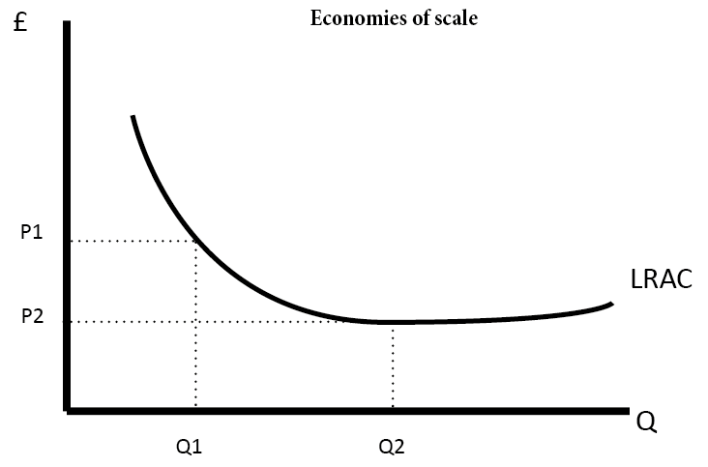
Economies of scale
  occur when increased output leads to lower unit costs. (lower average costs)
  Competitive advantage
https://www.economicshelp.org/wp-content/uploads/2008/03/economies-of-scale-id2.png

Slide 24
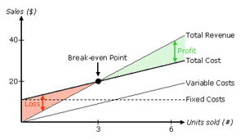
BEP – Break- Event point
is the point at which total cost and total revenue are equal. There is no net loss or gain, and one has "broken even," though opportunity costs have been paid and capital has received the risk-adjusted, expected return. (www.en.wikipedia.org)
https://www.readyratios.com/reference/analysis/break_even_point.html

