Slide 1
Support activities

Slide 2
Human resources management
it is designed to maximize employee performance in service of an employer's strategic objectives
HR departments are responsible for overseeing employee-benefits design, employee recruitment, training and development, performance appraisal, and rewarding (e.g., managing pay and benefit systems).^{(wikipedie.org)}

Slide 3
HRM basic functions:
Staffing - is the recruitment and selection of potential employees, done through interviewing, applications, networking
training and development - is the next step in a continuous process of training and developing competent and adapted employees
motivation - is key to keeping employees highly productive. This function can include employee benefits, performance appraisals and rewards
maintenance - involves keeping the employees' commitment and loyalty to the organization.

Slide 4
5 steps in planning human resources
Determining the workload
Study of jobs in the company
Forecasting human resource needs
Inventory of manpower
Improvement plan

Slide 5
Determining the workload
The kind and magnitude of the workload determines:
  Organizational structure
  Number of employees needed
  Quality of employees needed

Slide 6
Improvement plan
Implementing and improving of the plan to meet the objectives for the corporation.

Slide 7
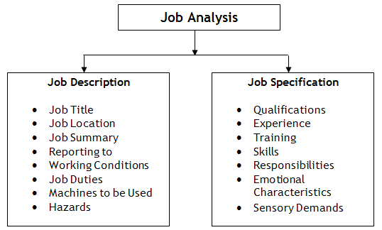
Study of jobs in the company – job analysis (https://www.managementstudyguide.com/job-description-specification.htm)
Job description
Job specification

Slide 8
Job description
Job description includes basic job-related data that is useful to advertise a specific job and attract a pool of talent. It includes information such as job title, job location, reporting to and of employees, job summary, nature and objectives of a job, tasks and duties to be performed, working conditions, machines, tools and equipments to be used by a prospective worker and hazards involved in it.
Purpose of Job Description
The main purpose of job description is to collect job-related data in order to advertise for a particular job. It helps in attracting, targeting, recruiting and selecting the right candidate for the right job.
It is done to determine what needs to be delivered in a particular job. It clarifies what employees are supposed to do if selected for that particular job opening.
It gives recruiting staff a clear view what kind of candidate is required by a particular department or division to perform a specific task or job.
It also clarifies who will report to whom.

Slide 9

Job description – quality manager

Slide 10
Job description
Quality Manager Responsibilities(https://resources.workable.com/quality-manager-job-description)
Include:
Understanding customer needs and requirements to develop effective quality control processes
Devising and reviewing specifications for products or processes
Setting requirements for raw material or intermediate products for suppliers and monitoring their compliance

Slide 11
Job brief
We are looking for an experienced Quality Manager to ensure that our products and services meet all necessary requirements before they reach the consumer.
The Quality Manager, or Quality Assurance Manager, will inspect the final product to make sure it has been built with compliance to legal standards and meets customer expectations. A great quality manager is thorough and observant with an eye for detail.
They must fully understand the requirements for the product or service and have a sense of responsibility towards our potential and existing customers as well as the competition.
The goal is to help preserve our reputation by ensuring that our products and services are capable to drive sustainable growth.

Slide 12
Responsibilities
Understand customer needs and requirements to develop effective quality control processes
Devise and review specifications for products or processes
Set requirements for raw material or intermediate products for suppliers and monitor their compliance
Ensure adherence to health and safety guidelines as well as legal obligations
Supervise inspectors, technicians and other staff and provide guidance and feedback
Oversee all product development procedures to identify deviations from quality standards
Inspect final output and compare properties to requirements
Approve the right products or reject defectives
Keep accurate documentation and perform statistical analysis
Solicit feedback from customers to assess whether their requirements are met
Submit detailed reports to appropriate executives
Be on the lookout for opportunities for improvement and develop new efficient procedures

Slide 13
Requirements
Proven experience as quality manager
Conscientious and responsible
A keen eye for detail and a results driven approach
Outstanding communication skills
Excellent organizational and leadership skills
Proficient in MS Office
In depth understanding of quality control procedures and relevant legal standards
Excellent math abilities and working knowledge of data analysis/statistical methods
BSc/ Ba in business administration or relevant field
Certification of quality control is a strong advantage (ISO 9000 etc.)

Slide 14
Job specification
Also known as employee specifications, a job specification is a written statement of educational qualifications, specific qualities, level of experience, physical, emotional, technical and communication skills required to perform a job, responsibilities involved in a job and other unusual sensory demands. It also includes general health, mental health, intelligence, aptitude, memory, judgment, leadership skills, emotional ability, adaptability, flexibility, values and ethics, manners and creativity, etc.
Purpose of Job Specification
Described on the basis of job description, job specification helps candidates analyze whether are eligible to apply for a particular job vacancy or not.
It helps recruiting team of an organization understand what level of qualifications, qualities and set of characteristics should be present in a candidate to make him or her eligible for the job opening.
Job Specification gives detailed information about any job including job responsibilities, desired technical and physical skills, conversational ability and much more.
It helps in selecting the most appropriate candidate for a particular job.

Slide 15
Forecasting human resource needs
Both short-term and long term staffing needs to be based on the projected sales, office growth, attrition and other factors.
How many specialist , professionals or executives are needed?
What is the level of each?
What kind of specialization should each have?
What other production personnel are necessary and how many for each category?

Slide 16
Inventory of manpower
Assess the following:
Skills
Career strenghs
Weaknesses
Potentials
promotability

Slide 17
Two approach of planning
Top down planning – the personal needs of an organization is to begin by defining the organiaztion´s goals into human resource requirements. Objectives are sometimes difficult to translate into personnel needs.
Bottom up planning- this perspective emphasizes information on current employees.

Slide 18
The stages of manpower planning
Examination of existing situaton
Planning to assess and determine future objectives
Organization
Precise the requirements
Career requirements

Slide 19
Recruitment
Internal vs. External
Depends on the existing situation
Existing environment

Slide 20
Internal recruitment
Advantages:
Cheaper and quicker to recruit
People already familiar with the business and how it operates
Provides opportunities for promotion with in the business – can be motivating
Business already knows the strengths and weaknesses of candidates
Disadvantages:
Limits the number of potential applicants
No new ideas can be introduced from outside
May cause resentment amongst candidates not appointed
Creates another vacancy which needs to be filled

Slide 21
External recruitment
Advantages:
Outside people bring in new ideas
Larger pool of workers from which to find the best candidate
People have a wider range of experience
Disadvantages:
Longer process
More expensive process due to advertising and interviews required
Selection process may not be effective enough to reveal the best candidate

Slide 22
Short-term staffing needs
Help with administrative duties causes by extended absence of an employee, maternity leave, retirement and so on.
Temporary workers- hired through an agency, lower cost than full-time employees, do not need vacation or sick time.

Slide 23
Long-term staffing need
Employees for long time assignement
Usually based on external recruitment
Employment agreement terminated
Employment agreement non-terminanted
Service contract agreement
Agency work

Slide 24
Personnel manager
Is responsible for:
  Assisting and advising managing director on personal policy ensuring policy is made known to staff and is effectively carried out.
  Developing and maintaining procedrures in cojuction with other departmental heads for recruitment and training.
  Determining and maintaining good relations with trade unions and other bodies concerned with employment and working conditions.
  Ensuring adequate safety precautions and welfare services including canteen and health services.
  Assisting employees with personal problems, maintaining records and statistics of employment.

Slide 25
Special duties:
Advising and assisting manageing director on personnel policy formulation and the development of training schemes for supervisory staff.
Representing the company in all negotiations with trade unions and trade associations and maintainging interest in new ideas in personnel management

Slide 26
Important factors in personnel policy
Remuneration
Security
Opportunity
Status
Justice
Democracy
General

Slide 27
Factors of organization structure
Strategies and goals
Used technology
Product distribution
Size of company
Financial situation
Stability of environment

Slide 28
Process analysis
  Need to know
  operations
  sequencies
  information
  Inputs and outputs
  variant
→company process structure

Slide 29
Method
Write down all the activities in accurate details
To connect the activities with the needed inputs and outputs (resources, documents, information)
To allign the activities into logical sequencies
Fullfill the decission node

Slide 30
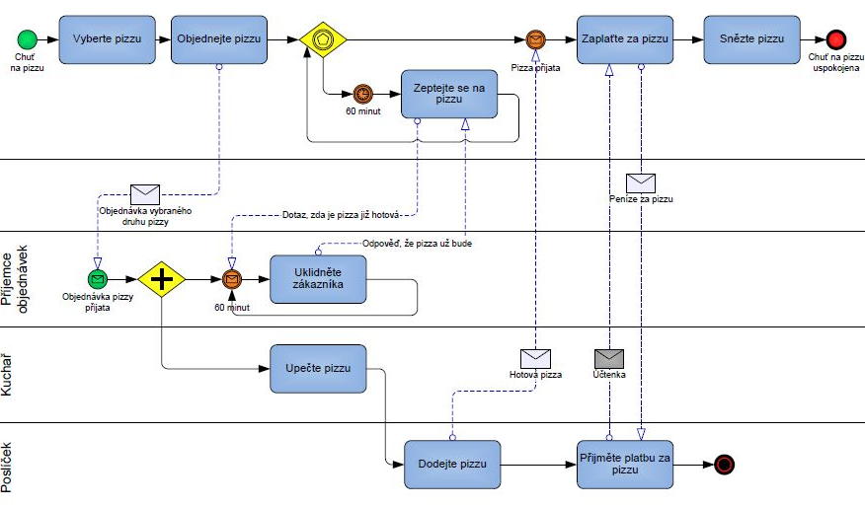
Zdroj: Šafrová-Drášilová, 2016

Slide 31
Job design
Basic principles:
A variety of tasks sufficient not to lead to boredom.
Tasks which have some onvious relationship to the whole task.
A work cycle of just the right lenght bearing in mind physical demandsand concentration of an average person.
Some provision to allow the individual to set quality and standards and feedback by management on personal results to keep motivation strong.
The need for care, skill and effort so that the work will carry respect in the community.

Slide 32
Job design
Job rotation
Job enrichment
Increased responsibility – wider range of duties added
Job enlargement
Relief from boredom
Autonomous work groups
Extension of work plus assitional tasks to obtain a complete unit
Areas of responsibility are delegated to group
JOB DESIGN

Slide 33
Personal competencies
Competencies are combinations of knowledge, skills and attitudes that employees develop and apply for successful working. They emphasize aspects of learning that apply within and across all subject areas.
It helps :
  Employee development
  Completation of tasks
  Personnel planning
  Employees recruitment
  Setting the mativation systems

Slide 34
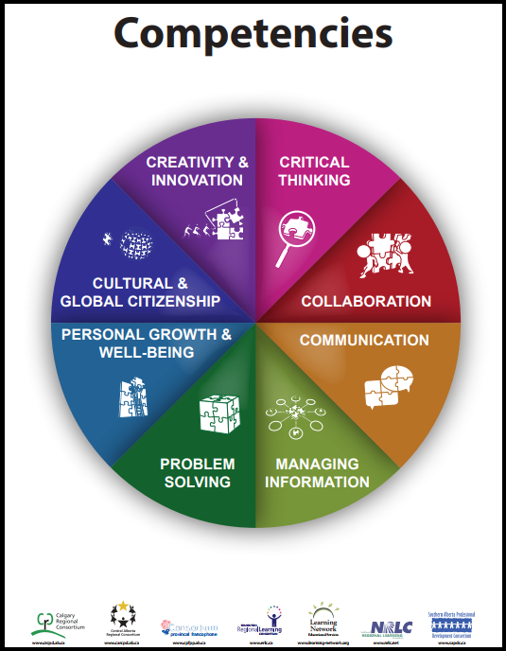
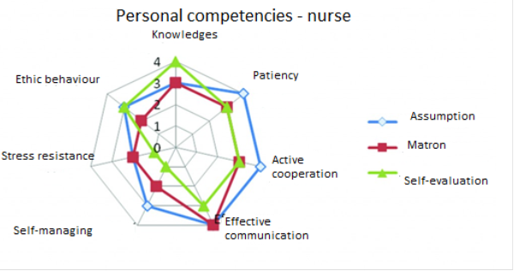

Slide 35
Procedure for recruitment and selection of staff
Staff requisitionform is required to be completed
Advertisement – important to word the advertisement correctly so applicants who are not really suitable do not apply.
Short list drawn up and interviews arranged.
References can be taken up before the interviews and used to detemine the final selection at the interview.
Interviews – many forms
Tests for specific skills
Medical examination
Information for succesfull candidates

Slide 36
Forbidden questions(examples)
  Pregnancy and health
  Are you pregnant?
Personal situation
  Are you married?
  How old are you?
Family affairs
  How many childred do you have?
Sexual orientation
  Are you homosexual?
Religion
  What is your religion?

