Slide 1
Balanced Scorecard
Ing.J.Skorkovský,CSc.
and various listed resources
Department of Corporate Economy

Slide 2





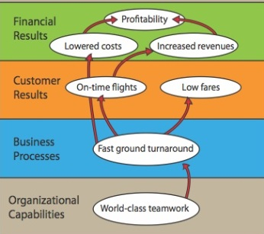
Balanced Scorecard and continuum of value (1st part)
Balanced Scorecard is a step in the continuum describing value
and how the value is created
Mission – why we exist (To refresh the world –Coca-Cola)
Values – what is important to us
Vision – what we want to be (best drinks)
Strategy – our game plan
Strategy map – translate to strategy
Balanced scorecard – measure and focus
See next show
Mission example : To be a teacher. And to be known for inspiring my students to be more than they thought they could be.

Slide 3
Balanced Scorecard and continuum of value (2nd part)
Balanced Scorecard is a step in the continuum describing value
and how the value is created
Target – what WE need to do (plan, project, budget, …)
Personal Objectives – what I need to do
Strategic Outcomes
Satisfied Shareholders
Delighted Customers
Efficient and Effective Processes
Motivated and Prepared Workforce

Slide 4




Definition
BS developed by Robert Kaplan and David Norton
BS examines a firm´s performance in four critical areas
Finances – how should we look to our shareholders ?
Customers – how should we look to our customer ?
Processes – at which business processes must we excel ?
Learning and Growing – how will we sustain our ability to change and improve ?
Resource : Operation Management, Quality and Competitiveness in Global Environment, Russel &Taylor

Slide 5
Basic strategy map (two lower BS levels)
Processes
Production and Services
Lower cost of production
Continuous improvement (Kaizen)
Reduced cycle time (see Little´s law)
Shorter production lead times
Working capital efficiency (fin. leverage)
MRP,MRP_II
Advanced Planning and Scheduling
Good Resource Planning
Perfect way of cost calculation (actual-expected)
Application of Theory of Constraints
SCM-Supply Chain Management
Lower cost of transport
Better way of replenishment
Better delivery performance
Supplier Relationship
Lower cost of ownership
JIT delivery
TQM – High quality supply
Risk Management
Financial risks
Cash flow management
Operational risk
Technological risk
Human capital Organizational Capital Information Capital
Excellent training
of resources
Efficient and flexible
structures and reporting
system, teamwork, culture
Analytic applications
BI, transaction processing
applications=ERP, ..)
Resource : Operation Management, Quality and Competitiveness in Global Environment, Russel &Taylor (not the red ones)

Slide 6
Basic strategy map (two upper BS levels)
Shareholder value
Productivity Strategy
Growth Strategy
Finance
Become industry cost leader (Gartner Magic Quadrant Matrix)
Maximize use of existing assets
Improve cost management
Strategy
Increase value of customer account
Stars and Milk Caws segments of Boston Matrix
Stable product portfolio
New resources generation (higher market share )
R&D related to current product portfolio
Competitive prices Low cost of supply Perfect Quality Deliveries in time
Processes – at which business processes must we excel (see previous slide) ?
Resource : Operation Management, Quality and Competitiveness in Global Environment, Russel &Taylor (not the red ones)

Slide 7
Balanced Scorcard worksheet
(50+80)/2
Explanations : FTL-full truck load, LTL- less than truck load , SPC=statistical process control, EDI=electronic data interchange, Cycle time=time/unit=(e.g.7 min/1 customer request)
Resource : Operation Management, Quality and Competitiveness in Global Environment, Russel &Taylor

Slide 8
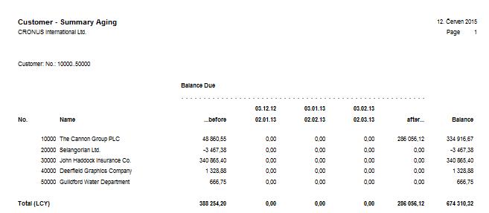
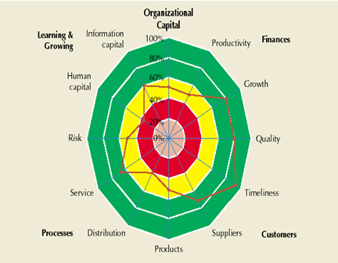
ERP outputs and BS
Report generated from
ERP MS Dynamics NAV
Financial way of
reporting
BS way of reporting
(Radar Chart)
Based on KPI estimation in % out
analysed company is excellent,
but on the other hand,
collecting money, credit limit
and overdue management
is falling behind
Resource : Operation Management, Quality and Competitiveness in Global Environment, Russel &Taylor (only radar chart)

Slide 9
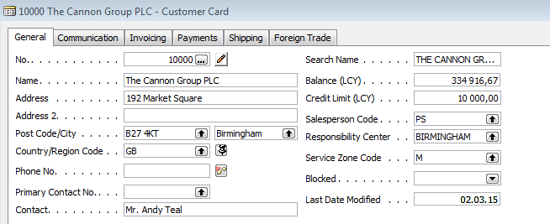
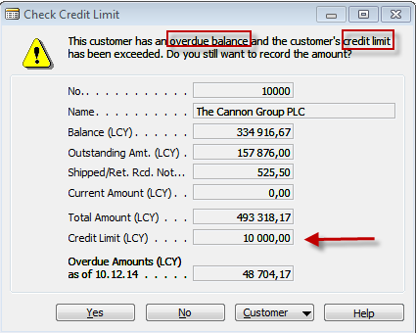
ERP forms related to customer aging report

Slide 10
BS and OM
Finances – how should we look to our shareholders ?
Processes – at which business processes must we excel ?
Customers – how should we look to our customer ?
Learning and Growing – how will we sustain our ability to change and improve ?
Project management
Theory of constraints
Production
Linear programming
Total quality
management
Product postitioning
Business Intelligence
Workflow
Critical chain
Drum –buffer-rope
MRP-MRP-II,JIT,APS
Cutting, blending
Pareto, Ishikawa FBD
Boston Matrix
Gartner QM
Decision
making
CONWIP
Logistics
Yield management
Kepner-Tregoe
EOQ, ABC
Hurviwtz
Little´s law
Prospect theory

Slide 11
Strategic initiatives
(two lower BSC layers to see Target-Measurement-Intention-Action program)
Satisfied shareholders
Growth of selling
Growth of margins
Action
program
Provided values
Better relationships
Target
Measurement
Intention
To keep
(maintain)
customers
Ratio
WIN/LOST
Action selling
Ratio WIN/LOST
Bigger market
share
Selling channel turnover
Image support
New customers
By 100 %
2 years
(increase)
Newcomers
Unpleasant surprises
Quantity of
problems
By 50 % 2 years
(decrease))
Program of
direct
marketing
Marketing
skills
% skill
% OK customer
data
By 100% 1 year
By 80 % 2 years
New SW
training
Marketing skills
Customer database

Slide 12
Test 1
What is the main goal of a company?
A) Obtain the highest profit
B) Find solutions that will be in the best interests of stakeholders
C) Produce as many products as possible
D) A and C
E) None of the above
Notes:
B)

Slide 13
Test 2
Which of the following is Operations Management Technology not concerned with?
A)Product & Service Technology
B)Process Technology
C) Globalization technology
D)Information Technology
E)All of the above
Notes:
C)

Slide 14
Test 3
Which of the following would be considered an input when converting inputs into outputs during the transformation process?
A) Land
B) Capital
C) Raw Materials
D) Facilities
E) All of the above
Notes:
E)

Slide 15
Test 4
Which of the following is not a key element of supply chain management ?
A)Purchasing
B) Suppliers
C) Location
D) Logistics
E) Managers decision
Notes:
E)

