Slide 1
Operation Management (OM) Introduction
Ing.J.Skorkovský, CSc,
Department of Corporate Economy
FACULTY OF ECONOMICS AND ADMINISTRATION
Masaryk University Brno
Czech Republic

Slide 2
Coordinates
Lecturer : Ing.Jaromír Skorkovský, CSc.
  Department of Corporate Economy (5th floor)
  miki@econ.muni.cz
  +420 731113517
Study material : will be updated regularly (is.muni.cz)
Attendance : seminar and lectures are obligatory – see subject specification (is.muni.cz) – first important condition to be admitted to exam)
Excuses : if serious reason emerges- only written from is accepted
Seminar work : will assigned after some theory will be presented. Accepted seminar work is the second condition to be admitted to exam)
Tuition plan : at the end of this slide show

Slide 3
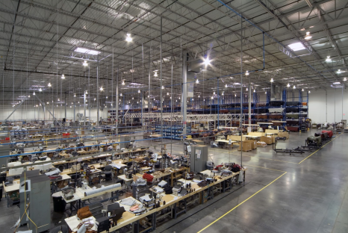
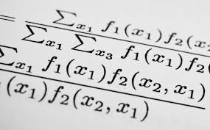
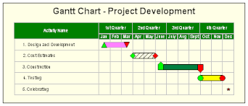
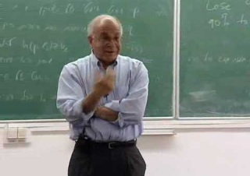
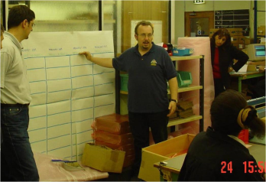
What is going on ?
Use of Operations Management (OM) in external environment
(main target)
General knowledge of OM methods acquired at university and long-standing experience
Knowledge of methods and experience from research and literature - teachers
Knowledge of methods and experience from outside world – consultants, managers, …
Extent of knowledge
Extent of knowledge
Synergy and put OM into practice

Slide 4
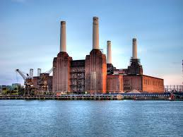
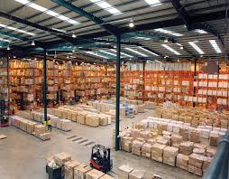




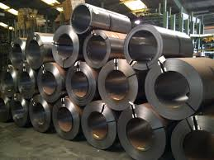
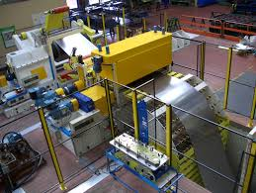
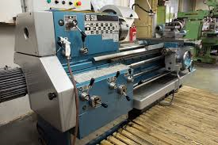
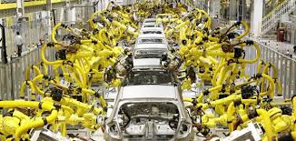
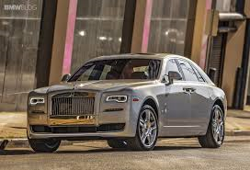
OM all around us
OM is the management of all processes used to design, supply, produce, and deliver valuable goods and services to customers
IN
Processing-transformation
Out
TQM = Total Quality Management
ERP: Logistics, Transportation ,
MRP, JIT, APS, Lean Manufacturing, Little´s law
ERP: Marketing, Selling, Invoicing, Payment,….

Slide 5
Some OM methods
Theory of Constraints
Balanced Scorecard
Project Management methods (Critical Chain, SCRUM,…)
Material Requirement Planning and Just-in-Time
Advanced Planning and Scheduling
Six Sigma – quality management
Boston, SWOT and Magic Quadrant Matrices
Little ´s Law (relations between WIP, Throughput and Cycle time)
Linear programming (cutting, blending,..)
Yield Management
Kepner-Tregoe (support of decision making)
Decision trees

Slide 6
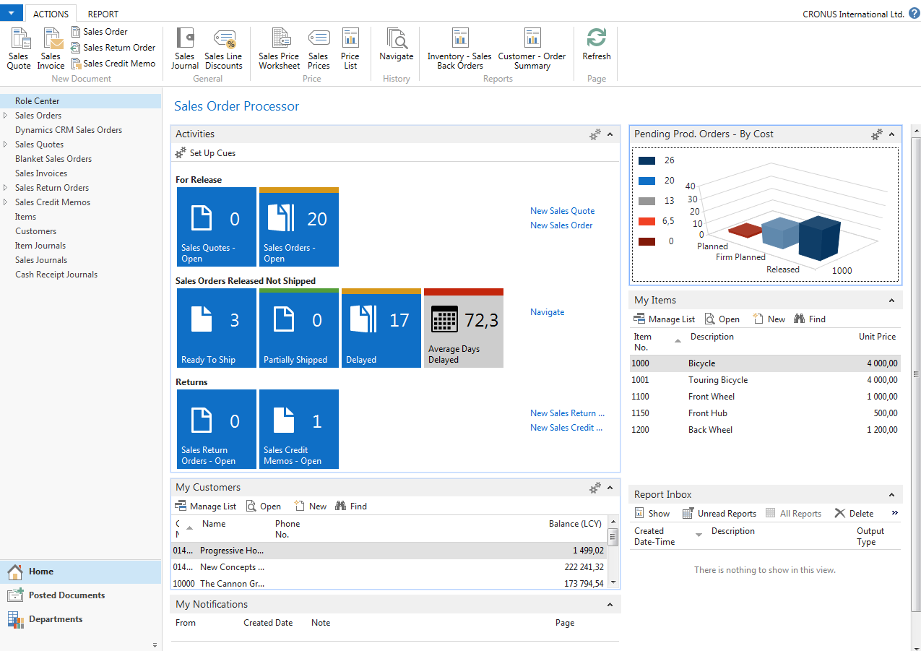
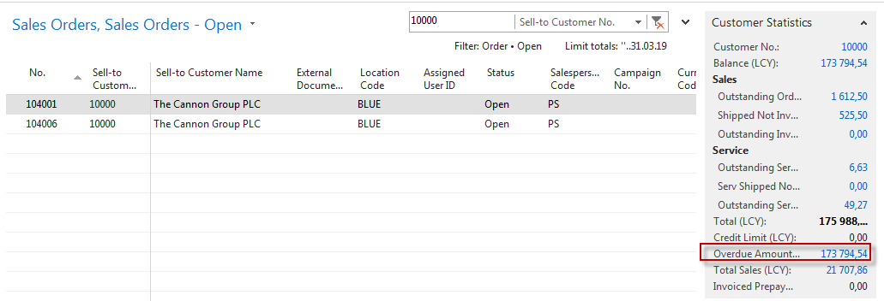
Some tools (ERP=Enterprise Resource Planning System)

Slide 7
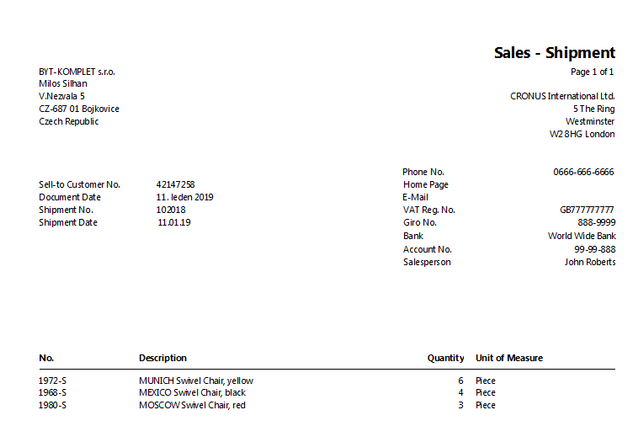
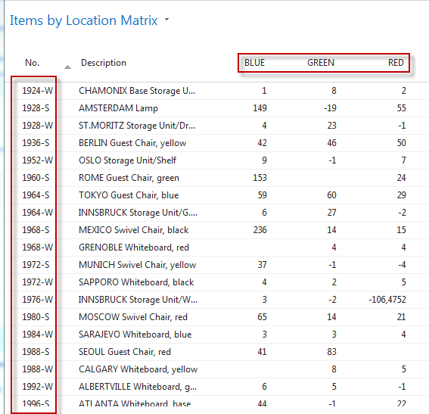
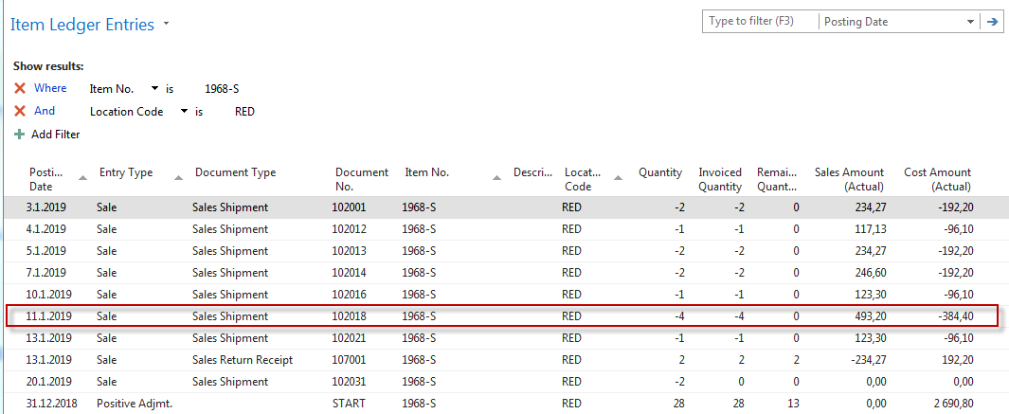
Some basic processes controlled by ERP –I (where Do we have our items)

Slide 8
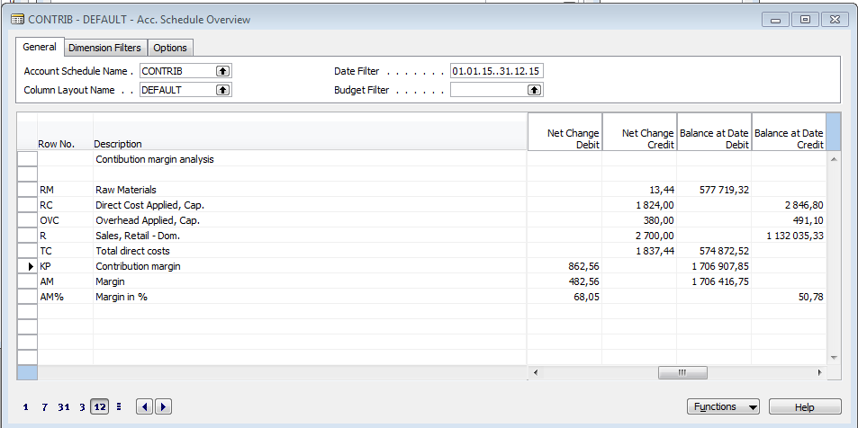
Some basic processes controlled by ERP –II.
Finance management (accounting)
  Reporting (BS, Income statement,..)
  Controlling (Cost management,…)
  Banking operations
Used abbreviations : BS– Balanced Sheet

Slide 9
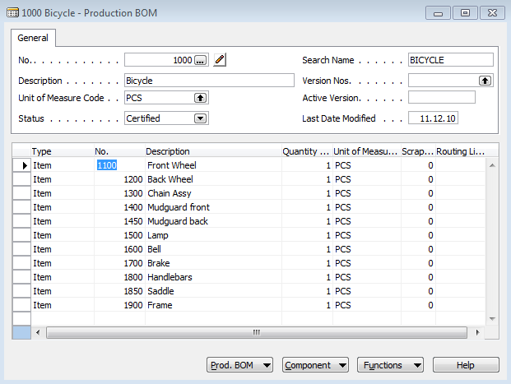
Some basic processes controlled by ERP –III.
Bill of material
Manufacturing
  Product design (BOM, Routing)
  Machines (Capacity management)
  Planning
  Product registration
  Concepts (Lean , MRP-II, JIT,DBR,….)
  QM
Used abbreviations : MRP-II – Manufactuirn Resource Planning = MRP+Resource Planning ; JIT – Just In Time; DBR-Drum-Buffer; QM-Quality Management

Slide 10
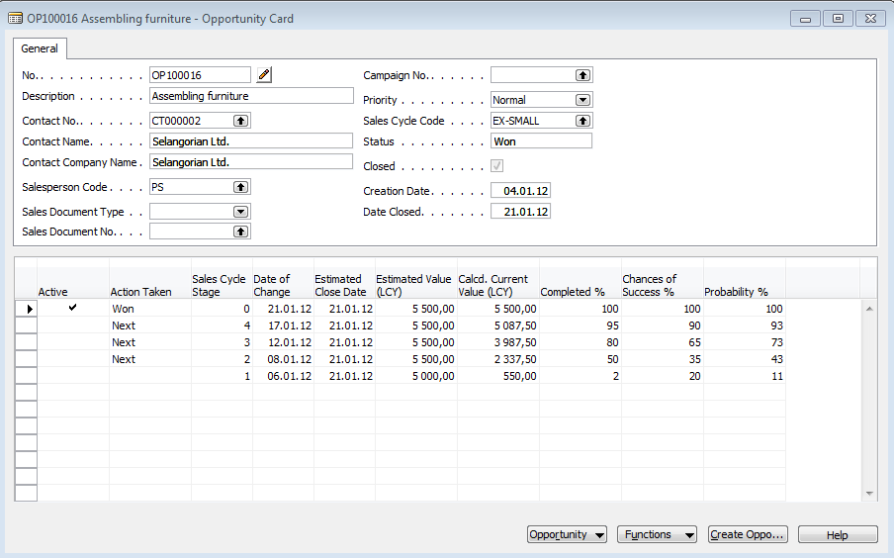
Some basic processes controlled by ERP –IV.
CRM
  Contact management
  Opportunities
  Market segmentation
  Getting new leads
Used abbreviations : CRM – Customer Relationship Management

Slide 11
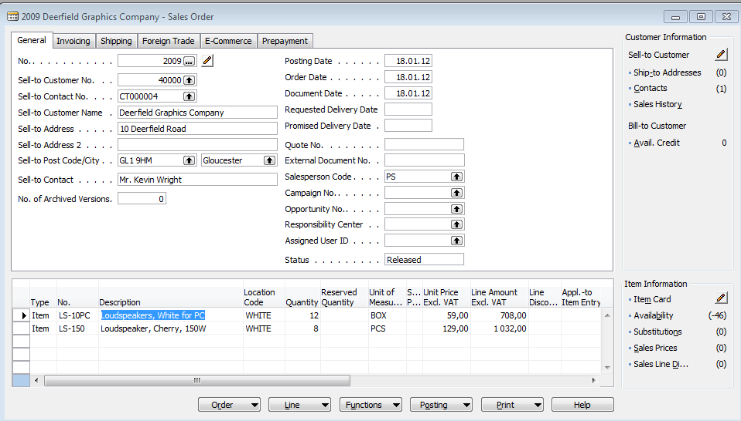
Some basic processes controlled by ERP –V.
Selling
  Credit limits
  Price lists and discounts
  Drop shipment
  Substitutions
  Blank orders
  Quotations
  Invoicing
  Due date performance
  ATP|CTP
Used abbreviations : ATP|CTP– Available to Promise | Capable to Promise

Slide 12
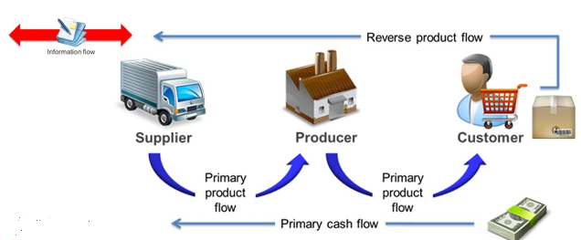
Controlling processes in Supply Chain Management (SCM)
Supply | Production | Orders (Demands)
 | Operation Strategies and Innovations , R&D
Forecasts, Blank Orders | Long term planning | Marketing
Logistic operations | Routing control, TQM | Packaging , Transportation
MRP, Replenishment | MRP_II ; JIT, Capacities | Cash flow
Strategic
Demand Planning
Planning levels
Tactical
Operational
Operational
Used abbreviations : R&D –Research and Development; TQM-Total Quality Management; JIT- Just –In-Time; MRP_II-Manufacturing and Resource Planning
Used abbreviations (slide number 3 ): : ERP - Enterprise Resource Planning ; APS – Advanced Planning and Scheduling

Slide 13
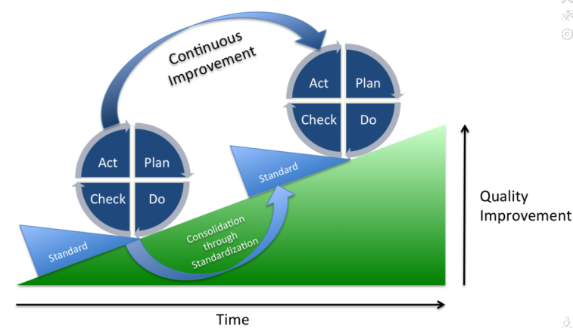
Deming cycle (based on periodicity)
Plan: Define the problem to be addressed, collect relevant data, and ascertain the problem's root cause (e.g. by use of TOC=Theory of Constraints)
Do: Develop and implement a solution; decide upon a measurement to gauge its effectiveness.
Check: Confirm the results through before-and-after data comparison.
Act: Document the results, inform others about process changes, and make recommendations for the problem to be addressed in the next PDCA cycle.
Used abbreviations : TOC – Theory of Constraints

Slide 14
Simple example of Deming cycle
Plan: Excessively high value of the stock, which is one of the reasons of low liquidity of our company (converting assets to cash)= problem's root cause detected by use of TOC=Theory of Constraints and Current Reality Tree (will be presented)
Do: Implement algorithm controlling stock replenishment based on MRP principle and ROP and Safety Stock level setup. Metrix for effectiveness will be inventory dollar days (IDD) - which is one of TOC metrics
Check: ERP inventory costing routines before and after implementation of stage Do application
Act: Document the results, inform others about process changes, and recommend how to continue in inventory management routines (e.g. use of EAN readers or calculation of inventory service level in order to speed up inventory procedures such as put-away and pick or optimize inventory level differently) in the next PDCA cycle.
Used abbreviations : MRP – Material Requirement Planning – will be presented; ROP – Reorder Point –see next slide); ERP- see slide number 12
IDD definition : https://elischragenheim.com/2016/05/23/throughput-dollar-days-tdd-and-inventory-dollar-days-idd-the-value-and-limitations/

Slide 15

Explanation of some terms used in PDCA Deming Cycle simple example (home study) I.
Service level :represents the expected probability of not hitting a stock-out. This percentage is required to compute the safety stock.
Intuitively, the service level represents a trade-off (compromise) between the cost of inventory and the cost of stock-outs (which incur missed sales, lost opportunities and client frustration among others).
M - stock-out cost (often 3 time the gross margin)
H - carrying cost per unit for the duration of the lead time
1l milk pack -> 1.50€ selling price, 10% margin -> =0,15 €. Lead time = 4 days.
The annual carrying cost is 1.50€ (the value is high because milk is a highly perishable product).
Stock-out cost ->3 time the gross margin, that is to say->M= 0.45€.
H=(4/365)x 1.5≈0.0055 H≈0.0055 . So p=98,5%
Resource: https://www.lokad.com/service-level-definition-and-formula

Slide 16
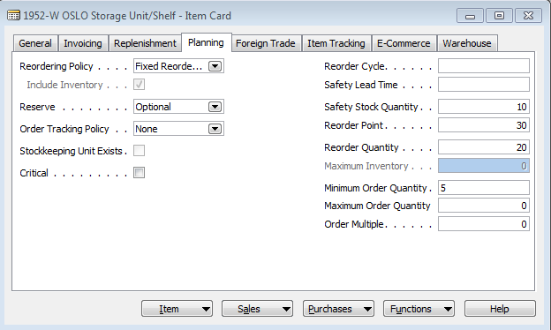
Explanation of some terms used in PDCA Deming Cycle simple example (home study) II.
Q
D= Demand = Reorder Quantity=EOQ
ROP= Reorder Point =50 (in our model)
80
1
ROP
50
D
2
D
Safety Stock
10
time
T
T
1
- No replenishment suggestion (current quantity >= ROP
2
-Replenishment is suggested (current quantity < ROP and quantity may be EOQ
Used abbreviations : EOQ – Economic Order Quantity – will be explained dúrin this course

Slide 17

Another point of view
This will be modified in following South African project show (example of Balanced Score Card use )
Project management
Theory of constraints
Production
Linear programming
Total quality
management
Product postitioning
Business Intelligence
Workflow
Critical chain
Drum –Buffer-Rope
MRP-MRP-II,JIT,APS
Cutting, blending
Pareto, ishikawa
Boston Matrix
Gartner QM
Decision
Making
SCRUM
CONWIP
Logistics
Pareto, Ishikawa
Product Life Cycle
Kepner-Tregoe
EOQ
Six Sigma
Yield management
Hurwitz
ABC
Prospect Theory
LEAN
Function block Logistic more in detail
will be presented later in this show
Little´s law
Used abbreviations : QM– Quadrant Matrix; CONWIP – Constant Work in Progress; EOQ – Economic Order Quantity ; MRP - Material Requirement Planning

Slide 18




Another point of view
Money
Product
Financial needs
Demand

Slide 19
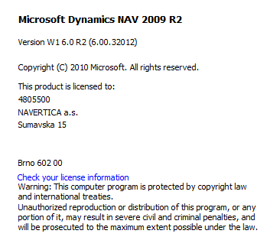
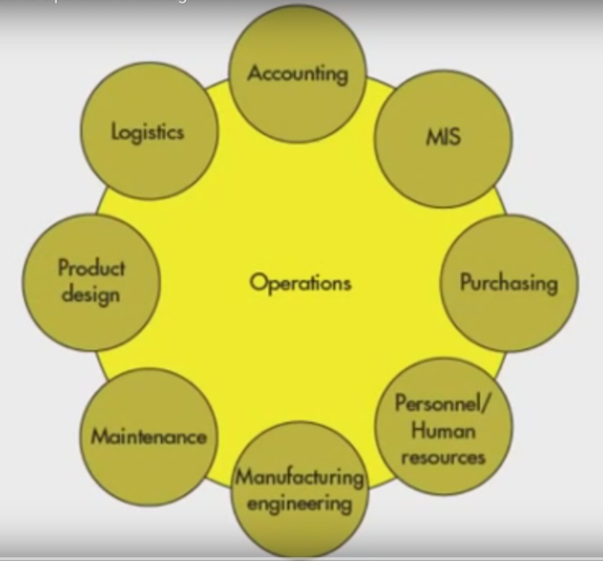
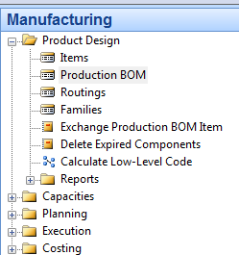
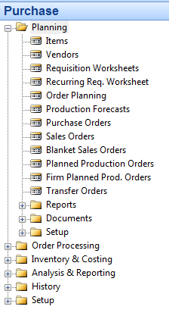
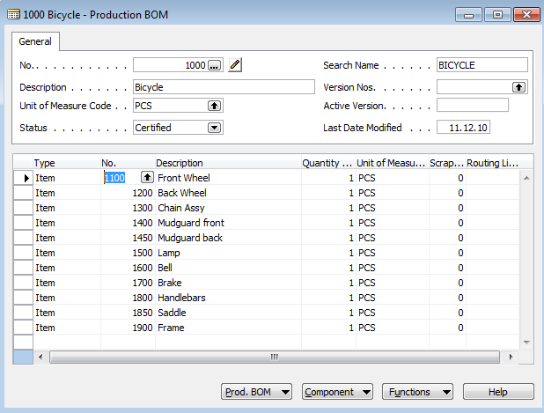
Operations
See next slide
Bill of material

Slide 20
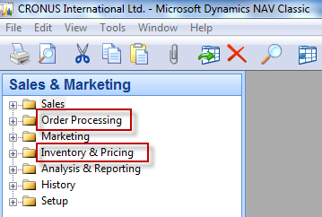
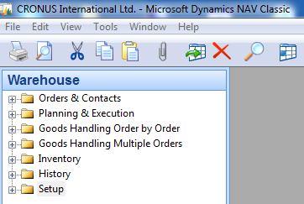
Function block Logistic-simplified
Inventory Management
Orders (dependent demand)
Inventory Costing
Warehouse Management
Forecasts (independent demand)
Transportation
Will be part of our course regarding ERP system MS Dynamics NAV

Slide 21
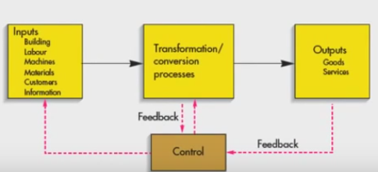
Procedures-simplified
Color agenda used later
Input
Transformation
Output
Resource (modified) : dowtsx

Slide 22
Processing (not organised set of processes, will be presented also as a introduction to project management PWP presentation later)
Load-despatch
Purchase Order
Reporting
Statistics
Consumption registration
Production Output registration
Inventory value
calculation
Output check
(Quality control)
Delivery
Production Planning
Sales Order
Component replenishment
Transfer
to
Production
Put-away
Cross-docking
Input check
Finished
goods to
Inventory
Picking from
Inventory
Invoicing
Payment
Resource : Skorkovský

Slide 23
Your main task (to organize processes based on business logic)
Sales Order
(demand)
Production Planning
Component replenishment
Purchase Order
Input check
Consumption registration
Transfer
to
Production
Picking from
Inventory
Inventory value
calculation
Put-away
Production Output registration
Inventory value
calculation
Cross-docking
Finished
goods to
Inventory
Load-despatch
Payment to
Vendor
Inventory value
calculation
Shipment
Invoicing
Output check
Payment from
Customer
Reporting
Statistics
Transformation
Output
Agenda
Input
Control
Logistics
Resource : Skorkovský

Slide 24


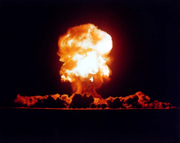
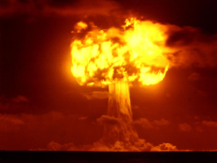
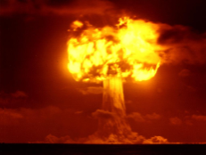
Your main task (possible problems, bottlenecks, undesirable effects..)
Sales Order
Production Planning
Component replenishment
Purchase Order
Input check
Consumption registration
Transfer
to
Production
Picking from
Inventory
Inventory value
calculation
Put-away
Production Output registration
Inventory value
calculation
Cross-docking
Finished
goods to
Inventory
Load-despatch
Payment to
Vendor
Inventory value
calculation
Shipment
Invoicing
Output check
Payment from
Customer
Reporting
Statistics
Application of TOC ->thinking tools->Current Reality Tree – first stage
Resource : Skorkovský

Slide 25

Your main task
(Search - HOW ??? Measure impacts –HOW ??? and Destroy – HOW ???)
Cause-Effect relation
Cause-Effect relation
Cause-Effect relations
Cause-Effect relation
Cause-Effect relation
Root Problem
(e.g.low profit )
Notes:
https://www.toc.tv/TV/video.php?id=701&open=excerpt#.V6xCP00kpFo

Slide 26

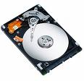
Basic problem I. (one of many)
We cannot solve our problems with the same level of thinking that created them !
Statement by Albert Einstein)
and at the same
time a minimum information, which could be used for decision making !!!!
We have
a huge data
quantity
Moore's law is the observation that the number of transistors in a dense integrated circuits doubles approximately every two years – so -> capacity of memory is going up

Slide 27
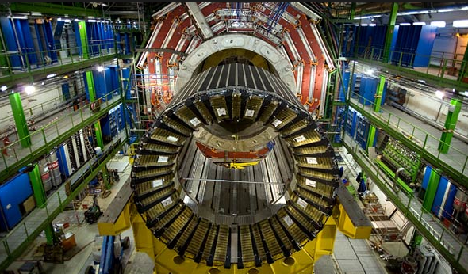
Big data and analysis problem
In test and measurement applications, engineers and scientists can collect vast amounts of data every second of every day.
For every second that the Large Hadron Collider at CERN runs an experiment, the instrument can generate 40 terabytes of data.
For every 30 minutes that a Boeing jet engine runs, the system creates 10 terabytes of operations information.
For a single journey across the Atlantic Ocean, a four-engine jumbo jet can create 640 terabytes of data.
Multiply that by the more than 25,000 flights flown each day, and you get an understanding of the enormous amount of data that exists (Rogers, 2011). That’s “Big Data.”
CERN = Conseil Européen pour la Recherche Nucléaire –Resource : https://home.cern/about
Hardon Collider-accelerator

Slide 28
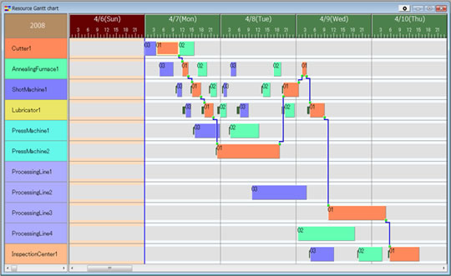
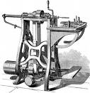

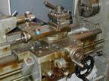
Basic problem II. (we need reliable data )
To solve it we should use finite capacity scheduling (APS)- will be presented later
T1+T2=X
Opt=Min(X)
T2
Op1
T2 = 0
Op1
Op2
Op2
Op3
Op3
T1 = 0
T1

Slide 29
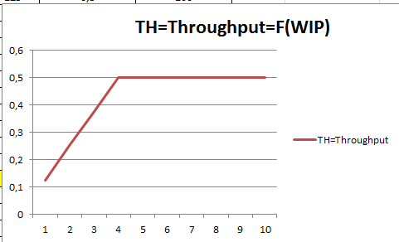
Basic problem III.
Will be explained in Little´s law presentation

Slide 30
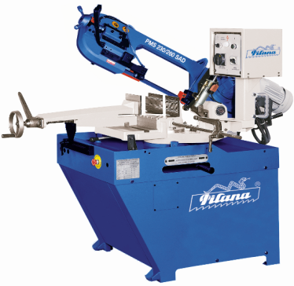
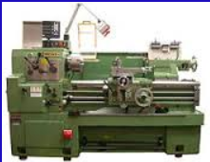
Basic problem (setup times) IV.
Black
White
White
Black
(Black ->White, Setup time=60 minut)
(White->Black, Setup time = 20 minut)

Slide 31
Basic problem V-I.(availability of components, home study !!)
Op1
A0
20 pcs of A7 and 20 pcs of A8
A1
A2
Op2
10 pcs of A4 adn 10 pcs of A5
(will be delivered in T1+X time )
A3
T0
Lead time A6
Op3
A4
A5
T1
A6
Op1
A7
A8
X= slack
Op2
T1
T1+X
Op3

Slide 32
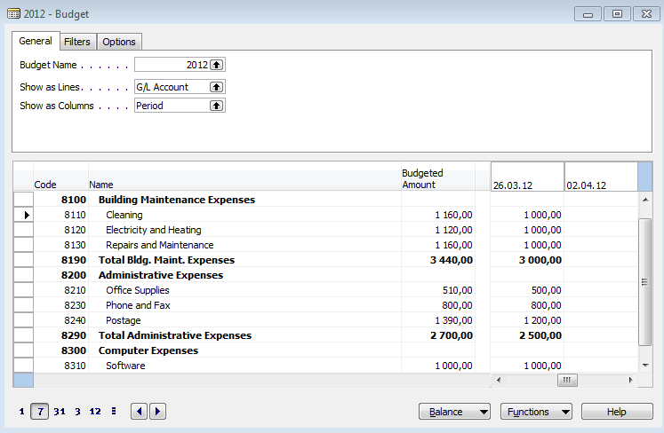
Basic problem VI-I. (over budget)

Slide 33
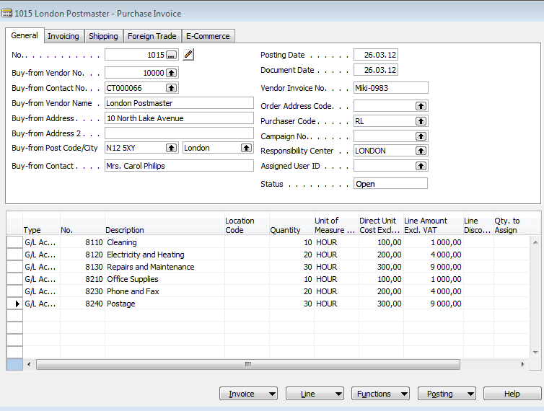
Basic problem VI-II. (over budget)

Slide 34
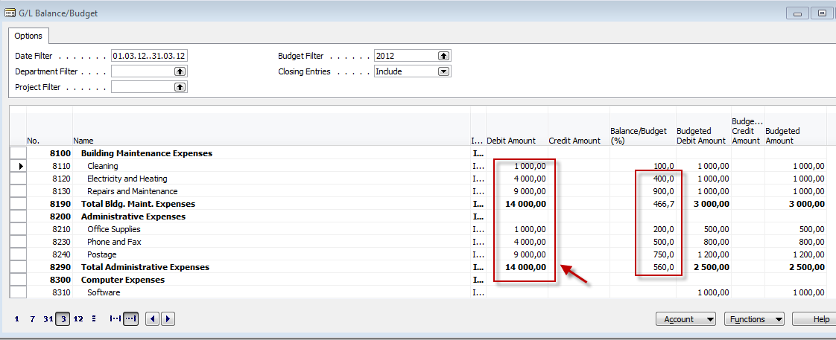
Basic problem VI-III. (over budget)

Slide 35
Tuition –plan-theory
OM-intro – done (this slide show)
Real project-South African client (wholesale)
Theory of constraints
Critical chain and project management
Quality management I. (Pareto+ Ishikawa)
Quality management II. (Six Sigma, Kaizen, Poka Yoke)
Business metrics (use of matrices – Boston, Gartner MQ)
Balanced Score Card
DBR , CONWIP (Constant Work In Progess)
Decision making (Kepner-Tregoe methodology,..)
P&Q analysis (mix of products)
Business Intelligence – intro and concept
Little´s law
Yield management – intro to concept
Linear programming – concept and use
Business Intelligence

Slide 36
Tuition –plan-ERP used in OM
ERP basics (principles) and ERP handling and installation
Purchase – basic parameters and impacts of parameter setting (Stock, General Ledger)
Sale - basic parameters and impacts of parameter setting (Stock, General Ledger, Discounts)
Inventory – basics
Transfers of items
Banking operations (posting and payments)
Customer Relationship Management
Basic tools used for analysis of created transactions

Slide 37

Thanks for your attention

