Slide 1
Introduction to MS Dynamics NAV XXX. (Discounts)
Ing.J.Skorkovský,CSc.
MASARYK UNIVERSITY BRNO, Czech Republic
Faculty of economics and business administration
Department of corporate economy

Slide 2
Discounts
Use of discounts:
Support of „Sales“ actions->lower stock value and better liquidity
Support of marketing ->new clients
Basic incentives for any type of client
In order to differentiate between clients (based on sales in last period or other criteria
Types :
Price ->modification of Unit Price
Line ->change final price in %
Invoice Discount ->based on level of invoiced amount

Slide 3
Basic Blocks
Customer
Discount Group
Window used
for Invoice Discount
Customer
Allow Line
Discount
Sales Button
Window used
for Price Discount sestup
Sales
header
Ikona Ceny (2016)
Sales line
ITEM
Window used
for Line Discounts in % setup
Item Discount
Group
Unit Price
Allow Invoice
Discount
Can be access either from
Customer Card or Item Card
Sales Button
Ikona Řádkové slevy (2016)

Slide 4
Window used for Line Discounts Setup (%)
Sales Type | Sales Code | Type | Code | Unit of Measure | Minimum | Line discount % | Starting date | Ending date
Customer | 10000 | 70102 (Item number) |  | PCS | 10 | 2
Customer Discount Group | Large Account | Item Discount Group | RESALE |  | 20 | 4
All Customers |  |  |  |  | 5 | 1
Campaign | Spring Campaign | Item Discount Group | BOOKS |  | 3 | 7

Slide 5
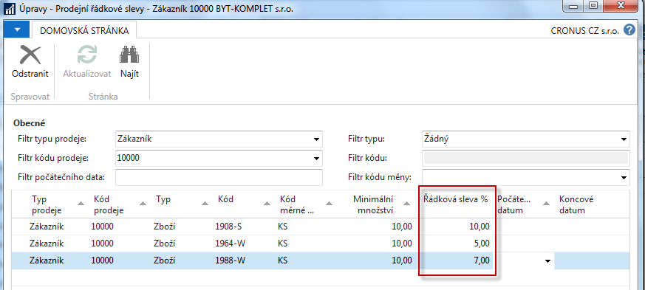
Window used for Line Discounts Setup (%)
Zákazník ->Navigace->Sekce Prodej->Řádkové slevy

Slide 6
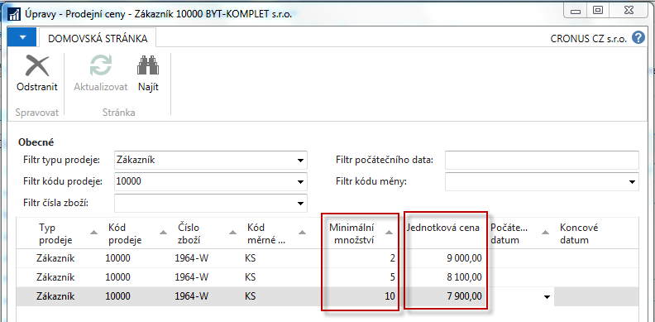
Window used for Sales Line Discounts Setup
Zákazník ->Navigace->Sekce Prodej->Ceny
Původní jednotková cena na kartě zboží je 10970

Slide 7
Discount combination
Price reduced from 100 to 90
Discount % =10
Final price after discounts were applied = 90*0,9=81

Slide 8
Prodejní řádky dokumentu (PO)

Slide 9
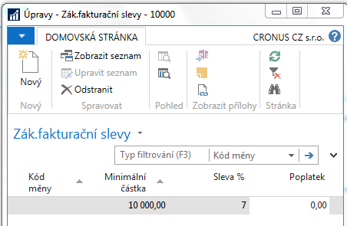
Fakturační sleva
Fakturační sleva musí být povolena a je nutné manuálně zahájit její výpočet, aby byla aplikována

Slide 10
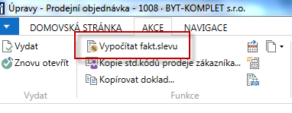
Výpočet kalkulační slevy

Slide 11
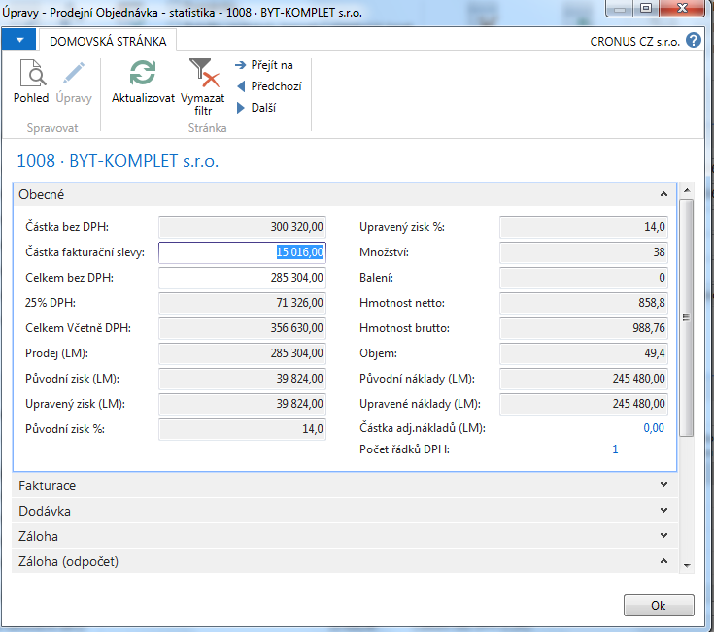
Statistika dokumentu F7

Slide 12
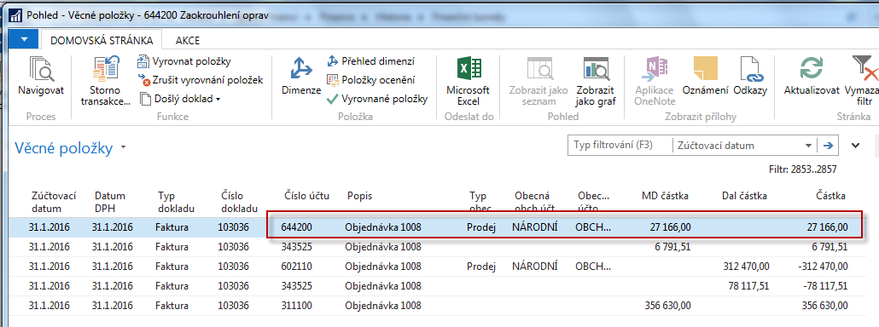
Položky hlavní knihy po zaúčtování
Oblasti->Finance->Archiv->Historie->Finanční žurnály

Slide 13
End of the section Discounts
This is the end Beautiful friend This is the end My only friend, the end…
So why worry now ……

