Slide 1
Sijil Joseph 469806 Richard Potsch 396628 Matti Saariaho 478083 Barbora Turakova 461977

Slide 2
Motivation – theories, concepts and Strategies
Definition:
Desire or willingness to do something.
"Motivation is generally viewed as a process through which an individual's needs and desires are set in motion”
-(Rakes, & Dunn, 2010).

Slide 3
Types of motivation 1. Extrinsic
Occurs when other things or people motivate
Reward or Punishment
Incentives, bonus
Disciplinary action
Increased pay
Decreased pay
Promotion
Criticism

Slide 4
Types of motivation 2. Intrinsic
From self-generated factors that influence people
Important, interesting work
Position design
Degree of autonomy
Opportunities available
Developing skills

Slide 5
Theories of Motivation
Content Theories:
Maslow’s Hierarchy Of Needs
Herzberg’s Motivation Hygiene Theory
McClelland’s Needs Theory

Slide 6
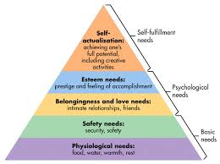
Maslow´s Hierarchy of Needs
Defined by the American psychologist (Abraham Harold Maslow)
People have five basic needs.
The first four categories are the scarce needs, fifth is need of existence or growth.
Lower needs are more important.

Slide 7
Herzberg’s motivation-hygiene theory
Introduced a two-factor model
Satisfaction and discontent are separate factors and not in a continuum
 | Low motivation | High motivation
High hygiene | ”Paycheck” | ”Dreamjob”
Low hygiene | ”Misery” | ”Calling"

Slide 8
McClelland’s three needs theory
Focuses on top of Maslow’s pyramid
Defines 3 needs regardless of age, sex or culture
Dominance of different types of motivation was shown to follow trends in different positions
Need for achievement | Need for power | Need for affiliation

Slide 9
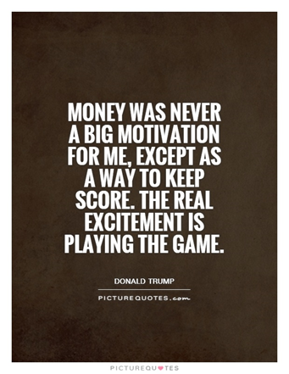
Motivation and Money
Key issue: How does financial rewards influence employees motivation and performance ?
Powerful force as it is linked to satisfaction of needs
Means of achieving a desired standard of living
Importance of money can be reduced after a certain stage
Association between salary and job satisfaction is fairly weak
Financial incentives negatively effect intrinsic motivation
People value money for various reasons
Different values are differentially linked to engagement
Personalities are predictors of engagement

Slide 10
Motivational Strategies
Based on Extrinsic Values:
Variable Pay Program
Piece Rate Pay Plan
Merit Based Pay Plan
Bonus
ESOP

Slide 11
Motivational Strategies
Based on Intrinsic Values:
Employee Recognition Program
Flexible Benefits
Goal Congruence

Slide 12
Thank you!
Questions?

