Slide 1
Linear programming-introduction
Ing.J.Skorkovský,CSc.

Slide 2
USE
Slitting and Levelling of material (coils, bars, sheets)-Cutting material, trimming,…
Blending - blending, diet, feeding rations for animals, ..
Transport problems - material flow from stock to the destination and route planning - shortest route
Assignment of resources with limited capacities - CCR
Sources : Operation Management, Quality and Competitiveness in a global environment, Russel and Taylor (ESF library),…

Slide 3
Formulation of the model
Product | Description | Work /hour | Material/pcs | Return/pcs
Dish (Miska) | x1 | 1 | 4 | 40
Mug (Hrnek) | x2 | 2 | 3 | 50
Which combination of products will have the greatest return
at the limits of maximum production capacity type = 40 hours
and the amount of material, that is limited to 120 kg of clay (jíl)?
Note: A similar task in terms of flow was solved in the P&Q example based on TOC
(only valid for Czech student), where the limitation was in resource
B and with a maximum capacity of 2400 minutes)

Slide 4
Basic structures and used terminology
We minimize our target function(cílová funkce)in the form of:
Z = c1*x1+c2*x2+…..+cn*xn with respect to the matrix of restrictive conditions:
(in our case c1=40 and c2=50)
A11*x1 + A12*x2+ …+ A1n*xn (<>=) B1
A21*x1 + A22*x2+ …+ A2n*xn (<>=) B2
Am1*x1 + Am2*x2+ …+ Amn*xn (<>=) B2
It is classical system of linear equations je Ax=B (restrictive conditions-omezení)
The solving of such a linear equation system, e.g. By use of GAUSS-JORDAN algorithm is not required with the help of Excel Solver.
xij : decision variable= level of operation activity specified by this variable
Bi : restrictive conditions , allowed deviations from the norm (in time and material)
cj : coefficient of the target function (in our case returns, meaning 40 and 50 )
Aij : restrictive coefficients : work and material for one unit (pcs) of the product
Systém lineárních rovnic

Slide 5
Example I (introduction to the problem – practical demonstration )
Product | Description | Work /hour | Material/pcs | Return/pcs
Dish | x1 | 1 | 4 | 40
Mug | x2 | 2 | 3 | 50
Z = c1*x1+c2*x2+…..+cn*xn (classical equation from) Z = co největší výnos)
Target function: Z= 40*x1+50*x2, which we must maximize (maximalizovat)
Maximal production capacity = 40 hours and Maximal quantity of material =120 kg
( to jsou dva prvky matice B (40,120)
Specifications of task restrictions by use of 2x2 matrix:
1*x1 + 2*x2 =40 (work- no more than 40 hours)
4*x1 + 3*x2 =120 (material=kg of clay in our case)->x1=(40-2x2)+3x2=120….
Manual solving : -> x1=24 a x2=8 and after substitution od variables (vyřešení 2 lineárních rovnic o 2 neznámých)
in target function we will get
Z=40*24+50*8=1360 (maximální výnos)
(optimal Return meets the point B – see next slide)
Rovnice dvou přímek

Slide 6
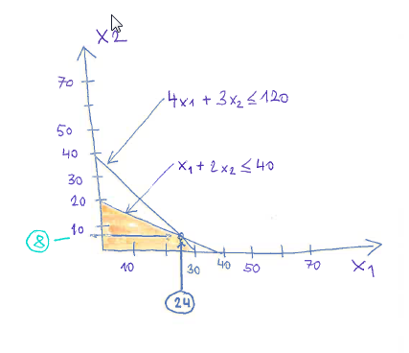
Graphical solution
B

Slide 7
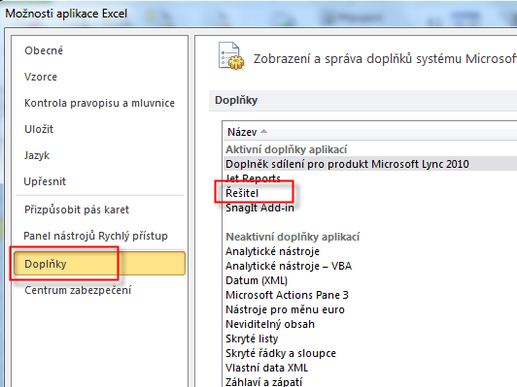
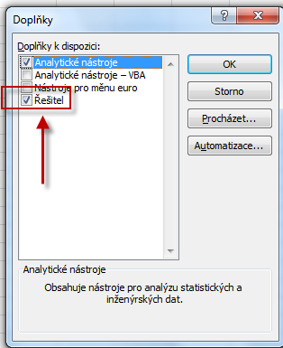
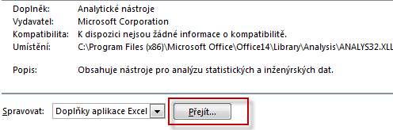

Use of Solver (Czech EXCEL)
Solver
Excel Setup
Comlements
Supplement
Solver
Solver

Slide 8

Use o solver (see actual Excel formulas on one of the the next slides)
Not for Czech courses !!!!! ->see next slides
x1
x2
 | Dish | Mug | Total | Capacity
Variables (x1, x2) | 0 | 0
Return | 40 | 50 | 0
Material | 4 | 3 | 0 | 120
Work | 1 | 2 | 0 | 40
Assignment
entered in table
Z
x1=Dish , x2=Mug, max 40 hod (B1), max 120 kg (B2)
Assignment
Target function Z = x1*c1 + x2*c2 = 40*x1+50*x2
4 * x1 + 3 *x2 =120 - capacity restrictions= max quantity of material =B1
1 * x1 + 2 *x2 = 40 -capacity restrictions by max work capacity=B2
Product | Description | Work /hour | Material/pcs | Return/pcs
Dish | x1 | 1 | 4 | 40
Mug | x2 | 2 | 3 | 50

Slide 9
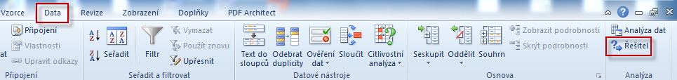
Solver start

Slide 10
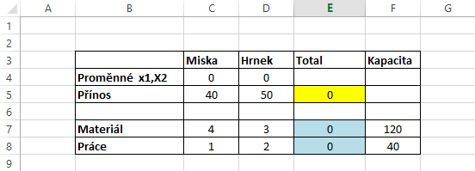
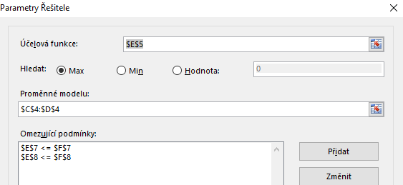
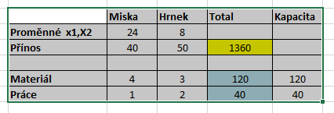
Use of Solver (Czech- not for MPH_AOPR )
Z = x1*c1 + x2*c2 = 40*x1+30*x2
E7=C7*C4+D7*D4=4*x1+3*x2=120
E8=C8*C4+D8*D4=x1+2*x2=40

Slide 11
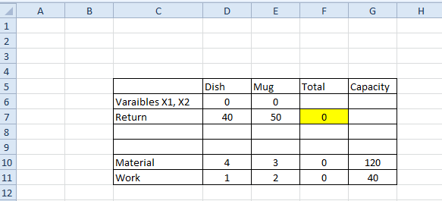
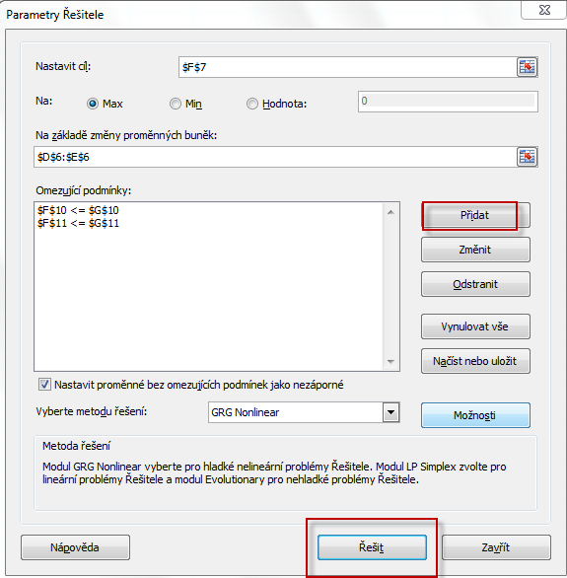
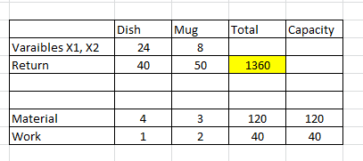
Use of solver (ENG)
Z = x1*c1 + x2*c2 = 40*x1+30*x2
F10=D10*D6+E10*E6=4*x1+3*x2=120
F11=D11*D6+E11*D6=x1+2*x2=40
Target
Variables
Restrictions
Solve it

Slide 12
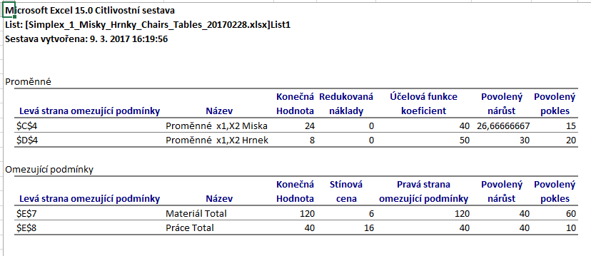
Využití Řešitele (use of Solver)

Slide 13
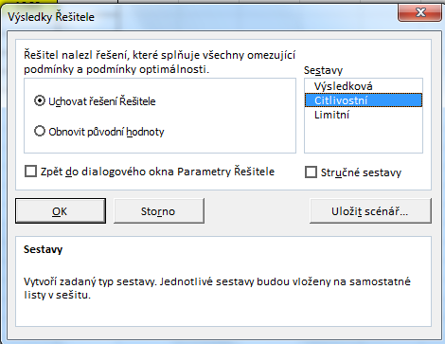
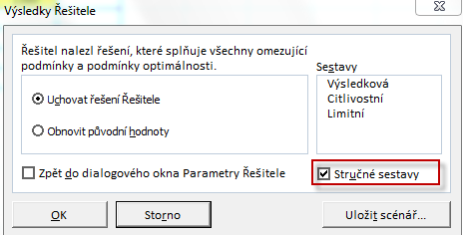
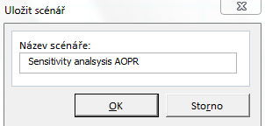
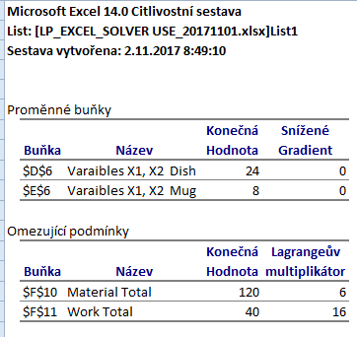
Use of Solver (English)
New Excel List

Slide 14
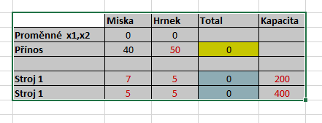
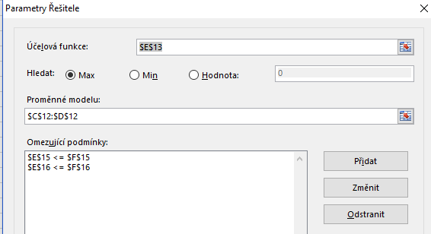
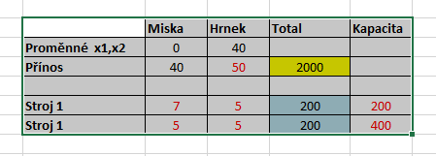
Změna úlohy- jiné výnosy jiná omezení typu práce na dvou strojích a jejich kapacitní omezení
(Change of parameters- not necessary fro MPH_AOPR !!!!!)

Slide 15

OK ?

