Slide 1
Instructions Valuation
The very basic of Financial Mathematics
Financial Mathematic
Lecture 1
Luděk Benada, Dagmar Linnertova
Department of Finance - 402, benada.esf@gmail.com
October 13, 2017
The Study materials prepared by
Mikhail Dmitrievich Balyka
BPF_AFMT

Slide 2
Simple and compound interest
Interest is the cost of borrowing money
Depending on how we calculate it, can be defined as simple interest or compound interest
Example: Suppose you deposite 1000$ into a bank at 10% per annum (the interest is calculated annually).
How much do you have 3 years later using:
Simple interest
Compound interest
BPF_AFMT

Slide 3

Simple and compound interest
Simple interest is calculated on the principal (amount you deposit). Since at the end of the 1st year we have:
1000 (our principal) + 1000*10% (interest)=1100
1000+1000*10%+1000*10%=1200 – 2nd year
1000+1000*10%+1000*10%+1000*10%=1300 – 3rd year
Or, using formula:
PV, FV – present and future value
r – interest rate
t – time in years
$$FV=PV×(1+rt)$$
BPF_AFMT
Notes:
Derivation of the formula: as it was mentioned, to find the amount of money in an account, one should add an interest to a principal. Hence, we have:
PV+Interest=PV+PVr=PV(1+r) -1st year
PV+PVr+PVr=PV(1+2r) – 2nd year
PV+PVr+PVr+PVr=PV(1+3r) – 3rd year
So, at the and of t-th year we have PV(1+tr)

Slide 4

Simple and compound interest
Compound interest is calculated on the principal plus the accumulated interest of previous periods:
1000+1000*10%=1100 – 1st year
1100+1100*10%=1210 – 2nd year
1210+1210*10%=1331 – 3rd year
Or, using formula:
n – number of compounding periods
$$FV=PV×{(1+r)}^{n}$$
BPF_AFMT
Notes:
Derivation of the formula:
FV=PV+PVr=PV(1+r) – 1st year
FV=PV(1+r)+rPV(1+r)=PV(1+r)[1+r]=PV(1+r)^2 – 2nd year
FV=PV(1+r)^2+rPV(1+r)^2=PV(1+r)^2[1+r]=PV(1+r)^3 – 3rd year
So, at the end of t-th year we have FV=PV(1+r)^n

Slide 5
Simple and compound interest
Money invested at compound interest grows faster than money left to grow at simple interest
BPF_AFMT
Notes:
If we have non-integer number of interest periods, then we can maximise our investment using a compound interest for an integer number of interest periods and simple interest for the rest.

Slide 6
Simple and compound interest
Combining simple and compound interest example
Let’s assume that we deposit 15000 at 7% p.a. into a bank which calculates interest 3 times a year (4 months). Also we know that we will have 20000 in a given time. So, what is the time, assuming we maximising our investment?
FV=PV*(1+r)^{n} 20000=15000*(1+0,07/3)^{n} 4/3=1,0233^{n}
t=ln(4/3)/ln1,0233=12,4725. (1)
Hence, we have 12 full interest periods, then we can write down the equation that combines two types of interest:
20000=15000(1+0,07/3)¹²*(1+0,07/3*t) t=0,4696 (2)
Note, that result 2 (0,4696) is less than the decimal part of result 1 (0,4725). It shows us that usage of simple interest is more effective than compounding in case of non-integer IP. Answer: 12 full interest periods (i.e. 12/3=4years)+0,4696 IP (i.e 0,4696*120days=56days)
BPF_AFMT
Notes:
If we have non-integer number of interest periods, then we can maximise our investment using a compound interest for an integer number of interest periods and simple interest for the rest.

Slide 7
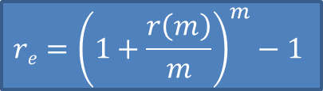
Simple and compound interest
Effective rate
It’s anually converted rate that gives the same interest earnings as the rate r(m) converted m times per year, where m≠1
Assume that the nominal compounded rate r(m) yields the same future value for 1$ invested for one year as the annually compound rate r_{e}
1+r_{e}=[1+r(m)/m]^{m}
$${re=\left(1+\frac{r\left(m\right)}{m}\right)}^{m}−1$$
BPF_AFMT

Slide 8

Simple and compound interest
Effective rate
Find the annual effective rates for 8% compounded:
quarterly; r_{e}=(1+0,08/4)⁴-1=8,24%
monthly; r_{e}=(1+0,08/12)¹²-1=8,3%
daily; r_{e}=(1+0,08/365)³⁶⁵-1=8,33%
$${re=\left(1+\frac{r\left(m\right)}{m}\right)}^{m}−1$$
BPF_AFMT

Slide 9

Simple and compound interest
Continuous compounding
What if we let the value of m in this formula become infinitely large?
This means that interest compounds more often than every second; in fact we say it’s compounded continuously.
Suppose you invest 1$ at 100% p.a. Let’s calculate the future value of this investment when interest compounds:
a) yearly b) quarterly c)monthly d)daily
$${re=\left(1+\frac{r\left(m\right)}{m}\right)}^{m}−1$$
BPF_AFMT

Slide 10
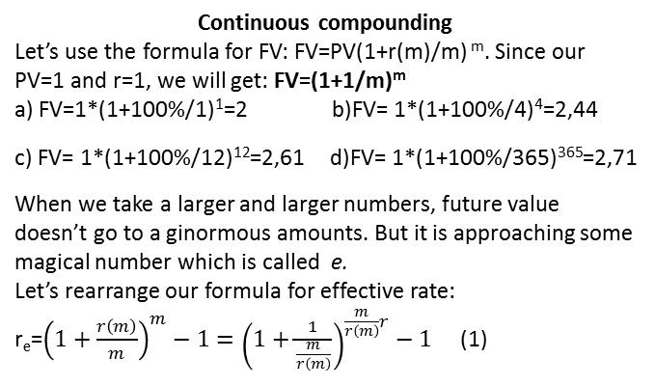
Simple and compound interest
Continuous compounding
Let’s use the formula for FV: FV=PV(1+r(m)/m) ^{m}. Since our PV=1 and r=1, we will get: FV=(1+1/m)^{m}
a) FV=1*(1+100%/1)¹=2 b)FV= 1*(1+100%/4)⁴=2,44
c) FV= 1*(1+100%/12)¹²=2,61 d)FV= 1*(1+100%/365)³⁶⁵=2,71
When we take a larger and larger numbers, future value doesn’t go to a ginormous amounts. But it is approaching some magical number which is called e.
Let’s rearrange our formula for effective rate:
r_{e}=${\left(1+\frac{r\left(m\right)}{m}\right)}^{m}−1={\left(1+\frac{1}{\frac{m}{r\left(m\right)}}\right)}^{\frac{m}{r\left(m\right)}r}−1$ (1)
BPF_AFMT
Notes:
e number is equal to 2,718281828
there is a tip how to memorise it: it is just 2,7 and then two times we have the birth year of Leo Tolstoy, which is 1828
probably, it is the best way to memorise the writer’s year of birth, but nevertheless, it works

Slide 11

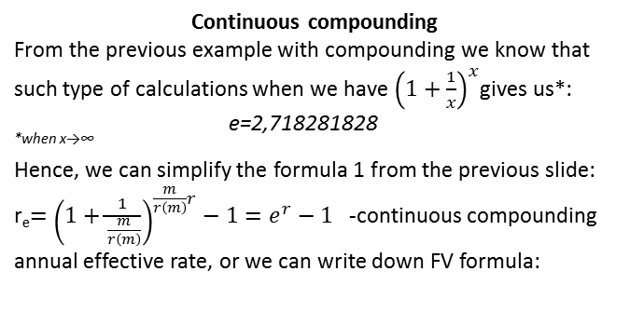
Simple and compound interest
Continuous compounding
From the previous example with compounding we know that such type of calculations when we have ${\left(1+\frac{1}{x}\right)}^{x}$gives us*: e=2,718281828
^{*when x→∞}
Hence, we can simplify the formula 1 from the previous slide: r_{e}$={\left(1+\frac{1}{\frac{m}{r\left(m\right)}}\right)}^{\frac{m}{r\left(m\right)}r}−1=e^{r}−1$ -continuous compounding annual effective rate, or we can write down FV formula:
$${FV=PV×e}^{ft}$$
BPF_AFMT
Notes:
How we derive FV=PV*e^ft:
1) FV=PV(1+r)^n - future value formula
2)FV=PV(1+e^r -1)^t - replace r by the effective rate (e^r – 1) and n by the number of years t
3)FV=PV*e^rt - simplify

Slide 12
Simple and compound interest
Continuous compounding
Example:
1) Find annual effective rate for 8% compounded continuously
r_{e}=e^{0,8}-1=8,3287%
2) Find the nominal rate r compounded continuously that will produce an effective rate of 8%
r_{e}=e^{f}-1 , that is f=ln(1+r_{e}) f=ln(1,08)=7,696%
3) Find the future value of 4000 invested for 42 months (3,5 years) at 8% compounded continuously
FV=PV*e^{ft}=4000*e^{0,08*3,5}=5292,52
BPF_AFMT

Slide 13
Simple and compound interest
Discount interest rate
Let’s consider the concept of discount rate on the following example:
If you borrow 500$ for a year at a 10% discount rate, the banker would give you 450$ and expect you to pay back 500$ at the end of the year (i.e. Interest collecting is up front).
If it were a simple interest, you would get the entire 500$ but pay back 550$.
Hence, with simple interest 500$ - PV, but with discount interest 500$ - FV
BPF_AFMT

Slide 14


Simple and compound interest
Discount interest rate
As we know, FV=PV(1+rt) or PV=FV/(1+rt), so we can express d in terms of r :
$$PV=FV×(1−dt)$$
$$d=\frac{r}{1+r}$$
BPF_AFMT

Slide 15
Simple and compound interest
Compound interest and taxation
An interest earned on an investment is a taxable income. And we need to deduct this tax amount from the interest.
The way we calculate it depends on a tax period (TP) and interest period (IP). There are three possible situations:
IP=TP
TP>IP
TP – just once, at the end of your investment
Let’s calculate it using the following example:
We deposit 1000$ into a bank at 5% p.a. For 10 years. Tax rate is 10%. Calculate the future value after tax FV_{tax}.
BPF_AFMT

Slide 16

Simple and compound interest
Compound interest and taxation
IP=TP=1 year
FV=PV(1+r)^{n} to calculate the tax we need to understand that every year our interest is reduced by the amount of tax or in other words our interest rate reduced by the tax rate i.e it is r*(1-tax)
Hence, after the 1st year we have FV_{tax}=PV[1+r*(1-t)] or after n periods:
FV_{tax}=1000[1+0,05*(1-0,1)]¹⁰=1552,97
$${FVtax=PV[1+r×\left(1−tax\right)]}^{n}$$
BPF_AFMT

Slide 17

Simple and compound interest
Compound interest and taxation
b) IP=3 months TP=1 year TP>IP
FV=PV(1+r)^{n} to calculate the tax we need to understand that before we deduct the tax amount, we obtain some interest for several IP in one year: FV=PV(1+r/m)^{m} by subtracting “1” from FV we obtain interest which we can use to calculate the interest after tax: PV[(1+r/m)^{m} -1]*(1-tax).
Now we can move back “1” to get FV and raise it to the power of years:
$${{FVtax=PV[((1+\frac{r}{m})}^{m}−1)×(1−tax)+1]}^{t}$$
BPF_AFMT

Slide 18

Simple and compound interest
Compound interest and taxation
FV_{tax}=1000[((1+0,05/4)⁴-1)*0,9+1]¹⁰=1565,66
$${{FVtax=PV[((1+\frac{r}{m})}^{m}−1)×(1−tax)+1]}^{t}$$
BPF_AFMT

Slide 19

Simple and compound interest
Compound interest and taxation
c) TP=once per 10 years IP=1 year
FV=PV(1+r)^{n} to calculate the tax we need to find the interest obtained during these 10 years
I=PV(1+r)^{n}-1 then we can define the interest after tax multiplying it by (1-tax) and finally add back “1” and obtaining the future value after tax:
FV_{tax}=1000[(1+0,05)¹⁰-1]*0,9+1=1566,01
$${FVtax=PV[((1+r)}^{t}−1)∗(1−tax)+1]$$
BPF_AFMT

