Slide 1
3. Determinants of demand
Demand for product – is the quantity of good or service that customer are willing and able to purchase during a specified period under a given set of conditions.
Derived demand is the demand for all inputs used by a firm.
The knowledge of demand for our products is one of the key success factors for our company and presents the competitive advantage for the firm. The estimation of demand is easy in short-term range
But very challenging in long-term range ( external factors)

Slide 2
Kotler, Keller( 2007) Companies can prepare as many as 90 different types of demand estimates for six different product levels, five space levels, and three time periods. Each demand measure serves a specific purpose.
The potential market is the set of consumers with a sufficient level of interest in a market offer.
The available market is the set of consumers who have interest, income, and access to a particular offer.

Slide 4
The target market is part of the qualified available market the company decides to pursue.
The penetrated market is the set of consumers who are buying the company’s product.

Slide 5
Market demand for a product is the total volume that would be bought by a defined customer group in a defined geographical area in a defined time period in a defined marketing environment under a defined marketing program. Market demand is not a fixed number, but rather a function of the stated conditions. For this reason, we call it the market demand function . (Kotler, Keller2007)

Slide 6
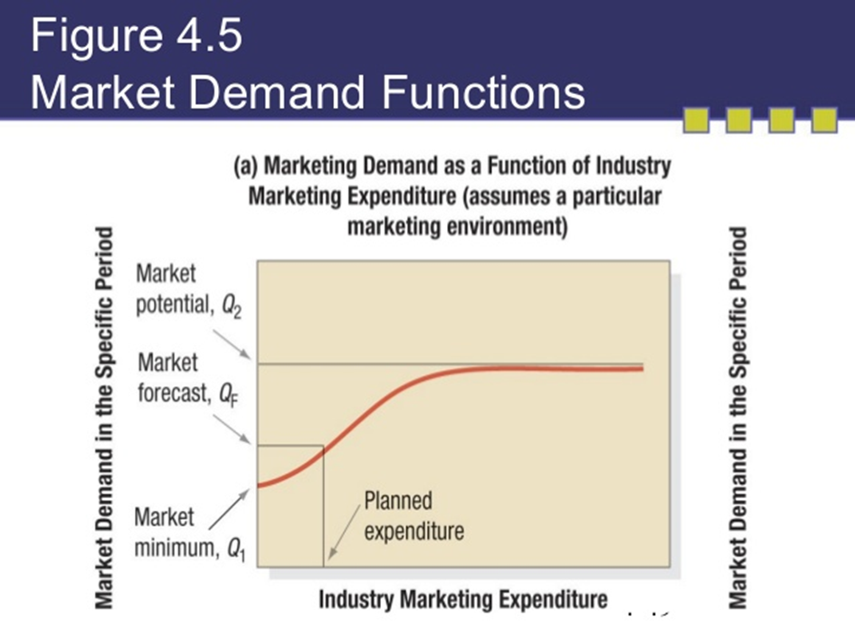

Slide 7
Q1 – market minimum would take place without any demand stimulating expenditures ( for example on marketing)
Q2 – market potential– marketing expenditures beyond a certain level would not stimulate much further demand.
The distance between Q1 and Q2 shows the overall marketing sensitivity of demand.
If the difference between Q1 and Q2 is large, that means expansible market –good for investing in marketing
If the difference between Q1 and Q2 is small, that means non-expansible market – not affected by the level of marketing expenditure

Slide 8
Market forecast- There can be only one actual level of industry marketing expenditure. The market demand corresponding to this level of expenditure is called the market forecast .
Market potential – limit approached by market demand as industry marketing expenditures approach infinity for a given marketing environment.
Company demand – is the company´s estimated share of market demand at alternative levels of company marketing effor in a given time period.

Slide 9
Methods of demand estimation
Consumer interviews ( questionnaires),
market studies and experiments,
expert opinion,
historical market data– regression statistics, statistic analysis
market testing – direct sales of products

Slide 10
Methods of demand estimation – market research
Problem definition
to define clearly the problem to be tackled
Exploratory research
to identify information gaps and specify the need for further research
Quantitative research
utilising a sufficiently large and random sample to enable market segment size to be stimated and strenghtof opinions to be gauged.
Analysis and interpretation
following data colection, statistical techniques and models can be employed to turn the data generated into meaningful information to help with segmentation

Slide 11
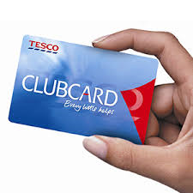
Case study
Tesco use loyalty card to build profiles of its customers so that it can „generate a map of how an individual thinks, worksand more importantly, shops. The map classifies consumers across 10 cathegories: wealth, promotions, travel, charities, green, time poor, credit, living style, creature of habit and adventurous“( Hooley et, al. 2012)

Slide 12
Methods of estimation
Basic methods of edemand estimation can be divided as (Horáková, Kubát, 2002):
1) subjective and open-minded
2) Quantitative and qualitative
3) Simple and analytical
Subjective methods – conected with intuition, opinions and knowledge of interested persons (expert opinions)
Open – minded methods - based on the raw data collection – statistic methods are used to evaluate the gained data Kvalitativní metody jsou založena na slovním vyjádření prognózované budoucnosti. Jde o systematické nezaujaté shromáždění údajů a provedení úsudku.
Quantitative methods - include surveys, observation ar experimentation.
Qualitative methods- unstructured or semi-structured interviewing methods designed to encoured respondents to reply freely and express their real feeling, opinion and motivatin.
Simple methods – estimation of only one variable.
Analytical methods – demand estimation based on the correlation and realtions between more variables

Slide 13
Demand influencing non-pricing factors (Keřkovský, 2016):
Rent.
Preferences .
Consumers expectations
Prices of supplements or complements.
Nuber of conusmers etc.

Slide 14
Necenové faktory ovlivňující primárně poptávku
( Keřkovský, 2016)

Slide 15
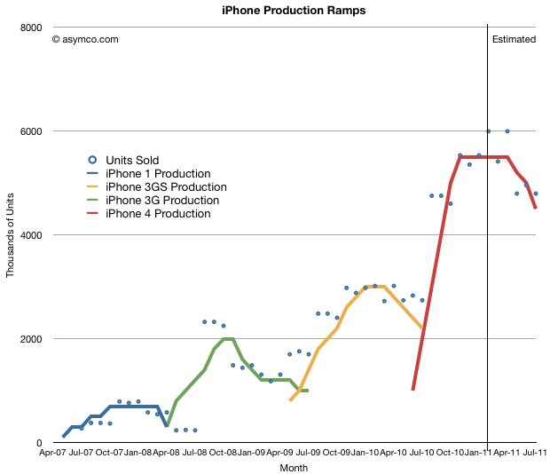
iPhone demand forecasting zdroj: http://www.asymco.com/2011/03/28/predicting-iphone-sales-for-dummies/

Slide 16
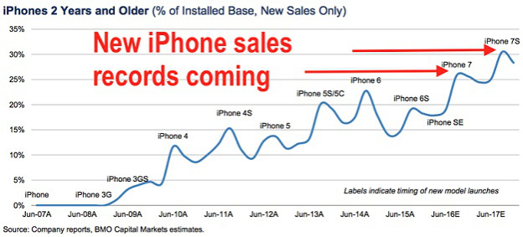

Slide 17
Consumers behaviour
Consumer behaviour entails "all activities associated with the purchase, use and disposal of goods and services, including the consumer's emotional, mental and behavioural responses that precede or follow these activities“.
(Kardes, F., Cronley, M. and Cline, T., Consumer Behavior, Mason, OH, South-Western Cengage, 2011 p.7 )

Slide 18
Consumer behaviour is connected with:
purchase activities: the purchase of goods or services; how consumers acquire products and services, and all the activities leading up to a purchase decision, including information search, evaluating goods and services and payment methods including the purchase experience
use or consumption activities: concerns the who, where, when and how of consumption and the usage experience
disposal activities: concerns the way that consumers dispose of products and packaging; may also include reselling activities such as eBay and second-hand markets
Kardes, F., Cronley, M. and Cline, T., Consumer Behavior, Mason, OH, South-Western Cengage, 2011 p.9; Sassatelli, R., Consumer Culture: History, Theory and Politics, Sage, 2007, p. 10

Slide 19
Purchasing behaviour can also be affected by external influences, such as:
Culture and subculture: based on age, geographic, religious, racial, and ethnic differences
Social class – very difficult to measure, division in society according educational attainment, income and occupation
Reference group – indivudial makes the decission according values being used by someone else ( family, friends, sport team, political party etc.).
  Opinion leader – influence people due to his/her product knowledge, expertise or credibility

Slide 20
Types of behaviour:
Product value and shopping value
Product value - similar for both online and offline shoppers
Shopping value – different if you are shopping online or offline due to the experience
https://www.youtube.com/watch?v=24_HO_KUttY
https://www.youtube.com/watch?v=zVplgl3-pRM

