Slide 1
Finance

Slide 2
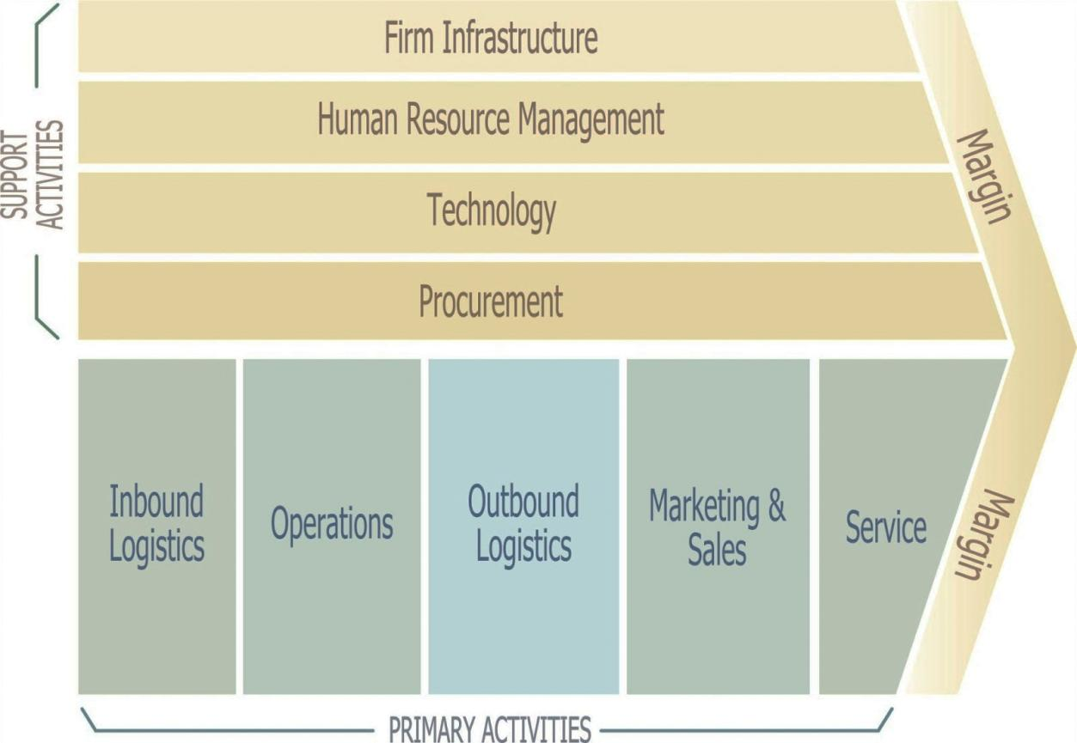
Where we are?

Slide 3
A company
Accounting point of view - generally sum of assets (investments) and liabilities (capital)
Structure of each important
Financial management (rules, tools)

Slide 4
Means and sources of a company
Means – concrete composition of the buildings, tools, inventory, accounts receivable, goodwill, know-how, money the company owns (assets)
Sources – the origin of wealth in a company (capital)

Slide 5
Financial structure
In the balance sheet
  shows structure of your assets
  shows the nature of the capital (structure of financing)

Slide 6
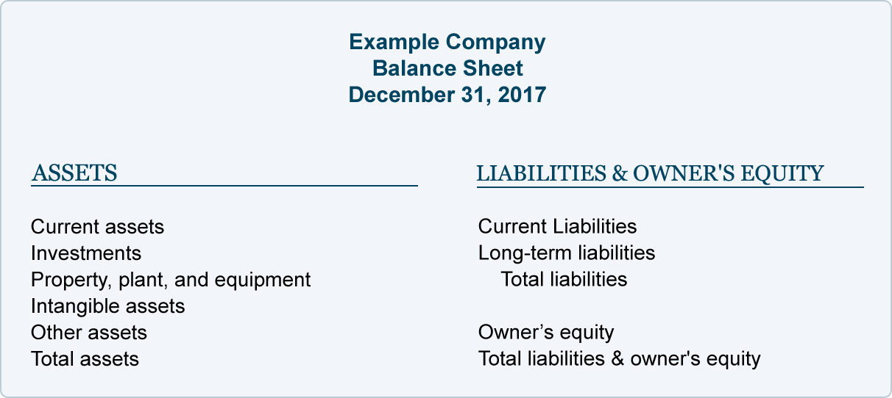
Balance sheet
Investment part
Capital part
Payment part

Slide 7
TOTAL ASSETS
Receivables from subscriptions
Fixed assets
Intangible fixed assets
Incorporation expenses
Research and development
Software
Valuable rights
Goodwill ( +/- )
Other intangible fixed assets
Intangible fixed assets under construction
Advance payments for intangible fixed assets
Tangible fixed assets
Land
Constructions
Equipment
Perennial corps
Breeding and draught animals
Other tangible fixed assets
Tangible fixed assets under construction
Advance payments for tangible fixed assets
Adjustment to acquired assets
Long-term financial assets
Shares - controlled organizations
Shares in accounting units with substantial influence
Other securities and shares
Loans to controlled and controlling organizations and to accounting unit with substantial influence
Other financial investments
Financial investments acquired
Advance payments for long-term financial assets
Current assets
Inventory
Materials
Work in progress and semi-products
Finished products
Animals
Merchandise
Advance payments for inventory
Long-term receivables
Trade receivables
Receivables from controlled and controlling organizations
Receivables from accounting units with substantial influence
Receivables from partners, cooperative members and association members
Long-term deposits given
Estimated receivable
Other receivables
Deffered tax receivable
Short-term receivables
Trade receivables
Receivables from controlled and controlling organizations
Receivables from accounting units with substantial influence
Receivables from partners, cooperative members and association members
Receivables from social security and health insurance
Due from state - tax receivable
Short-term deposits given
Estimated receivable
Other receivables
Short-term financial assets
Cash
Bank accounts
Short-term securities and ownership interests
Short-term financial assets acquired
Accruals
Deferred expenses
Complex deferred costs
Deferred income

Slide 8
TOTAL LIABILITIES
Equity
Registered capital
Registered capital
Company´s own shares and ownership interests (-)
Changes of registered capital ( +/- )
Capital funds
Share premium
Other capital funds
Diferences from revaluation of assets and liabilities ( +/- )
Diferences from revaluation in tranformation of companies ( +/- )
Differences from transformation of companies (+/-)
Diferences from valuation in transformation of companies (+/-)
Reserve funds, statutory reserve account for cooperatives, and other retained earnings
Legal reserve fund / indivisible fund
Statutory and other funds
Profit / loss - previous years
Retained earnings from previous years
Accumulated losses from previous years
Other profit / loss - previous years
Profit / loss - current year (+/-)
Other sources
Reserves
Reserves under special statutory regulations
Reserves for pension and similar payables
Income tax reserves
Other reserves
Long-term payables
Trade payables
Payables to controlled and controlling organizations
Payables to accounting units with substantial influence
Payables from partners, cooperative members and association members
Long-term advances received
Issues bonds
Long-term notes payables
Estimated payables
Other payables
Deffered tax liability
Short-term payables
Trade payables
Payables to controlled and controlling organizations
Payables to accounting units with substantial influence
Payables from partners, cooperative members and association members
Payroll
Payables to social securities and health insurance
Due from state - tax liabilities and subsidies
Short-term deposits received
Issued bonds
Estimated payables
Other payables
Bank loans and financial accomodations
Long-term bank loans
Short-term bank loans
Short-term accomodations
Accruals
Accrued expenses
Deffered revenues

Slide 9
Balance sheet
Investment part
Capital part
Payment part

Slide 10
Assets 1 of 2
Fixed assets (investment assets)
  Usage longer than 1 year
  Is subject do depreciation
Current assets (operating)
  Various forms (material, money, accounts payable)
  Still changing from one form to another
  Indicator - Absolute liquidity – ability to change to be used as a payment method

Slide 11
Assets 2 of 2
Assets structure is derived from:
  sector and branch of industry
    (technology, standard values, …)
  financial policy of the company
    (aggressive, defensive, strength, …)

Slide 12
Equity
represents what shareholders own, so it is often called shareholder's equity.
Equity = Total Assets – Total Liabilities
The two important equity items are paid-in capital and retained earnings.

Slide 13
Liabilities
There are current liabilities and non-current liabilities.
Current liabilities are obligations the firm must pay within a year, such as payments owing to suppliers.
Non-current liabilities, meanwhile, represent what the company owes in a year or more time. Typically, non-current liabilities represent bank and bondholder debt.

Slide 14
Investment and financing

Slide 15
Definition
Investing = bonding the capital in the assets (allows a production process in terms of revolution of current assets)
Financing = raising money for a business, obtaining capital

Slide 16
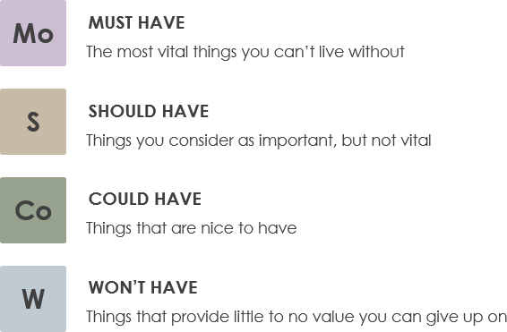
Investing on start (assets part)
Planning necessary think and calculate

Slide 17
Investing in between (assets part)
Technical vs. Economical lifespan
Technical
  How long can machine produce flawless goods
Economical
  How long is effective to use the machine according to:
    Operating costs
    Revenues higher than interest rate
    Taxes

Slide 18
Investment calculation
Static
  Cost comparison
  Profit comparison
  Profitability comparison
  Payback comparison
Dynamic
  Net present value (NPV)
  Internal rate fo return (IRR)

Slide 19
Static
Cost of purchase + cost of planned lifespan
  (must be same capacity, profit not shown)
Profit – comparison of expected profit
Profitability – ROA, ROE, ROS
Payback of additional costs =
(Cost 2 – cost 1) / (operating cost 1 – operating cost)

Slide 20
Dynamic (NPV)
NET PRESENT VALUE

Slide 21
Dynamic (IRR)
Internal rate of return – NPV = 0

Slide 22
Financing (capital part)
Own capital (equity)
Foreign capital (liabilities – debt, credit…)
Alternatives – leasing
Strategic planning and calculating necessary (there are rules)

Slide 23
Financing
Debt financing vs. Equity financing
Debt financing (capital) – source of investment rely on borrowed funds
Sources of debt capital: banks, credit unions, relatives and friends
Equity financing (capital) – selling shares of the company to investors
Sources of equity capital: relatives and friends, business angels and venture capitalists, partners

Slide 24
Key planning factors of capital
Own sources (equity)
  Will of owners to invest
  Legal necessity
  Profit generation ability
  Dividend policies (profit parting)
Foreign sources (debt)
  Long term liabilities (mother company)
  Short term liabilities (terms of payments of accounts payable and receivable)
  Sum of liabilities of the company (for accepting further credit)

Slide 25
Financing (rules 1)
Gold rule of financing
There should be match between the time of the bonding of the capital in assets and the time of the availability of the capital for their purchase
Gold balance rule
narrow definition – fixed assets should be financed by equity, current assets by debts
wide definition – fixed assets should be financed by long term debts, current assets by the short term ones

Slide 26
Financing (rules 2)
Vertical capital structure
Share among the equity and foreign capital should be 1:1 (leverage ratio – debt to equity)

Slide 27
Financing (rules 3)
assets = liabilities
long term assets = long term liabilities
long term assets = own capital
Foreign capital = own capital
ROE!

Slide 28
Financial statements 1
So far we have been talking about balance sheet (the structure of assets and liabilities)

Slide 29
Financial statements 2
There are also
  Profit and loss statement
  Cash flow statement
  Annual report
  Auditor comment

Slide 30
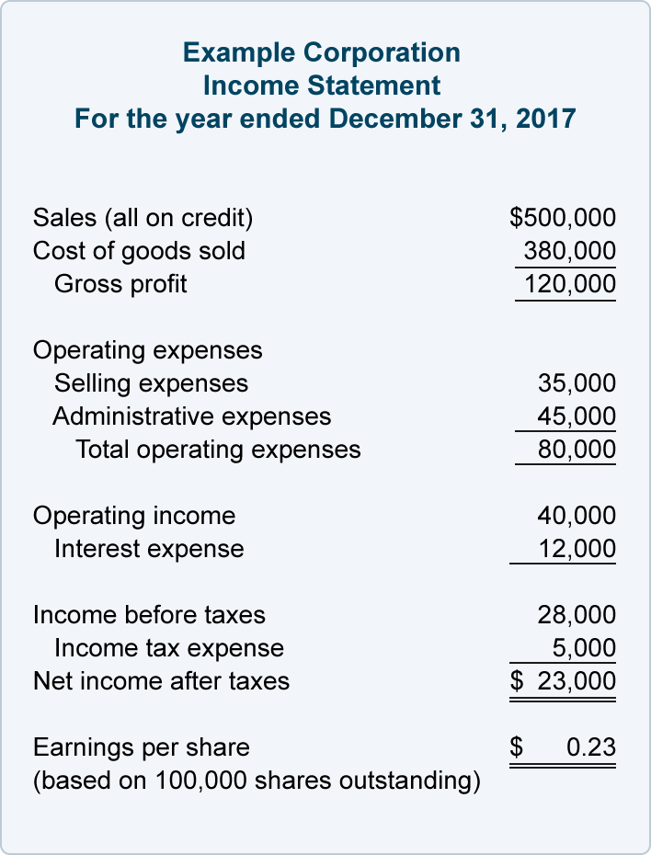
Profit and loss statement
Shows how the assets are working in you company – effectivity
Revenue – expenses = Income
Measure the performance over specific period of time

Slide 31
Cash flow statement
Shows how stable you are in the short run.
Shows inflow and outflow of money.

Slide 32
Annual report and auditor comment
Annual report
  Describes what really happened in the company, what were the plans, what is the accounting standard etc.
Auditor comment
  Verifies that statements are ok from point of accounting accuracy etc.

Slide 33
Financial statements 3
All of them are very important source of information about what happened in your company.
In the Czech Republic – companies in business register of specific size MUST publish statements!
Used for tax purposes
Used for financial planning
Used for financial analysis…

Slide 34
Financial analysis

Slide 35

Sources of information
Accounting of a company (reliable, auditors chamber revision)
National statistics
Statistics of ministries/departments
Accounting of competition

Slide 36

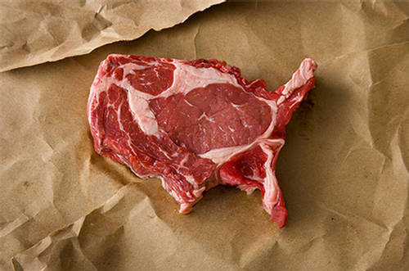
„Meating“ a problem
Verified accounting does NOT mean that you have no problem and it will be easy
Accounting standards are different across Europe
Czech Standards vs. __________ standards vs. IFSR vs. US GAAP

Slide 37
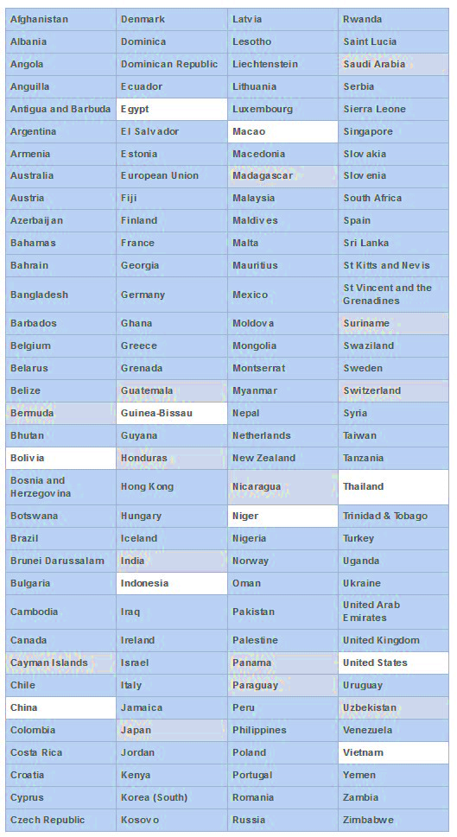
IFRS
The 116 jurisdictions in blue require IFRS for all or most domestic publicly accountable entities (listed companies and financial institutions).
Jurisdictions that permit or require IFRS for at least some domestic publicly accountable entities are in grey.
Jurisdictions that do not require or permit IFRS for any domestic publicly accountable entities are in white.

Slide 38
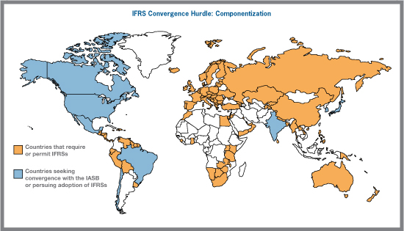
IFRS MAP

Slide 39
Sources case study in the Czech Republic
www.justice.cz – business register with financial data of competition and…. you!
Mpo.cz – Ministry of industry and trade (sector statistics for industry)
www.czso.cz Czech statistical office
www.magnusweb.cz – source of financial data of competition
Bloomberg terminal FEA MU – source of financial data

Slide 40
Full financial analysis steps
Absolute indicators analysis (percentage, vertical analysis)
Calculation of relative indicators (ratios)
Comparison of these indicators (rations) to business sectors and branches (how?)
Evaluation of indicators and values in time (trends, horizontal analysis)
Evaluation of relations of these indicators (USA Du-Pont, CZE – pyramid settings of indicators)
Analysis of strengths and weaknesses and proposal of measures

Slide 41
Financial analysis
For evaluation of financial health
Indicators of rentability and profitability
Indicators of debtness
Indicators of solvency
Indicators of external market evaluation

Slide 42
1. Absolute indicators
Percentage of fixed assets and current assets
  Is your company capitally strong of weak?
  What is structure of your assets?
  Is there any risk of bancrupcy?
  What should we prioritize in planning?
  Do I make profit? (just yes/no answer, but does not show how good I am)

Slide 43
2. Calculation of relative indicators (ratios)
THIS IS THE CORE OF FINANCIAL ANALYSIS
For evaluation of financial health
  Indicators of profitability and profitability
  Indicators of activity
  Indicators of debtness (financial leverage)
  Indicators of solvency (liquidity)
  Indicators of external market evaluation

Slide 44
Profitability
Relation between investment and return
Simple fraction but…
What is return?
Return is earning?
Which one?
Earning
Earing before interests, taxes, depreciation and amortization (EBITDA)
Depreciation and amortization
Earning before interest and taxes (EBIT)
Interests
Earning before taxes (EBT)
Taxes
Earning after taxes (EAT)

Slide 45
Profitability ratios
ROA = EBIT/assets
  (how profitable my assets are)
ROS = EAT/sales
  (how good I am in the comparable industry)
ROE = EAT/equity
  (how much I earn of my money)
ROCE, ROI, RO…..whatever
Optimal? Higher the better…

Slide 46
Activity 1 of 2
General activity indicator
Turnover of total assests = sales(revenues) / total assest
  (productivity of assets, Optimal: good if ≥1)
Financial and production indicators (important in shops)
Turnover of current assets = sales/ current assets (mostly inventory = inventory turnover – „number of purchasing to warehouse“)
Time of turnover = 365/turnover of current assets
Optimal depends on industry and technology.

Slide 47
Activity 2 of 2
Financial stability (cash flow)!
  Turnover ratio of accounts payable (TAP) and turnover ratio of accounts receivable (TAR)
TAP (TAR) = sales / average AP(AR)
Time of turnover = 365/TAP
Optimal? TAP ≥ TAR

Slide 48
Debtness (financial leverage) 1 of 2
Related to the extend to which a firm relies on debt financing rather than equity, Important! – Who is the creditor!
Debt ratio (creditor risk) = total debts / total assets
  (risk ratio for anybody to lend you money)
Leverage(debt to equity) = equity / foreign capital
  (Is your company stable and still “yours”?)
Interest coverage = Earning (EBIT) / interest expense
  (Are you able to cover necessary expenses or have to sell building? ☹ )

Slide 49
Debtness (financial leverage) 2 of 2
Optimal? According to rules of capital structure!
Debt ratio (creditor risk) ≤ 1
Leverage(debt to equity) = 1 : 1
(standard world-wide - 60:40)

Slide 50
TERM - Liquidity
Liquidity (absolute)- describes the degree to which an asset or security can be quickly bought or sold in the market without affecting the asset's (investopedia.com)
Liquidity (relative) – ability of the company to pay all accouts payable in the proper terms

Slide 51
Indicators of solvency (liquidity) 1 of 3
Ability of a company to fulfil the requested payment on time (pay off accounts payable)
Based on relation of current assets and short term liabilities
Short term liabilities (accounts payable)
usually from core business activity
Liabilities to external subjects

Slide 52
Indicators of solvency (liquidity) 2 of 3
Current ratio = current assets/ short term liabilities
Quick ratio (acid test) = (current assets-inventory)/ short term liabilities
Cash ratio = financial assets (cash, bank account)/ short term liabilities

Slide 53
Indicators of solvency (liquidity) 3 of 3
Optimal? Depends on strategy…
 | aggresive | normal | defensive
cash | 0,2 | 0,2 | 0,2
quick | 0,4-0,7 | 0,7-1 | 1-1,5
current | under 1,6 | 1,6-2,5 | over 2,5

Slide 54
Indicators of external market evaluation
Only for marketed companies (in CZE 19 companies)
P/E ratio – price/earning ratio = market price of share/ EAT per share
Share rate (market/book ratio) = market price/nominal price (book value)
EAT per share (EPS) = EAT/number of shares
Dividend yield = dividend/share price

Slide 55
3. Comparison of these indicators (rations) to business sectors and branches (How?)
Find appropriate competition, fnd average industry values…then compare
  www.justice.cz – business register with financial data of competition and…. you!
  Mpo.cz – Ministry of industry and trade (sector statistics for industry)
  www.czso.cz Czech statistical office
  www.magnusweb.cz – source of financial data of competition
  Bloomberg terminal FEA MU – source of financial data

Slide 56
4. Evaluation of indicators and values in time (trends, horizontal analysis)
What it means?
What is the reality?
What happened?
What can be done?

Slide 57
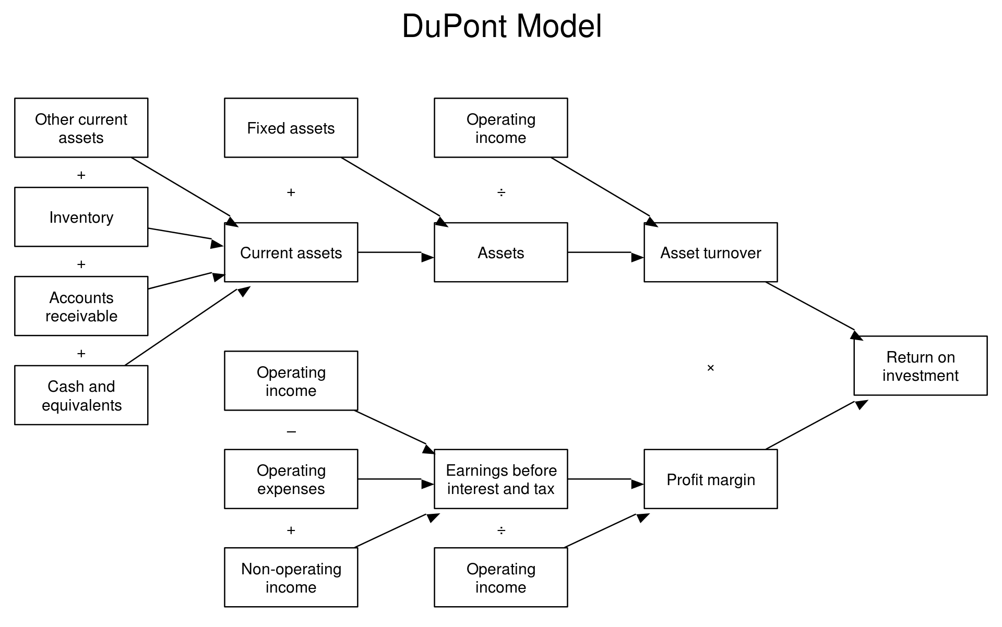
5. Evaluation of relations of these indicators (USA Du-Pont, CZE – pyramid settings of indicators)
Basically disassembling the top level indicator to individual indicators, used for analysis of sensitivity of top level indicator

Slide 58
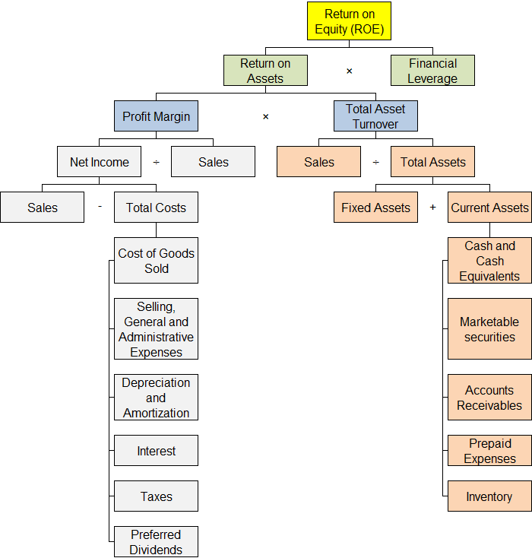

Slide 59
6. Analysis of strengths and weaknesses and proposal of measures
Problems?
How to solve them?
Do we have adequate means to solve it?

Slide 60
Common problems
Low profitability – too much assets
Bank will not finance us – too much debt
We can not pay employees – liquidity
Are we having a lot of assets?
Sell off, factoring, reversal leasing…

Slide 61
Time to
Earning After Taxes
EAT
Enjoy your quick lunch

